Slide 1
Elementary-Building Game
Team CafeStarz
Seungchul-Lee(PM,SA),
Mingyu-Kim(SA),
Hojeong-Lee(SD),
YongJae-Lee(SD)

Slide 2
Contents
A. Goal
A1. Huge Goal
A2. Specific Goal
B. Game
C. Schedule

Slide 3
Goal
Huge Goal
“educational application for teaching programming concepts for elementary school children”
- oop_proejct_instructions.pdf

Slide 4
Goal
Specific Goal
Loop
Module
How? => play Game!

Slide 5
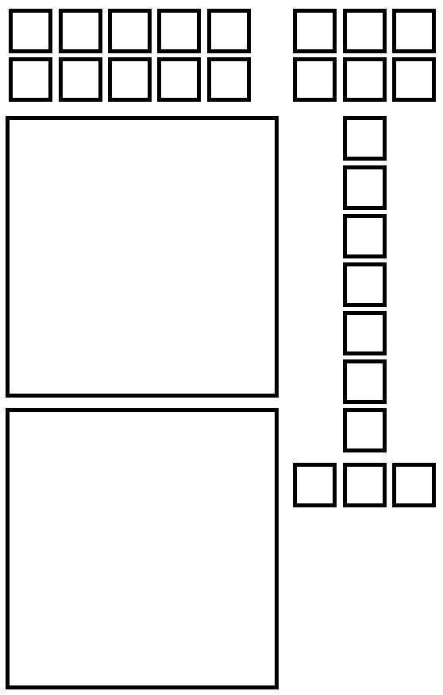
Game
user’s goal in game
There are command buttons
By arrange commands
User can make a building

Slide 6
Elementary-Building
Instructions
Modules (Queues)
User Board
Execution Queue
Goal Board
Start/Stop Command

Slide 7
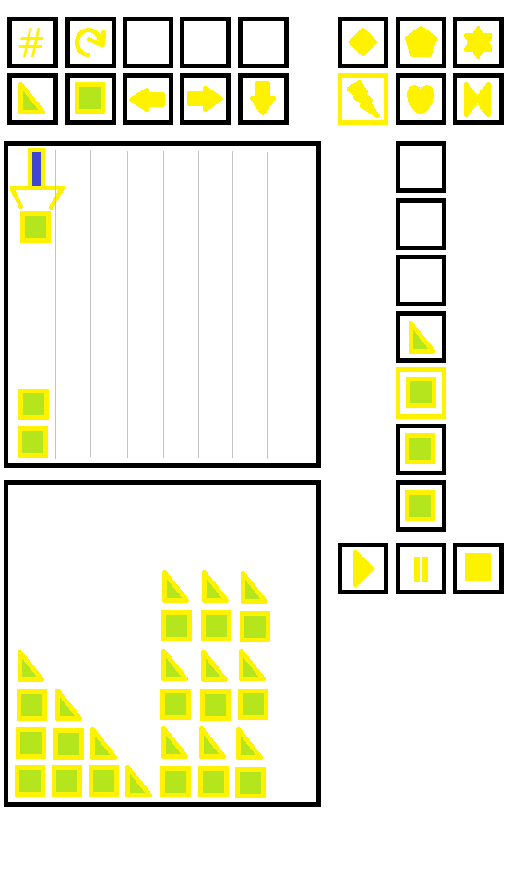
Current Module
Program Counter
Elementary-Building

Slide 8
Schedule
April | Sun | Mon | Tue | Wed | Thu | Fri | Sat
1st week | What we are going to make? (make a requirement sheet)
2nd week | Making requirement sheet & java swing package research
3rd week | Draw class-diagram based on requirement sheet
4th week | Draw class-diagram based on requirement sheet & write comments
5th week | Implementation of class-diagram
*Regular meeting time : Fri 04:00 p.m. at pal 334,
Tue 04:00 p.m. at pal 334

Slide 9
Schedule
May | Sun | Mon | Tue | Wed | Thu | Fri | Sat
6th week | Implementation
7th week | Implementation
8th week | Test & Debug
9th week | Test & Debug

Slide 10
Schedule
May | Sun | Mon | Tue | Wed | Thu | Fri | Sat
10th week | Test & Debug, prepare final pt
11th week | Submit source code

