Slide 1

Machine Learning
Lee Sutton
February 21st, 2017
SFU SciProg Group

Slide 2
Topics
Introduction to machine learning and classification
Binary classification using logistic regression
Multi-class classification using logistic regression
Support vector machinesWhere to go from here

Slide 3
What is Machine Learning
Some Terminology
Input features (x). This is the input data we feed into a ML model
Target (t). These represent the “answers” to training
Types of Data
Training data: To teach a ML model we feed it training data. This training data can have target data so that we can assess how well we trained the model
Testing Data: The best way to test a model’s true ability is to test it with data that it has not seen before
When we train and test a model, we use segment the data and “hide it” from the model

Slide 4
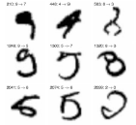
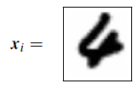
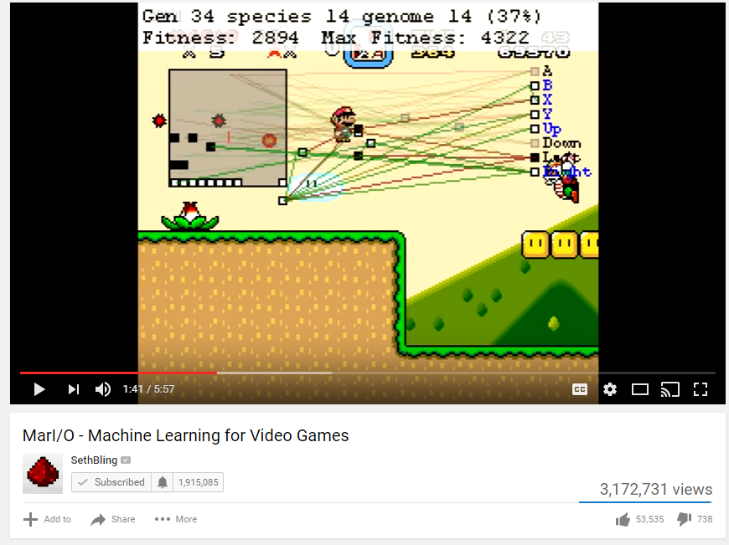
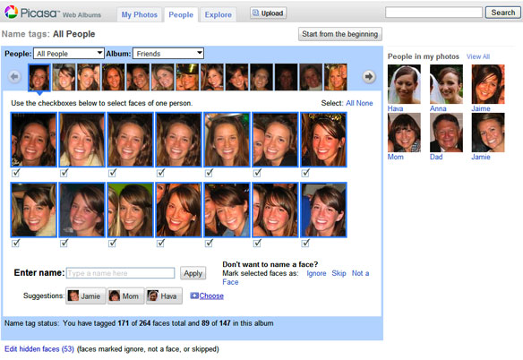
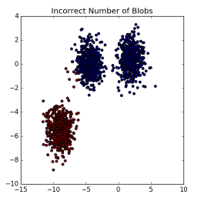
Types of Machine Learning
Supervised Learning
Unsupervised Learning
Reinforcement Learning

Slide 5
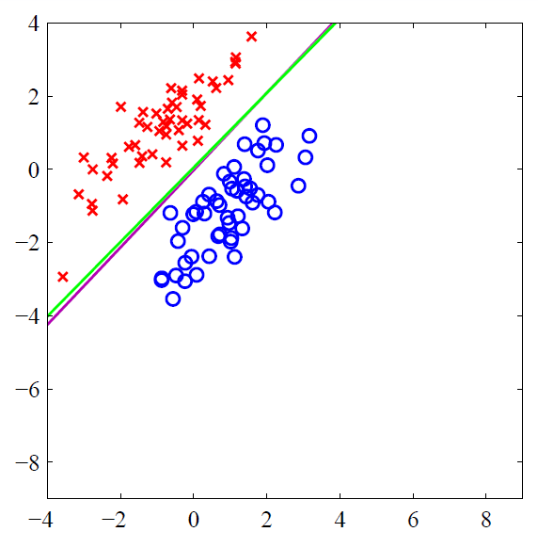
Types of Machine Learning: Supervised
We have training data which includes the target data (answers)
Regression
Problems where the target data is considered continuous
Modeling population growth or stock prices over time
Classification
The target data is discrete
Classifying a tumor biopsy as malignant or benign
Recognizing handwriting (optical character recognition)
Classifying images of cats and dogs

Slide 6
Types of Machine Learning: Unsupervised
If only the input data is provided, we are doing unsupervised learning
Segmenting data into groups based on variance
Clustering photos in Picasa
The model is looking for similarity in the inputs and grouping them

Slide 7

Types of Machine Learning: Reinforcement
Sometimes we don’t have target data to give the model… yet
The model does its best with the data, guesses, and we tell it whether it is right or wrong
The model receives negative and positive feedback and evolves over time
Just like how children learn
Related area: Genetic Algorithms
Example: Someone built a model to play Super Mario
At first it just mashed keys
Over time it learned to play the game
https://www.youtube.com/watch?v=qv6UVOQ0F44

Slide 8
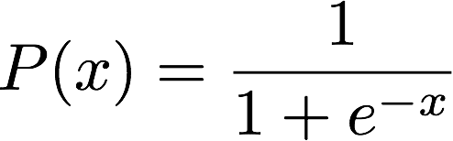
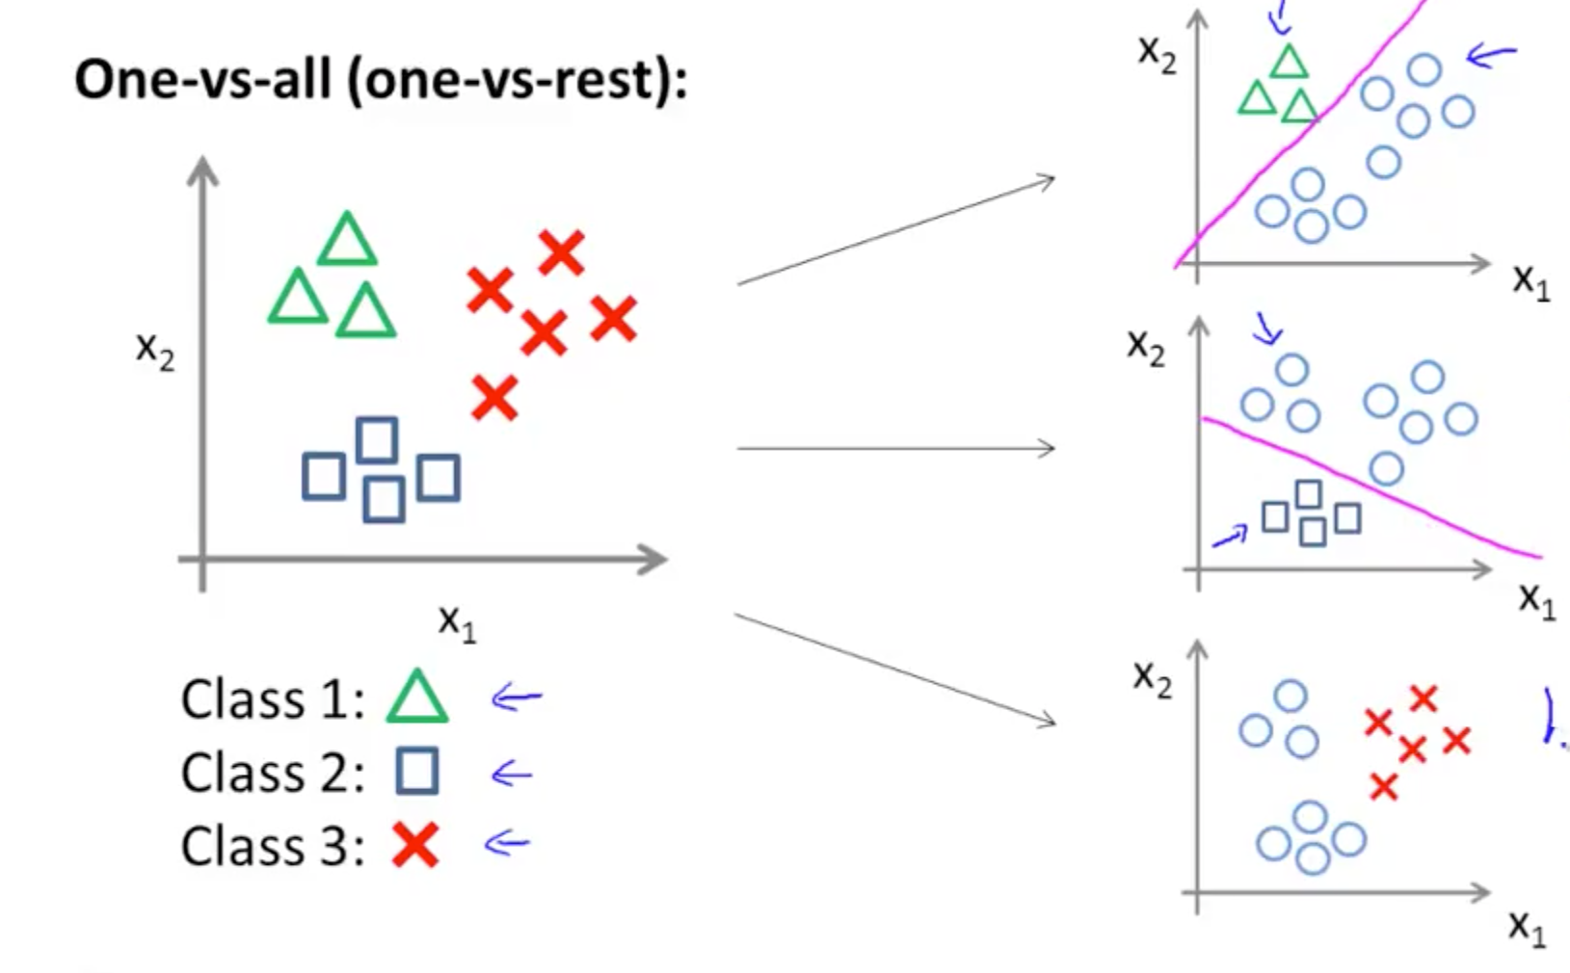
Logistic Regression
Model the probability that the input data falls into class 1 or class 0 (binary classification)
We use the logistic function
But we can expand this idea to fit multiple classes uses the ”one vs. all” algorithm
Input feature x
Images:
http://scikit-learn.org/stable/auto_examples/linear_model/plot_logistic.html#sphx-glr-auto-examples-linear-model-plot-logistic-py
https://www.coursera.org/learn/machine-learning/lecture/68Pol/multiclass-classification-one-vs-all

Slide 9
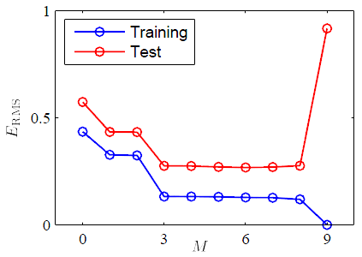
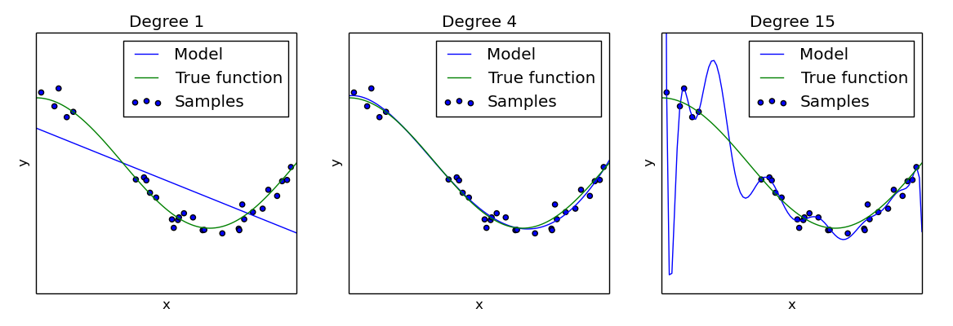
Overfitting
Why not use the highest order polynomial possible?
Our training error would continue to decrease
Overfitting!
However the model may perform poorly against its test data
The model would fail to generalize against new data
Always split data into training and test data!

Slide 10
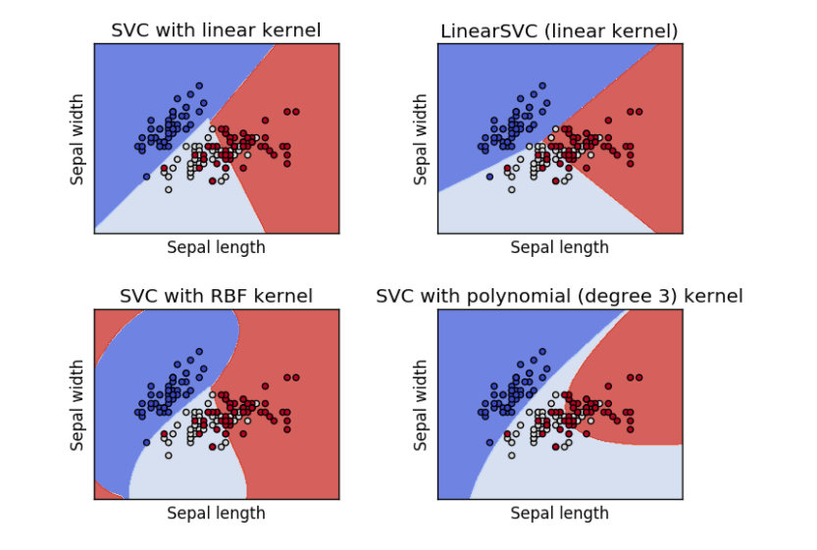
Support Vector Machines
Instead of fitting the data with a regression model, we fit a hyperplane to separate the data
Goal is to maximize the margin between the hyperplane and our data
Relies on only a few data points close to the margin
Scales up to multiple classes when we use multiple hyperplanes
Can change the kernel to modify the shape of the boundaries

Slide 11
Conclusion
We have talked about the various types of Machine Learning problems at a high level
There are several resources for more learning on the topic
http://sciprog.ca/
http://scikit-learn.org/stable/
https://www2.cs.sfu.ca/~mori/courses/cmpt726/
https://www.udacity.com/course/intro-to-machine-learning--ud120
https://www.coursera.org/learn/machine-learning

