Slide 1





TALKBOT
Powered by
Saltlux US team
8/30/2022

Slide 2
Talkbot Report
Summary(Aug 2022)
Counts | Aug-22 | Total
Total users | 7 | 7
Total messages | 24 | 24
Avg number of messages | 3.4 | 3.4
*The counts are consolidated numbers of Nate and Maven.
Our suggestions to enhance user engagement and Talkbot usage

Slide 3
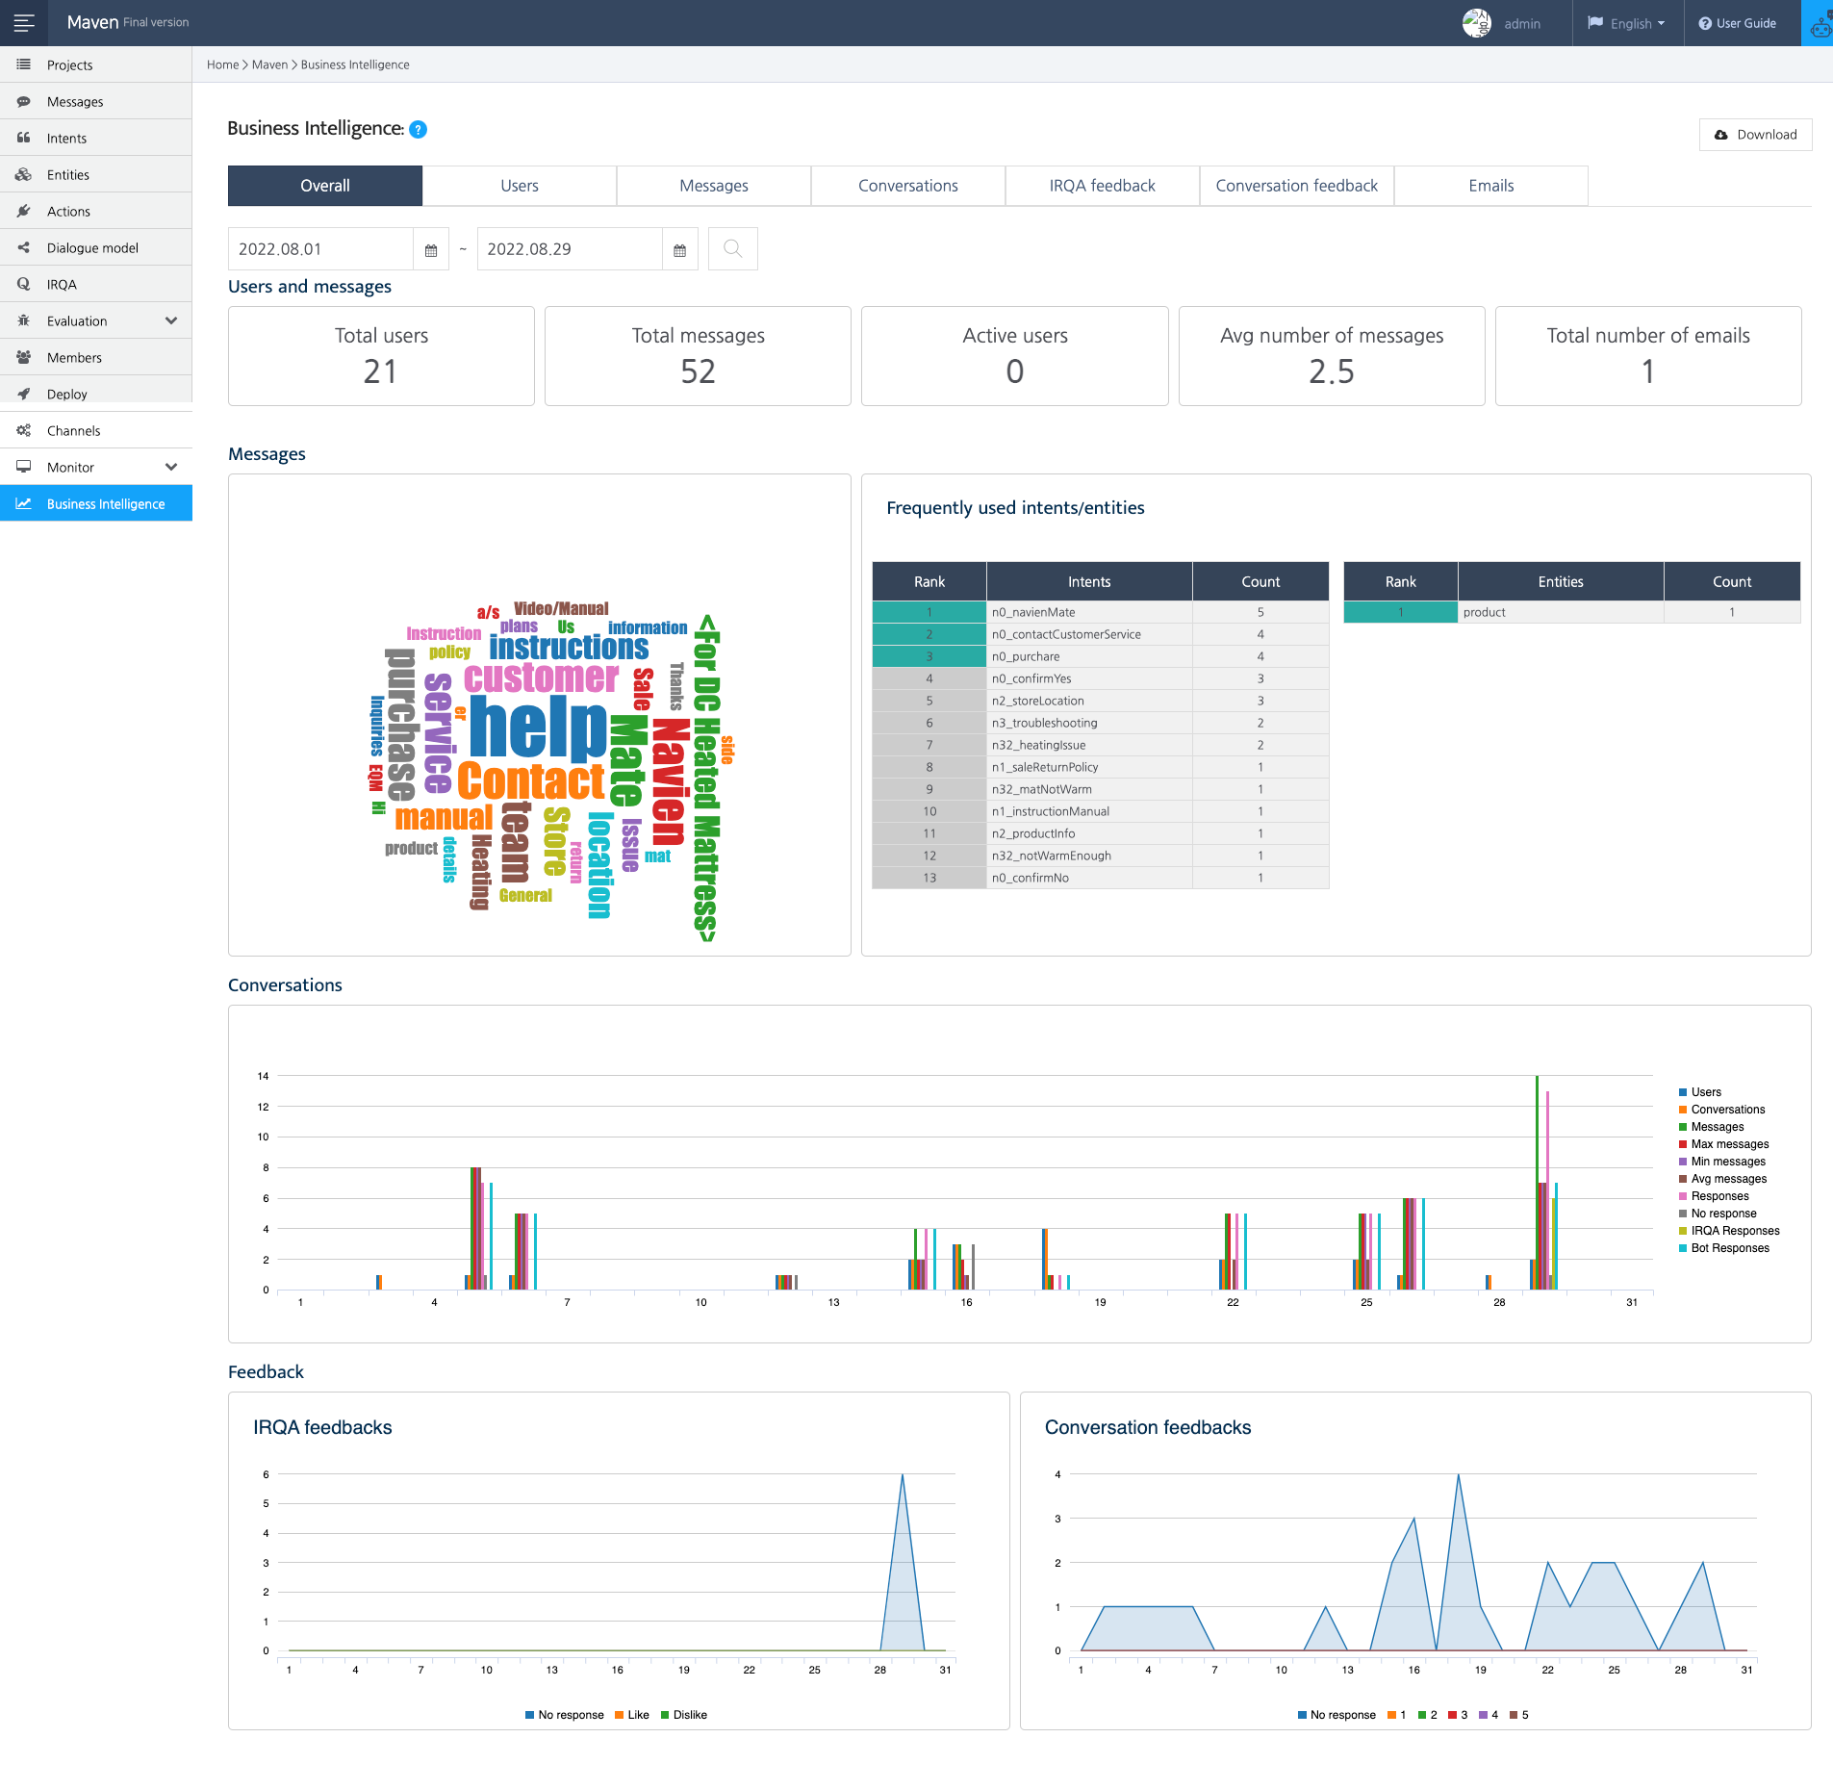
Talkbot Report
Nate & Maven Feb 2022

Slide 4
Talkbot Report
Nate & Maven Feb 2022

Slide 5
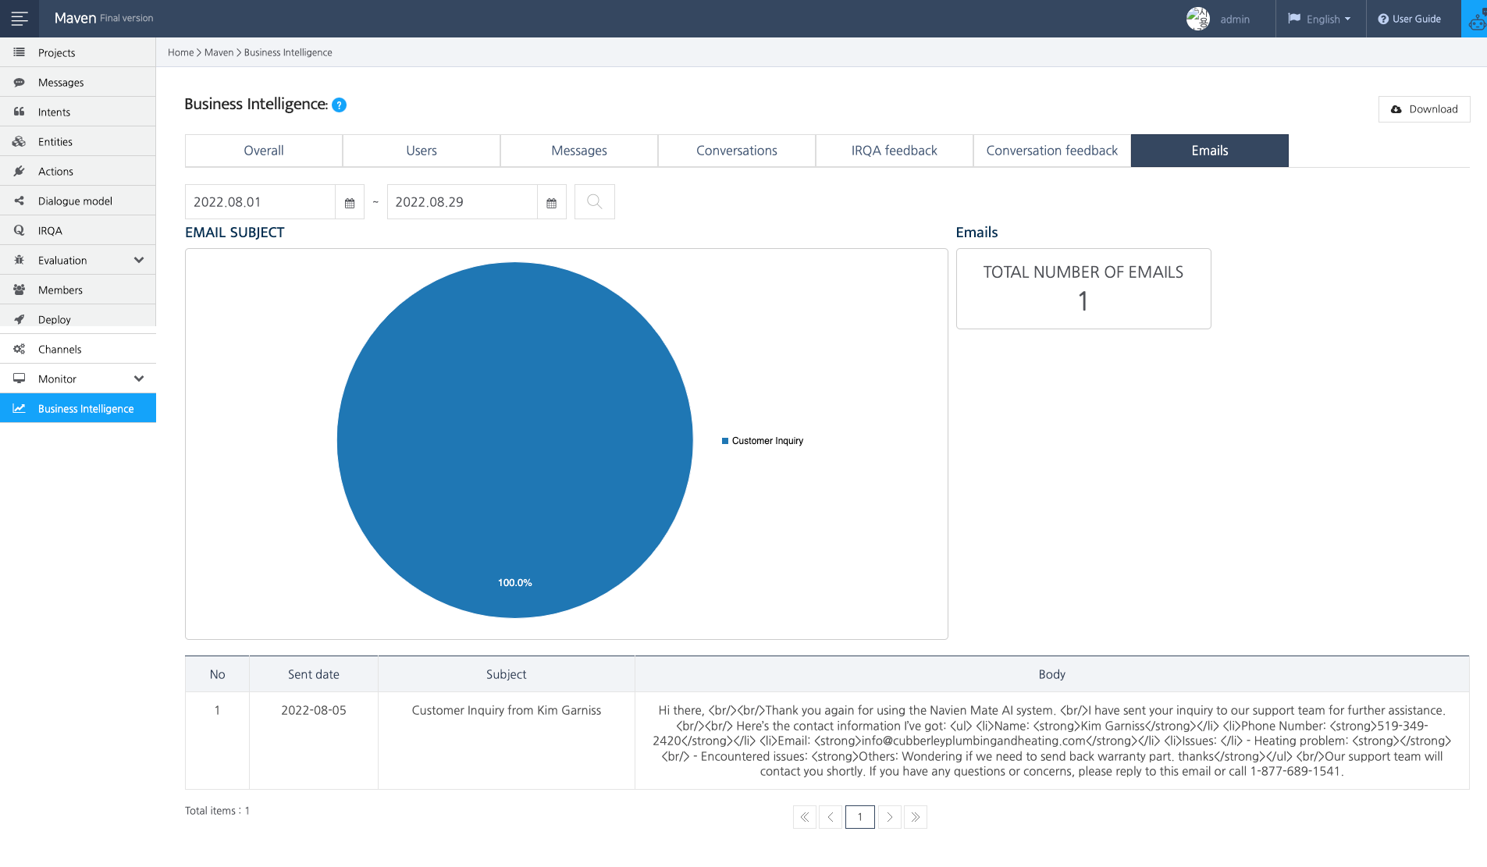
Talkbot Report
Maven Feb 2022
5

Slide 6
Thank you!
m a y A I h e l p y o u
6

