Slide 1
Public or Private?
Nahom Abraha, Su-Ah Lee, Kayla Hart

Slide 2
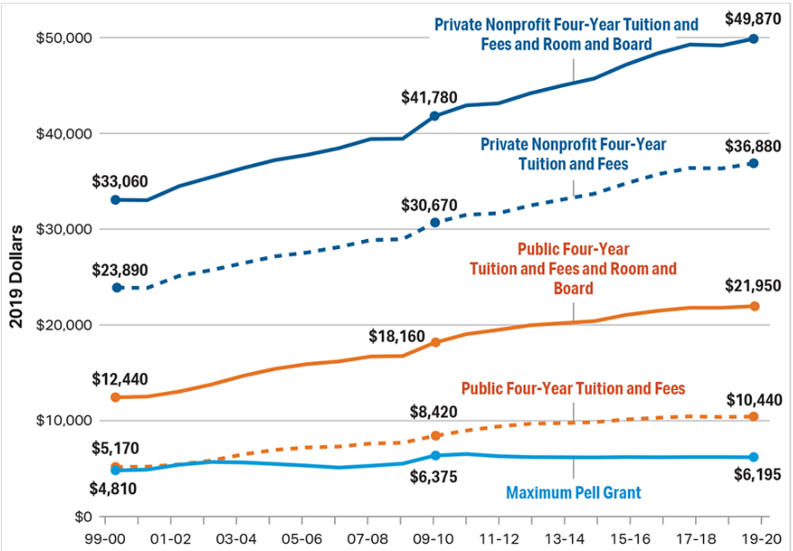
Introduction
Private vs Public University Costs
Pell Grant
Attendance Cost
Post-Grad Salary
(“Pell Grants: recipients, etc., 2019)

Slide 3
Data Notes
Data Source: College Scorecard from National Center for Education Statistics
Updated: October 2019
More private schools than public schools listed
Usage of Density Curves, Histograms, Box Plots, CDFs

Slide 4
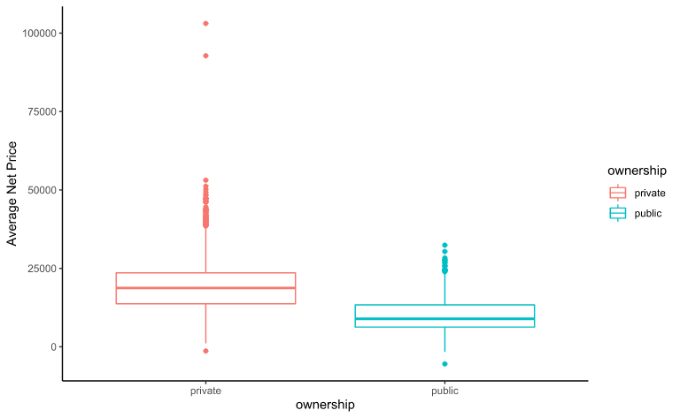
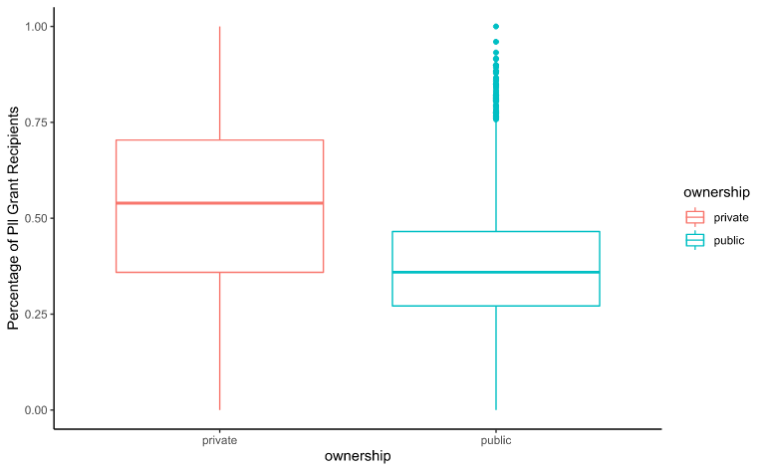
Pell Grant & Net Price
Average Net Price
Pell Grant disbursement

Slide 5
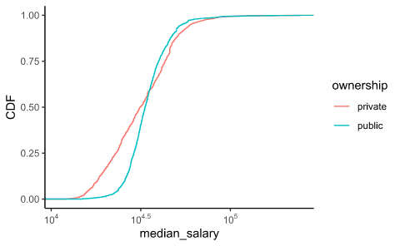
Expected Earning
As shown by the CDF for any given percentile rank in the range from 0 to 60, the corresponding salary is higher for public schools compared with that of private schools.
Notes:
@ any point (x)salary,the percentile rank show
-> mention that it’s left-right discrepancy not top down
-> everything is log

Slide 6
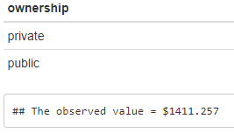
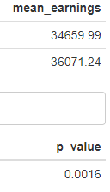
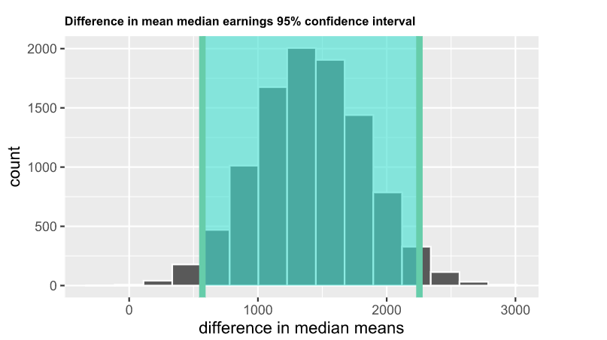
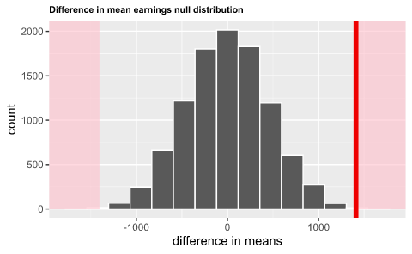
Hypothesis Testing and 95% Confidence Interval
CI = ($575, $2240)

Slide 7
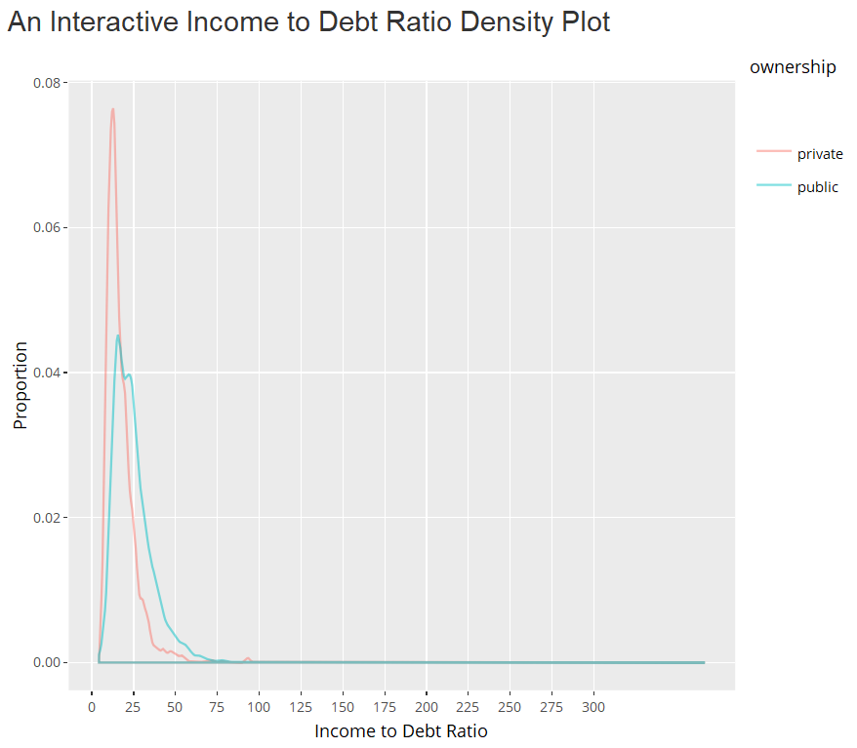
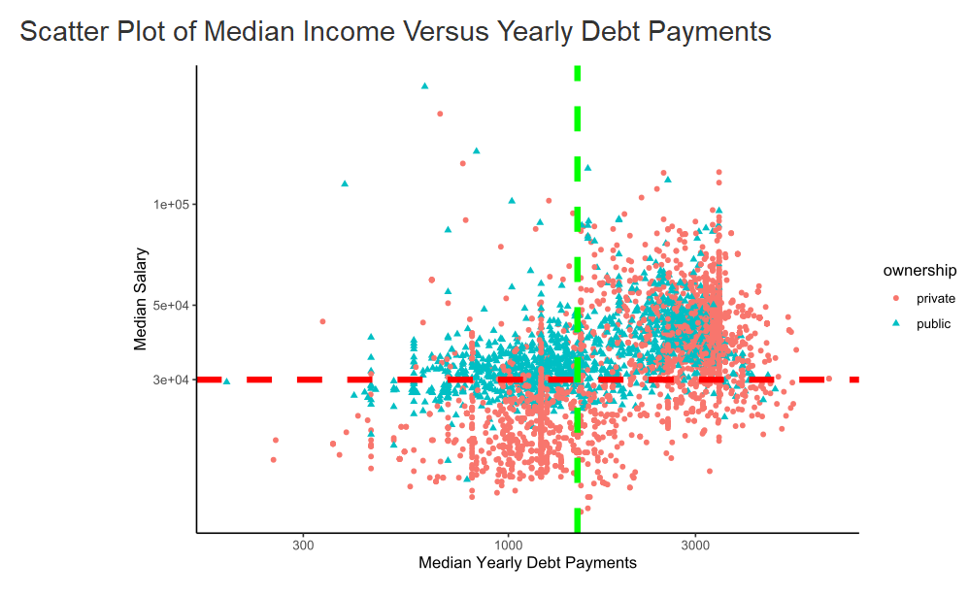
Income-Debt
Notes:
>> Scatter: y-salary, x-debt payments

Slide 8
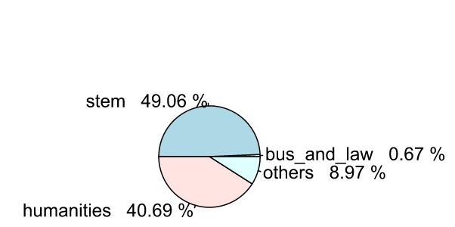
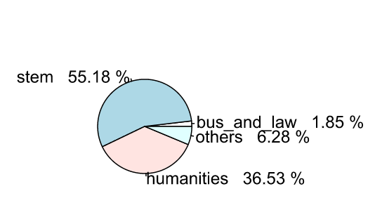
Degree Offered
Private
Public

Slide 9
Conclusion
Future Endeavors
Private proportionally earns more Pell Grants
Public University students pays lower average net price
On average, public earns more than private over pay levels
Public earns higher salary within 10 years of graduation
Comparison of Variables
Unemployment Rate
Re-sampling

Slide 10
Bibliography
The Cost of College Continues to Rise. (n.d.). Retrieved from https://www.usnews.com/education/best-colleges/paying-for-college/articles/paying-for-college-infographic.
Federal Pell Grant Program. (2015, June 4). Retrieved from https://www2.ed.gov/programs/fpg/index.html.
Pell grants: recipients, maximum Pell and average Pell – Research – College Board. (2019, November 1). Retrieved from https://research.collegeboard.org/trends/student-aid/figures-tables/pell-grants-recipients-maximum-pell-and-average-pell.
Staff. (2018, September 6). Public vs. Private College ROI. Retrieved from https://www.lexingtonlaw.com/blog/loans/public-vs-private-college-roi.html.

Slide 11
Bibliography
Trends in College Pricing 2019 Highlights. (2019, November 6). Retrieved from https://research.collegeboard.org/trends/college-pricing/highlights.
Wei, S. (n.d.). How Your College Choice Affects Your Career. Retrieved from https://www.nerdwallet.com/blog/nerdscholar/college-and-career-study/.
What Is the Difference Between Private and Public Colleges?: Choosing a School. (2018, June 25). Retrieved from https://withfrank.org/how-to-pay-for-college/what-do-i-need-to-prepare-for-college/choosing-a-school/what-is-the-difference-between-private-and-public-colleges/.
Woodruff, M. (2014, January 6). Is Public Or Private College A Better Investment? Retrieved from https://www.businessinsider.com/public-and-private-college-costs-2014-1.

