Slide 1
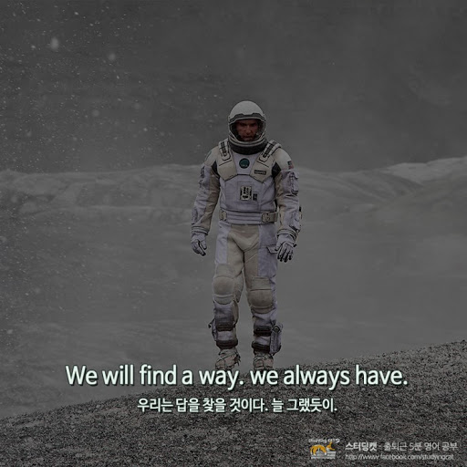

SOLAFY
Sign in
Sign up
Problem
Board
Group
about_SOLAFY
박상우님 환영!

Slide 2
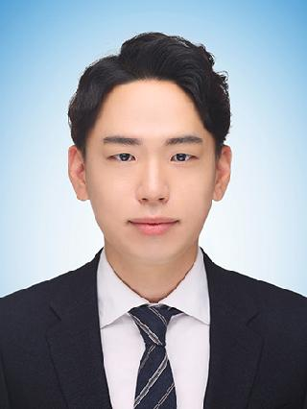
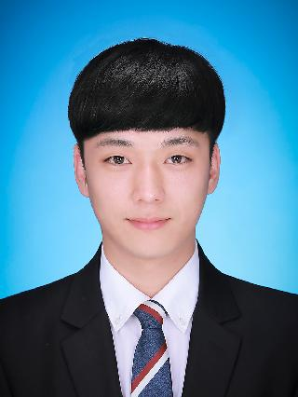
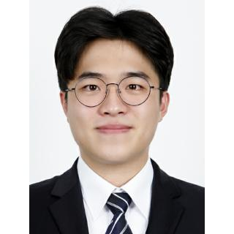
4기
박상우
SSAFY 4기
https://github.com/upswp
윤기현
SSAFY 4기
https://github.com/KiHyeonYun
서범석
SSAFY 4기
https://github.com/callipenguin

