Slide 1
CPE 186 Computer Hardware Design
FIFO
Prof. J. Pang

Slide 2
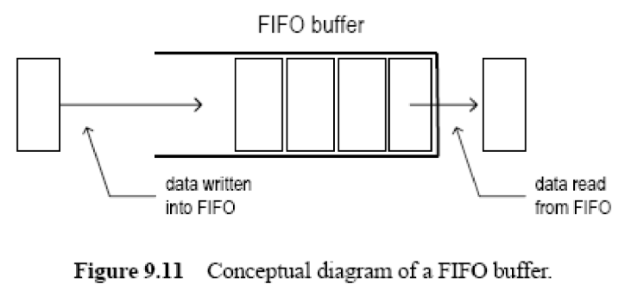
FIFO

Slide 3
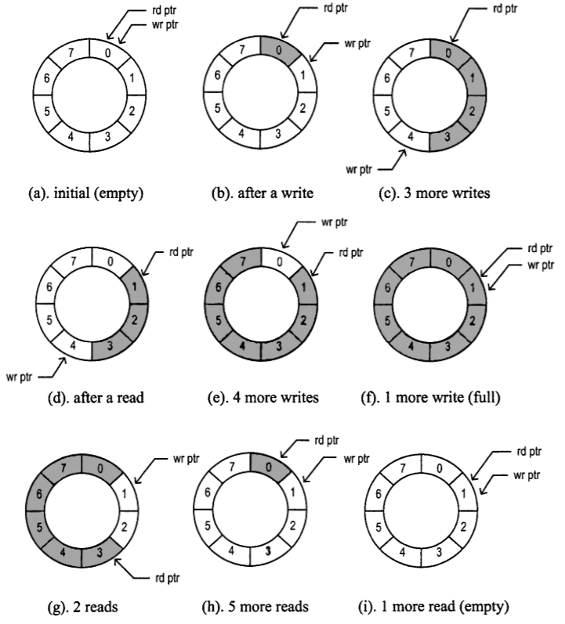
FIFO

Slide 4
FIFO
library ieee;
use ieee.std_logic_1164.all;
use ieee.std_logic_unsigned.all;
use ieee.std_logic_arith.all;
entity fifo_sync is
port(
clk, reset: in std_logic;
wr, rd: in std_logic;
full, empty: out std_logic;
w_addr,r_addr:out std_logic_vector(1 downto 0)
);
end fifo_sync;
architecture arch of fifo_sync is
signal full_flag, empty_flag: std_logic;
signal w_ptr_reg, r_ptr_reg: std_logic_vector(2 downto 0);
begin
process(clk, reset)
begin
if(reset='1') then
w_ptr_reg <= (others=>'0');
r_ptr_reg <= (others=>'0');
elsif (rising_edge(clk)) then
if(wr='1' and full_flag='0') then
w_ptr_reg <= w_ptr_reg + 1;
end if;
if(rd='1' and empty_flag='0') then
r_ptr_reg <= r_ptr_reg + 1;
end if;
end if;
end process;

Slide 5
FIFO
full_flag <= '1' when ((r_ptr_reg(2) /= w_ptr_reg(2)) and
( r_ptr_reg(1 downto 0) = w_ptr_reg(1 downto 0)))
else '0';
empty_flag <= '1' when r_ptr_reg = w_ptr_reg else '0';
w_addr <= w_ptr_reg(1 downto 0);
r_addr <= r_ptr_reg(1 downto 0);
full <= full_flag;
empty <= empty_flag;
end arch;

Slide 6
FIFO
library ieee;
use ieee.std_logic_1164.all;
use ieee.std_logic_unsigned.all;
use ieee.std_logic_arith.all;
entity tb_fifo_sync is
end tb_fifo_sync;
architecture tb of tb_fifo_sync is
component fifo_sync
port (clk : in std_logic;
reset : in std_logic;
wr : in std_logic;
rd : in std_logic;
full : out std_logic;
empty : out std_logic;
w_addr : out std_logic_vector (1 downto 0);
r_addr : out std_logic_vector (1 downto 0));
end component;

Slide 7
FIFO
signal clk : std_logic := '0';
signal reset : std_logic;
signal wr, rd : std_logic;
signal full, empty : std_logic;
signal w_addr, r_addr : std_logic_vector (1 downto 0);
constant clkPeriod : time := 10 ns;
signal TbSimEnded : std_logic := '0';
begin

Slide 8
FIFO
stimuli : process
begin
wr <= '0'; rd <= '0';
reset <= '1';
wait for 2 ns;
wr <= '1'; rd <= '0';
wait for 7 * clkPeriod;
wr <= '0'; rd <= '1';
wait for 7 * clkPeriod;
wr <= '0'; rd <= '0';
wait for 2 * clkPeriod;
TbSimEnded <= '1';
wait;
end process;
end tb;
dut : fifo_sync
port map (
clk => clk,
reset => reset,
wr => wr,
rd => rd,
full => full,
empty => empty,
w_addr => w_addr,
r_addr => r_addr );
clk <= not clk after clkPeriod/2
when TbSimEnded /= '1' else '0';

Slide 9
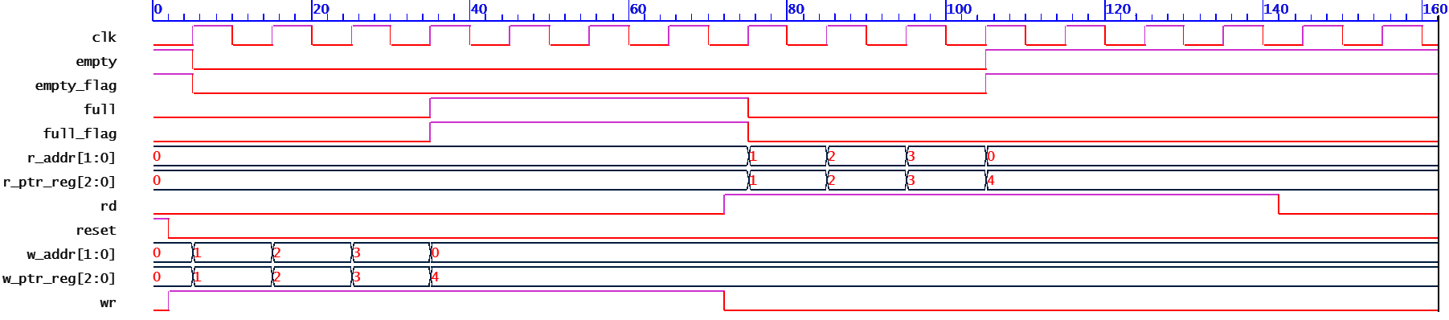
FIFO

Slide 10
FIFO
module fifo(clk, reset, wr, rd, full, empty, w_addr, r_addr);
input clk, reset;
input wr, rd;
output full, empty;
output [3:0] w_addr, r_addr;
reg [3:0] w_addr, r_addr;

Slide 11
FIFO
always@(posedge clk)
begin
if(reset)
begin
w_addr <=0;
r_addr <=0;
end
else
if( wr && !full)
w_addr <= w_addr + 1;
if( rd && !empty)
r_addr <= r_addr + 1;
end
assign full = ((r_addr[2]!=w_addr[2]) && (r_addr[1:0]==w_addr[1:0]))?1'b1:1'b0;
assign empty= (r_addr == w_addr) ? 1'b1 : 1'b0;
endmodule

Slide 12
RAM
module ram (clk, w_addr, din, we, oe, r_addr, dout);
input clk;
input [2:0] w_addr;
input [15:0] din;
input we, oe;
input [2:0] r_addr;
output [15:0] dout;
reg [15:0] ram_reg;
reg [15:0] memory [7:0];
always @(posedge clk) begin
if (we)
memory[w_addr] <= din;
end
always @(posedge clk) begin
ram_reg <= memory[r_addr];
end
assign dout = (~we && oe) ? ram_reg : 8'hzz;
endmodule

