Slide 1
HMM+MCMC for Predicting Stock Return

Slide 2
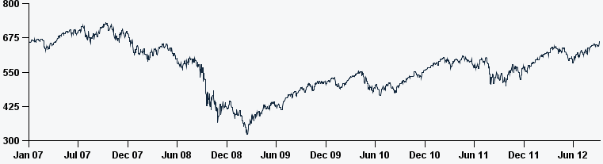

Motivation
Random Walk Hypothesis
Stock price is unpredictable
It is not the full picture!
Underlying value of companies, irrationality of investors, herding behavior…
Linear Model:$y_{t}=β_{0}+β_{1}y_{t−1}+ε, ε∼N(0, σ)$

Slide 3
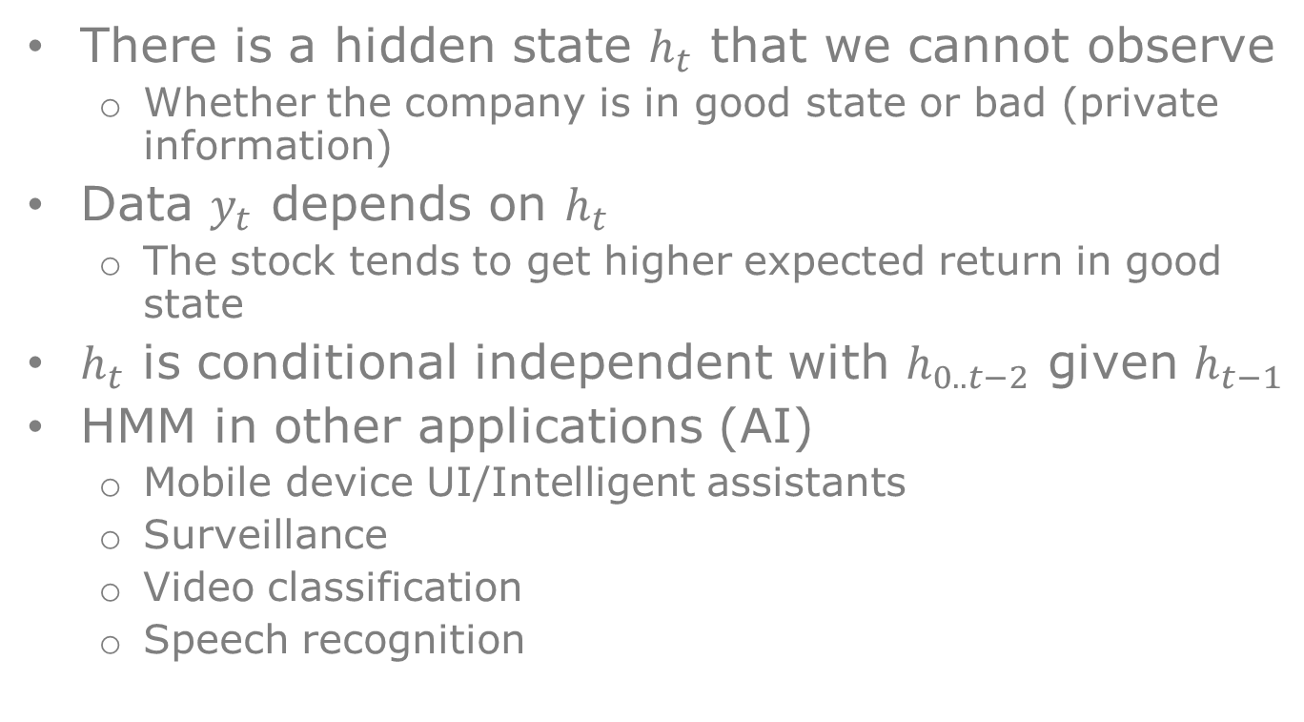
Hidden Markov Model
There is a hidden state $h_{t}$ that we cannot observe
Whether the company is in good state or bad (private information)
Data $y_{t}$ depends on $h_{t}$
The stock tends to get higher expected return in good state
$h_{t}$ is conditional independent with $h_{0..t−2}$ given $h_{t−1}$
HMM in other applications (AI)
Mobile device UI/Intelligent assistants
Surveillance
Video classification
Speech recognition

Slide 4
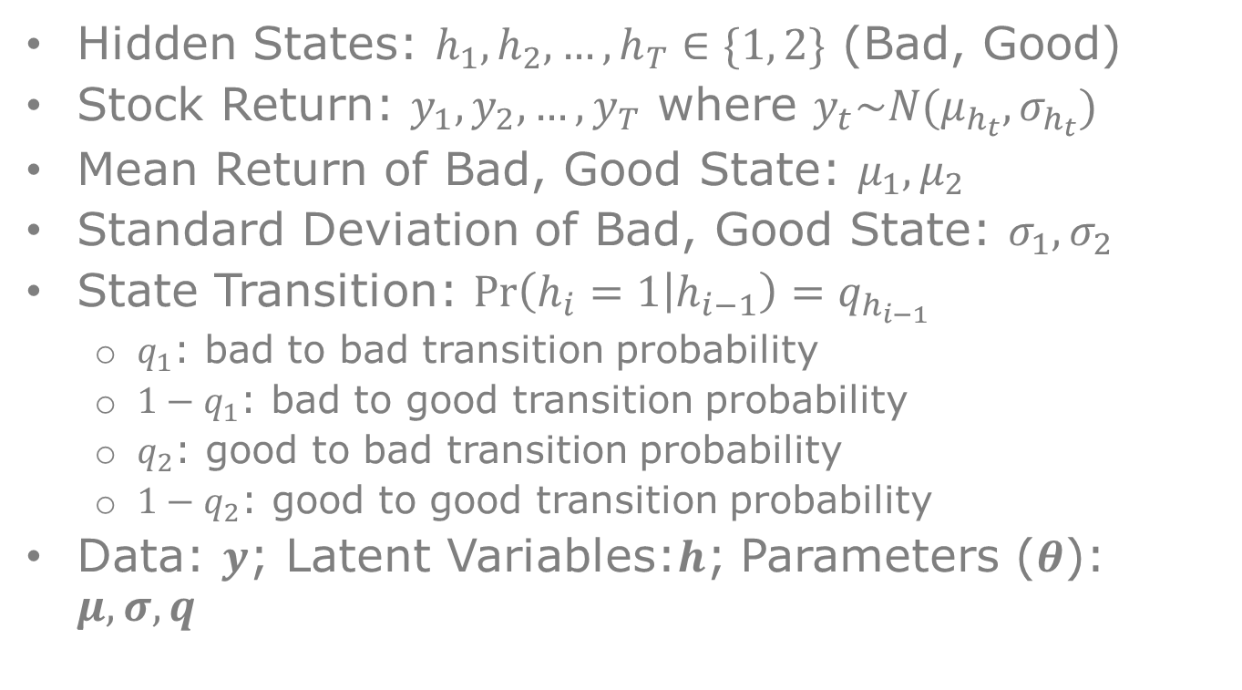
Our Model
Hidden States: $h_{1},h_{2},…,h_{T}∈\{1, 2\}$ (Bad, Good)
Stock Return: $y_{1},y_{2},…,y_{T}$ where $y_{t}\sim N(μ_{h_{t}},σ_{h_{t}})$
Mean Return of Bad, Good State: ${μ_{1},μ}_{2}$
Standard Deviation of Bad, Good State: $σ_{1},σ_{2}$
State Transition: $\operatorname{Pr}\left(h_{i}=1 | h_{i−1}\right)=q_{h_{i−1}}$
$q_{1}$: bad to bad transition probability
$1−q_{1}$: bad to good transition probability
$q_{2}$: good to bad transition probability
$1−q_{2}$: good to good transition probability
Data: $y$; Latent Variables:$h$; Parameters ($θ$): $μ,σ,q$

Slide 5
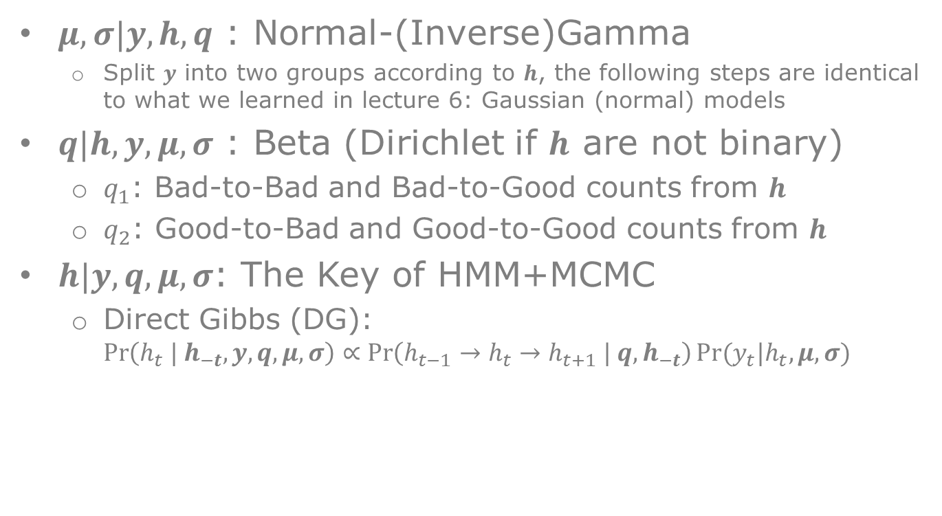
MCMC – Full Conditional
$μ,σ|y, h, q$ : Normal-(Inverse)Gamma
Split $y$ into two groups according to $h$, the following steps are identical to what we learned in lecture 6: Gaussian (normal) models
$q|h, y, μ, σ$ : Beta (Dirichlet if $h$ are not binary)
$q_{1}$: Bad-to-Bad and Bad-to-Good counts from $h$
$q_{2}$: Good-to-Bad and Good-to-Good counts from $h$
$h|y, q, μ,σ$: The Key of HMM+MCMC
Direct Gibbs (DG): $\operatorname{Pr}\left(h_{t} | h_{−t},y, q, μ, σ\right)∝\operatorname{Pr}\left(h_{t−1}→h_{t}→h_{t+1} | q,h_{−t}\right)Pr⁡(y_{t}|h_{t},μ, σ)$

Slide 6
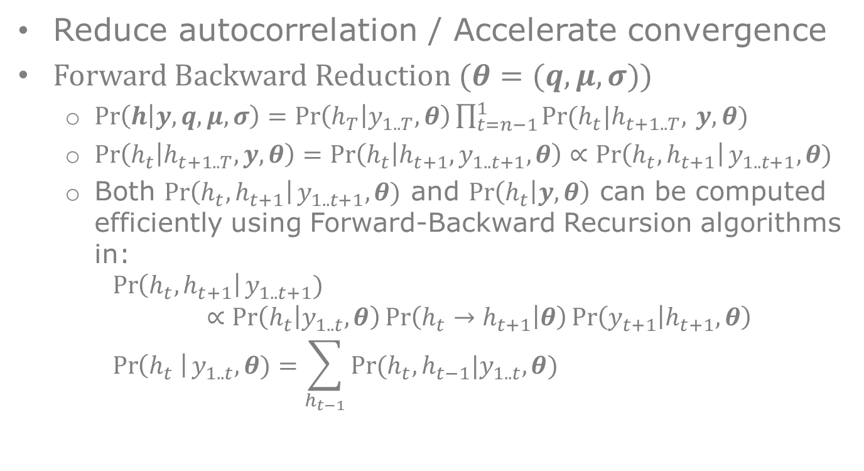
Batch Update
Reduce autocorrelation / Accelerate convergence
Forward Backward Reduction ($θ=(q,μ,σ)$)
$Pr\left(h | y, q, μ,σ\right)=Pr\left(h_{T} | y_{1..T},θ\right)\prod_{t=n−1}^{1}{Pr⁡(h_{t}|h_{t+1..T},} y,θ)$
$\operatorname{Pr}\left(h_{t} | h_{t+1..T}, y, θ\right)=\operatorname{Pr}\left(h_{t} | h_{t+1},y_{1..t+1},θ\right)∝\operatorname{Pr}\left(h_{t},h_{t+1}\right|y_{1..t+1}, θ)$
Both $\operatorname{Pr}\left(h_{t},h_{t+1}\right|y_{1..t+1}, θ)$ and $Pr\left(h_{t} | y,θ\right)$ can be computed efficiently using Forward-Backward Recursion algorithms in: $\operatorname{Pr}\left(h_{t},h_{t+1}\right|y_{1..t+1})∝\operatorname{Pr}\left(h_{t} | y_{1..t},θ\right)\operatorname{Pr}\left(h_{t}→h_{t+1} | θ\right)\operatorname{Pr}\left(y_{t+1} | h_{t+1},θ\right)$ $\operatorname{Pr}\left(h_{t} \right|y_{1..t}, θ)=\sum_{h_{t−1}}{Pr⁡(h_{t},h_{t−1}|y_{1..t},θ)}$

Slide 7
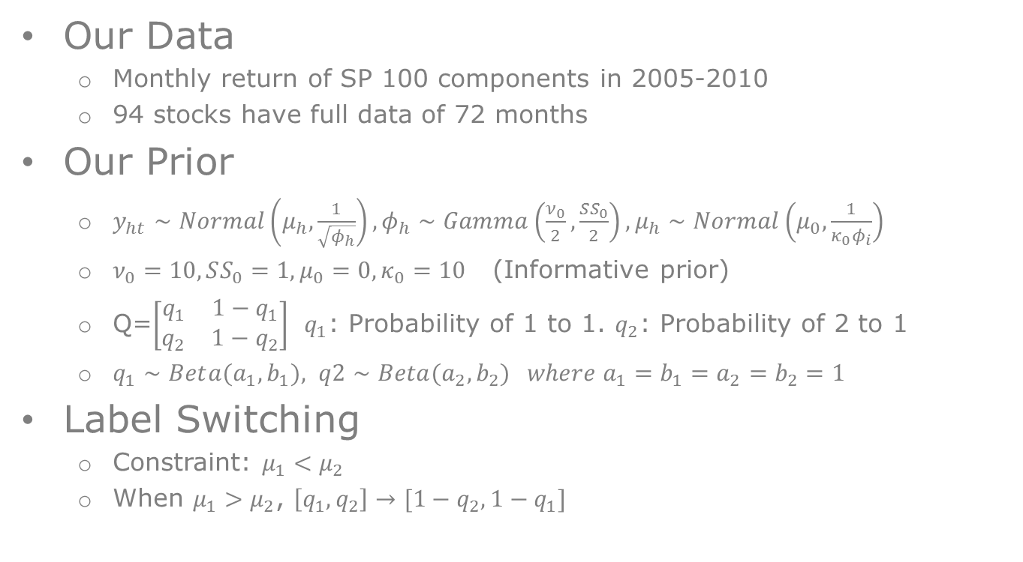
Implementation
Our Data
Monthly return of SP 100 components in 2005-2010
94 stocks have full data of 72 months
Our Prior
$y_{ht}∼Normal\left(μ_{h},\frac{1}{\sqrt{φ_{h}}}\right), φ_{h}∼Gamma\left(\frac{ν_{0}}{2},\frac{SS_{0}}{2}\right), μ_{h}∼Normal\left(μ_{0},\frac{1}{κ_{0}φ_{i}}\right)$
$ν_{0}=10, SS_{0}=1, μ_{0}=0, κ_{0}=10$ (Informative prior)
Q=$\left[\begin{matrix}q_{1} & 1−q_{1} \\ q_{2} & 1−q_{2}\end{matrix}\right]$ $q_{1}$: Probability of 1 to 1. $q_{2}$: Probability of 2 to 1
$q_{1}∼Bet{a(a}_{1},b_{1}), q2∼Beta(a_{2},b_{2}) where a_{1}=b_{1}=a_{2}=b_{2}=1$
Label Switching
Constraint: $μ_{1}<μ_{2}$
When $μ_{1}>μ_{2}$, $\left[q_{1},q_{2}\right]→[1−q_{2},1−q_{1}]$

Slide 8
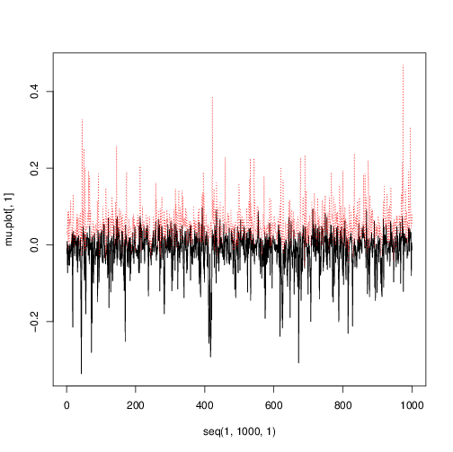
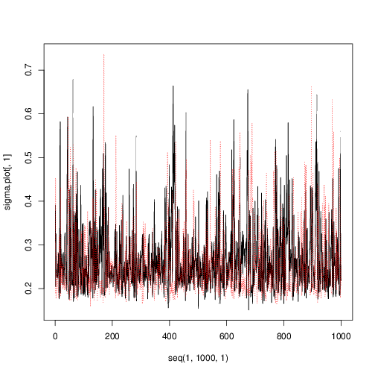
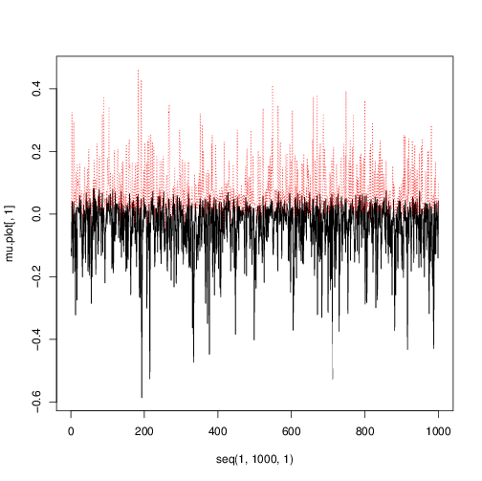
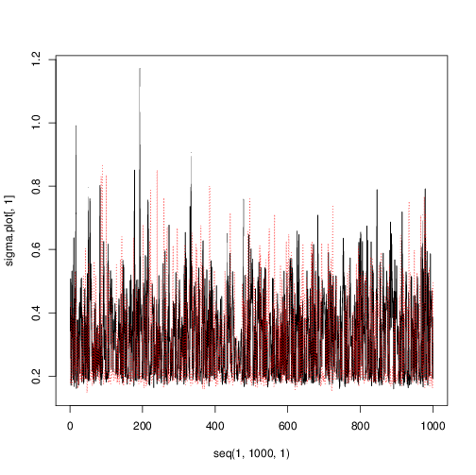

Statistical Inference
Traceplot of $μ_{h}$ and $σ_{h}$ for one stock
DG FB
Averaged Q matrix
Stock have higher probability to stay in the same state
DG FB
$$\left(\begin{matrix}0.54 & 0.46 \\ 0.45 & 0.55\end{matrix}\right) \left(\begin{matrix}0.69 & 0.31 \\ 0.29 & 0.71\end{matrix}\right)$$

Slide 9
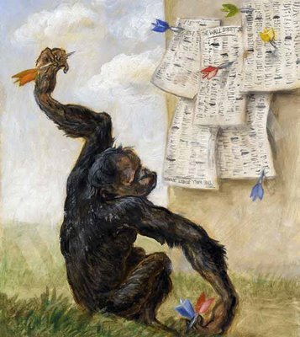
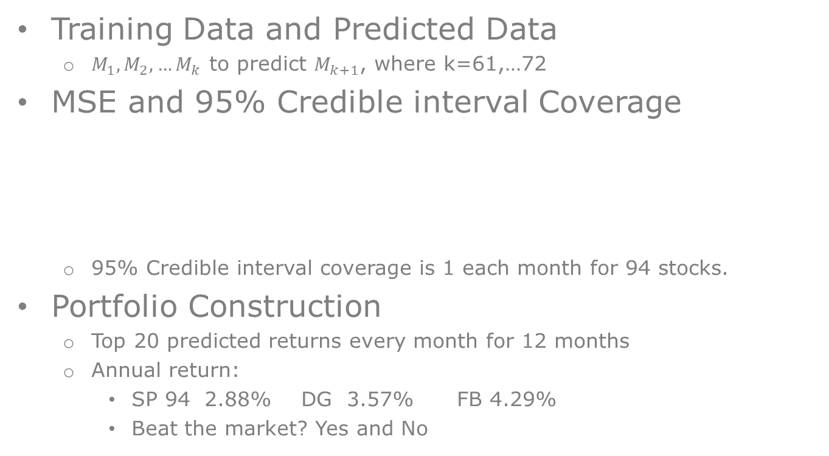
Prediction
Training Data and Predicted Data
$M_{1},M_{2}, …M_{k}$ to predict $M_{k+1}$, where k=61,…72
MSE and 95% Credible interval Coverage
95% Credible interval coverage is 1 each month for 94 stocks.
Portfolio Construction
Top 20 predicted returns every month for 12 months
Annual return:
SP 94 2.88% DG 3.57% FB 4.29%
Beat the market? Yes and No
M | 61 | 62 | 63 | 64 | 65 | 66 | 67 | 68 | 69 | 70 | 71 | 72
DG | 0.06 | 0.05 | 0.04 | 0.05 | 0.05 | 0.04 | 0.06 | 0.07 | 0.08 | 0.09 | 0.06 | 0.06
FM | 0.01 | 0.01 | 0.01 | 0.01 | 0.01 | 0.01 | 0.01 | 0.01 | 0.01 | 0.01 | 0.01 | 0.01

Slide 10

Thanks
Questions?

