Slide 1
Write Up <Snake game>
Mobile system engineering dept.
Chang Yoon Lee
32183641

Slide 2
<Snake Game>
Contents
Intro
Considerations
Main Function
Other Functions
Outro

Slide 3
1. Intro
This write up is for ‘Snake Game’ for ‘Basic Programming 2’ project.
First is about the method used for fixing the error.
Second is about important things to understand the program.
Third is related to the functions used in a program.

Slide 4
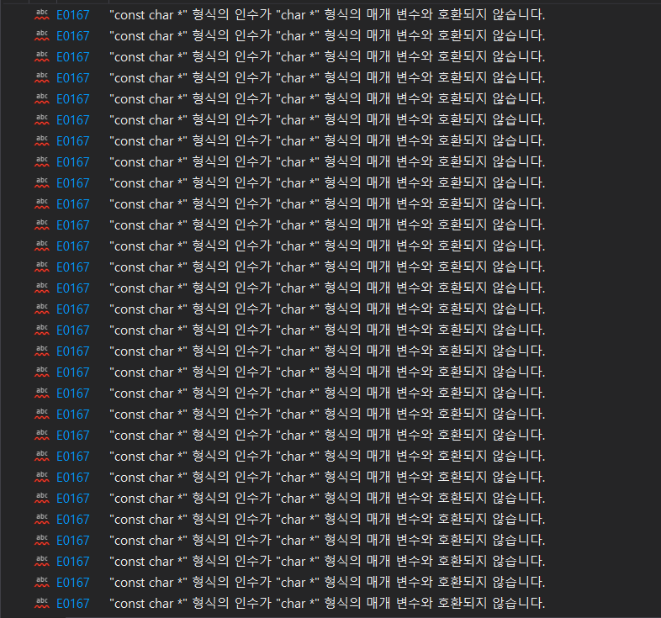
Handling the errors.
2. Considerations
This error occurs because the function ‘gotoxy()’ takes the variable as string.
Those “” sentence forms were given as a constant value.
They don't have a variable assigned to them, so they can't change it.
Therefore, it seems that we should receive the char as a function counter in the form of a constant, i.e. a constant value.

Slide 5

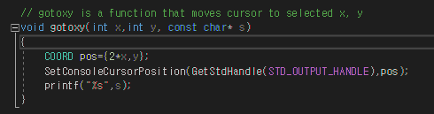

Things to consider before analyzing the code.
2. Considerations
Header file for Delay
windows.h: Header file for gotoxy which cursor move & printer letters on Console
conio.h: Header for kbhit() that a function inputs key value

Slide 6
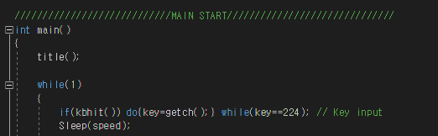
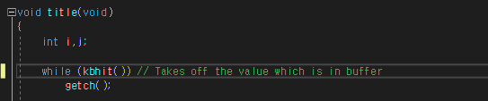
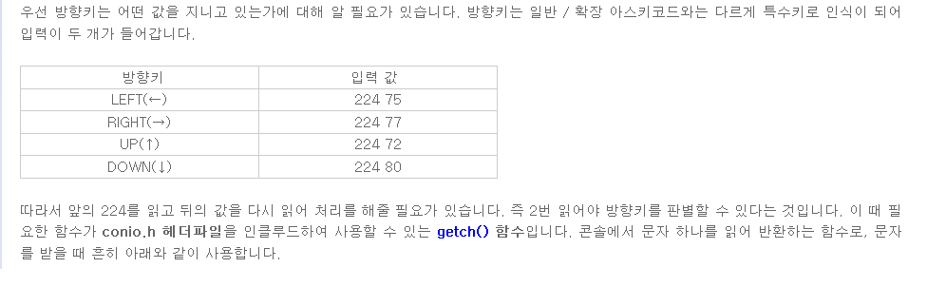
Why we used this method?
2. Considerations
http://blog.naver.com/PostView.nhn?blogId=8527l&logNo=30177393048&parentCategoryNo=&categoryNo=24&viewDate=&isShowPopularPosts=false&from=postView

Slide 7
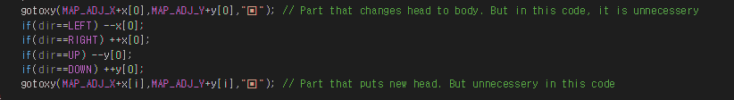

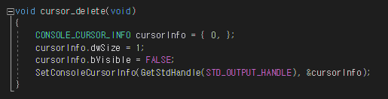
Changed points
2. Considerations
Changed the snakes head and body. Because of this, it is fine enough to delete the code related to snake’s head.
Changed the food style.
Added function which deletes the console cursor.

Slide 8
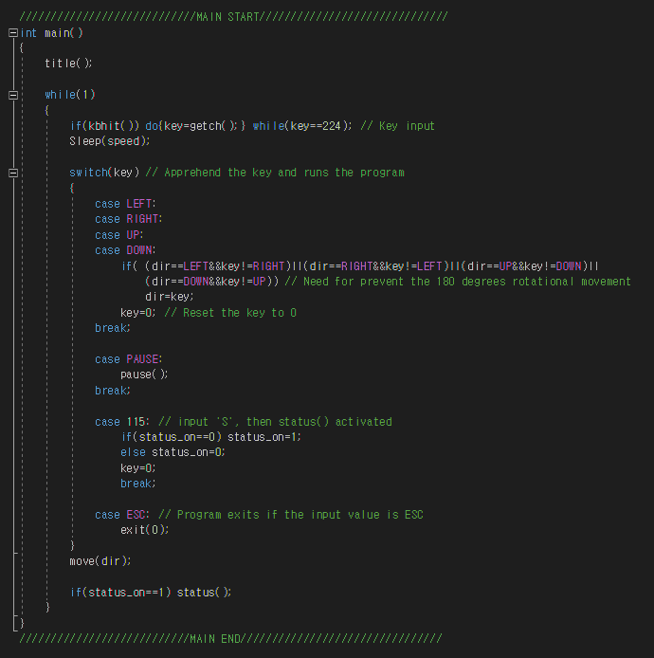
3. main()
Found out that key 115 is a key value of letter ‘S’. And if we input ‘S’ while the game playing, the status for developers are opens.
Found out that there are code to prevent the 180 degrees rotation.
ESC is for exit the game, and it is shown at the title.

Slide 9
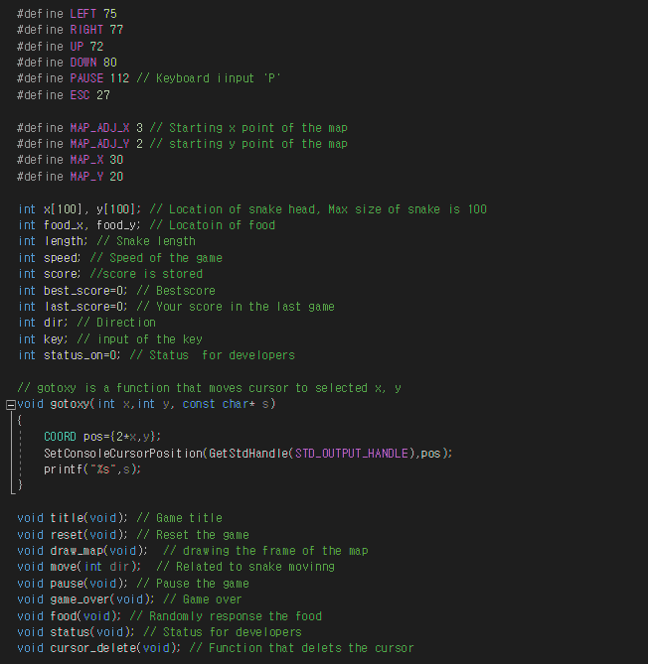
4-1. Functions and Variables
Here are the comments for variables, and functions.
These comments explains about the roles of functions and where variables are used.

Slide 10
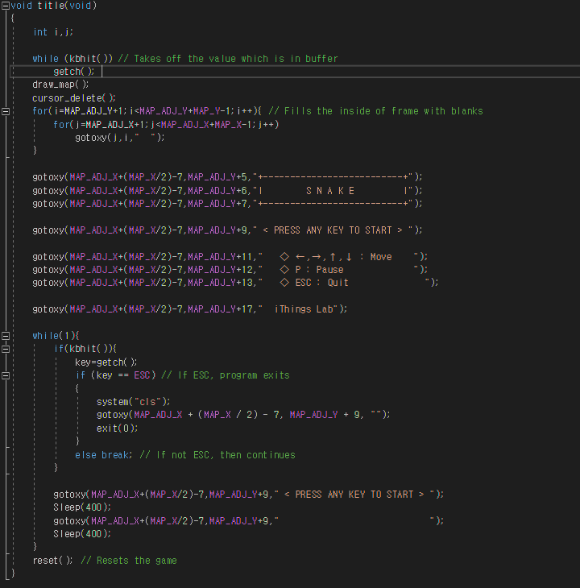
4-2. title()
Get char (Which is buffer)
UI Displays
Get char
Char is ESC?
YES
NO
exit(0)
reset()

Slide 11
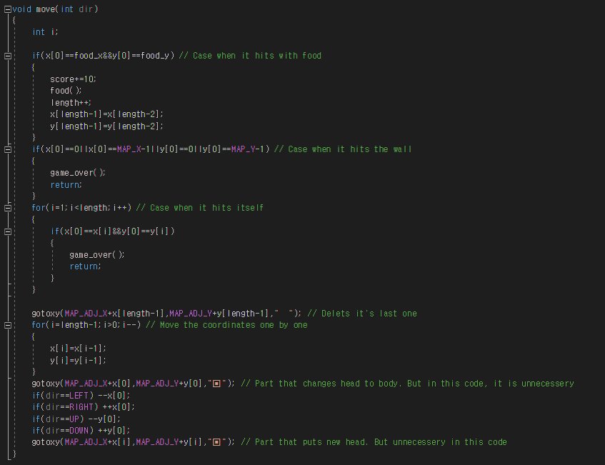
4-3. move()
Hits Food
Hits wall
Hits itself
Score + 10
Length + 1
game_over()
Change head to body
Judged by dir
Left
Right
Up
Down

Slide 12
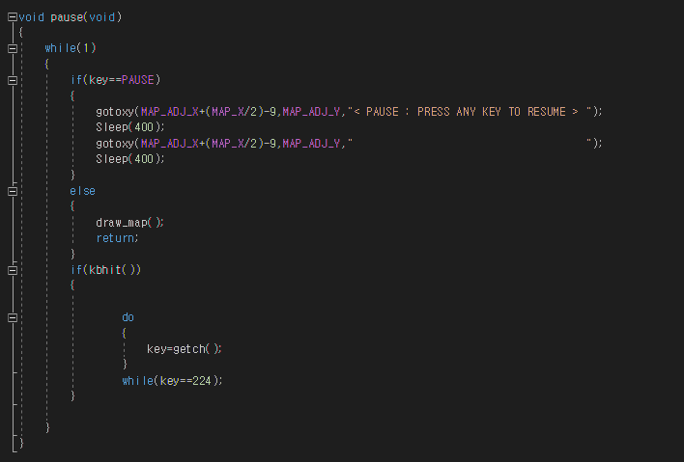
4-4. pause()
Key == Pause?
YES
NO
UI displays
draw_map()
Is Keyboard hit?
Get char

Slide 13
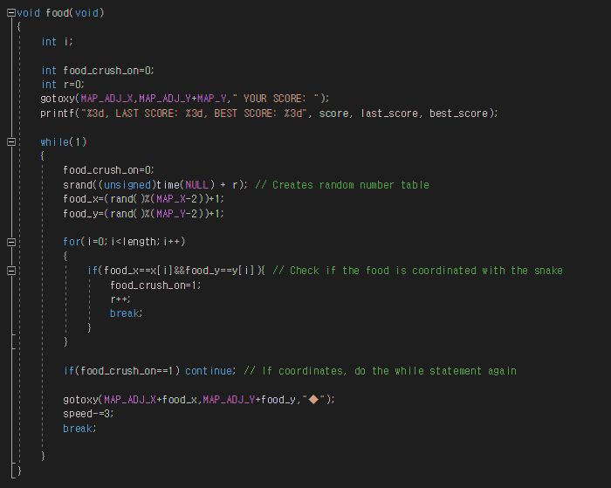
4-5. food()
Print score, last_score, and best_score
Creates random number list
Store random number in food_x and food_y
Check if the food coordinates with snake
YES
NO
Do the while statement again
speed -3

Slide 14
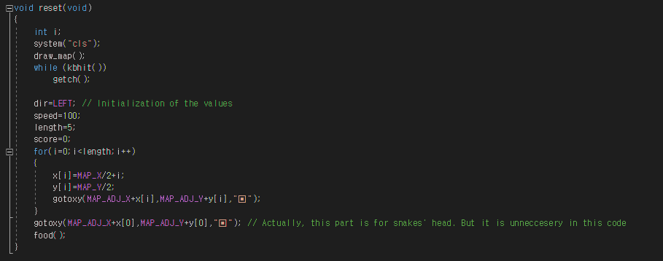
4-6. reset()
draw_map()
Initialization
Draw the snake
food()

Slide 15
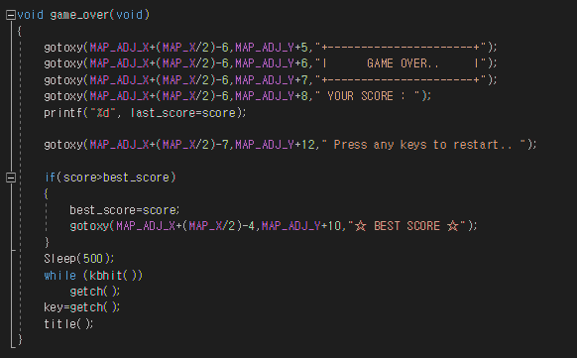
4-7. game_over()
Game over UI
score > best_score?
YES
best_score = score
NO
Get char
title()

Slide 16
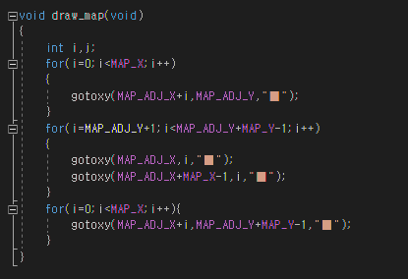
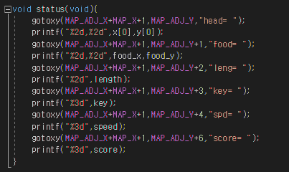
4-8. draw_map(), status()
Literally, it draws the map in a order
Top
Right pillar
Left pillar
Bottom
Status shows
head’s location
Food’s location
Length of the snake
Key value
Speed of the game
Score

Slide 17
5. Outro
You can check more about program in my git.
Here is my git address: https://github.com/LeeChangYoon
This program is currently in development.
To see the progress, check my git above.

