Slide 1
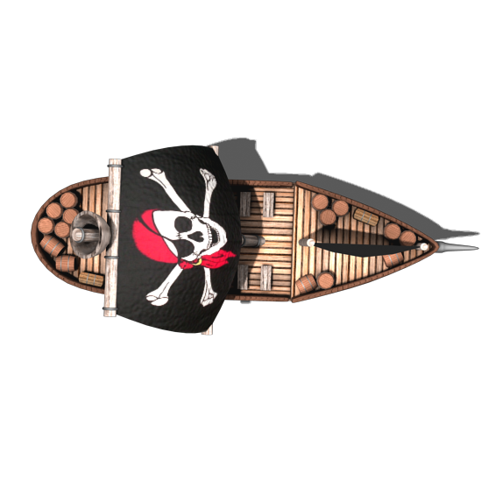
Pirates.io
Lee Elliott
1602346

Slide 2

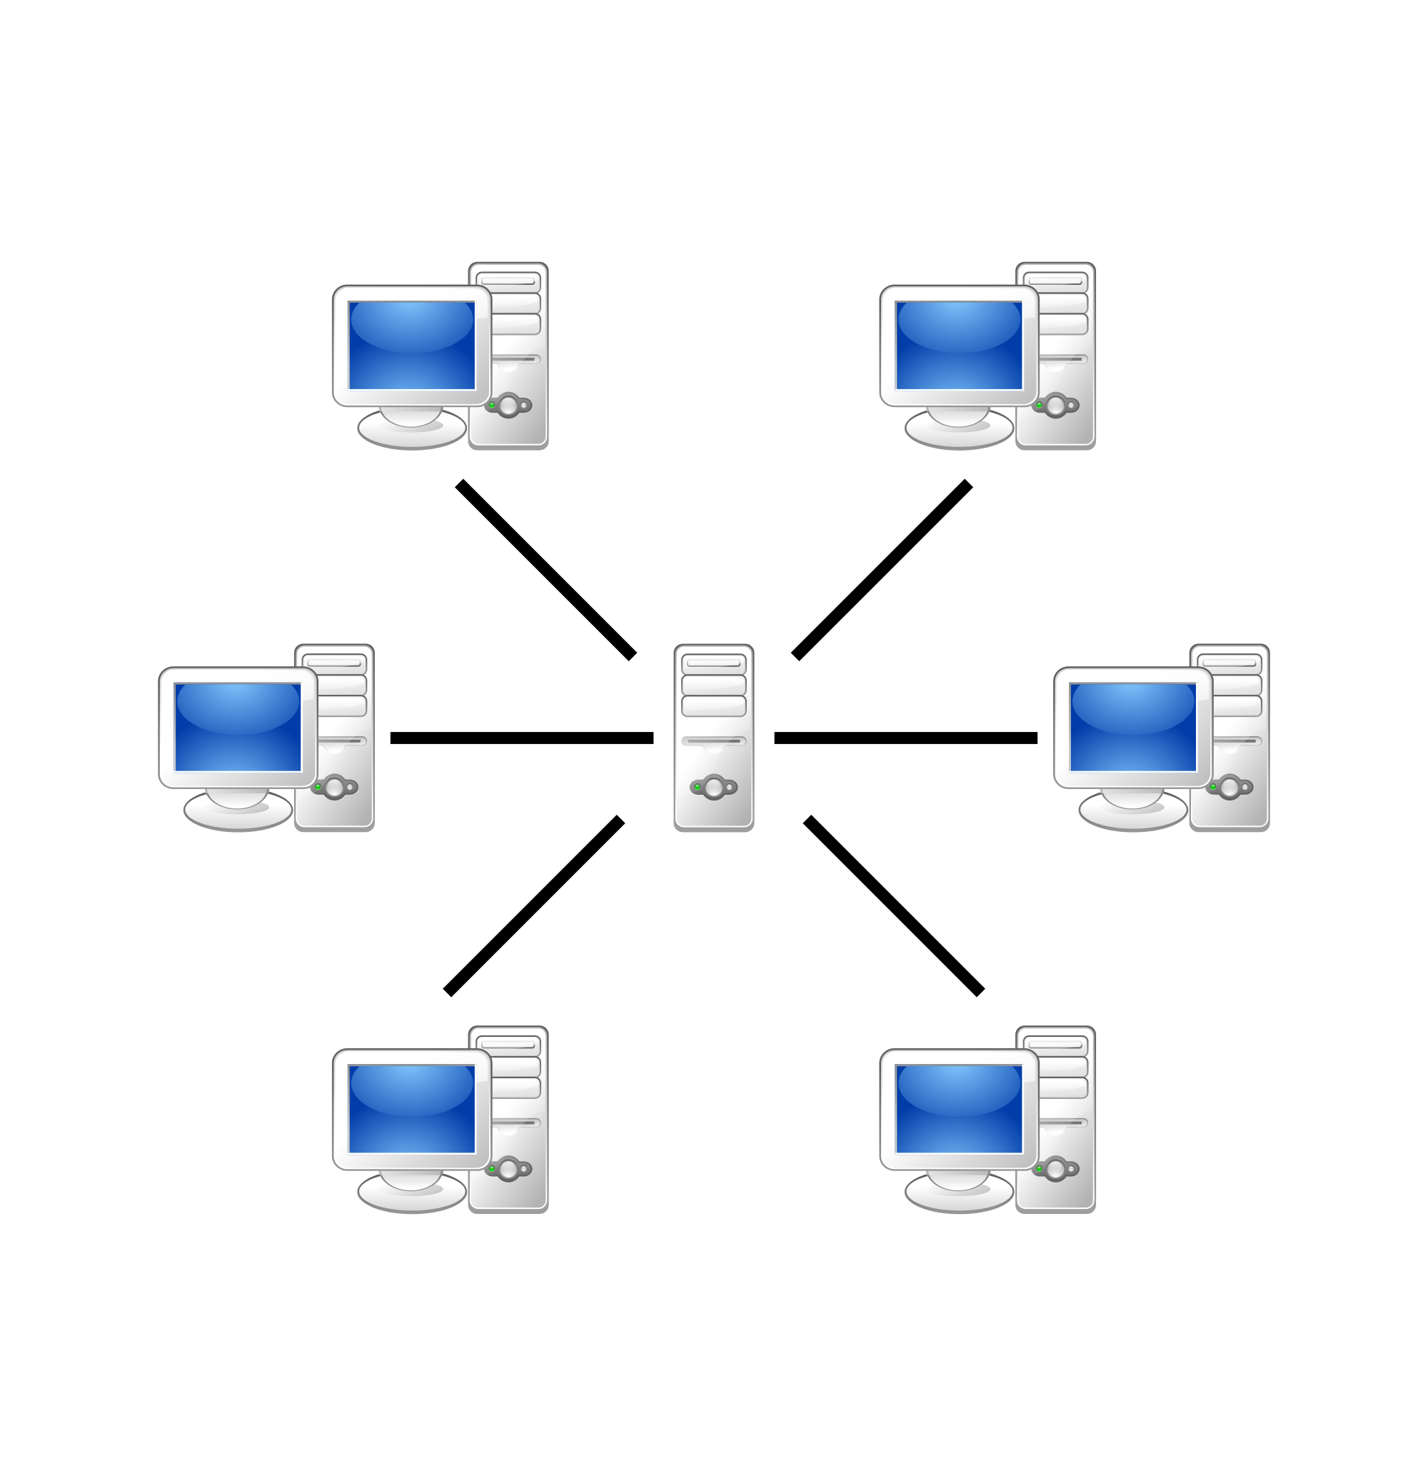
Network Architecture
Application Layer Protocol
SFML packets
Only 3 packet types
Update of status from client
Position, Size, Origin and Rotation
Update of “enemies” from server
Packet type 1
Number of connected clients
Loop to add “ID”, Position, Size, Origin and Rotation
Server full message from server
Packet type 2
String containing message
Packet from client sent every 0.2s
Packet type 1 sent to client every 0.2s
Server/client
Multiple clients connected
Maximum of 50 clients
Could potentially have client count increased if desired
Clients only have to send one message
Transport Layer Protocol
User Datagram Protocol (UDP)

Slide 3
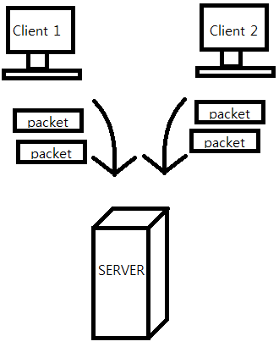
Network API
Sockets
SFML UDP sockets
Similar to WinSock and ships with SFML
WinSock was designed for the client/server model
Simple to implement
Portable so can be used on most platforms
UDP
Computationally less expensive than TCP
Tethered connection not necessary and not feasible
UDP less reliable than TCP
Packet loss can be accounted for using other means

Slide 4

Network Structure and Integration
Client / Server model
Client sends single packet containing their status
Client expects to receive one of two packet types
Packet type 1 provides client with status details of all connected clients, which the client uses to update their stored list
Packet type 2 provides a polite server full message, which stops client sending messages to the server but allows client to “play offline”
Server sends one of two packet types
Packet type 1 sent to connected clients
Packet type 2 sent to prospective clients when server is full

Slide 5

Prediction and Interpolation
Interpolation
Position data received from server is stored in a variable in the enemy.
In the update function, this is compared to the current position of the enemy
If these do not match, interpolation is used to move the enemy towards the server provided position
A similar method is used to control the rotation of the enemy
Interpolation is used to hide disparity in location and rotation caused by lag or packet loss

Slide 6

Evaluation
Interpolation of rotation method made the application seem jerky
This method was altered and an improvement was observed
More improvement could still be made
Prediction could be added to accompany the interpolation
Could improve seamlessness
Could make discrepancies much bigger
A different interpolation method is needed for both player movement and enemy position correction
A more rounded turning circle for movement
Improved rotation correction
Tested using Clumsy
Noticeable issues when using several functions at the same time
The interpolation does an adequate job of minimizing the effects of lag, dropped packets and throttle
Duplicate and out of order had no effect at all
Tamper is extremely effective at disrupting this application

