Slide 1
Installer for Ignition Applications

Slide 2
The Problem
Products have too many pieces
Installations are confusing, tedious
Need way to check what is installed
No way to validate installation

Slide 3
Alternatives
InstallShield
InstallAnywhere
Enterprise Administration Module
DIY

Slide 4
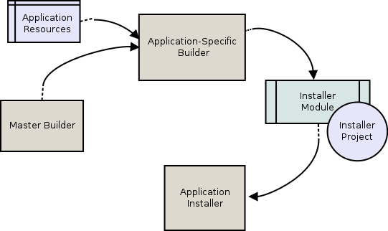
Workflow

