Slide 1
Installer for Ignition Applications

Slide 2
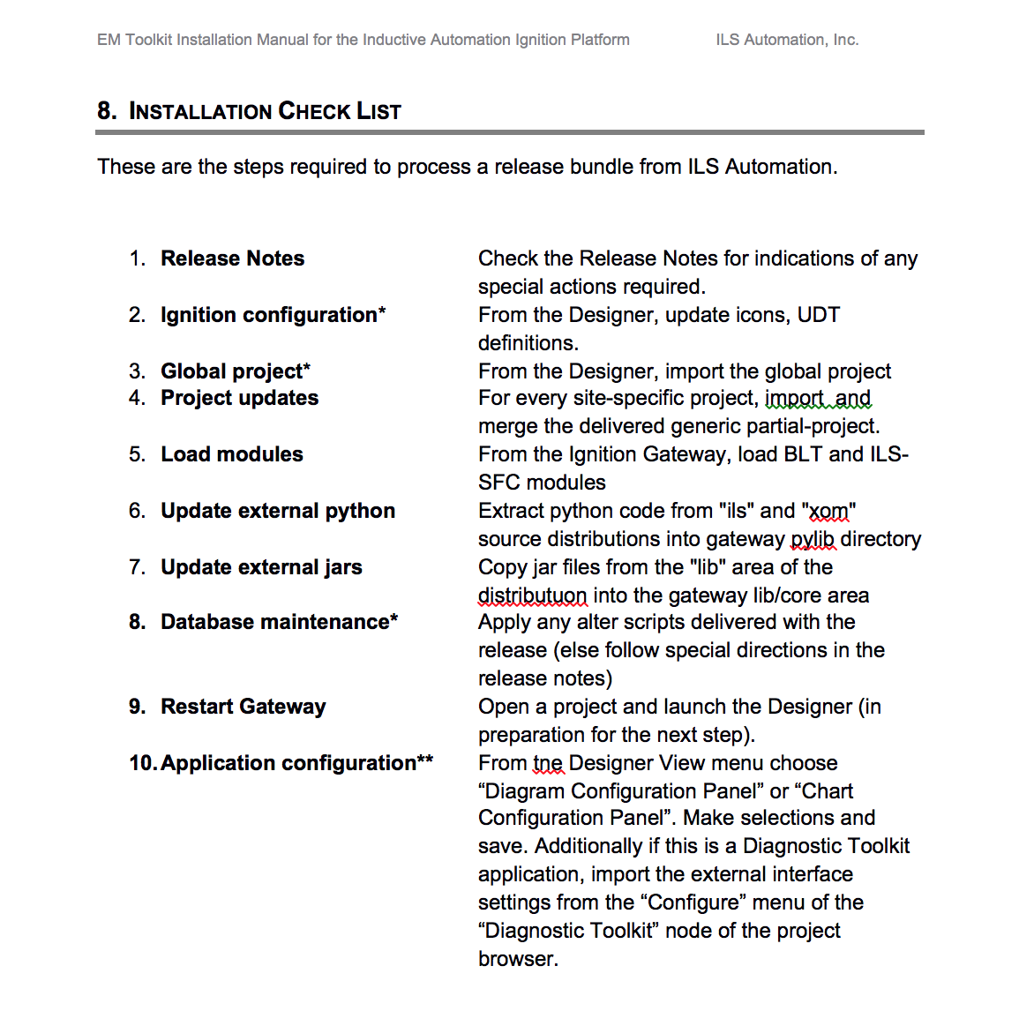
The Problem
Installation Checklist

Slide 3
Design Goals
Completely scripted experience
Package in single file
No outside dependencies

Slide 4
Alternatives
InstallShield
InstallAnywhere
Enterprise Administration Module
POI

Slide 5
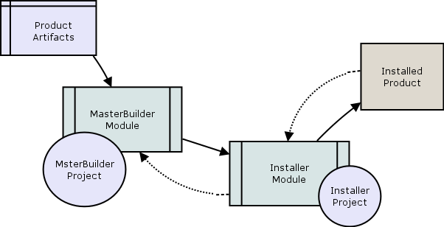
Workflow

Slide 6
Next (proposal)
Consensus on goals/objectives?
Consensus on architecture?
Travis: prototype end-user installer

Slide 7
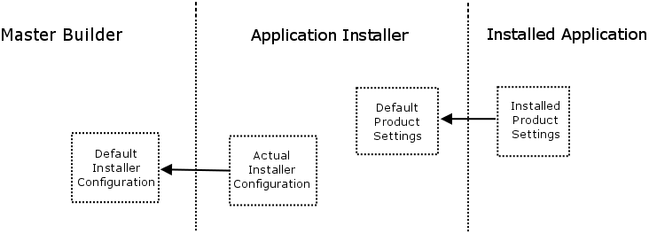
Configuration Sharing

