Slide 1
Installer for Ignition Applications

Slide 2
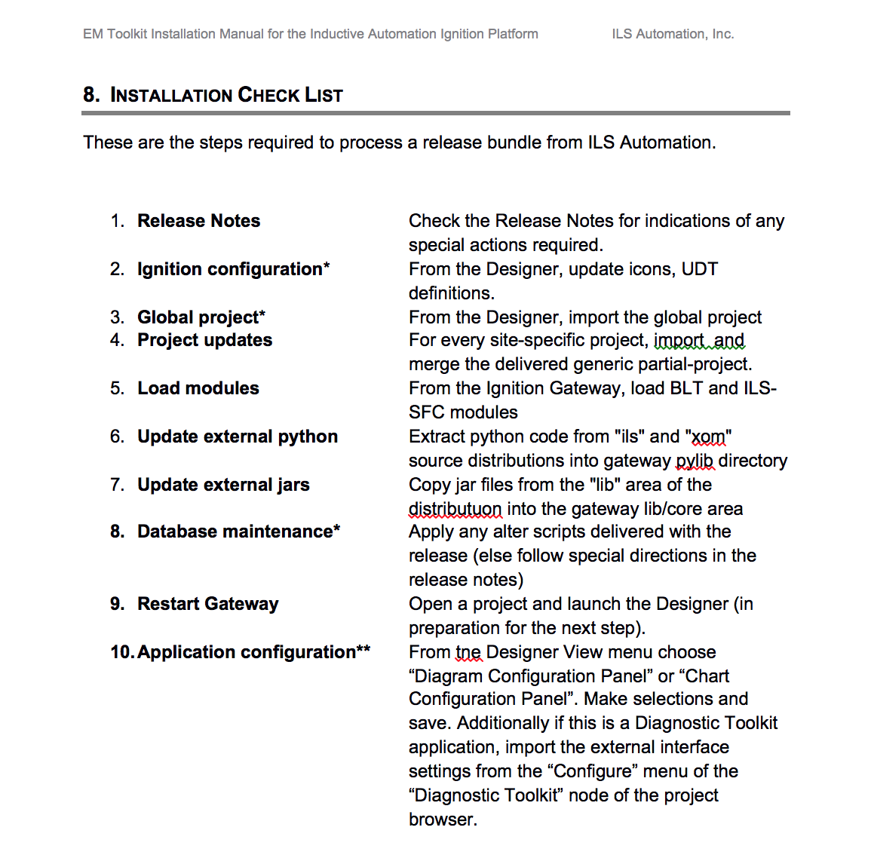
The Problem
Installation Checklist

Slide 3
Design Goals
Completely scripted experience
Package in single file
No outside dependencies

Slide 4
Alternatives
InstallShield
InstallAnywhere
Enterprise Administration Module
POI

Slide 5
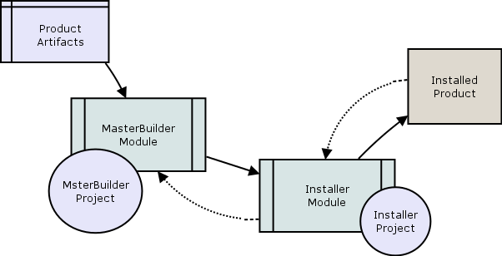
Workflow

Slide 6
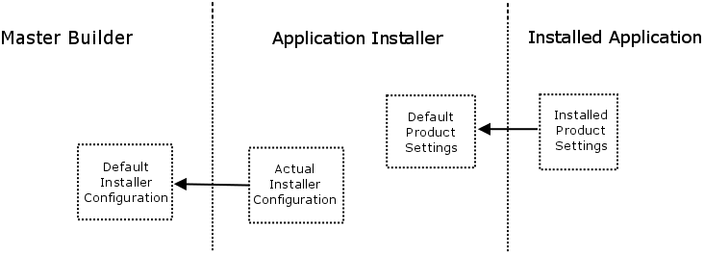
Configuration Sharing

