Slide 1
Permeability Transformer Study
Uchenna Odi, ARAMCO AMERICAS upstream

Slide 2
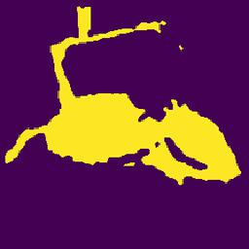
Goals and Accomplishments
Goal: Create predictive workflow to predict (z direction) permeability from pore network images of an injection process under different pressures.
Accomplishments:
Parsed velocity fields (x, y, z)
Converted matlab files in Python environment
Stored as numpy arrays
Converted to Pore Network representations
Converted arrays to images for machine/deep learning training
Extracted pore network slides.
x, y, z directions. 256 images per direction per pressure = 3840 images.
Permeability = f[Pressure, Slice Orientation (x, y, or z), Slice image (x, y, z)]
Issues
Some images non-unique across pressures. Presents a problem in training models.

Slide 3
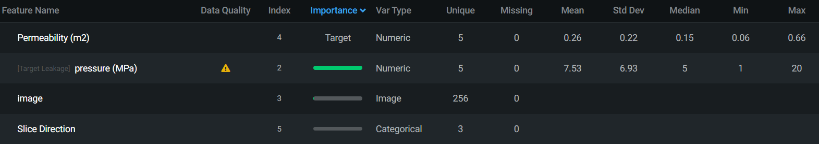
Results
Unique Images/Slices across x, y, z direction for all pressures
Velocity fields are shown to be unique (3840 unique velocity fields across 5 pressures and 3 directions.
Pore networks are not shown to be unique (only 256 unique images across 5 pressures and 3 directions).
May cause issues in training image dependent pore network machine/deep learning models.
Overall Results show that its possible to train a model to predict permeability from slice direction, pore network images, and pressure.

Slide 4
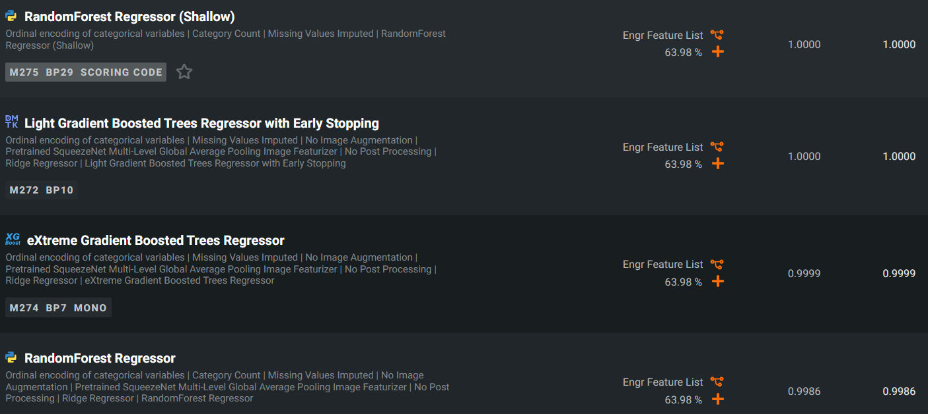
Model Competition for Best Model
Cross Validation
Validation

Slide 5
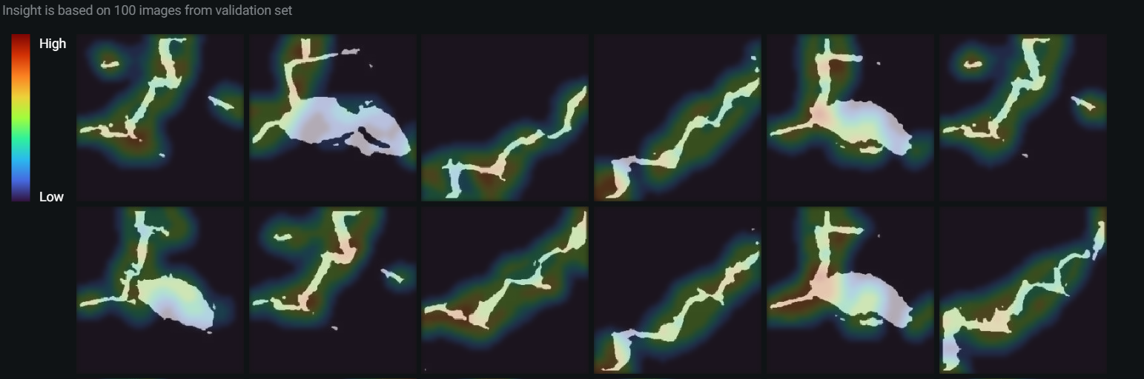
Model can pick up uniqueness of images

