Slide 1




Boosting the Performance of Alias-Aware IFDS Analysis with CFL-based Environment Transformers
Haofeng Li, Chenghang Shi, Jie Lu, Lian Li and Jingling Xue
Institute of Computing Technology,
Chinese academy of sciences
University of Chinese Academy of Sciences
University of New South Wales
Notes:
Good morning, everyone. I am Haofeng Li， an assistant professor at the institute of computing technology of chinese academy of sciences. Today I am happy to present my work which is Boosting the Performance of Alias-Aware IFDS Analysis with CFL-based Environment Transformers, and this is joint work with Chenghang Shi, Jie Lu, Lian Li and Jingling Xue.

Slide 2

IFDS
Boosting the Performance of Alias-Aware IFDS Analysis with CFL-based Environment Transformers
The IFDS analysis framework solves Inter-procedural, context-sensitive, and flow-sensitive analysis of Finite Distribute Subset data-flow problems. To implemant field-sensitivity, current works usually use Access Path (𝑣. 𝑓∗) to represent data-flow facts.
Reps et al. ^{[1]} transforming IFDS problems into a special kind of graph-reachability problem
[1]Thomas Reps, Susan Horwitz, and Mooly Sagiv. 1995. Precise interprocedural dataflow analysis via graph reachability. In Proceedings of the 22nd ACM SIGPLAN-SIGACT symposium on Principles of programming languages (POPL '95). Association for Computing Machinery, New York, NY, USA, 49–61. DOI:https://doi.org/10.1145/199448.199462
Notes:
What is IFDS? The IFDS framework, initially proposed by Reps, solves inter-procedural, context-sensitive, and flow-sensitive analysis of finite distribute subset data-flow problems. IFDS problem can be transformed into a special kind of graph-reachability problem.

Slide 3



IFDS
Boosting the Performance of Alias-Aware IFDS Analysis with CFL-based Environment Transformers
IFDS can be used to solve a wide range of problems:
  pointer analysis
  taint analysis
  slicing
  bug detection
  shape analysis
  …
Notes:
The IFDS analysis algorithm has been implemented in various analysis and compilation frameworks, such as WALA, SOOT, and LLVM. Meantime, it can be used to solve a wide range of problems, such as pointer analysis, taint analysis, slicing analysis, bug detection, shape analysis and so on.

Slide 4
IFDS
Boosting the Performance of Alias-Aware IFDS Analysis with CFL-based Environment Transformers
IFDS algorithm is time-intensive
Time complexity: O(|E||D|³)
  E represents edges in the graph
  D represents the set of data-flow facts. Access Path (𝑣.𝑓∗) is usually used to represent the element in D. K-Limiting is used to limit the length of field access seqence to limit the unbounded size of D.
16/2,950 Android apps are unanalyzable on a computer server with 730GB of RAM and 64 Intel Xeon CPU cores^{[1]}
[1]V. Avdiienko, K. Kuznetsov, A. Gorla, A. Zeller, S. Arzt, S. Rasthofer, and E. Bodden, “Mining apps for abnormal usage of sensitive data,” in Proceedings of the 37th International Conference on Software Engineering - Volume 1, ser. ICSE ’15. IEEE Press, 2015, p. 426–436.
Notes:
Although the IFDS algorithm can solve data-flow problems precisely, mentime, it requires a significant amount of time. The time complexity is: the big O of E plus the cube of D where the D represents the set of data-flow facts. Generally, the Access Path (𝑣.𝑓∗) is usually used to represent the element in D. In a previous study, an IFDS-based tool cannot analyze some applications in 24 hours on a super computer. In this paper, we propose a new field-sensitive approach to reduce the size of D to improve performance.

Slide 5
Example
Boosting the Performance of Alias-Aware IFDS Analysis with CFL-based Environment Transformers
Access-Path-based IFDS Analysis
Notes:
Next, I will introduce our approach by using a simple example. the return value of method source is assigned to variable s at line two. we suppose the return value of method soure is sensitive.

Slide 6
Example
Boosting the Performance of Alias-Aware IFDS Analysis with CFL-based Environment Transformers
Access-Path-based IFDS Analysis
Notes:
the variable s is stored to different fields of variable a at lines three and four.

Slide 7
Example
Boosting the Performance of Alias-Aware IFDS Analysis with CFL-based Environment Transformers
Access-Path-based IFDS Analysis
Notes:
The method foo is invoked at line five with variable a as actual parameter.

Slide 8
Example
Boosting the Performance of Alias-Aware IFDS Analysis with CFL-based Environment Transformers
Access-Path-based IFDS Analysis
Notes:
In method foo, formal parameter x is assigned to variable y which is returned later.

Slide 9
Example
Boosting the Performance of Alias-Aware IFDS Analysis with CFL-based Environment Transformers
Access-Path-based IFDS Analysis
Notes:
at line six value is loaded from b.g to variable c which is actual parameter of method sink at line seven. Now, the questions is: can the data extracted from method source at line two flow to the method sink at line seven?

Slide 10
FlowDroid
Boosting the Performance of Alias-Aware IFDS Analysis with CFL-based Environment Transformers
Access-Path-based IFDS Analysis
Notes:
Firstly, I will introduce how access path based taint analysis based on IFDS algorithm to solve this problem. variable s is tainted at line two.

Slide 11
FlowDroid
Boosting the Performance of Alias-Aware IFDS Analysis with CFL-based Environment Transformers
Access-Path-based IFDS Analysis
Notes:
the access path a.f is tainted through store statement at line three

Slide 12
FlowDroid
Boosting the Performance of Alias-Aware IFDS Analysis with CFL-based Environment Transformers
Access-Path-based IFDS Analysis
Notes:
Meantime, tainted fact s is propagated along Control flow graph.

Slide 13
FlowDroid
Boosting the Performance of Alias-Aware IFDS Analysis with CFL-based Environment Transformers
Access-Path-based IFDS Analysis
Notes:
at line four, s taints the access path a.g.

Slide 14
FlowDroid
Boosting the Performance of Alias-Aware IFDS Analysis with CFL-based Environment Transformers
Access-Path-based IFDS Analysis
Notes:
s continues to be propagated along CFG.

Slide 15
FlowDroid
Boosting the Performance of Alias-Aware IFDS Analysis with CFL-based Environment Transformers
Access-Path-based IFDS Analysis
Notes:
access path a.f is propgated to line five

Slide 16
FlowDroid
Boosting the Performance of Alias-Aware IFDS Analysis with CFL-based Environment Transformers
Access-Path-based IFDS Analysis
Notes:
access paths a.f and a.g both of which have the same base variable a are propagated to x.f and x.g seperately.

Slide 17
FlowDroid
Boosting the Performance of Alias-Aware IFDS Analysis with CFL-based Environment Transformers
Access-Path-based IFDS Analysis
Notes:
x.f and x.g taint y.f and y.g seperately at line nine.

Slide 18
FlowDroid
Boosting the Performance of Alias-Aware IFDS Analysis with CFL-based Environment Transformers
Access-Path-based IFDS Analysis
Notes:
then the four access paths are propagated along cfg seperately.

Slide 19
FlowDroid
Boosting the Performance of Alias-Aware IFDS Analysis with CFL-based Environment Transformers
Access-Path-based IFDS Analysis
Notes:
due to return flow, access paths a.f a.g b.f and b.g are tainted after line 5.

Slide 20
FlowDroid
Boosting the Performance of Alias-Aware IFDS Analysis with CFL-based Environment Transformers
Access-Path-based IFDS Analysis
Notes:
at line six, only the access path b.g can taint c

Slide 21
FlowDroid
Boosting the Performance of Alias-Aware IFDS Analysis with CFL-based Environment Transformers
Access-Path-based IFDS Analysis
Notes:
the other access paths are propagated along cfg

Slide 22
FlowDroid
Boosting the Performance of Alias-Aware IFDS Analysis with CFL-based Environment Transformers
Access-Path-based IFDS Analysis
Notes:
then the access path c is propagated to line seven and matches with the actual parameter of method sink.

Slide 23
FlowDroid
Boosting the Performance of Alias-Aware IFDS Analysis with CFL-based Environment Transformers
Access-Path-based IFDS Analysis
leak
Notes:
Then we can find a leak from line two to line seven. As we can see, during the solving process, there is a lot of redundant propagation of access paths which have the same base variables.

Slide 24
IDEDroid
Boosting the Performance of Alias-Aware IFDS Analysis with CFL-based Environment Transformers
Our Approach
Notes:
So, how can we reduce redundant propagations of access paths that share the same base variables? Intuitively, we can only propagate base variables along CFG. The question then become: how to model field access? We will introduce our approach with the same example. Similairy, s is tainted at line two.

Slide 25
IDEDroid
Boosting the Performance of Alias-Aware IFDS Analysis with CFL-based Environment Transformers
Our Approach
Notes:
at line three, a.f is tainted by s, here, Rather than computing tainted access path a.f, we only propagate base varaible a and map field access f to it. here we use horizontal lines above f to represent store f.

Slide 26
IDEDroid
Boosting the Performance of Alias-Aware IFDS Analysis with CFL-based Environment Transformers
Our Approach
Notes:
similarly, at line four, a is tainted with a map from a to store g.

Slide 27
IDEDroid
Boosting the Performance of Alias-Aware IFDS Analysis with CFL-based Environment Transformers
Our Approach
Notes:
then only base variable a is propagated to base variable x which is the formal parameter of method foo.

Slide 28
IDEDroid
Boosting the Performance of Alias-Aware IFDS Analysis with CFL-based Environment Transformers
Our Approach
Notes:
at line nine, base variable y is tainted.

Slide 29
IDEDroid
Boosting the Performance of Alias-Aware IFDS Analysis with CFL-based Environment Transformers
Our Approach
Notes:
then base variables x and y are propagated along cfg, a and b are tainted due to return flow.

Slide 30
IDEDroid
Boosting the Performance of Alias-Aware IFDS Analysis with CFL-based Environment Transformers
Our Approach
Notes:
at line six, the value is loaded from b.g to c, here we taint the base variable c with a map from base varaible c to load g, here we use g without horizontal line to represent load field operation.

Slide 31
IDEDroid
Boosting the Performance of Alias-Aware IFDS Analysis with CFL-based Environment Transformers
Our Approach
Notes:
finally, base variable c is propagated to line seven.

Slide 32

IDEDroid
Boosting the Performance of Alias-Aware IFDS Analysis with CFL-based Environment Transformers
Our Approach
$$valid path :\overline{g} g$$
Notes:
when propagating base variables, we collect the field accesses each base variable mapped. when a taint propagation path is discovered, there are some field access sequences will be constructed concurrently. Then we will check whether every field access sequence is valid. for instance, the green path is a taint propagation path, the field access sequence is store g load g which is valid.

Slide 33

IDEDroid
Boosting the Performance of Alias-Aware IFDS Analysis with CFL-based Environment Transformers
Our Approach
$$invalid path :\overline{f} g$$
Notes:
however, for another taint propagation path, the blue path, the field access sequence is store f load g which is invalid.
The above is an example of our approach.

Slide 34
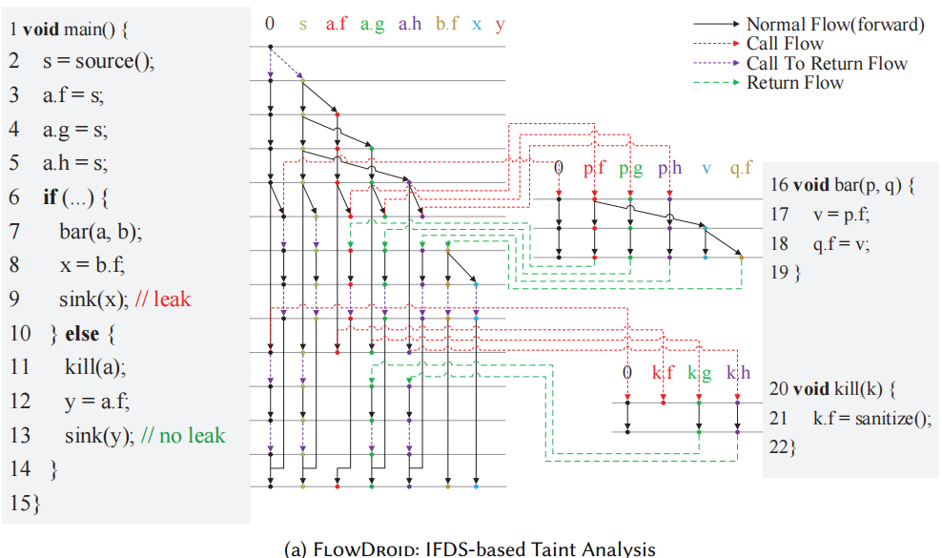
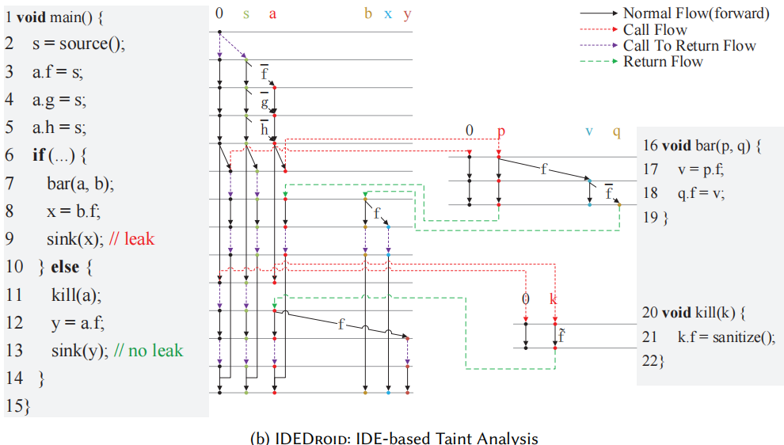
Conclusion
Boosting the Performance of Alias-Aware IFDS Analysis with CFL-based Environment Transformers
Time complexity: O(|E||D|³)
In our benchmarks, access-path-based IFDS analysis processes 5.3× more facts (D) than our approach on average, peaking at 9.3× for CGZCA.
IDEDroid significantly outperforms FlowDroid, achieving speedups 222× on average.
Notes:
Here is a more complex example, In practice, the code will be more complex. Our approach can significantly reduce data-flow facts to improve performance. I will introduce in evaluation

Slide 35
Challenges
Boosting the Performance of Alias-Aware IFDS Analysis with CFL-based Environment Transformers
Challenges
Q1. How to propagate base variables and construct field accesses concurrently?
Q2. How to model field access?
Q3. How to solve it efficiently?
Our approach
A1. IFDS => IDE
A2. Flow-sensitive CFL for Field-Sensitivity
A3. Efficient CFL-Reachability Solving
Notes:
So how can we do it? its not easy. There are three challenges. Number one: How to propagate base variables and construct field accesses concurrently? Number two: How to model field access? Number three: How to solve it efficiently? the right is our solution
I will introduce our approach in the following slides.

Slide 36
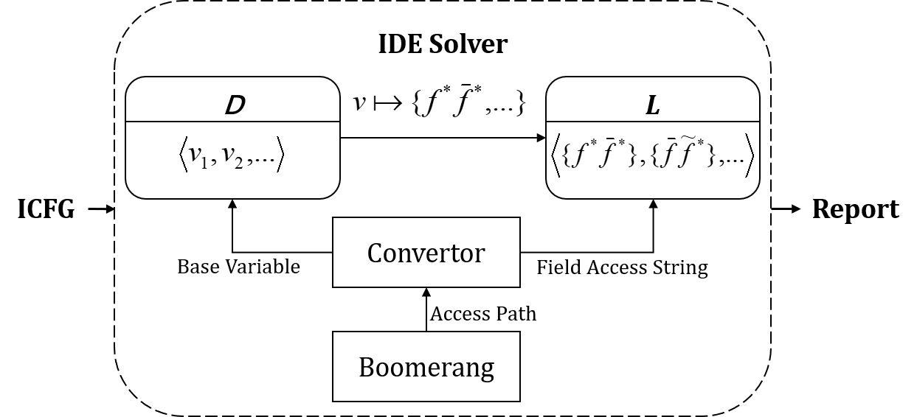
Framework
Boosting the Performance of Alias-Aware IFDS Analysis with CFL-based Environment Transformers
Framework
IDEDroid reinterprets the generation of access paths as a CFL for field-sensitivity and formulates it as an IDE problem. IDEDroid uses Boomerang, a demand-driven, flow-, field-, and context-sensitive pointer analysis, for alias queries at field stores of base variables in 𝐷.
In IDEDroid, env(𝐷, 𝐿) associates each base variable 𝐷with a set 𝐿of field access strings, where each string 𝑙∈ 𝐿 consists of labels $\overline{f}$, 𝑓, $\tilde{f}$, or 𝜖for the empty string
Notes:
this is the overview of our approach. We reinterpret the generation of access paths as a CFL for field-sensitivity and formulate it as an IDE problem. We use boomerang for alias queries.

Slide 37
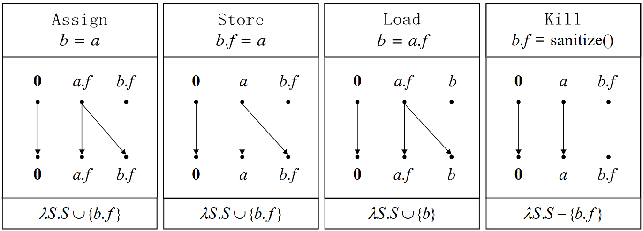
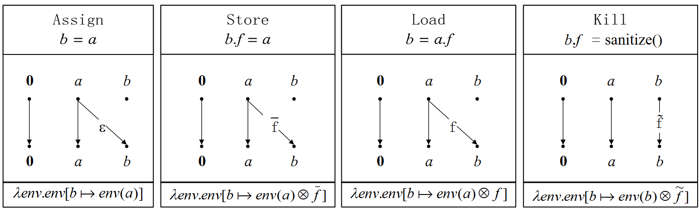
Flow Functions
Boosting the Performance of Alias-Aware IFDS Analysis with CFL-based Environment Transformers
FlowDroid
IDEDroid
details in the paper
Notes:
Different from access-path-based ifds analysis, which propagates access path along iter-procedure cfg, we use IDE algorithm to propagate base variables and construct field access sequence concurrently. IDE algorithm is an extension of IFDS
here is the flow functions of FlowDroid and IDEDroid, Flowdroid is access path based ifds analysis, and idedroid is our approach.

Slide 38
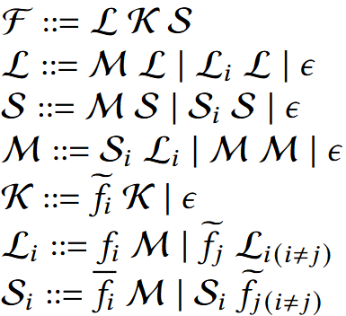
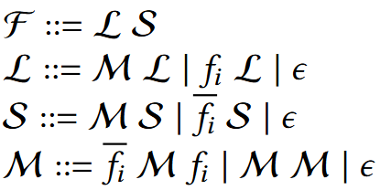
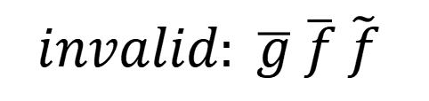
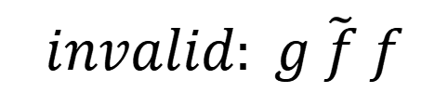
CFL
Boosting the Performance of Alias-Aware IFDS Analysis with CFL-based Environment Transformers
checking field access string
(a) CFG for field access
without kill
(b) CFG for field access
$$invalid: g \tilde{f} f$$
$$invalid: \overline{g} \overline{f} \tilde{f}$$
Notes:
we can use IDE algorithm propogate base variables and construct the field access sequences. but how can we check whether a feild access sequence is valid?
the Context free language for field access can solve this problem, here is the standard context free grammar for field-sensitivity. unfortunately, this grammar can only express flow-insensitive field access, this will disrupts the flow-sensitivity of the original IFDS/IDE analysis. so we introduced kill operation in the grammar to guarantee flow-sensitivity. We use wave lines above a field to represent kill operation aka，sanitize operation. here is the extended grammar, and the details are in the paper.

Slide 39

CFL
Boosting the Performance of Alias-Aware IFDS Analysis with CFL-based Environment Transformers
Efficient CFL-Reachability Solving
Solving CFL-Reachability problem is time-intensive.
$l_{1}∈L, l_{2}∈L { l}_{1}{×l}_{2} ×$represnets Cartesian product
$F_{1}∈l_{1}, F_{2}∈l_{2} { F}_{1 }$and $F_{2}$ are valid field access strings ${ F}_{1}F_{2}$
Notes:
there is another problem: Solving CFL-Reachability for field-sensitivity is time-intensive. the theory time complexity of it is equal to solving IFDS/IDE algorithm. so we need an efficient algorithm to check whether a field access seqence is valid.
in our situation, we only check and construct valid access strings when we propagate base variables. so the problem becomes to : given two valid field access strings, how to check whether the combination of them is valid?

Slide 40
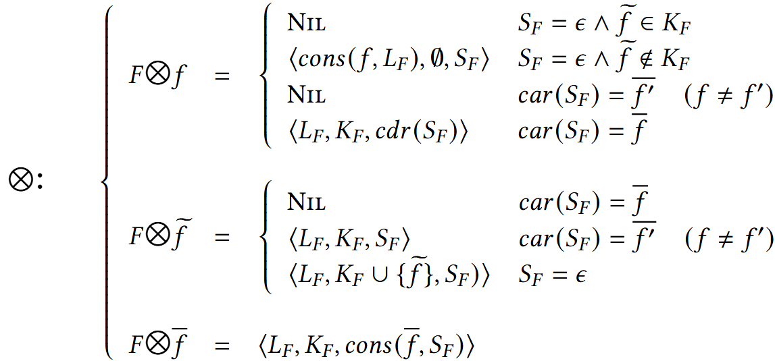








CFL
Boosting the Performance of Alias-Aware IFDS Analysis with CFL-based Environment Transformers
Efficient CFL-Reachability Solving
$$...\tilde{f}⊗f$$
$$...\tilde{g}⊗f$$
$$...\overline{g}⊗f$$
$$...\overline{f}⊗f$$
$$...\overline{f}⊗\tilde{f}$$
$$...\overline{g}⊗\tilde{f}$$
$$...\tilde{g}⊗\tilde{f}$$
$$...g⊗\tilde{f}$$
details in the paper
Notes:
acorrding to this insights, we propose an efficient algorithm. this is the formalization of our efficient cfl-rechability solving. details are in the paper

Slide 41
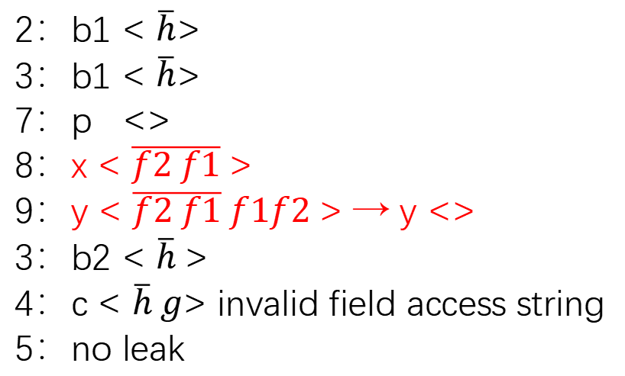
Precision
Boosting the Performance of Alias-Aware IFDS Analysis with CFL-based Environment Transformers
Precision
2-limiting
1 main() {
2 b1.h = source();
3 b2 = foo(b1);
4 c = b2.g;
5 sink(c); //no leak
6 }
7 foo(p) {
8 x.f1.f2 = p;
9 y = x.f1.f2;
10 return y;
11}
FlowDroid
IDEDroid
2：b1.h
3：b1.h
7：p.h
8：x.f1.f2.*
9：y.*
3：b2.*
4：c.*
5：leak(false positive)
2：b1 < $\overline{h}$>
3：b1 < $\overline{h}$>
7：p <>
8：x < $\overline{f2 f1}$>
9：y < $\overline{f2 f1} f1f2$> → y <>
3：b2 < $\overline{h}$>
4：c < $\overline{h} g$> invalid field access string
5：no leak
Notes:
obviously, our approach can reduce the size of data flow facts to improve the performance of the original IFDS algorithm. In addition, our approach can also improve presion. let us look at this example. for access-path based ifds analysis, b1.h is tainted at line two, p.h is tainted at line seven. at line eight, x.f1.f2.h is tainted. Suppose here we limit the field access length is two. K-limiting is standard technology to bound the size of access path. due to k-limiging, we over-approximately cut the last field h and replaced with star. so tainted access path becomes to x.f1.f2.*. at line nine, y.* is tainted. then b2.* is tainted due to return flow. because we don’t known which field of b2 is tainted, at line four, we just over-approximately taint c.*. this will result in a false positive at line five. In our approach, we check and discard the matched field access string $\overline{f2 f1} f1f2$, so our approch will not exceed the k-limiting and preserve precision.

Slide 42
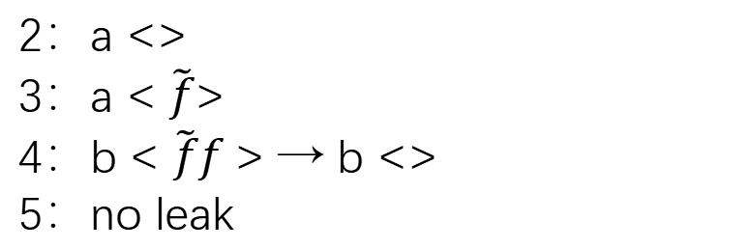
Precision
Boosting the Performance of Alias-Aware IFDS Analysis with CFL-based Environment Transformers
Precision
1 main() {
2 a = source();
3 a.f = sanitizer();
4 b = a.f;
5 sink(b); //no leak
6 }
FlowDroid
IDEDroid
2：a.*
3：a.*
4：b.*
5：leak(false positive)
2：a <>
3：a < $\tilde{f}$>
4：b < $\tilde{f}f$> → b <>
5：no leak
Notes:
this is another example. access path based IFDS cannot model kill operation for some cases. Our approach can model kill operation explicitly.

Slide 43
Evaluation
Boosting the Performance of Alias-Aware IFDS Analysis with CFL-based Environment Transformers
Benchmarks:
  14 apps (FossDroid) + 10 apps (Drebin)
Platform:
  Intel Core(TM) i5-10210U machine (2.11GHz) with 40 GB of RAM
  Time budget: 5 hours
  FlowDroid + Boomerang
  IDEDroid + Boomerang
Configs:
  Default sources, sinks, summaries and so on from Boomerang
IDEDroid and FlowDroid identified identical leaks on 327 unit tests from Boomerang
Questions:
  RQ1. How does IDEDroid’s performance compare with that of FlowDroid?
  RQ2. Does IDEDroid offer greater precision than FlowDroid?
  RQ3. Can IDEDroid facilitate tradeoffs between efficiency and precision?
Notes:
here is the experiments. We evaluate idedroid and flowdroid on 14 benign applications from fossdroid and 10 malware applications from drebin. both tools use the same configurations such as sources, sinks, and so on. Then To evaluate the impact of our research we focused on the some research questions.

Slide 44
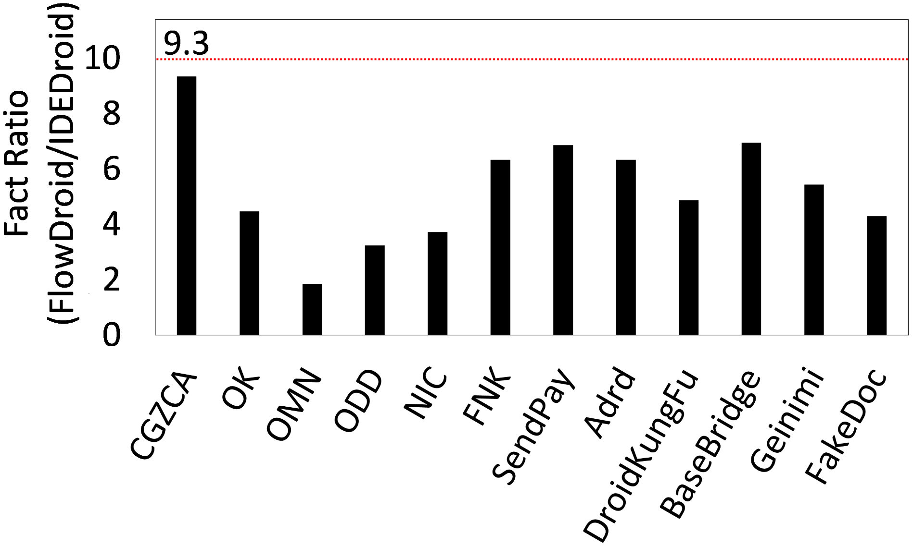
RQ1
Boosting the Performance of Alias-Aware IFDS Analysis with CFL-based Environment Transformers
Facts
The ratio of the data-flow facts processed by FlowDroid over that of IDEDroid.
Notes:
our approach can reduce the size of data-flow facts significantly. here is the ratio of the data-flow facts processed by FlowDroid over that of IDEDroid. for the first benchmamrk, the facts produced by flowdroid are almost 10x larger than that of idedroid.

Slide 45
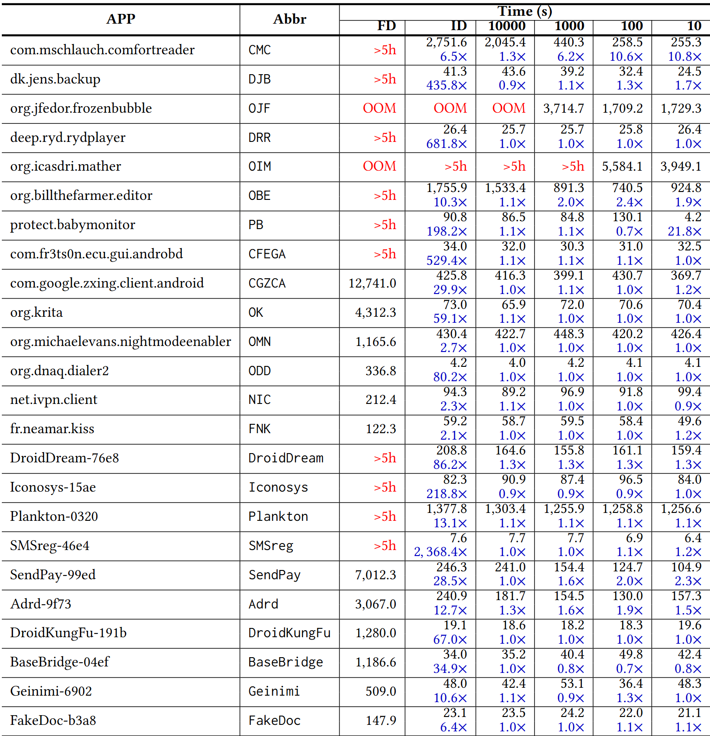
RQ1
Boosting the Performance of Alias-Aware IFDS Analysis with CFL-based Environment Transformers
Speedup
Average: 222.0×
Min: 2.1× (FNK)
Max: 2, 368.4×(SMSreg)
Notes:
IDEDroid significantly outperforms FlowDroid, achieving speedups ranging from 2.1× (FNK) to an impressive 2, 368.4× (SMSreg), with an average speedup of 222.0×.

Slide 46



RQ1
Boosting the Performance of Alias-Aware IFDS Analysis with CFL-based Environment Transformers
681.8×
MusicPiped
529.4×
AndrOBD
Reduce FP
Notes:
here are some famous open-source applications, idedroid can analyze them in tens of seconds. idedroid can also imporve presion. I will introduce later.

Slide 47
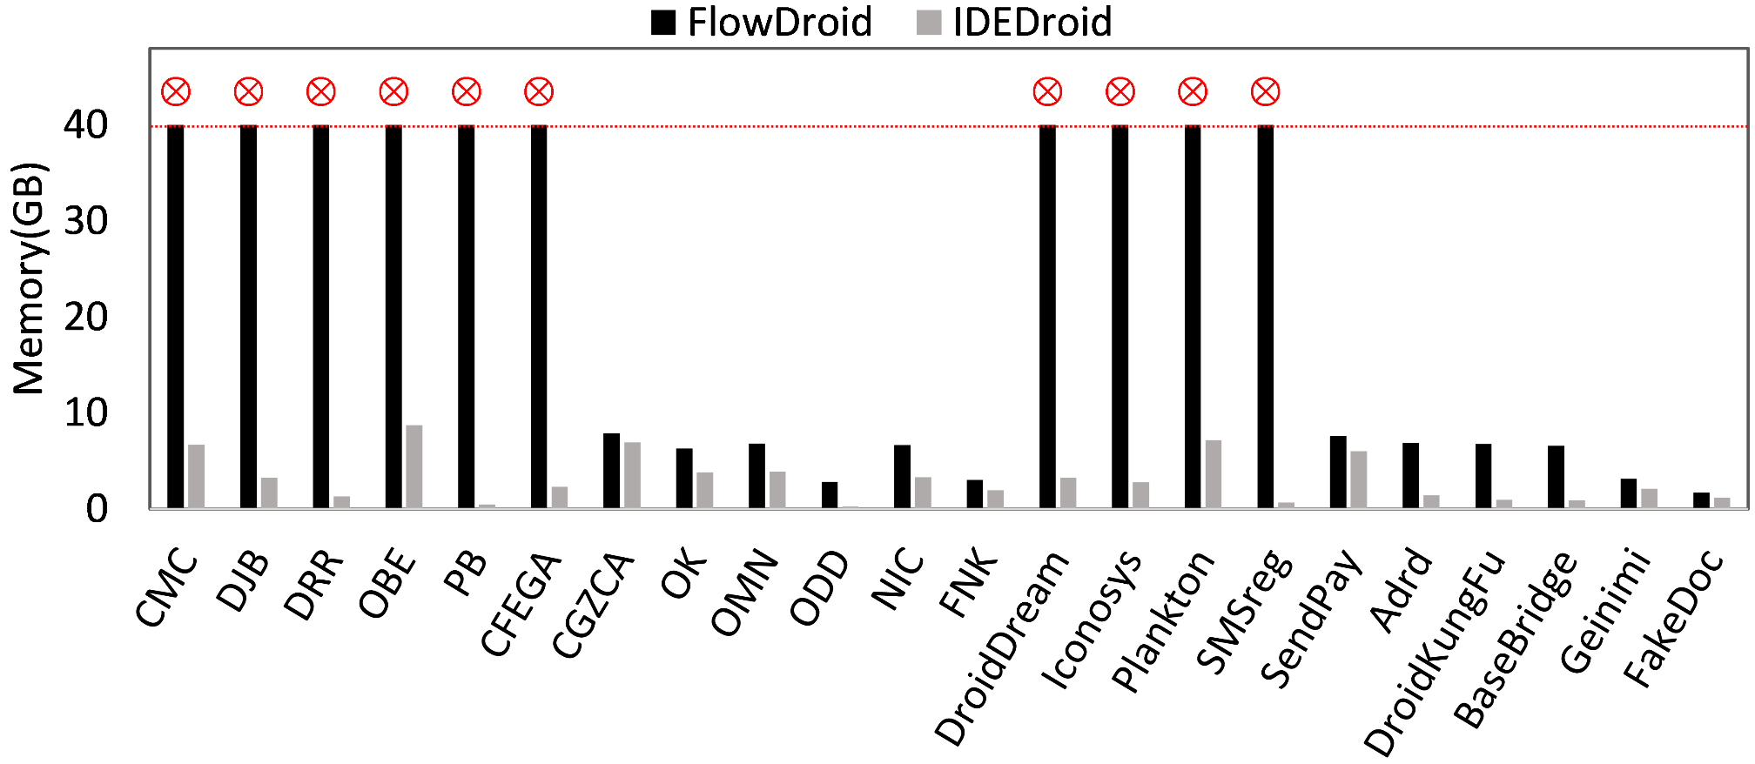
RQ1
Boosting the Performance of Alias-Aware IFDS Analysis with CFL-based Environment Transformers
Memory
Average: FlowDroid/IDEDroid = 3.6
Notes:
for all benchmarks, idedroid always use less memory than flowdroid.

Slide 48
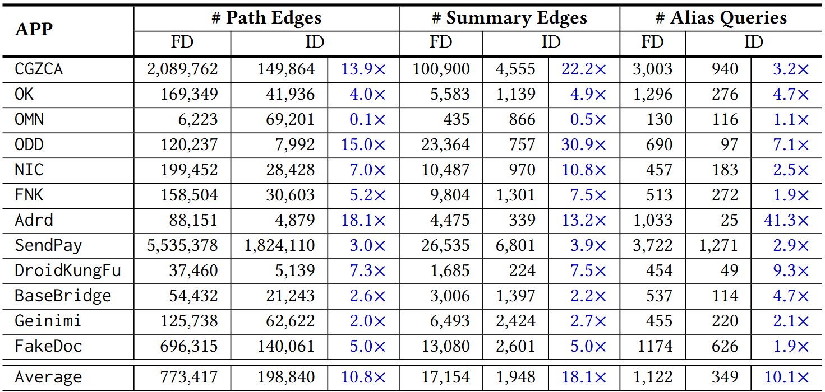
RQ1
Boosting the Performance of Alias-Aware IFDS Analysis with CFL-based Environment Transformers
PathEdges+Summaries+Alias
Notes:
there are three key benefits of our CFL-based approach over the traditional access-path-based approach for enforcing field-sensitivity in the IFDS/IDE framework:
Firstly, idedroid generates fewer data-flow facts i have introduced in the previous slides. secondly, idedroid can reduce fewer propagations which means fewer path edges and summary edges. thirdly, idedroid can trigger fewer alias queries.

Slide 49
RQ2
Boosting the Performance of Alias-Aware IFDS Analysis with CFL-based Environment Transformers
Precision
APP | leaks
 | FlowDroid | IDEDroid
CGZCA | 26 | 23
OK | 5 | 4
Geinimi | 21 | 18
FakeDoc | 26 | 25
Notes:
Question 2 precision. there are four benchmarks, idedroid reported fewer leaks than flowdroid, After manual verification, all of these leaks are false positives of flowdroid.

Slide 50
RQ3
Boosting the Performance of Alias-Aware IFDS Analysis with CFL-based Environment Transformers
Limiting Field Accesses Per Base Variable
The default setting for IDEDroid allows unrestricted number of field accesses per base variable.
 | IDEDroid₁₀₀₀₀ | IDEDroid₁₀₀₀ | IDEDroid₁₀₀ | IDEDroid₁₀
Average | 1.1 | 1.5 | 1.9 | 2.8
Max | 1.3 | 6.2 | 10.6 | 21.8
The speedups with field accesses per base variable limited to 10,000, 1,000, 100, and 10 compared to its default setting
Notes:
Question 3. IDEDroid also offers two strategies for balancing precision and efficiency. the first, Limiting Field Accesses Per Base Variable, after Limiting Field Accesses Per Base Variable idedroid can further speed up. Meantime, The precision for most apps remains unchanged even for limiting to 100 and 10

Slide 51
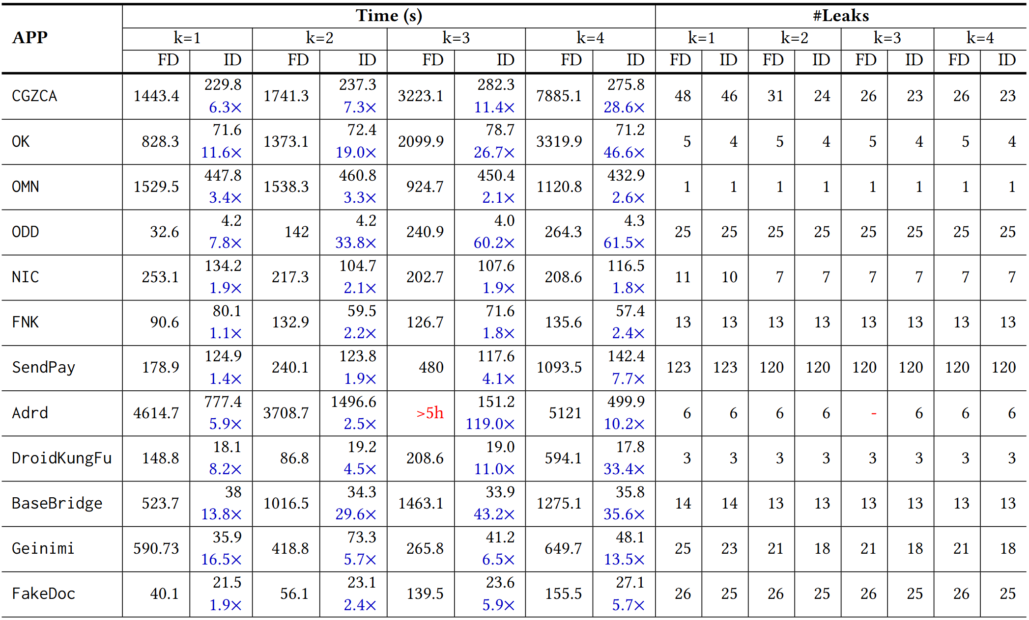
RQ3
Boosting the Performance of Alias-Aware IFDS Analysis with CFL-based Environment Transformers
Limiting Field Access Lengths
Notes:
the second, Limiting Field Access Lengths, same as traditional k-limiting technology. flowdroid limits access path length whereas IDEDroid limits field access string length. Under different k ( from 1 to 5), no matter performance or pricision, idedroid is always better than flowdroid

Slide 52

Thanks!
lihaofeng@ict.ac.cn
https://leehaofeng.github.io

