Slide 1


CORE-V Cores Roadmap
Davide Schiavone | davideⓐopenhwgroup.org
Jérôme Quévremont | jerome·quevremontⓐthalesgroup·com
Arjan Bink | arjan.binkⓐsilabs.com

Slide 2



CORE-V Family History
Initial contribution of open-source RISC-V cores from ETH Zurich PULP Platform and the OpenHW Group is the official committer for these repositories
OpenHW Cores Task Group has the mandate to develop feature and functionality roadmap for the CORE-V Family of open-source RISC-V processors
Chair: Arjan Bink, Silicon Laboratories
Vice-Chair: Jérôme Quévremont, Thales Research & Technology
Core | Bits/Stages | Description
CV32E40P (RI5CY) | 32bit / 4-stage | A family of 4-stage cores that implement, RV32IMFCXpulp, optional 32-bit FPU, instruction set extensions for DSP operations including HW loops, SIMD extensions, bit manipulation and post-increment instructions.
CVA6 (Ariane) | 32 & 64bit / 6-stage | A family of 6-stage, single issue, in-order CPU cores implementing RV64GC extensions with three privilege levels M, S, U to fully support a Unix-like (Linux, BSD, etc.) operating system. The cores have configurable size, separate TLBs, a hardware PTW and branch-prediction (branch target buffer, branch history table and a return address stack).

Slide 3
CORE-V P/Ns, Gates, TRLs
Reference Material

Slide 4
CORE-V Cores P/N Syntax
CV32E40P
FAMILY
CORE-V
WL
word-length
CLASS
Embedded, Application
IDENTITY
pipe length, version
MODIFIER
special cases

Slide 5
OpenHW Project Framework
Gate
Purpose
Criteria
PC
Project Concept
Green-light of project concept by TWG
Proposed scope, initial view of the components and features, why do this project?
PL
Project Launch
Full project launch approval by TWG
Outline of the requirements, features, components, project supporters, risks, high level schedule
PA
Plan Approved
Communicate project plan to TWG, (allowing member participation and review
Project plan full checklist, project methodology. initial agile backlog, requirements specification
Project work
PF
Project Freeze
Completion of releasable project content
RTL Freeze checklist or other final checklist has been completed

Slide 6
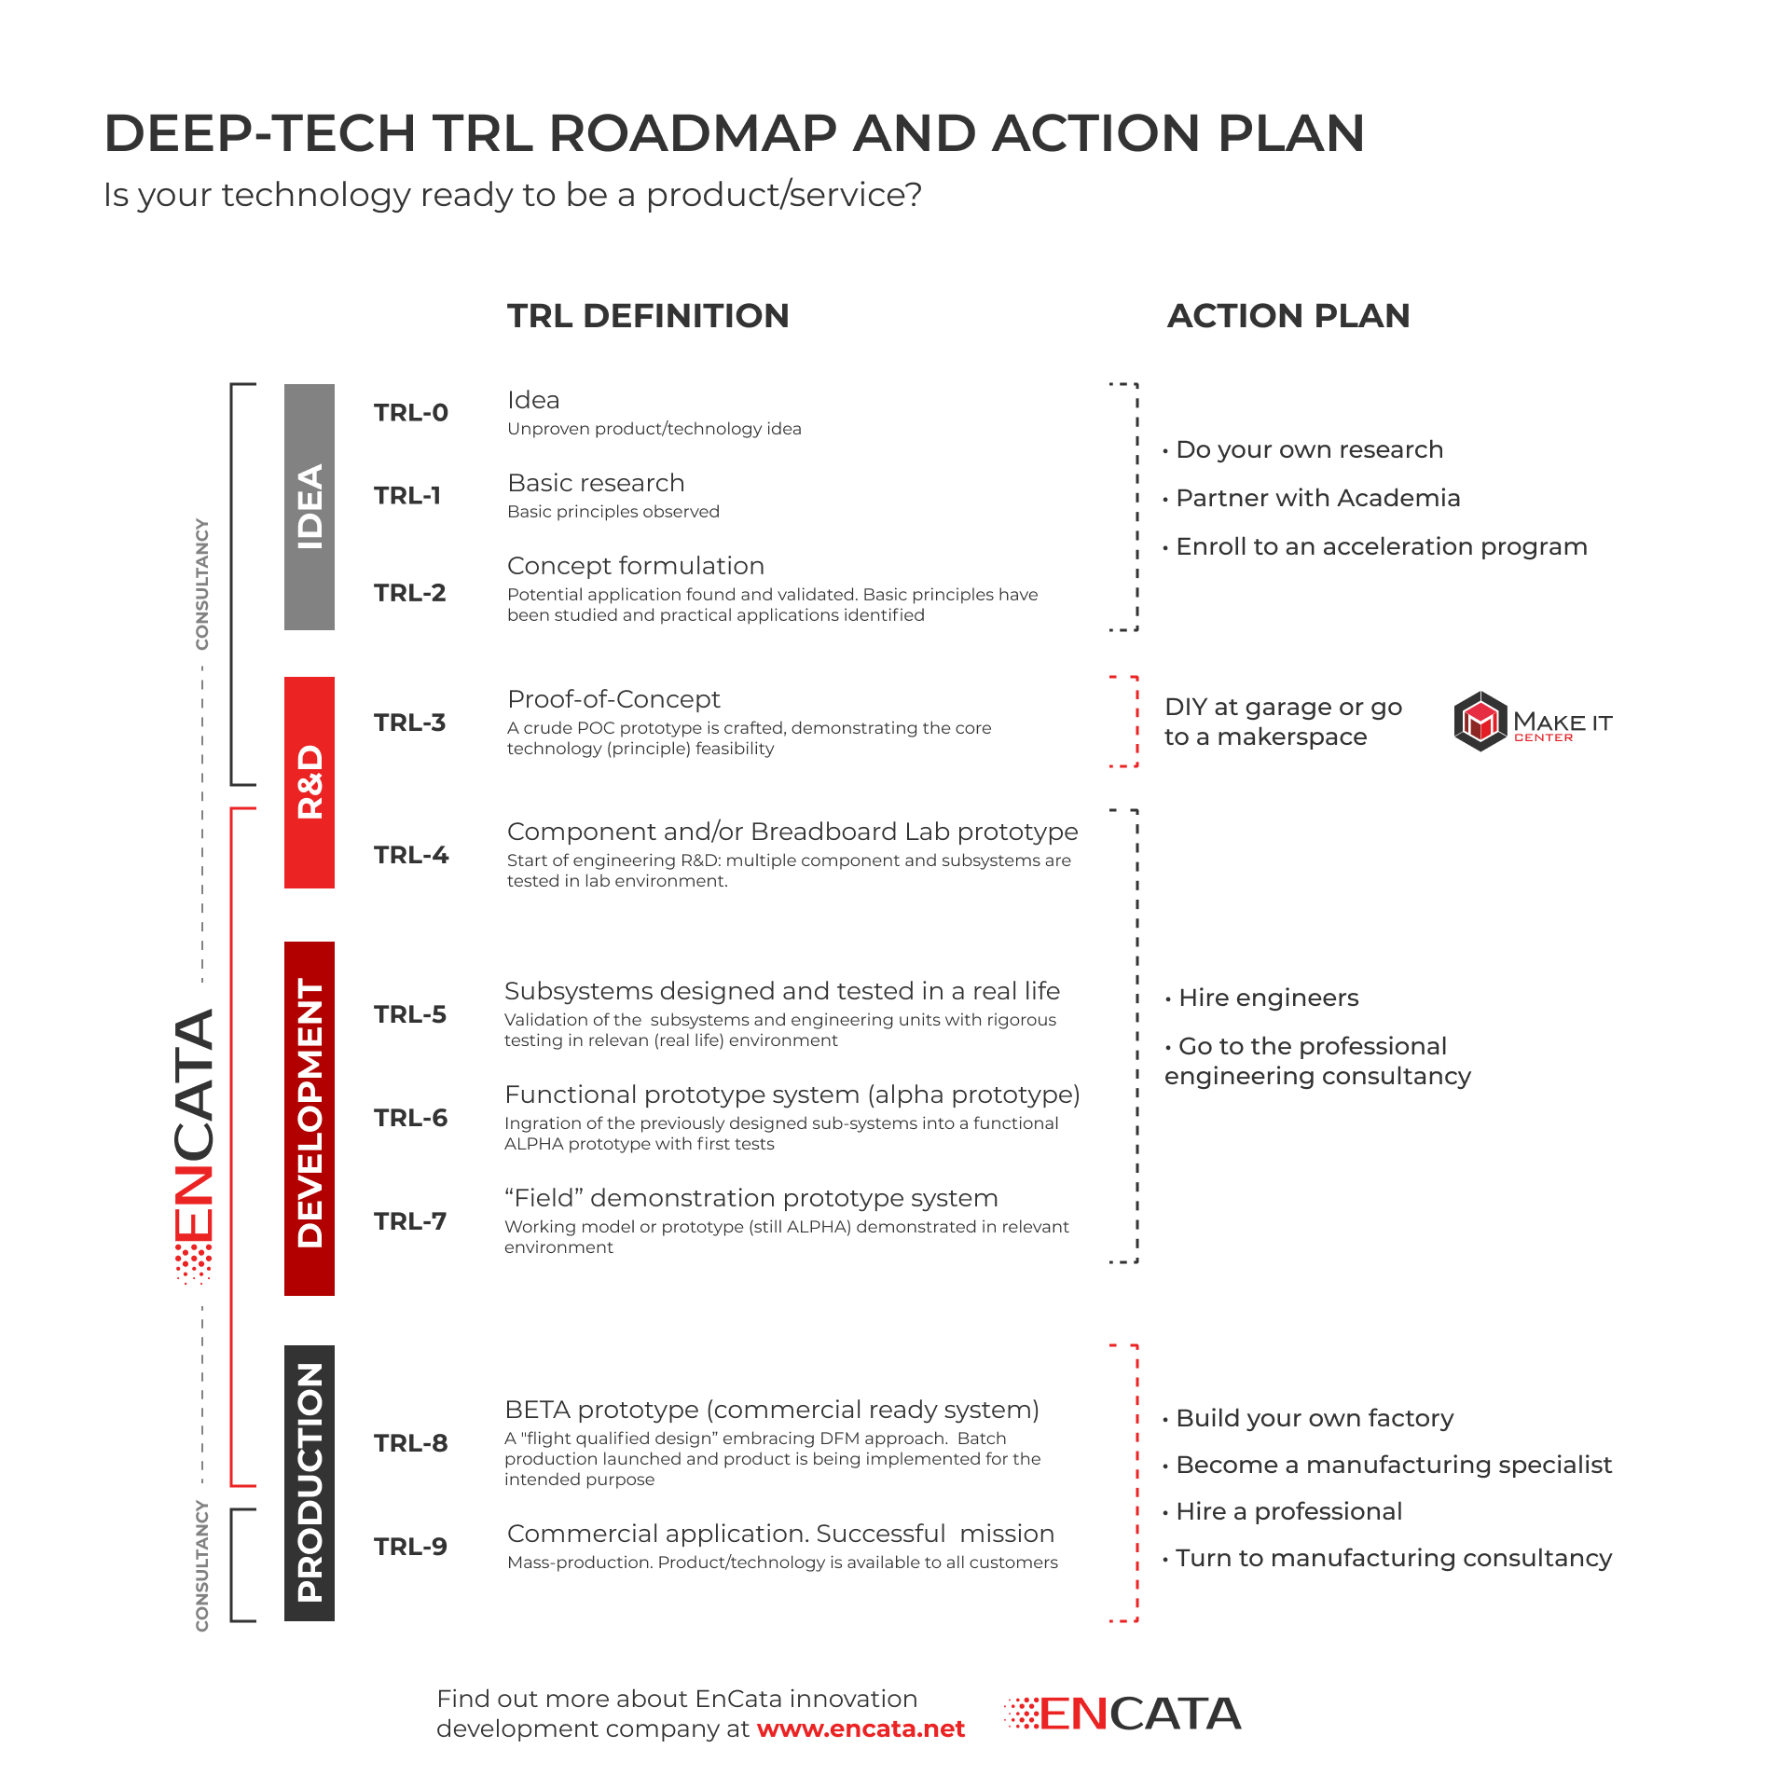
TRL Scale
OpenHW Technology Outputs
OpenHW IP Adopters

Slide 7
TRL Levels as Utilized by OpenHW
TRL | OpenHW Utilization
1- Basic Principles Observed | OpenHW research projects may target TRL-1 as project output, e.g. to develop novel approaches to core or accelerator architecture
2- Concept Formulation | Core IP or accelerator development projects to produce open source technology are typically initiated as TRL-2 concepts, identifying principles and applications of the IP The OpenHW Project Concept Gate output includes a TRL-2 description of the Core IP
3- Proof of Concept | Core IP or accelerator development projects will pass through TRL-3 as the (RTL) design completes. Poof of concept is shown by core compilation and demonstration of basic operations (e.g. Linux booted, Coremark results, hello-world)
4- Component Prototype | Core IP or accelerator projects will pass through TRL-4 as they produce preliminary PPA results (via synthesis scripts for FPGA or ASIC) and/or run preliminary application code, such as an accelerator running machine learning code.
5- Subsystem Designed and Tested | Core IP projects reach TRL-5 as they complete full verification. The OpenHW RTL Freeze checklist process verifies that the design is fully ready for industrial adoption.
6- Functional (Alpha) Prototype | OpenHW designed IP that is integrated into an MCU system or other device reaches TRL-6 as prototype Silicon is fabricated and demonstrated
7- Field Demonstration Prototype | OpenHW development boards incorporating a prototype Silicon system with OpenHW Software reach TRL-7 as they are demonstrated and deployed

Slide 8
CORE-V RISC-V Cores Roadmap
CVA6
RV{32|64}IMAC[FD]Zicsr
6-stage, M/S/U-mode, CLINT, AXI, MMU, I$, D$
FPGA-optimized flavor for CV32A6, eXtension interface considered, FENCE.T instruction considered
Application
CVA6
CV32E40P
RV32IM[F]CZicount_Zicsr_Zifencei [PULP_XPULP][PULP_CLUSTER][PULP_ZFINX]
4-stage, M-mode, CLINT, OBI
CV32E40P (‘tag::v2’)
Completion of of PULP_XPULP, F
CV32E40S
RV32IMC[Xsecure]Zicsr_Zifencei[_Zce]
4-stage, M/U-mode, CLINT, OBI, PMP, Security
CVE4
Embedded
CV32E40X
RV32IM[A][F]C[B][P][X]Zicount_Zicsr_Zifencei[_Zce]
4-stage, M-mode, CLINT, OBI, eXtension interface
CV32E20
RV32[I|E][M]CZicount_Zicsr_Zifencei[_Zce]
2-stage, M-mode, [CLINT|CLIC], OBI
CVE2
20Q4
21Q2
21Q4
22Q2
22Q4
Project Freeze PF
Plan Approved PA
Project Launch PL
Project Concept PC

Slide 9
CORE-V Embedded-class Cores

Slide 10
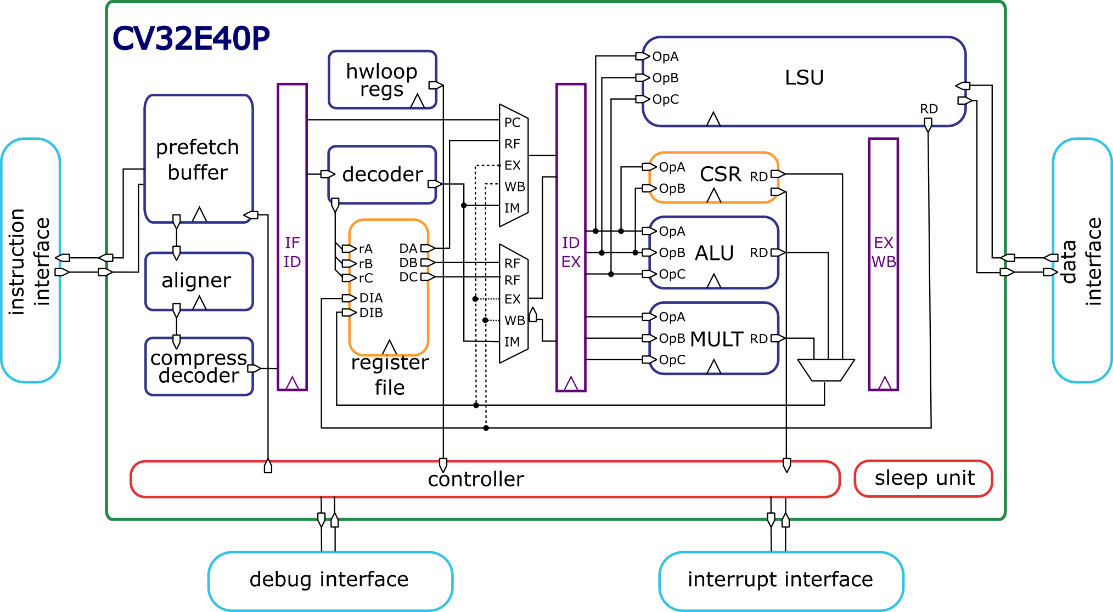
CV32E40P – PF / TRL 5
4-stage, in-order, single-issue
RV32IM[F]CZicount_Zicsr_Zifencei [PULP_XPULP][PULP_CLUSTER][PULP_ZFINX]
M-mode, CLINT, OBI
‘RTL Freeze’ achieved
RV32IMC extensions verified
Step&Compare with Imperas as reference model (100% coverage)
Interrupts and Debug
Activities on RVFI interface
Facilitating sim-based step&compare verification FSM and formal verification

Slide 11
CV32E40P – preliminary PPA
CV32E40P
COREMARK/MHz: 2,91
Technology | Frequency | Area | Comments
TSMC 16nm | 909MHz | 53,4kGE | No FPU

Slide 12
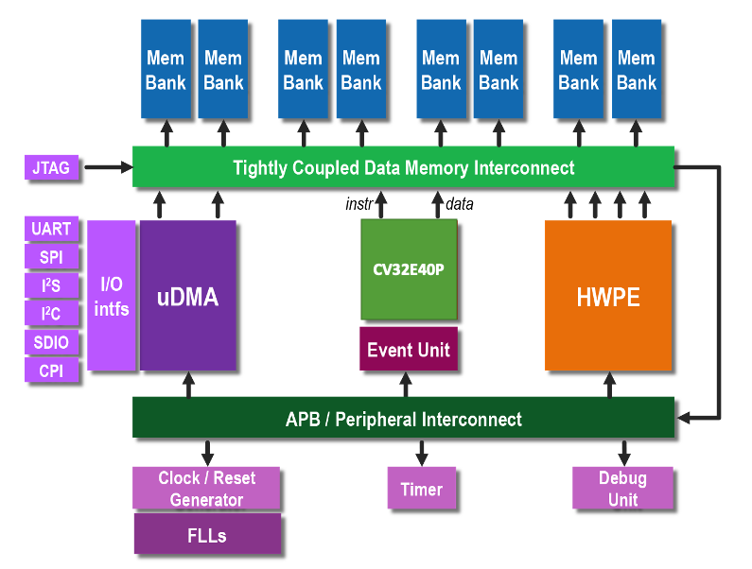
CORE-V MCU with CV32E40P
MCU that includes CV32E40P, memories, and peripherals
based on PULPissimo from ETH
Production of the CORE-V MCU SoC in Globalfoundries GF22FDX will take CV32E40P towards TRL 6
FPGA prototype available on a Genesys 2 board

Slide 13
CV32E40P tag::v2 – PL / TRL 3
RV32PULP_XPULP extensions
Verification and Reference Model
Moving the existing instructions to the RISC-V custom space
SW support with upstream GCC and LLVM compiler
LEC to v1 when PULP_XPULP=0
RV32F extensions
Verification
CV-DBG
Moving, documenting, and verifying the external RISC-V Debug module
Project goal: industrial grade (TRL 5)

Slide 14
CV32E40P tag::v2 – preliminary PPA
CV32E40P with PULP_XPULP
COREMARK/MHz: 3,19
Technology | Frequency | Area | Comments
UMCL 65nm | 560MHz | 40,7kGE | No FPU – based on RI5CY
Globalfoundies GF22FDX | 938MHz* | N/A | No FPU – based on RI5CY
TSMC 16nm | 769MHz | 84,5kGE | No FPU, 1 extra Perf. Counter
Xilinx Genesys 2 | 20MHz** | 7kLUTs 2,5kFFs 7 DSP | No FPU
Zynq Ultrascale+ | 140MHz | 8,4kLUTs 2,7kFFs 7 DSP | No FPU – based on RI5CY
*freq in PULPissimo on SCMs and use of Forward Body-Bias **freq with FPU in PULPissimo, not max frequency

Slide 15
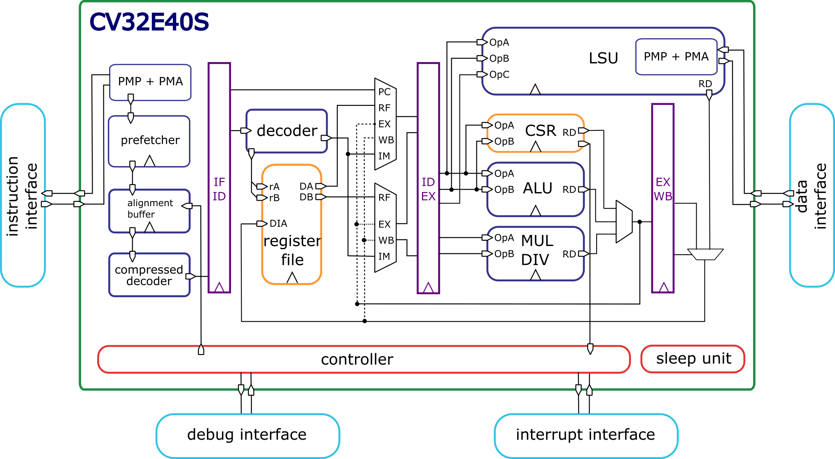
CV32E40S – PA / TRL 2
4-stage, in-order, single-issue
RV32IMC[Xsecure]Zicsr_Zifencei[_Zce]
M/U-mode, CLINT, OBI, ePMP, PMA, bus error
Secure core
Reduction of side-channel attacks
_Zce (iff ratified)
PPA optimizations wrt CV32E40P
Verification
Project goal: industrial grade (TRL 5)

Slide 16

CV32E40X – PA / TRL 2
4-stage, in-order, single-issue
RV32IMC[ABP]Zicount_Zicsr_Zifencei[_Zce][X]
M-mode, CLINT, OBI, PMA, bus error
Compute intensive core
CV-X-IF interface to offload custom extensions
_Zce, RV32B and RV32P (iff ratified)
PPA optimizations wrt CV32E40P
Verification
Project goal: industrial grade (TRL 5)

Slide 17
CV32E20 – PC / TRL 1
2-stage, in-order, single-issue
RV32{I,E}[M]CZicount_Zicsr_Zifencei[_Zce]
M-mode, [CLIC, CLINT], OBI
Low area core
Optimized power and area for control-oriented applications
Starting point lowRISC Ibex (which started from ETH zero-riscy)
Clean-up parameters
Aligning IP interface with CV32E40* cores
Project goal: industrial grade (TRL 5)

Slide 18
CORE-V Application-class Cores

Slide 19
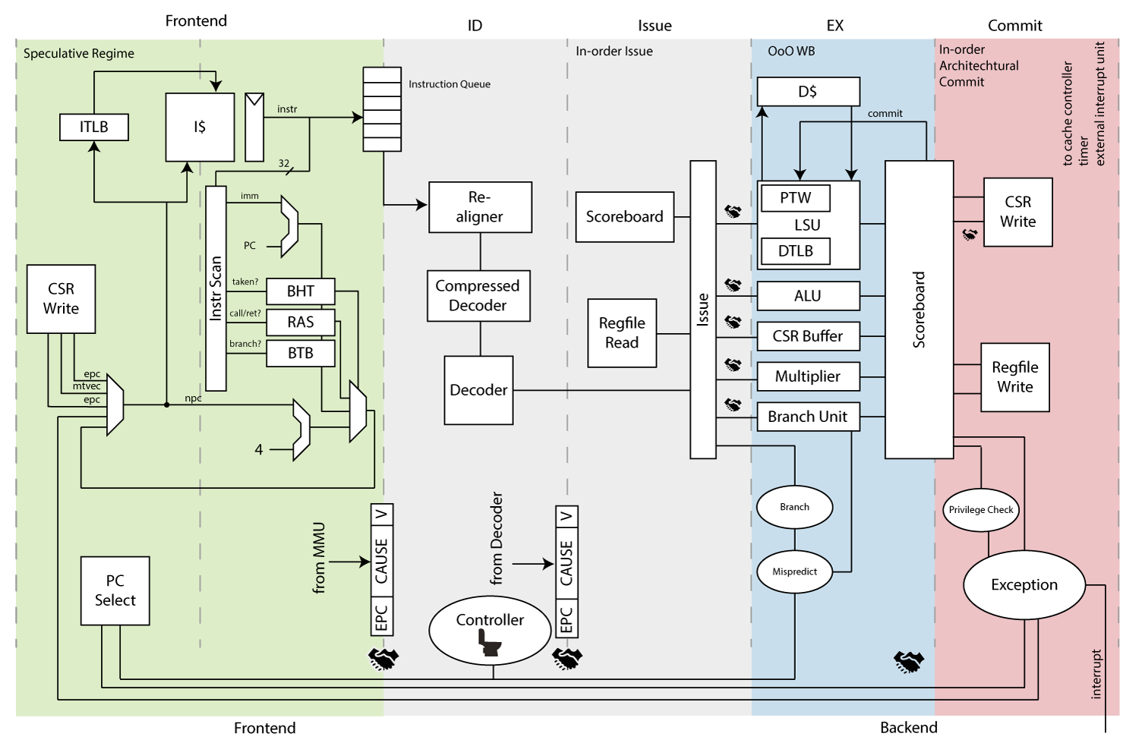
CVA6
6-stage, in-order, single-issue
RV{32|64}IMAC[FD]Zicsr
M/S/U-mode, CLINT, AXI
Flexible application core
Linux-compatible thanks to MMU
32 or 64 bit (CV32A6, CV64A6) from same RTL (64b from ETH, 32b from Thales)
L1 caches
Project goal: industrial grade (TRL 5)
Currently drafting specifications, entry point for next stages

Slide 20
CV64A6 – PA / TRL 4
Verification
RV64GC (RV64IMAFDC), debug, interrupts, privileges… to verify
sim-based Step&Compare, formal verification considered
RVFI interface
New documentation
reStructured text-based as for the other cores
FPGA optimizations
Target the Xilinx Genesys2, but not a Soft-Core!

Slide 21
CV32A6 – PA / TRL 3
32b version support for
Pipeline
MMU
Floating-point
Linux
Verification
RV32GC (RV32IMAFDC), debug, interrupts, privileges… to verify
sim-based Step&Compare, formal verification considered
RVFI interface
PPA optimizations
ASIC
FPGA (vendor-independent soft-core)

Slide 22
CVA6 – preliminary PPA
CV64A6
COREMARK/MHz: 2,19
DMIPS/MHz: 1,53
Technology | Frequency | Area | Comments
Globalfoundies GF22FDX | 1,7GHz | 210kGE | No FPU, No Caches
28nm | 740MHz | 211kGE | No FPU, No Caches
Zynq Ultrascale+ | 95MHz | 39,7kLUTs 23,2kFFs 37 DSP 37 BRAM (cache)

Slide 23
CVA6 – preliminary PPA
CV32A6
COREMARK/MHz: 2,25
DMIPS/MHz: 1,35
Technology | Frequency | Area | Comments
28nm | 740MHz | 87kGE | No FPU, No Caches, smaller CSR config., multicycle MUL, No MMU, No branch prediction, smaller scoreboard
Zynq Ultrascale+ | 120MHz | 13,9kLUTs 9,3kFFs 4 DSP 32 BRAM (cache) | No FPU, No Caches, No MMU

Slide 24
CORE-V Core Logic Blocks
IP surrounding the CORE-V COREs

Slide 25
CORE-V Core Logic Blocks
CV-DBG
Core Logic
CV-FPU
CV-VEC
20Q4
21Q2
21Q4
22Q2
22Q4
Project Freeze PF
Plan Approved PA
Project Launch PL
Project Concept PC

Slide 26
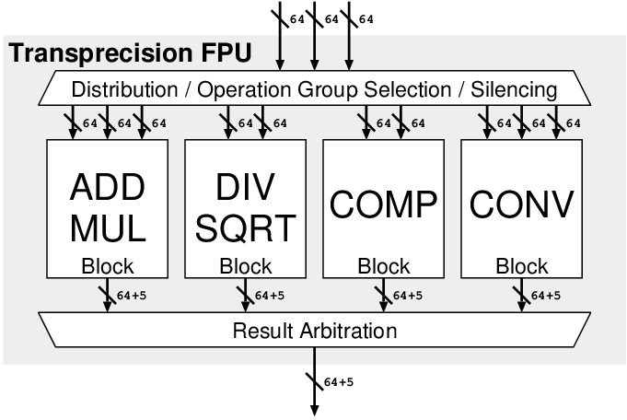
CV-FPU – PL / TRL 3
Standalone co-processor that computes floating-point RISC-V RVF and RVD extensions
Parts of other projects as
CV32E40Pv2, CV32A6, CV64A6
Possible starting point ETH fpnew:
Documentation
resTructured text documentation
Verification stand-alone or as part of the cores
Project goal: industrial grade (TRL 5)

Slide 27
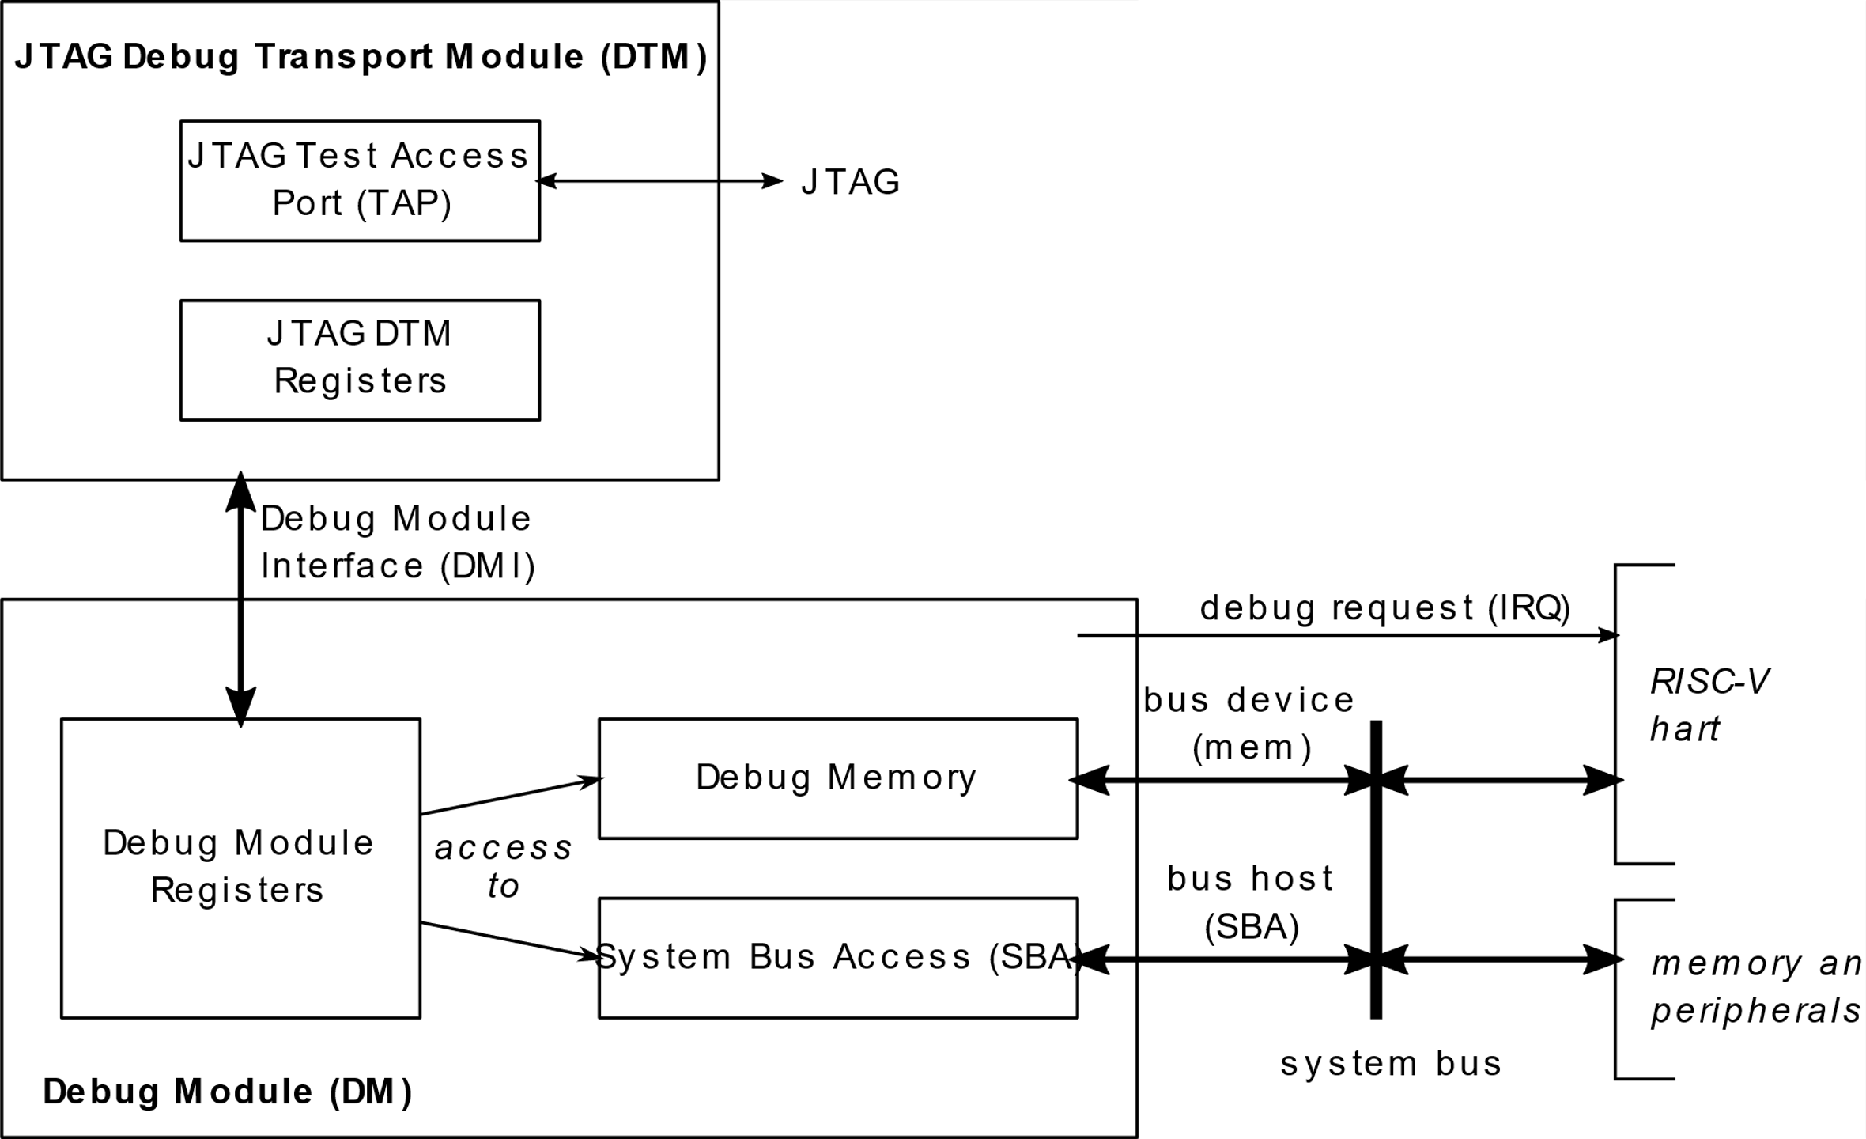
CV-DBG – PL / TRL 3
Standalone IP that implements RISC-V Debug Module
Debug Transport Module, and ROM for Execution based debug
Parts of other projects as
CV32E40Pv2, CV32A6, CV64A6
Possible starting point ETH riscv-dbg:
Documentation
resTructured text documentation
Verification stand-alone or as part of the cores
Project goal: industrial grade (TRL 5)

Slide 28
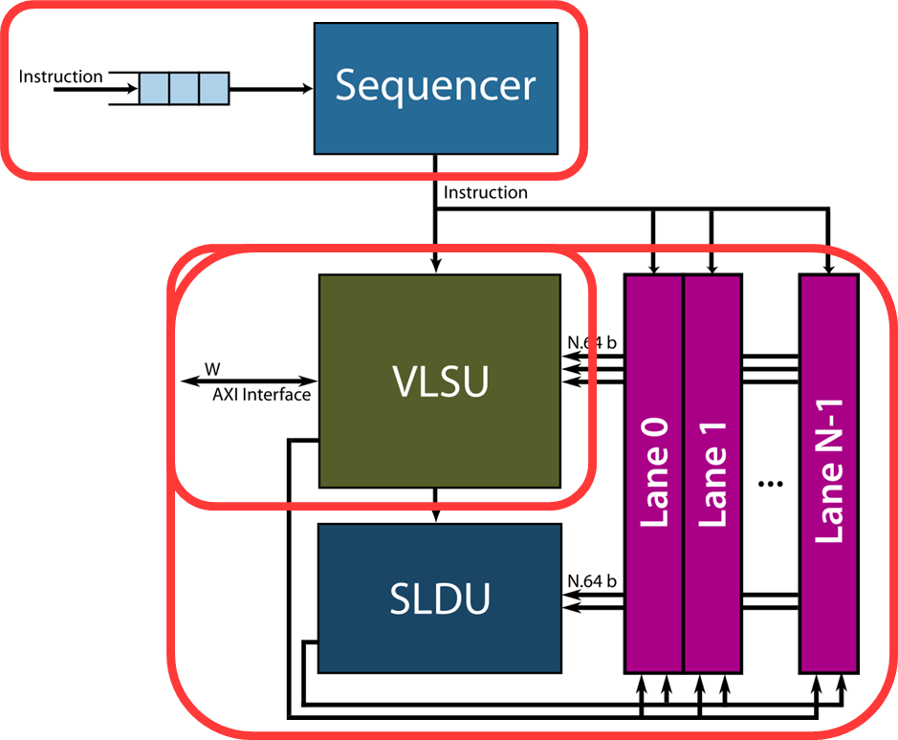
CV-VEC – PC / TRL 3
Standalone co-processor that computes vectorial instructions based on RISC-V RVV extensions
Starting point ETH ara
RVB vector extensions and mixed-precision
SW support for ML applications
Implementation in Globalfoundries 22FDX
Compatible with CV64A6
Part of OpenHW Accelerate research program with Mitacs, CMC Microsystems, Polytechnique Montréal & ETH Zurich → TRL 4

Slide 29
CORE-V SPECs
Specifications for RISC-V COREs

Slide 30
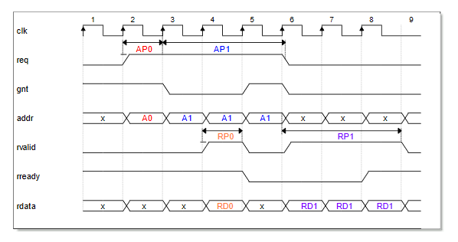
Open Bus Interface (OBI) Spec
Memory Bus spec for RISC-V cores
Handshake based on ARM AMBA AXI
Coupled Read-Write channels
Easily translatable to ARM AMBA protocols
AXI, AHB
Based on: https://raw.githubusercontent.com/openhwgroup/core-v-docs/master/cores/cv32e40p/OBI-v1.0.pdf

Slide 31
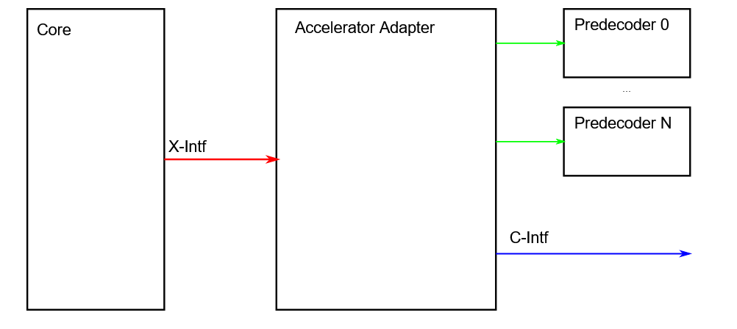
CV-X-IF Spec
Bus spec to allow RISC-V cores to offload RV extensions
CV32E40X will leverage this interface the most
CV32E40P and CVA6 will evaluate it
Based on: https://github.com/pulp-platform/riscv-extension-interface
Verification
Formal verification needed to test the spec
Allows the cores to be agnostic about the custom extension definition

Slide 32
and
OpenHW Group is a not-for-profit, global organization driven by its members and individual contributors where HW and SW designers collaborate in the development of open-source cores, related IP, tools and SW such as the CORE-V Family of open-source RISC-V cores
OpenHW Group & CORE-V Family of open-source RISC-V cores for use in high volume production SoCs
Visit the OpenHW CORE-V Cores GitHub repository and contribute
Learn more at OpenHW TV
Follow us on Twitter @openhwgroup & LinkedIn OpenHW Group

