Slide 1


CORE-V-MCU Repo Management
Mike Thompson mike@openhwgroup.org
© OpenHW Group
August 2021
1

Slide 2
Outline
Goals.
Eclipse Workflow and Roles.
Branching Strategy for CORE-V-MCU.
CI Strategy for CORE-V-MCU.
© OpenHW Group
August 2021
1

Slide 3
Goals
Establishing a single “origin” repository for all: https://github.com/openhwgroup/core-v-mcu.
Create a stable platform for consumers of core-v-mcu.
Allow for rapid development.
Align the team on a repository management strategy.
Make it clear: “who does what”.
© OpenHW Group
August 2021
3

Slide 4
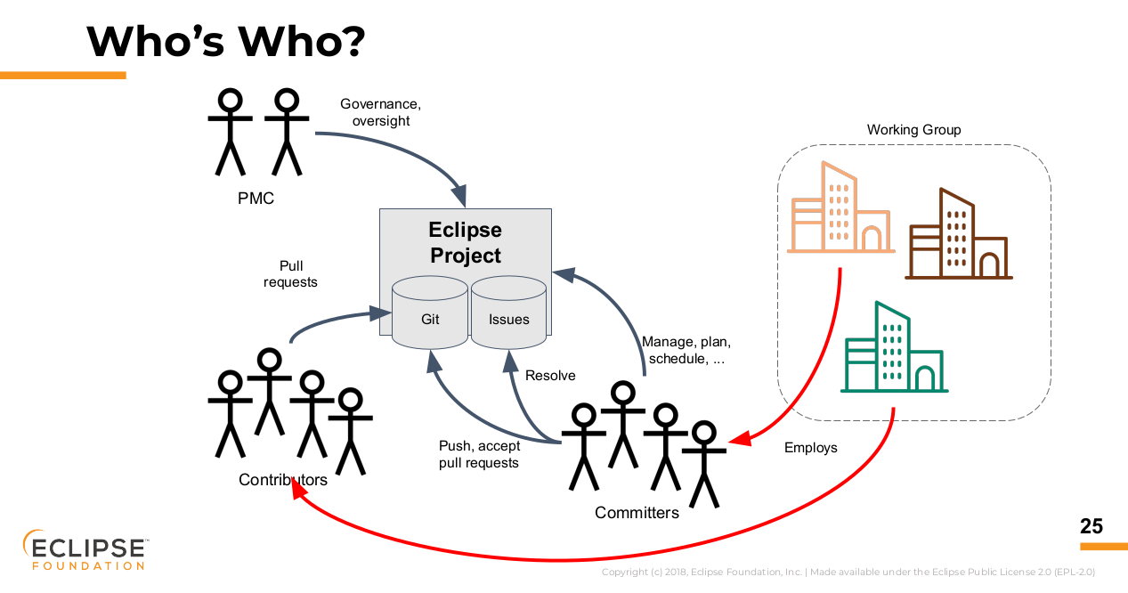
Eclipse Workflow
© OpenHW Group
August 2021
4

Slide 5
Roles in the Eclipse Workflow
PMC:
Currently an OpenHW staff member
Liaison with Eclipse Foundation
Contributor:
In theory, can be anyone, from anywhere.
Must be covered by an Eclipse Contributor Agreement (ECA or MCCA).
Committer:
A Committer is a Contributor who was elected to the Committer role by their peers.
Responsible for accepting Pull-Requests into the Repo.
© OpenHW Group
August 2021
5

Slide 6
Git Branch Flow
We will use a well know Git-flow:
https://nvie.com/posts/a-successful-git-branching-model/
Successfully deployed on CORE-V-VERIF.
Git-flow for CORE-V-MCU will be a simplified version.
© OpenHW Group
August 2021
5

Slide 7
Git Branches, Releases, Tags
Git explicitly supports the concept of branches.
Git does not assign any special meaning to branches.
The usage and meaning of branches is “by convention”.
Git does not explicitly support the concept of a release.
This is a GitHub concept.
A git tag is a special thing and is not managed in the same way as a branch.
A git tag is essentially pointer to a specific commit (Hash).
A tag cannot be changed (but you can always create new ones).
© OpenHW Group
August 2021
5

Slide 8
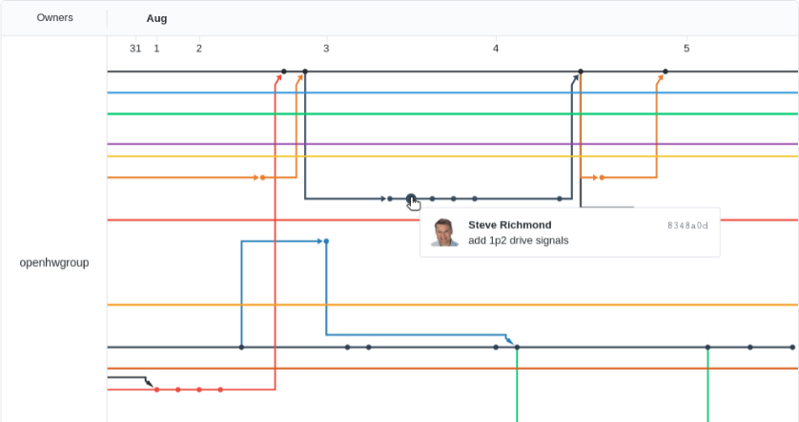
Branch Identification
A git branch is uniquely identified by its URL and HASH:
The branch name is an attribute of the branch, but it not explicitly used by git itself (the humans use branch names).
© OpenHW Group
August 2021
5

Slide 9
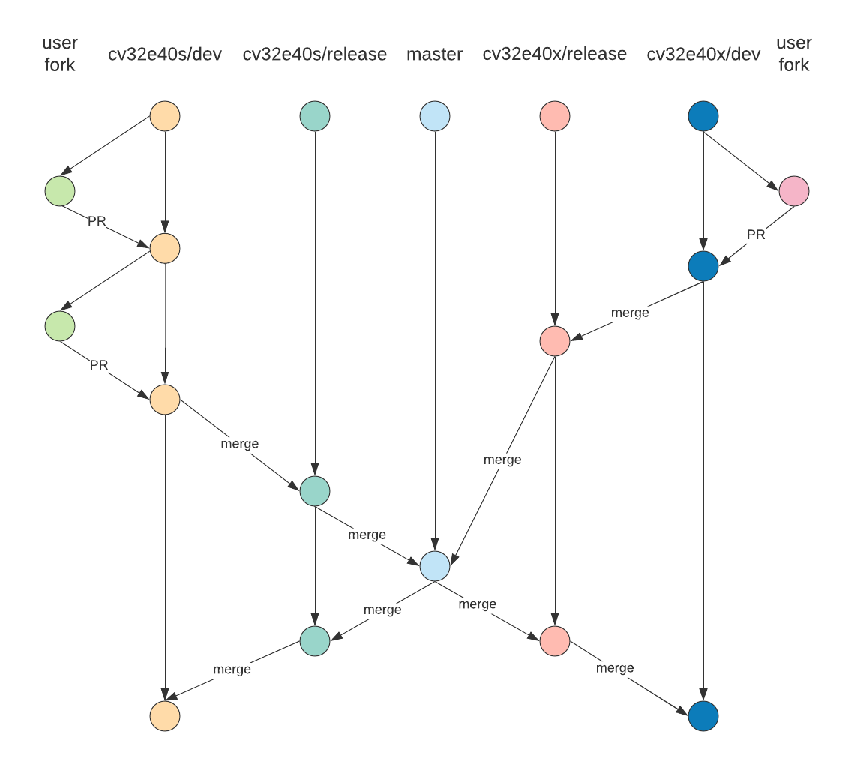
Example: CORE-V-VERIF Git Workflow
Each core has its own “dev” and “release” branch:
“dev” is for new feature additions.
“release” branches can withstand full regression.
Contributors make pull-requests to “dev” branches.
Committers:
Review and merge pull-requests.
merge to release and master branches periodically.
© OpenHW Group
August 2021
5

Slide 10
Single Point of Origin for CORE-V-MCU
Git does not support this concept:
In git, the original repo and any forks from there are all equal.
Our shared goal is to define a single repo that is accepted by both Contributors to, and Consumers of, CORE-V-MCU as the “gold standard” repo.
All work starts and ends at https://github.com/openhwgroup/core-v-mcu
All Contributors create a fork from OpenHW repo and issue pull-requests from their fork to the OpenHW repo.
Automated CI triggered by merges to both dev and master.
All Consumers clone from OpenHW repo.
Typically use the latest version of the master branch.
© OpenHW Group
August 2021
<number>

Slide 11
Branching Strategies for CORE-V-MCU
Option 1: keep it simple:
Single “dev” branch: all developer pull-requests to this branch.
No need for “release” branch.
Use “master” branch for latest stable version.
Create a tag when the RTL is frozen.
Option 2: simple, with explicit release branches:
Option 1 with added releases.
Helpful for Consumers; slightly more work for Committers.
© OpenHW Group
August 2021
<number>

Slide 12
CORE-V-MCU Project Roles
Duncan Bees:
Technical Program Director (PMC and interface to Eclipse Foundation).
Mike Thompson:
Committer and CI set-up (in a support role to Greg).
Greg Martin:
Committer, CI set-up.
Tim Saxe, others:
Contributors.
Software team members:
Consumers.
© OpenHW Group
August 2021
<number>

Slide 13
Open Questions
Where do the CI regressions run?
Quicklogic?
OpenHW AWS virtual machines?
Metrics?
What are our Committer/Contributor/Consumer Training Requirements?
© OpenHW Group
August 2021
<number>

Slide 14
Conclusions
After reviewing with the OpenHW staff and QuickLogic team, the following decisions were made:
Use “Option 1” branching strategy.
CI regression should run with Verilator.
CI regression should run on a cloud resource provided by an OpenHW member (options: AWS or Metrics).
© OpenHW Group
August 2021
<number>

Slide 15
THANK YOU
© OpenHW Group

Slide 16
BACKGROUND
© OpenHW Group

Slide 17
CORE-V-VERIF Git Flow Branches
master
Always runs, always passes ci_check
May fail random simulations due to RTL instability or test code instability
No compile failures nor warnings allowed
Public releases (i.e. RTL freeze tags) only ever allowed off of master
cv32e40<n>/dev
Each core maintains a development branch
Most user PRs target this branch
ci_check should be stable
© OpenHW Group
March 2021
<number>

Slide 18
Core-v-verif Git Flow Branches
cv32e40<n>/release
Used to stage a merge into master from a core/dev branch
Used to stage merge from master back to develop
Maintained by OpenHW committers
© OpenHW Group
March 2021
<number>

Slide 19
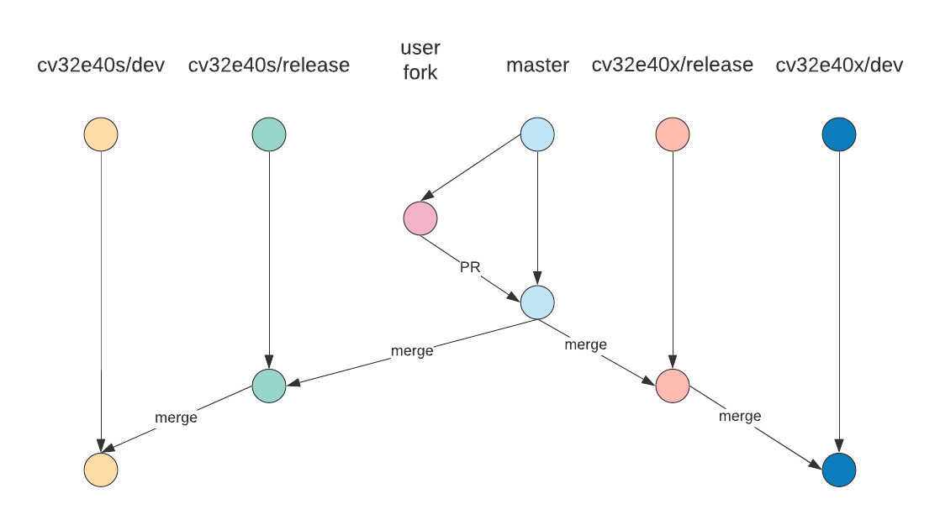
Core-v-verif Git Flow Hotfix Workflow
For immediate fixes of issues
For common or infrastructure updates
Should be pushed out to core dev branches as soon as possible
© OpenHW Group
March 2021
<number>

Slide 20
Core-v-verif Branches – Use Cases
OpenHW contributor
Create a fork of core-v-verif
Determine core of interest and upstream merge to that development branch (e.g. cv32e40s/dev)
Create commits and push branch to fork
Create PR to cv32e40s/dev
Merge
OpenHW committer merges cv32e40s/dev to cv32e40s/release
Note: Ideally all cores merged at once
Each release merged to master
ci_check
Push to master
Merge master back to cv32e40s/release for each core
Merge cv32e40s/release to cv32e40s/dev for each core
© OpenHW Group
March 2021
<number>

Slide 21
Core-v-verif Branches – Use Cases
Hotfix
Quick fix needed for release
Common update needs applied to all cores quickly
User fork against master
ci_check on all cores
PR reviewed by Mike and/or Steve
Merge back to cv32e40<n>/release and cv32e40<n>/dev for each core
© OpenHW Group
March 2021
<number>

Slide 22
Core-v-verif Branches – When to merge
Will ask project/core leads every Thursday if there is need for a merge
Types of changes that require timely merges:
Common infrastructure in TB (lib/ mk/)
Common scripts (bin/)
Schedule of merges
No more than 1 month between merges
TBD: Look into generating reports of “dry-run” merges nightly to help determine when to merge
© OpenHW Group
May 2020
<number>

Slide 23
Core-v-verif Continuous Integration
With multiple cores and branches in development it becomes more critical to ensure all active branches are stable
Triggered CIs
Via Github actions, any push on a defbranch ca
Each core will have a ci_check regression YAML defined in its regress/
Purpose: Ensure sanity and stability
Scheduled CIs
Via Github actions, start large scale regressions on a nightly timer
Purpose: Track test pass/fail progress, track coverage, provide data for convergence
OpenHW will enable Metrics account for OpenHW members to track results via core-v-verif
© OpenHW Group
March 2021
<number>

Slide 24
Triggered CIs
Branch | YAML | Name (Metrics) | Typical Action(s)
cv32e40x/dev | cv32e40x_ci_check.yaml | cv32e40x_ci_check_dev | User PR approval Release merge-back PR
cv32e40x/release | cv32e40x_rel_check.yaml | cv32e40x_ci_check_release | Release branch PR Release merge-back PR
cv32e40p/dev | cv32e40p_ci_check.yaml | cv32e40p_ci_check_dev | User PR approval Release merge-back PR
cv32e40p/release | cv32e40p_rel_check.yaml | cv32e40p_rel_check_release | Release branch PR Release merge-back PR
cv32e40s/dev | cv32e40s_ci_check.yaml | cv32e40s_ci_check_dev | User PR approval Release merge-back PR
cv32e40s/rel | cv32e40s_rel_check.yaml | cv32e40s_rel_check_release | Release branch PR Release merge-back PR
master | cv32e40x_rel_check.yaml cv32e40p_rel_check.yaml cv32e40s_rel_check.yaml | cv32e40x_rel_check_master cv32e40p_rel_check_master cv32e40s_rel_check_master | User hotfix PR approval Merges from release branch
© OpenHW Group
March 2021
<number>

Slide 25
Scheduled CIs
Measure coverage on all
On /dev branches
Minimal set per core:
cv32e40<n>_full_regression.yaml
cv32e40<n>_benchmark.yaml
cv32e40<n>_compliance.yaml
Others added as coverage/testing needs apply
e.g. adding regressions that target specific features of a core that need more targeted testing and coverage analysis
© OpenHW Group
March 2021
<number>

