Slide 1


Branches and CIs for core-v-verif
Steve Richmond steve.richmond@silabs.com
© OpenHW Group
March 2021
1

Slide 2
Outline
Branches
CI proposals
Triggered CIs
Timed Cis
© OpenHW Group
January 2021
1

Slide 3
Branch Goals
Enable per-core development to proceed mostly uninterrupted
Ensuring all repos use common infrastructure properly
Ensure all in-flight tests are compatible with testbench/infrastructure changes
Minimize user burden
© OpenHW Group
March 2021
3

Slide 4
Branch Flow
Will use: Git-flow
https://nvie.com/posts/a-successful-git-branching-model/
© OpenHW Group
March 2021
3

Slide 5
Core-v-verif Git Flow Branches
master
Always runs, always passes ci_check
May fail random simulations due to RTL instability or test code instability
No compile failures nor warnings allowed
Public releases (i.e. RTL freeze tags) only ever allowed off of master
cv32e40<n>/dev
Each core maintains a development branch
Most user PRs target this branch
ci_check should be stable
© OpenHW Group
March 2021
3

Slide 6
Core-v-verif Git Flow Branches
cv32e40<n>/release
Used to stage a merge into master from a core/dev branch
Used to stage merge from master back to develop
Maintained by OpenHW committers
© OpenHW Group
March 2021
3

Slide 7
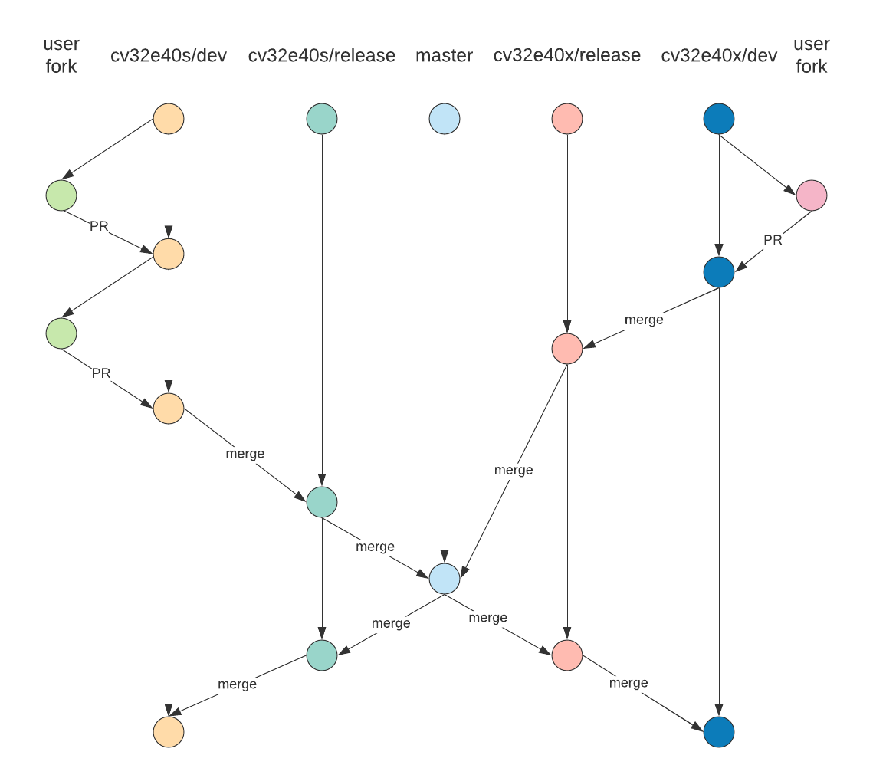
Core-v-verif Git Flow Standard Workflow
Users interact with dev branches
OpenHW merges to release and master periodically
All PRs still must be approved
© OpenHW Group
March 2020
3

Slide 8
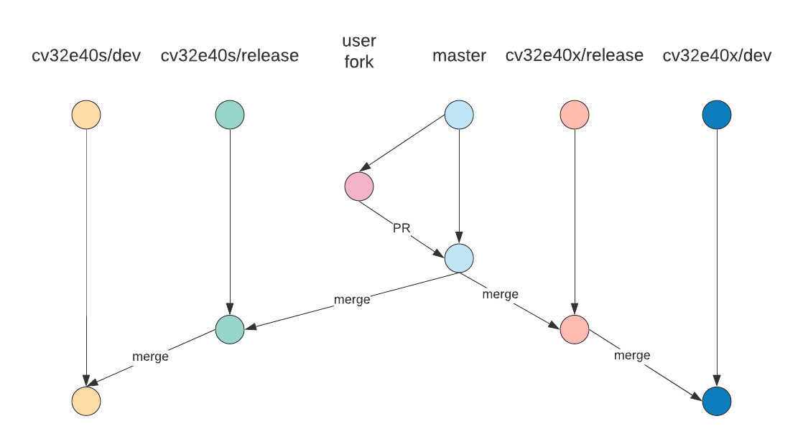
Core-v-verif Git Flow Hotfix Workflow
For immediate fixes of issues
For common or infrastructure updates
Should be pushed out to core dev branches as soon as possible
© OpenHW Group
March 2021
3

Slide 9
Core-v-verif Branches – Use Cases
OpenHW contributor
Create a fork of core-v-verif
Determine core of interest and upstream merge to that development branch (e.g. cv32e40s/dev)
Create commits and push branch to fork
Create PR to cv32e40s/dev
Merge
OpenHW committer merges cv32e40s/dev to cv32e40s/release
Note: Ideally all cores merged at once
Each release merged to master
ci_check
Push to master
Merge master back to cv32e40s/release for each core
Merge cv32e40s/release to cv32e40s/dev for each core
© OpenHW Group
March 2021
3

Slide 10
Core-v-verif Branches – Use Cases
Hotfix
Quick fix needed for release
Common update needs applied to all cores quickly
User fork against master
ci_check on all cores
PR reviewed by Mike and/or Steve
Merge back to cv32e40<n>/release and cv32e40<n>/dev for each core
© OpenHW Group
March 2021
3

Slide 11
Core-v-verif Branches – When to merge
Will ask project/core leads every Thursday if there is need for a merge
Types of changes that require timely merges:
Common infrastructure in TB (lib/ mk/)
Common scripts (bin/)
Schedule of merges
No more than 1 month between merges
TBD: Look into generating reports of “dry-run” merges nightly to help determine when to merge
© OpenHW Group
May 2020
3

Slide 12
Core-v-verif Branches – How to merge
Merging Order: (note: <gid> means “you GitHub ID”)
Branched off the HEAD of master into a new branch: <gid>/pr/master_merge_<yymmdd> (this is the branch intend to use for a PR later).
Branched off that new branch, into <gid>/pr/master_merge_<yymmdd>_<core>
Branched off that branch into <gid>/pr/master_merge_<yymmdd>_<core_from>_<core_to> to merge in 40x_release on top of where I already merged 40p_release.
Same with silabs-robin/pr/master_merge_220118_40p_40x_40s.
Finally, silabs-robin/pr/master_merge_220118_40p_40x_40s_x2s is where I am currently doing the manual merge/copy of the 40x directory into the 40s directory.
When that ...40p_40x_40s_x2s branch is done (and passing "rel_check"), I'll merge that all into my silabs-robin/pr/master_merge_220118 and make a PR into openhwgroup's master.
© OpenHW Group
May 2020
3

Slide 13
Core-v-verif Continuous Integration
With multiple cores and branches in development it becomes more critical to ensure all active branches are stable
Triggered CIs
Via Github actions, any push on a defbranch ca
Each core will have a ci_check regression YAML defined in its regress/
Purpose: Ensure sanity and stability
Scheduled CIs
Via Github actions, start large scale regressions on a nightly timer
Purpose: Track test pass/fail progress, track coverage, provide data for convergence
OpenHW will enable Metrics account for OpenHW members to track results via core-v-verif
© OpenHW Group
March 2021
3

Slide 14
Triggered CIs
Branch | YAML | Name (Metrics) | Typical Action(s)
cv32e40x/dev | cv32e40x_ci_check.yaml | cv32e40x_ci_check_dev | User PR approval Release merge-back PR
cv32e40x/release | cv32e40x_rel_check.yaml | cv32e40x_ci_check_release | Release branch PR Release merge-back PR
cv32e40p/dev | cv32e40p_ci_check.yaml | cv32e40p_ci_check_dev | User PR approval Release merge-back PR
cv32e40p/release | cv32e40p_rel_check.yaml | cv32e40p_rel_check_release | Release branch PR Release merge-back PR
cv32e40s/dev | cv32e40s_ci_check.yaml | cv32e40s_ci_check_dev | User PR approval Release merge-back PR
cv32e40s/rel | cv32e40s_rel_check.yaml | cv32e40s_rel_check_release | Release branch PR Release merge-back PR
master | cv32e40x_rel_check.yaml cv32e40p_rel_check.yaml cv32e40s_rel_check.yaml | cv32e40x_rel_check_master cv32e40p_rel_check_master cv32e40s_rel_check_master | User hotfix PR approval Merges from release branch
© OpenHW Group
March 2021
3

Slide 15
Scheduled CIs
Measure coverage on all
On /dev branches
Minimal set per core:
cv32e40<n>_full_regression.yaml
cv32e40<n>_benchmark.yaml
cv32e40<n>_compliance.yaml
Others added as coverage/testing needs apply
e.g. adding regressions that target specific features of a core that need more targeted testing and coverage analysis
© OpenHW Group
March 2021
<number>

