Slide 1
Gitlab-CI
Yannick Casamatta - THALES

Slide 2
Gitlab CI March update
We keep the same objectives:
CI integrated into the core-v-verif and cva6 repository
Easily usable for all organizations
Not only for PR validation but also for development
March update:
New workflow
Allow Co-development between CVA6 and CORE-V-VERIF
Preserve resources by launching full pipeline only on stable branches
Allow launching regression with a personal repo on github
Private Setup repository to easily adapt CI to run time env of each organization
New jobs included
Keep same hash of cva6/core-v-verif for a given pipeline
example: prevents CI to not use the same version of CVA6 in case of new commit in CVA6 branch during the execution of the core-v-verif CI
Code optimizations

Slide 3
Gitlab CI March update
Workflow is based on branches name
master*, rc*, hotfix*, cva6/dev* -> full pipeline
dev*, feature* -> short pipeline
cvvdev/master*, cvvdev/rc*, cvvdev/hotfix* -> full pipeline
cvvdev/dev*, cvvdev/feature* -> short pipeline
Mode co-development by usage of prefix 'cvvdev'
If CI launch by core-v-verif repo:
will not use stable branch of cva6 but same ref name as repo trigger
If CI launch by cva6 repo:
will not use stable branch of core-v-verif but same ref name as repo trigger

Slide 4
Gitlab CI regular mode
devA
devB
CHALLENGE CORE-V-VERIF AGAINST STABLE CVA6
CHALLENGE CVA6 AGAINST STABLE CORE-V-VERIF
STABLE
STABLE
master*, rc*, hotfix*, cva6/dev*
dev*, feature*
CVA6
CORE-V-VERIF

Slide 5
Gitlab CI on cvvdev* branches name
cvvdev/devA
cvvdev/devB
CHALLENGE CORE-V-VERIF AGAINST DEV CVA6
CHALLENGE CVA6 AGAINST DEV CORE-V-VERIF
STABLE
cvvdev/devA
cvvdev/master*, cvvdev/rc*, cvvdev/hotfix*
STABLE
cvvdev/dev*, cvvdev/feature*
CVA6
CORE-V-VERIF

Slide 6
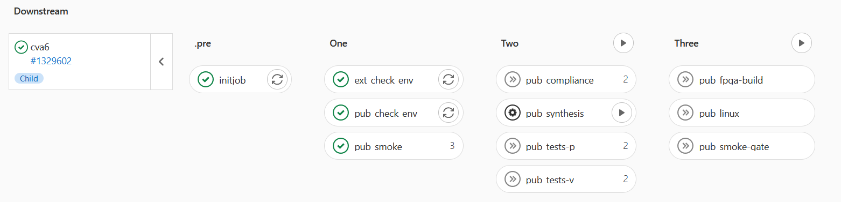
Details of regression
Initjob: get sha from branch name
ext_check_env: print env private
pub_check_env: print env public
pub_smoke: smoke test on all target
pub_compliance: compliance with verilator
pub_testv/p: testp/v with verilator
pub_linux:
pub_fpga-build: bitstream generation
pub_synthesis: synthese asic
pub_smoke-gate: smoke post on netlist asic

Slide 7
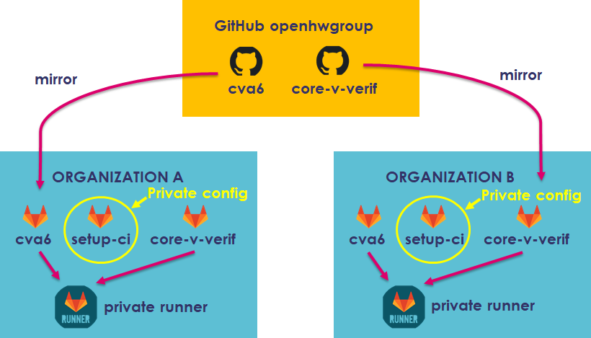

Slide 8
Setup-ci:/cva6/core-v-verif-cva6.yml
Example is given in core-v-verif repository, path: .gitlab-ci/example/setup-ci–example/
variables: RISCV: /opt/common/tools/gcc-10.2.0 VERILATOR_ROOT: /opt/common/tools/verilator-4.110 SPIKE_ROOT: /opt/common/tools/spike BBL_ROOT: /opt/common/tools/Linux-ariane-sdk SYN_VCS_BASHRC: /opt/synopsys/vcs/XXXX/setup/bashrc.example SYN_DCSHELL_BASHRC: /opt/synopsys/syn/XXXX/setup/bashrc QUESTA_BASHRC: /opt/questa/XXXX/setup/bashrc VIVALDO_SETUP: /opt/xilinx/Vivado/XXXX/settings64.sh CVA6_REPO: https://github.com/openhwgroup/cva6 CVA6_BRANCH: master COMPLIANCE_REPO: https://github.com/riscv/riscv-compliance.git COMPLIANCE_BRANCH: master COMPLIANCE_HASH: 220e78542da4510e40eac31e31fdd4e77cdae437 COMPLIANCE_PATCH: ../../../cva6/riscv-compliance.patch TESTS_REPO: https://github.com/riscv/riscv-tests.git TEST_BRANCH: master TEST_HASH: f92842f91644092960ac7946a61ec2895e543cec DV_REPO: https://github.com/google/riscv-dv.git DV_BRANCH: master NUM_JOBS: 24 FOUNDRY_PATH: /techno/lib/stdcellXXXX TECH_NAME: core_XXXX05v25c SYNTH_PERIOD : 30 LIB_VERILOG: /techno/lib/verilog_XXXX/XXXX.v

