Slide 1


CSR Access Tests
Henrik Fegran henrik.fegran@silabs.com
Disclaimer: Work in progress
© OpenHW Group
August 2022
1

Slide 2
Outline
Current State of Affairs
Proposals
Example
© OpenHW Group
August 2022
2

Slide 3
What is the current state of affairs?
- Incomplete CSR description yaml.
- Cumbersome update process.
Update CSR file.
Regenerate test.
Requires non-automated modifications.
- Registers used in test are static.
- Does not handle design parameterization well (at all).
+ Recent WARL-handling added by lowRISC to RISCV-DV.
© OpenHW Group
August 2022
3

Slide 4
Incomplete CSR Description YAML
RO registers are omitted.
Parameter guarded CSRs.
CLIC registers.
Zc registers.
PMP registers.
Mhpmcounter registers.
(…) Future additions.
Result: Hard to maintain Yaml, documentation lacking, need a more self-documenting flow.
© OpenHW Group
August 2022
4

Slide 5
Cumbersome Update Process
Run gen_csr_test.py from riscv-dv directory.
Not directly compatible with core-v-verif test env.
Not a very user-friendly approach.
Script not visible until riscv-dv repository has been cloned.
Could be more intuitive…
Add license header, preamble and a few modified assembly functions to the resulting file.
Rename file, move to correct location.
Commit and create PR to git.
© OpenHW Group
March 2021
5

Slide 6
Proposal
Introduce wrapper script (Python)
Generate tests on the fly, no need to use checked-in test.
Added benefit of better coverage, as random source/destination registers are used for each run.
Automate the required manual alterations to the generated code with a template.
Added comment-based tags for preprocessing – currently: ### COND <Feature> [<optional threshold>] (…) ### ENDCOND.
Could also use the C preprocessor, but python-based approach might be more maintainable.
© OpenHW Group
March 2021
6

Slide 7
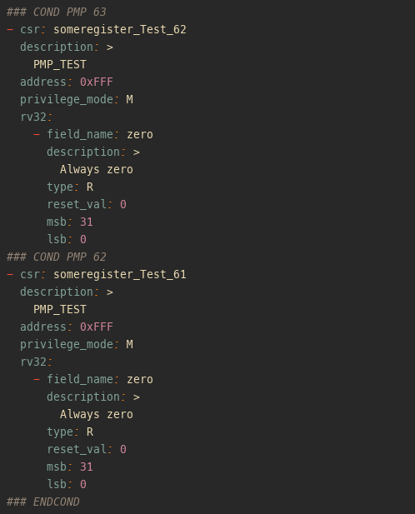
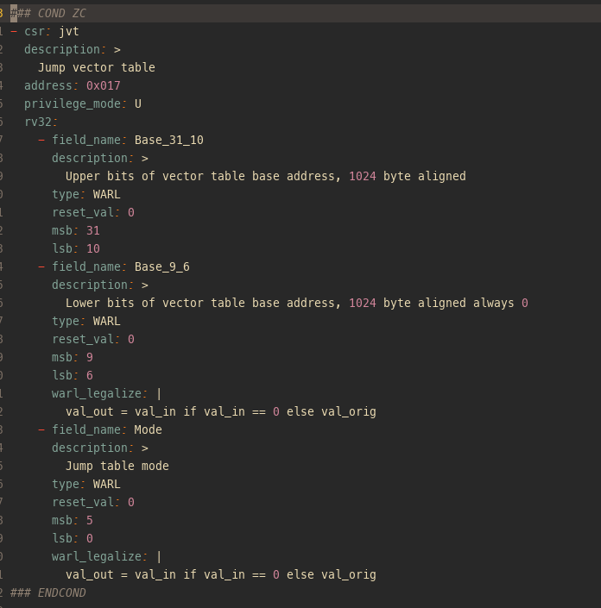
Example
Enable-tag to include registers based on command line parameters:
Alternatively, threshold for N number of feature registers:
© OpenHW Group
August 2022
7

