Slide 1


Verification Task Group May 6, 2021
Steve Richmond steve.richmond@silabs.com
Robert Chu robertchu@futurewei.com
Mike Thompson mike@openhwgroup.org

Slide 2
Outline
Administration
RVFI/RVVI Update
Open-source ISS Update
OBI Memory UVM Agent
Verification Plan Restructuring
Next-Gen Coverage Model Update
Open Issues

Slide 3
Administration
Reminder that attendance will be taken at all meetings
Attendance ensures voting eligibility per OpenHW bylaws
Active project engagement – please reach out to get involved
CVA6 (Jerome Quevremont/Mike Thompson)
Force ISG (Robert Chu)
CV32E40P_v2 (John Martin/Greg Tumbush)
CV32E40X/CV32E40S (Steve Richmond)

Slide 4
RVFI/RVVI Update
Note: This work is very much in progress…forks presented here are not stable so YMMV
Work has started on the E40X to implement a working RVFI
Halfdan Bechmann (design), Steve Richmond (verif) at SiLabs
https://github.com/silabs-halfdan/cv32e40x/tree/rvfi_integration
https://github.com/strichmo/core-v-verif/tree/strichmo/temp%2Frvfi_rvvi_initial_e40x
Testing against the Imperas model
Temporarily added make flag (USE_RVVI=0|1) to delineate
Use old tracer/step-compare USE_RVVI=0
Use new RVFI/RVVI step-compare USE_RVVI=1

Slide 5
RVFI/RVVI Update
Working
GPR checks
PC checks
Random simulations w/o stalls
Some random simulations w/ stalls
Priority on stall simulations
TBD
Interrupt signaling
Exception signaling
Debug request (halt) signaling
CSR checks

Slide 6
Open-Source ISS Update
Robert Chu gave an introduction to Handcar and provided some introductory slides
https://github.com/openhwgroup/core-v-docs/blob/master/verif/MeetingPresentations/Using%20Handcar%20Cosim%20APIs.pptx
Handcar provides a DPI layer to control Spike ISS
Load ELF
Step ISS
Read registers
Write registers

Slide 7
OBI UVM Agent Update
Create a UVM Agent for OBI
Replace mm_ram
Support new signals
Eventually support a memory model
https://github.com/openhwgroup/core-v-verif/issues/572
https://github.com/Datum-Technology-Corporation/core-v-verif/tree/datum-dpoulin_issue_572

Slide 8
Verification Plan Restructuring
Moving Verification Plans from core-v-docs to core-v-verif
Goals
Extract a common ISA-level Verification Plan
Co-locate core-specific plans with cores
Formally split formal and simulation plans
Highlight templates to be used
Initial PR is merged as a hotfix
https://github.com/openhwgroup/core-v-verif/pull/582

Slide 9
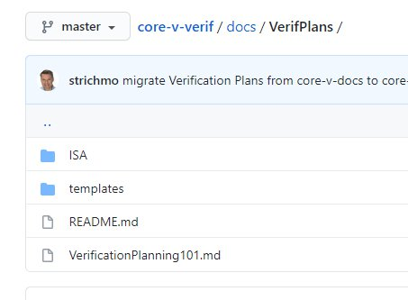
Verification Plan Restructuring
Common plan collateral
core-v-verif/docs/VerifPlans
Templates for simulation and formal
ISA plans
READMEs

Slide 10
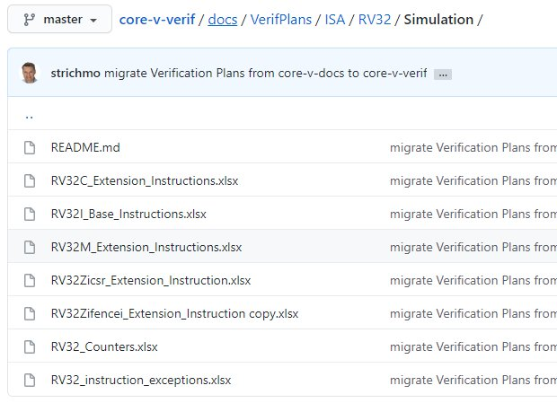
Verification Plan Restructuring
RV32 extensions populated from CV32E40P plan
Will add extensions as they are integrated onto Core-V cores
Will add coverage features in ISACOV (i.e. sequencing, hazards)

Slide 11
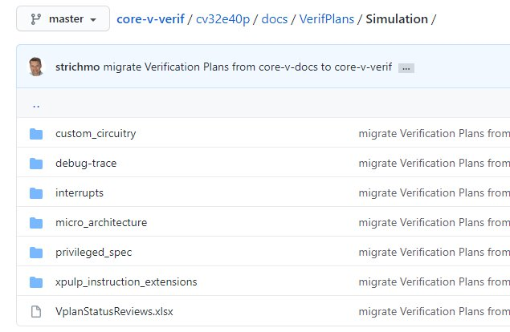
Verification Plan Restructuring
Core-specific plans
core-v-verif/<core>/docs/VerifPlans/Simulation
Markdown status here:
core-v-verif/<core>/docs/VerifPlans/README.md

Slide 12
Coverage Update
Initial ISACOV agent is merged into cv32e40x/dev
Note: merge cycle is occurring now so should be on master, cv32e40p/dev hopefully by end of 5/6/21
Spike-based disassembler online
Shared library checked in
Make target added to rebuild the disassembler (see README.md)
https://github.com/openhwgroup/core-v-verif/tree/cv32e40x/dev/lib/dpi_dasm
Very basic covergroups and data structures included

Slide 13
Coverage Update – Next Steps
Disclaimer: We need to write update formal Vplans for these features
Fork with features
https://github.com/strichmo/core-v-verif/tree/strichmo/temp/isacov_seq_preview
In the fork, use following make variable to enable ISACOV
USER_RUN_FLAGS=+USE_ISACOV

Slide 14
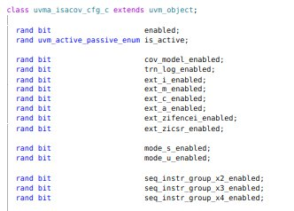
Coverage Update – Config Class
Philosophy
Use IEEE1800 covergroup, coverpoint and bins language hooks to configure coverage model for an implementation
Avoid refinement features
Configuration class offers knobs to enable extensions, features

Slide 15
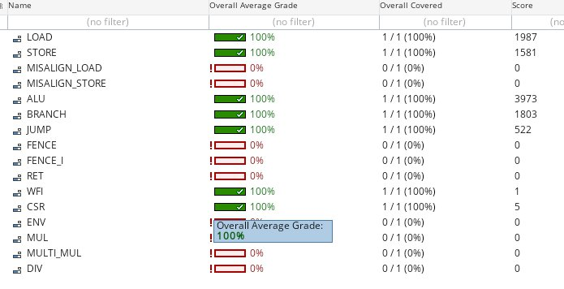
Coverage Update – Instruction Groups
Define “groups” of instructions to create “sequential” coverage of instructions
https://github.com/openhwgroup/core-v-verif/issues/575

Slide 16
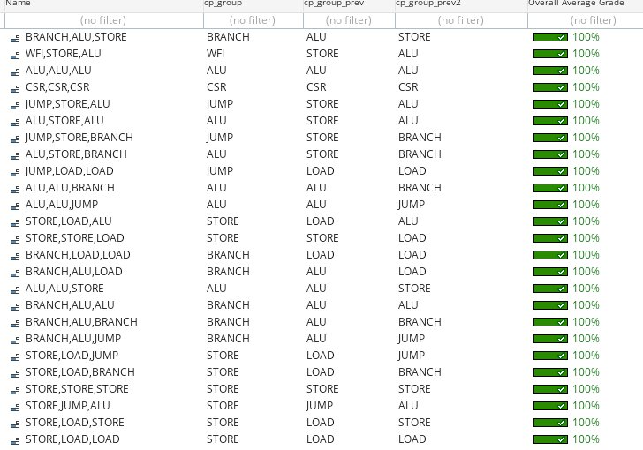
Coverage Update – Instruction Groups Sequences
Use the groups to define sequences of 2,3,4 instructions to ensure pipeline are exercised

Slide 17
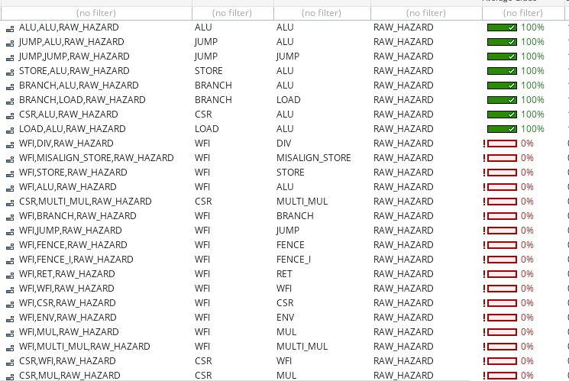
Coverage Update – Instruction Groups Hazards
Use register fields in the ISACOV instruction model to detect hazards in pipeline

Slide 18
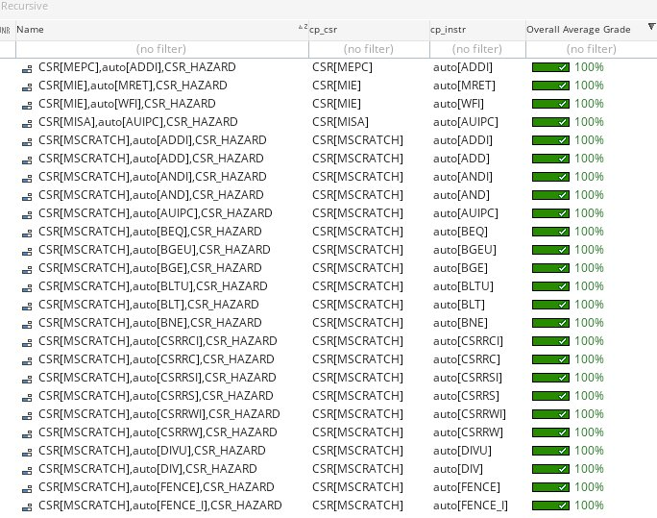
CSRs
Configuration class contains bitmask to make any CSR illegal
Agent configuration will remove CSRs based on config switches (e.g. mode_s_enabled)
Cores can override and customize as/if needed

Slide 19
Open Issues

