Slide 1


Verification Task Group May 26, 2020
Steve Richmond steve.richmond@silabs.com
Jingliang (Leo) Wang jingliangwang@futurewei.com
Mike Thompson mike@openhwgroup.org

Slide 2
Outline
Introduction
Goals – our Charter
Strategy
Completion Metrics
Workflow
CV32E40P Status
Schedule
Future Meetings

Slide 3
Introductions
Steve Richmond (Co-chair)
Jingliang (Leo) Wang (Co-chair)
Mike Thompson (Director of Engineering)
Everybody on the call
Welcome!
Can you please introduce yourself?

Slide 4
Goals - Charter
Provide comprehensive industrial-grade verification for the official OpenHW processor cores, subsystems and other IP using industry-proven languages and methodologies
Core verification including all plans, coverage, and sign-offs results will be readily available and repeatable
Initial focus on simulation-based verification but will facilitate emulation and formal verification
Create the structure and content of verification plans that will ensure correct functional operation of processors
Evaluate and select external collateral included but not limited to, code generators, processor models, etc. to assist with OpenHW verification
Architect testbenches to achieve VTG testing goals and enable the larger RISC-V community
Delegate project tasks and evaluate all technical contributions to maintain standards of quality and effectiveness in testbenches

Slide 5
Strategy
https://core-v-docs-verif-strat.readthedocs.io/en/latest/
Core testbench
Legacy PULP testbench
Facilitates compliance tests and XPULP tests
CV32E40 UVM Testbench Environment
Debug, Interrupts and Control/Status will be controlled via UVM agents and stimulated using UVM sequences
Will run all of the compliance and PULP tests from the core testbench
Introduces a random instruction generator (Google’s riscv-dv)
Self-checking with ISS from Imperas (OVPSim) with step-and-compare functionality – OpenHW members will receive a license

Slide 6
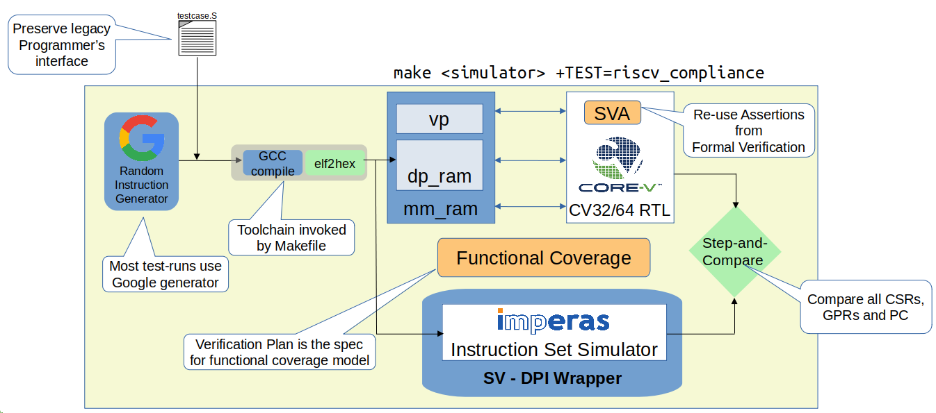
CV32E40 UVM Environment

Slide 7
Strategy – Future Improvements
Alternate code generators
Core-state aware code generation
Coverage-aware code generation
core-v-isg donation by NVIDIA
https://github.com/openhwgroup/core-v-isg
Introduction of formal methodology on core subsystems

Slide 8
Completion Metrics
The functions to be verified are documented here (including template):
https://github.com/openhwgroup/core-v-docs/tree/master/verif/CV32E40P/VerificationPlan
Functions from the verification plans will be extracted and mapped to coverage
TBD: Methodology for doing this – contributors, ideas?!
The VTG will define a sign-off regression
100% code & functional coverage with approved waivers
<n> iterations of random tests with zero failures
Compliance test suite
Directed tests for targeted coverage

Slide 9
Workflow
All tasks will be github issues on the verification site
https://github.com/openhwgroup/core-v-verif/issues
Projects on the github site will be used for task grouping
https://github.com/openhwgroup/core-v-verif/projects

Slide 10
Workflow
Tasks will be assigned by Mike
Contributors will use self-sourced compute infrastructure and tools to complete tasks
Contributor will issue pull-request when task is complete
A regression executed upon pull-request will signal to VTG and contributor if there are issues with the PR
Metrics dsim will be the sign-off simulator
Build infrastructure will attempt to support the 3 major commercial simulators
Contribution help needed for VCS
Coverage regressions will execute periodically for full regression pass/fail, coverage and testplan reports

Slide 11
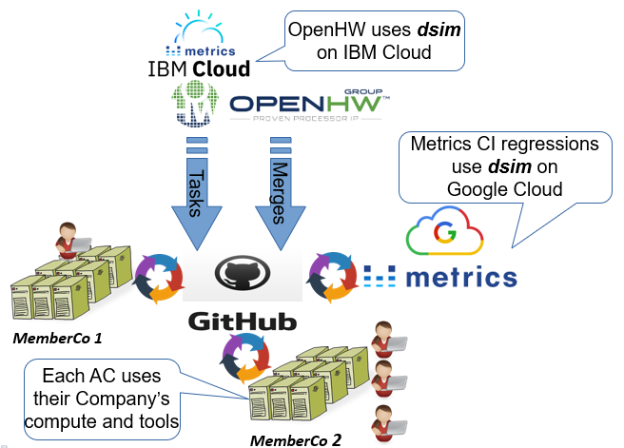
Workflow

Slide 12
CV32E40P Status
First core to be verified in OpenHW
Imperas ISS was integrated and released
Please try out Imperas license and give us feedback!
Google riscv-dv is being integrated
Toolchain stability is an issue
Working to define a unified test environment

Slide 13
CV32E40P Status
Critical to achieve this on schedule and with reasonable resource expectations
Burning Issues
Align on a toolchain (Thanks to SW TG for help!)
Complete the testplans
Ownership of interrupt verification
We need full time engineers!
Proposals for closure – remain in core but unverified
PULP extensions
FPU
Trace

Slide 14
CV32E40P Status
Near-term goals
Complete CV32E40P User Manual for functionality to be verified
Define coverage/plan measurement methodology
Define and implement testbench components for interrupts and debug

Slide 15
Next Meeting
Prefer a bi-weekly meeting
Length of meetings – 1.5 hours for future meetings
VTG’s intention is to use this meeting to replace Mike’s individual member meetings
Is this time OK? (Tuesdays @ 10am CDT)
Proposal to move to 930CDT for better alignment with Europe (goal to finish @6pm locally)
Please reach out to Leo or myself for meeting contributions or topic ideas
Thank you!

