Slide 1


Verification Task Group June 3, 2021
Steve Richmond steve.richmond@silabs.com
Robert Chu robertchu@futurewei.com
Mike Thompson mike@openhwgroup.org

Slide 2
Outline
Administration
RVFI/RVVI Update
OBI Memory UVM Agent
Next-Gen Coverage Model Update
Open Issues

Slide 3
Administration
Reminder that attendance will be taken at all meetings
Attendance ensures voting eligibility per OpenHW bylaws
Active project engagement – please reach out to get involved
CVA6 (Jerome Quevremont/Mike Thompson)
Force ISG (Robert Chu)
CV32E40P_v2 (John Martin/Greg Tumbush)
CV32E40X/CV32E40S (Steve Richmond)

Slide 4
RVFI/RVVI Update
Note: This work is very much in progress…forks presented here are not stable so YMMV
Work has started on the E40X to implement a working RVFI
Halfdan Bechmann (design), Steve Richmond (verif) at SiLabs
https://github.com/silabs-halfdan/cv32e40x/tree/rvfi_integration
https://github.com/strichmo/core-v-verif/tree/strichmo/temp%2Frvfi_rvvi_initial_e40x
Testing against the Imperas model
Temporarily added make flag (USE_RVVI=0|1) to delineate
Use old tracer/step-compare USE_RVVI=0
Use new RVFI/RVVI step-compare USE_RVVI=1

Slide 5
RVFI/RVVI Update –E40X
Working
GPR checks
PC checks
Random simulations w/ stalls
Interrupt signaling
Exception signaling
Debug request (halt) signaling
Some CSR checking
TBD
Integrate interrupt and debug signaling into the RVVI
Currently reusing Imperas BUS interface
CSR checks

Slide 6
RVFI/RVVI Update –E40X
Issues to solve before cut-over from old step-and-compare:
Integrate RVVI interrupt and debug signaling
Fix CSR checking issues

Slide 7
RVFI/RVVI Update – E40P
E40P has some work in progress but is not actively being worked
Can use cv32e40x work and branch as example
Issue to claim: https://github.com/openhwgroup/core-v-verif/issues/524

Slide 8
OBI UVM Agent Update
Content from David Poulin – Thanks!

Slide 9
Coverage Update
ISACOV is merged to cv32e40x/dev
Also master and cv32e40p/dev branches based on last week’s merge cycle
Use following make variable to enable ISACOV
USER_RUN_FLAGS=+USE_ISACOV
Added instruction groups, CSRs, register hazards and instruction groups
In progress – validation script for checking ISACOV field extraction versus tracer
Will be in progress for a while due to availability of tracer on RVFI

Slide 10
Coverage Update
Plan to cut over to ISACOV and deprecate old coverage model in next 2 weeks
To add:
CSR filtering based on mode settings

Slide 11
Miscellaneous
VerifPlan template updates – Checking criteria
https://github.com/openhwgroup/core-v-verif/issues/635
DSIM failure on SVA w/ WFIs and failure to handle null points in coverpoint guard conditions - FIXED
All WFI tests restored in release check regressions
Thanks Metrics for fast turnaround!
https://github.com/openhwgroup/core-v-verif/issues/619
IP/UVC testbench support – open issue

Slide 12
Open Issues

Slide 13
OBI Memory Agent
Integration with cv32e40p UVM Test Bench

Slide 14
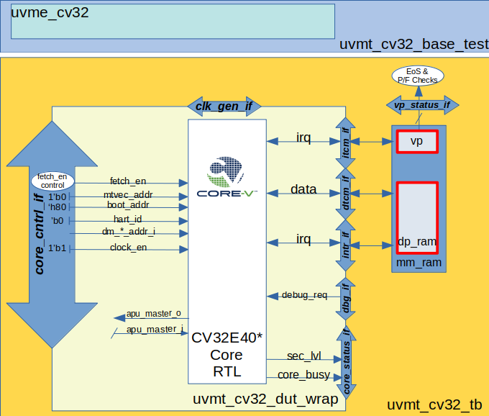
Current situation - cv32e40p
Part of the test environment is in the TB
cv32e40p Test Bench / DUT Wrapper
mm_ram
vp - virtual peripherals
dp_ram - instruction memory (read-only)
Passive OBI Agent collecting coverage in uvme_cv32e40p (not pictured)

Slide 15
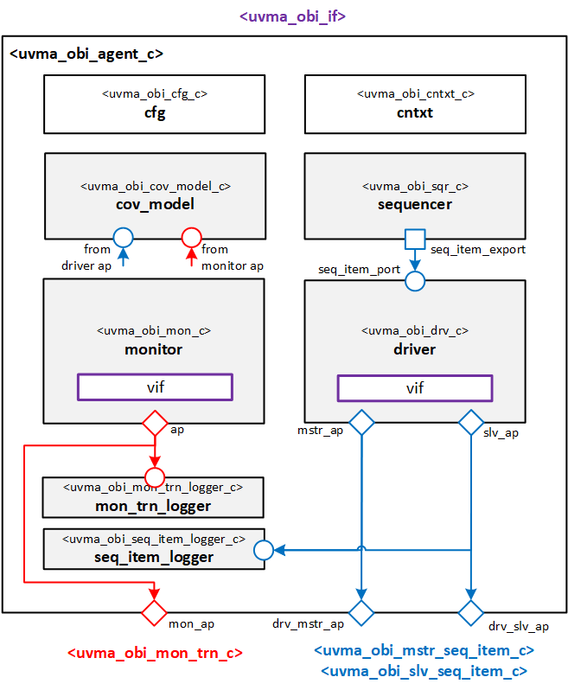
The OBI Memory Agent
UVM based, almost identical architecture to clknrst, interrupt agents
Implements OBI 1.1 (interface has 1.2 signals)
Active (2 modes) & Passive (1 mode)
Sequencer and driver do double duty
‘mstr’ mode
run access sequences to test ‘slv’ mode
use as a converter for a RAL
‘slv’ mode
run ‘slv’ sequences that respond to access requests from a ‘mstr’
these requests come from the monitor’s “early-access” analysis port
Very dumb, doesn’t know anything about memories or cores
“Business Logic” is captured in “user” sequences (or virtual sequences)
Very incomplete error detection
Dedicated self-test environment (uvme_obi_st_env_c) and test bench (uvmt_obi_st_tb)
mstr <-> slv topology

Slide 16
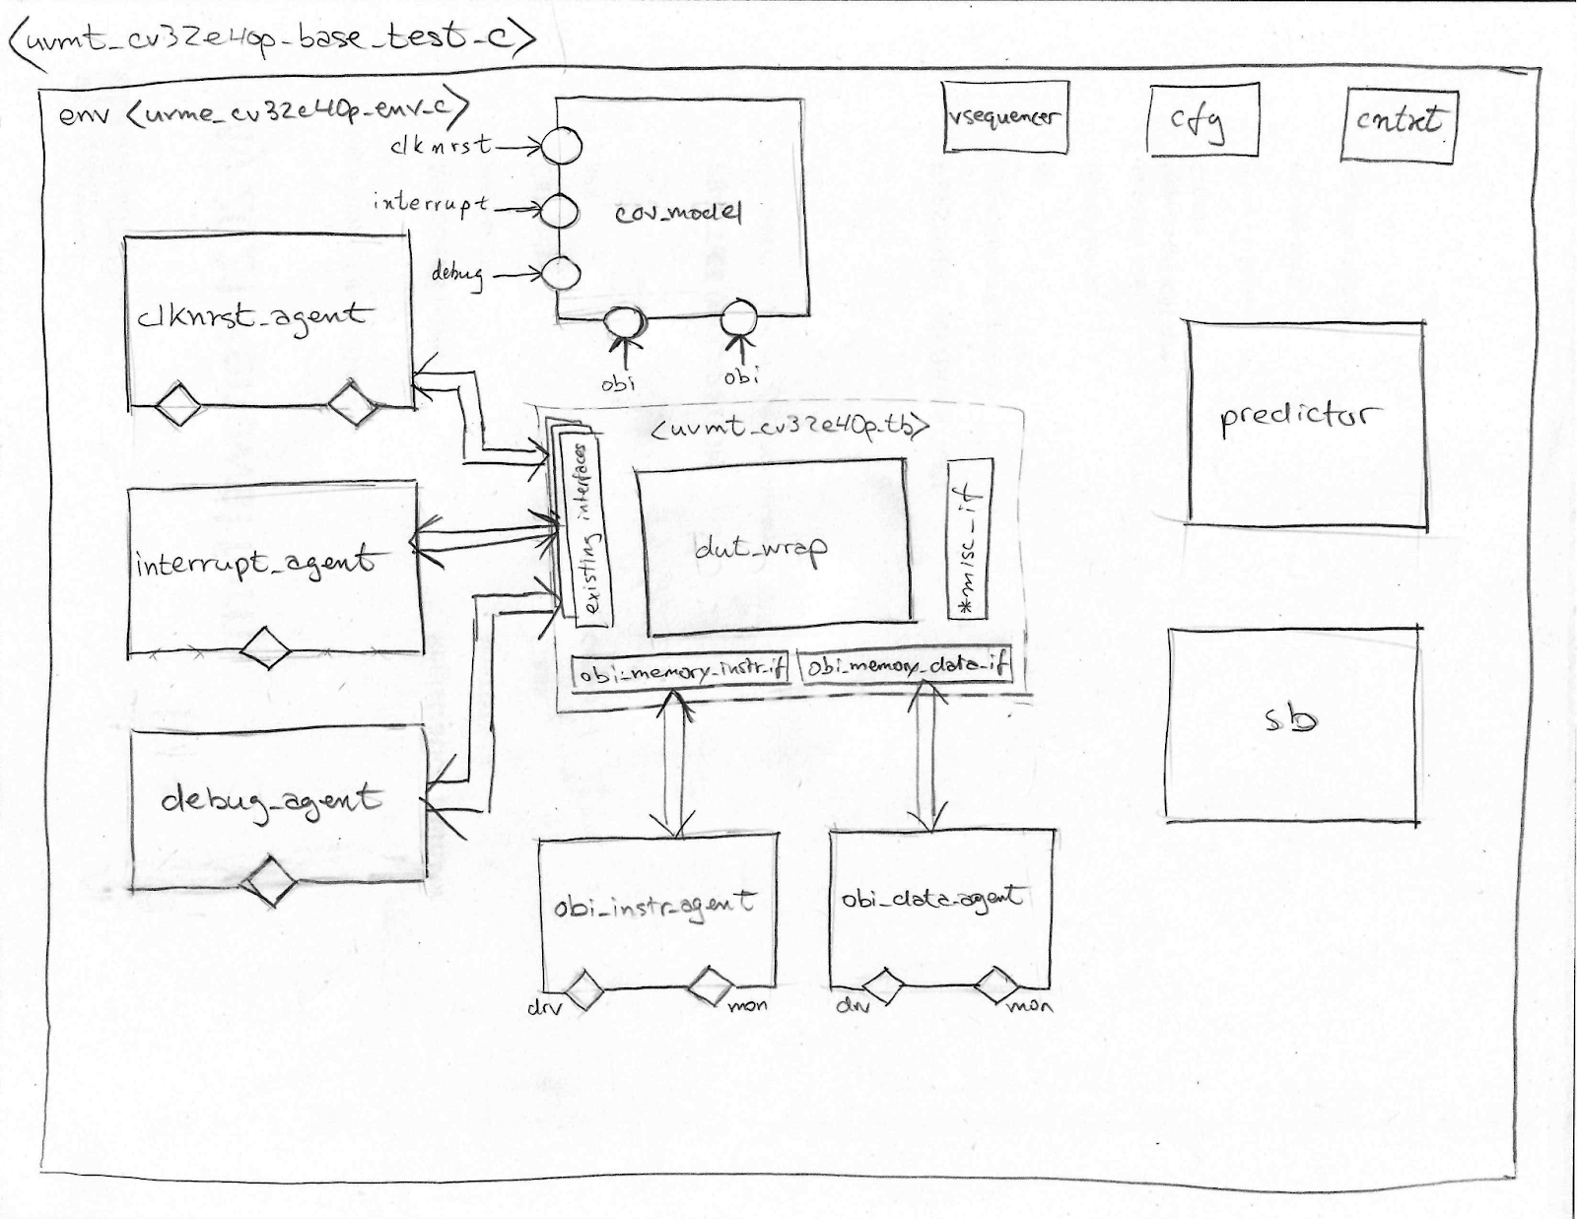
Integrating the OBI Memory Agent
2 new Instances of the new Agent
obi_instr_agent
obi_data_agent
2 new virtual sequences
uvme_cv32e40p_vp_vseq_c
Implements vp
uvme_cv32e40p_instr_vseq_c
Implements dp_ram
Automatically executed at run_phase()
New interface (“misc_if”) used by vp vseq to access dut_wrap signals for irq, debug, etc.
No other major changes
Existing OBI agent can be kept or deprecated once OBI memory agent is stable.

Slide 17
Current Status (June 2nd 2021)
Development branch: Mike Thompson’s merge_obi_mem
Existing OBI Agent still in repo
OBI Memory Agent actually named “OBI Memory Agent” (uvma_obi_memory_pkg) to avoid name conflict with existing OBI agent.
obi_memory_instr_agent
obi_memory_data_agent
Compiling, elaborating, simulating, but not passing sanity (DSIM, XRUN)
Agent locking up after first read from core
Protocol understanding mixup, monitor doesn’t end transaction correctly
Should be simple fix
No debug yet on VP virtual sequence
No implementation yet of “misc_vif” to finish VP implementation for testing
OBI ST Env+TB need some love, integration lockup demonstrates further testing needed to have robust agent, but at least new changes can be tested by themselves in separate branches before integration into core environments
Where to store and simulate non-core test benches? Currently running ST simulations from lib/uvm_agents/uvmt_obi_st/bin. Not a long-term solution. Suggestion:
root/
obi/
/agent
/env
/sim
/tb
/tests

Slide 18
Source
https://github.com/MikeOpenHWGroup/core-v-verif/tree/merge_obi_mem

