Slide 1


Verification Task Group July 16, 2020
Steve Richmond steve.richmond@silabs.com
Jingliang (Leo) Wang jingliangwang@futurewei.com
Mike Thompson mike@openhwgroup.org

Slide 2
Outline
Project Management
ISG Evaluation
Simulation Control

Slide 3
Project Management
NPIs/Evaluation Control Points
Progress made on these fronts
Duncan Bees, OpenHW Program Manager is driving this to the TWG for collation and evaluation

Slide 4
ISG: Criteria
Criteria on evaluating ISGs: which ISG meets OpenHW needs
Example of past effort comparing ISGs:
https://github.com/openhwgroup/core-v-docs/blob/master/verif/ISGs/Google_and_Nvidia_Random_Instruction_Generator_Comparison(scored).pdf
New metrics should be added and weighted.
Evaluate if there is any coverage closing issue with ISG currently in use.

Slide 5
ISG: Testbench Support
Support only one ISG or multiple ISGs?
Obvious benefit: improvements in stimuli quality and coverage
The effort needed to support multiple ISGs.
Key point to look-into
Enables active and real-life scenario comparison:
Who finds it first?
Can you find it too given the clue?

Slide 6
ISG: Easy of use
Initial learning curve
Test template collection growth:
Configurability
Maintainability
Reusability, aggregation of components (sequence)
Adapting to new project

Slide 7
Simulator Control
Proposal for scope of simulation control standardization
Goals:
Provide an easy-to-understand, consistent interface for customizing and using a git checkout
Abstract common operations for consistency between simulators
Enable industry contributors to easily integrate their tool flows
Fully document usage and examples in Verification Strategy
Incorporate some extremely simple “get-started” examples in README.md
Steve can contribute Xcelum/Questa updates

Slide 8
Coding Standards
Specify standard technologies to be used in implementation of the Core-V-verif infrastructure
This does not extend to ISG implementations and TB code
Make – to invoke simulator, coverage, regression, test generation, etc.
Python – use python3 in all scripts
Requirement: user must incorporate python3 into PATH
OpenHW python must only use standard modules
YAML – Input and control files

Slide 9
Output directory
Proposal: add an output directory to each Makefile location
cv32/sim/uvmt_32/<simulator>_results
Follows the example in dsim.mk
All generated files targeted to that directory
Test output would go to:
testname.<index>
<index> defaults to 0
Supports multiple runs
Easy cleanup!
Common locality of logs

Slide 10
Outline
Main goal of this meeting is to foster open discussion in following areas
VTG Logistics (minutes, slides, future meetings)
Project Management
New Product Introduction
Decision Control Points
Project management flow
Simulator testbench support
ISG evaluation criteria

Slide 11
Environment Variables
Create a set of CV_ variables for setting defaults in a user shell
Can be overridden on any make call on command line
Makefiles will provide sensible defaults for optional variables
Makefiles will detect if required
Required
CV_RISCV : Home of the software toolchain
Optional
CV_SIMULATOR : Default simulator for all makes
CV_SIM_PREFIX : Prepended to simulator calls
CV_TOOL_PREFIX: Prepended to tool calls (e.g. waves, coverage)
Allows for job control injection (e.g. bsub for LSF)

Slide 12
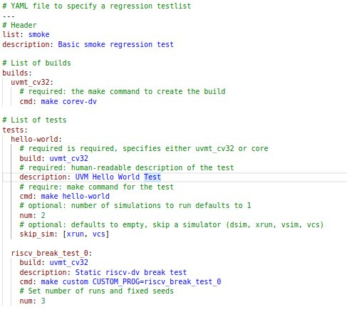
Regression List
Define YAML testlist format
Develop Python utility to validate and convert from YAML to proprietary format
e.g. dsim JSON

Slide 13
Waveforms
Make flags to be supported for each simulator
WAVES=1 => Post-process debug flow
Probe and dump post-process
Default enables full scope of tb module and design
ADV_DEBUG=1 => Use advanced debug tool for simulators
xrun => Indago
vsim => Visualizer
GUI=1 => Invoke interactive simulator
Also enables
Invoke waveform viewer (post-process)
make waves TEST=<test>

Slide 14
Coverage
make COV=1
Generates a simulator-specific coverage database
Canned scripts of coverage type
Covergroup+assertion+line(block)+expression+toggle
make cov TEST=<n>
Generate canned coverage report per test
In absence of test merge or report on all coverage found
make cov MERGE=YES
Find all coverage databases and merge
make cov GUI=YES
Start the coverage GUI per tool

Slide 15
Other ideas
Lots of duplication in current makefiles - YAMLize
Extract simulator flags to control files instead of Makefile
Tests in YAML manifests
Alignment with RTL manifests
Tools to map coverage to verification plans
Inline banner messages during test execution to highlight logs, output files, waveform, coverage commands, etc.

