Slide 1


Verification Task Group August 27, 2020
Steve Richmond steve.richmond@silabs.com
Jingliang (Leo) Wang jingliangwang@futurewei.com
Mike Thompson mike@openhwgroup.org

Slide 2
Outline
Actions from Last Week
Simulation Control Update
Open Issues

Slide 3
Actions from Last Week
Mike to propose exception simulation coverage holes covered by OneSpin formal verification to TWG – Scheduled for 8/31
Automated tag application to core-v-verif – No progress

Slide 4
Simulation Control Update
Completing Phase 2 of 2 next week
Regression support
Test specifications
More detailed review usage to be presented at CV32E40P Sprint meeting next week

Slide 5
Regression Updates
Regression goals at release
Enable generation of Metrics or shell script
Provide template for extension to other regression managers at contributor sites
Support parallelization of testing

Slide 6
Test Specification Updates
For directed and random tests, provide single target in each simulation Makefile
Provide standard way to pass runtime arguments, select generator options
Extensible to timeouts and other specialized options

Slide 7
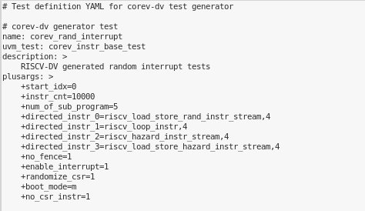
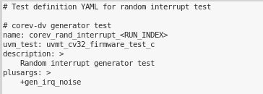
Test Specification Updates

