Slide 1


Verification Task Group October 7, 2021
Steve Richmond steve.richmond@silabs.com
Robert Chu robertchu@futurewei.com
Mike Thompson mike@openhwgroup.org

Slide 2
Outline
Administration
General news
Call for community
Infrastructure updates
Test program builds
PMA randomization
Regression support for configurations
E41/E40Pv2/A6 Updates
FPU verification
Open issues

Slide 3
Administration
Reminder that attendance will be taken at all meetings
Attendance ensures voting eligibility per OpenHW bylaws
Active project engagement – please reach out to get involved
CVA6 (Jerome Quevremont/Mike Thompson)
Force ISG (Robert Chu)
CV32E40X/CV32E40S (Steve Richmond)

Slide 4
News
Next week: Launch of the cv32e40s/dev branch
Merge cycles: Goal to start every other Thursday
One has started this morning
Many thanks to Henrik Fegran (@silabs-hfegran) for the PMA randomization efforts!

Slide 5
Call for Community
We have lots of tasks that could be addressed by the OpenHW Community!
We are here to support – contact Steve or Mike to get involved!
Add the 1.0 bitmanip to Google riscv-dv!
https://github.com/openhwgroup/core-v-verif/issues/923
Add LLVM to our test flow!
https://github.com/openhwgroup/core-v-verif/issues/844
Add the latest RISC-V architecture test infrastructure!
(This is the replacement of the compliance suite)
This needs to be scoped to determine whether to move to the latest Python test methodology
https://github.com/openhwgroup/core-v-verif/issues/819
https://github.com/openhwgroup/core-v-verif/issues/818

Slide 6
Test Program Build
Goals:
Enable crossing of core configurations with firmware test builds
Enable parallel firmware test builds
Allow for custom linker scripts with random corev-dv tests
No more generated files in the source tree
This includes the BSP
New path for firmware build output products:
<sim>_results/<cfg>/<test>/<run_index>/test_program/…
Examples
cv32e40x/sim/uvmt/xrun_results/default/hello-world/0/test_program
cv32e40x/sim/uvmt/vsim_results/pma_test_cfg_1/corev_rand_instr_test/test_program
cv32e40x/sim/uvmt/xrun_results/default/pma

Slide 7
Test Program Build
Individual test build outputs: (example for run_index == 1)
corev_rand_instr_test_1.S
corev_rand_instr_test_1.elf
corev_rand_instr_test_1.hex
corev_rand_instr_test_1.itb
corev_rand_instr_test_1.objdump
corev_rand_instr_test_1.readelf
linkcmds.dbgsec
linkcmds.memory
link.ld
linkcmds.fixadd
linkcmds.dbgsec

Slide 8
Test Program Build
Linker scripts are generated in corev-dv
linkcmds.memory -> Defines the memory sections (ram or multiple regions, dbg, nmi)
linkcmds.pmasec -> Maps regions from riscv-dv to memory sections
linkcmds.fixadd -> Maps fixed addresses from plusargs to handlers (boot, vector, NMI)
linkcmds.dbgsec -> Maps debug regions (code, exception, etc.)
link.ld includes the above and is hardcoded at:
link_corev-dv.ld
If a core does not support address randomization then symlink link_corev-dv.ld to standard link.ld

Slide 9
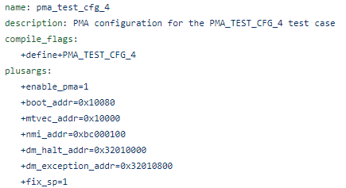
Test Program Build
Configuration support for PMA
The linker script outputs are fixed for a PMA configuration
Each PMA test configuration defines compile args and run-time plusargs
corev-dv and UVMT testbench use these plusargs
Example from:
cv32e40x/test/cfg/pma_test_cfg_4.yaml

Slide 10
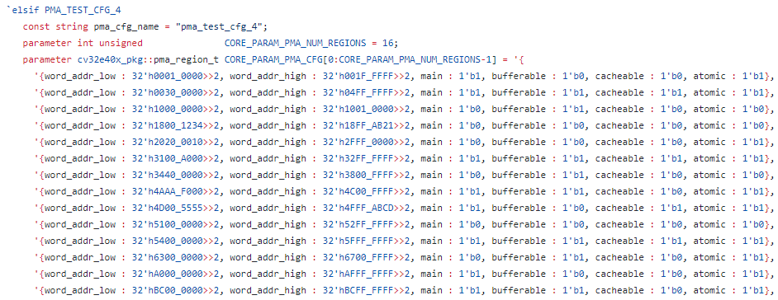
Test Program Build
corev-dv, UVMT and RTL import the parameters from the same package to set the actual PMA parameters
uvmt_cv32e40x_constants.sv

Slide 11
Test Program Build
TBD
Move mtvec handler into “static” location (similar to boot, NMI)
Solves issue of exceptions received right after boot
riscv-dv dynamically sets mtvec a handful of instructions into the test program

Slide 12
Regression support for configurations
More parameters will continue to be used in our cores
(CFG=<>) in make calls
Need to add these configurations to regressions in a scalable way
New tag (builds) added to YAML that can take a list of configurations to regress against
Extended support to Metrics, shell script and vManager output templates
Metrics and vManager will parallelize the builds

Slide 13
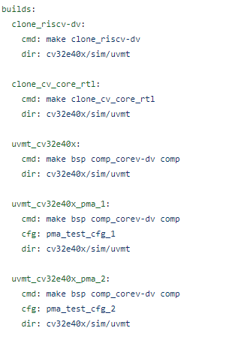
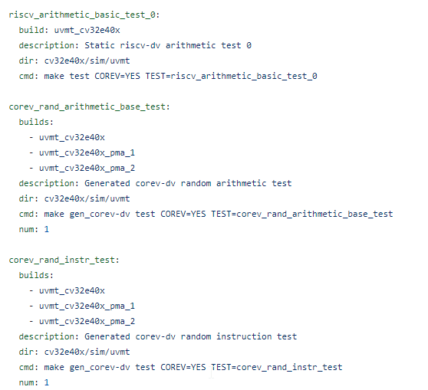
Regression support for configurations

Slide 14
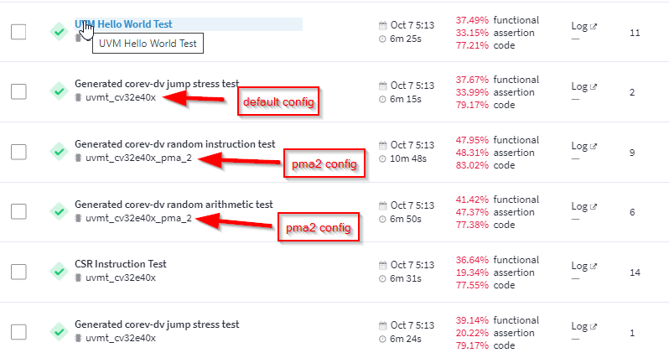
Regression support for configurations

Slide 15
Open Issues
Note: These are repeats from last month – no progress
Logging control
RVFI/RVVI emits a lot of logs
Example: hello-world now emits 18M of logs (cv32e40p -> 2M of logs)
Need to create control mechanism to control logs
Regression – no logs by default?
Recreate logs locally or in rerun (Metrics)
Plusarg registrations
Validate that user supplied plusargs (YAML or make command line) are supported to avoid misspellings
Documentation for supported plusargs
Singleton class definition to register, parse and fetch plusargs

