Slide 1


Verification Task Group November 4, 2021
Steve Richmond steve.richmond@silabs.com
Robert Chu robertchu@futurewei.com
Mike Thompson mike@openhwgroup.org

Slide 2
Outline
Administration
General news
Call for community
Infrastructure updates
LLVM update
Testbench Coding Standards
Testbench Lint
Open issues

Slide 3
Administration
Reminder that attendance will be taken at all meetings
Attendance ensures voting eligibility per OpenHW bylaws
Active project engagement – please reach out to get involved
CVA6 (Jerome Quevremont/Mike Thompson)
Force ISG (Robert Chu)
CV32E40X/CV32E40S (Steve Richmond)

Slide 4
News
cv32e40s/dev branch has launched
Merge cycles: Goal to start every other Thursday
One has started this morning
Silicon Labs will start adding the 1.0.0 B extension instructions to riscv-dv
LLVM support is now added to core-v-verif

Slide 5
Call for Community
We have lots of tasks that could be addressed by the OpenHW Community!
We are here to support – contact Steve or Mike to get involved!
Add the latest RISC-V architecture test infrastructure!
(This is the replacement of the compliance suite)
This needs to be scoped to determine whether to move to the latest Python test methodology
No update from last VTG meeting
https://github.com/openhwgroup/core-v-verif/issues/819
https://github.com/openhwgroup/core-v-verif/issues/818
Clean up Lint issues!

Slide 6
LLVM Support
Goals
Enable verification for users who want to use clang/LLVM
Enable verification of extensions where clang/LLVM have implementations before gcc
Enable benchmarking of compilers for interested users
Does not include
Mixing toolchains in regressions
Is currently merged to all core-v-verif branches

Slide 7
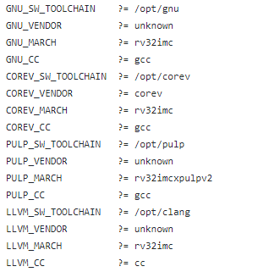
Selecting a toolchain
Environment variables are used
Reference common makefile
Set LLVM, GNU, COREV, or PULP to 1,YES,Y to use that toolchain
Default variables are CV_SW_TOOLCHAIN, CV_SW_VENDOR, CV_SW_MARCH in environment

Slide 8
LLVM/Clang
Used LLVM from Embecosm builds to test:
https://www.embecosm.com/resources/tool-chain-downloads/
In general clang is flag-compatible with gcc
core-v-verif will allow for some flag differences specifically with experimental extensions
Imperas also provides some toolchains for RISC-V:
https://github.com/Imperas/riscv-toolchains/branches/all

Slide 9
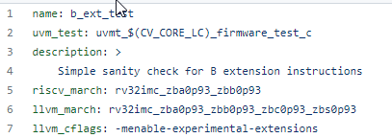
Test YAML Toolchain Flags
<tool>_march
Overrides march for toolchain if you use that tool (llvm,gnu,corev,pulp)
<tool>_cflags
Additional flags to the compilation step

Slide 10
Miscellaneous Toolchain Updates
BSP is now compiled “with” the testcase
Previously was compiled and linked per configuration
Ensures that switches such as march match from BSP to testcase
cv_regress now has toolchain switch
--toolchain=pulp|corev|llvm|gnu
Benchmarks should run with LLVM
coremark, dhrystone, embench

Slide 11
Testbench Coding Standards
https://github.com/openhwgroup/core-v-verif/blob/master/docs/CodingStyleGuidelines.md
Thanks to Brian Hunter, author of Advanced UVM for allowing these to be reused

Slide 12
Verissimo Lint Reports
https://dvteclipse.com/core5verif-verissimo/1/main/index.html
Using cv32e40p/dev as branch and platform to clean up
Mike is creating GitHub issues to clean up Lint errors

Slide 13
Open Issues
Note: These are repeats from last month – no progress
Logging control
RVFI/RVVI emits a lot of logs
Example: hello-world now emits 18M of logs (cv32e40p -> 2M of logs)
Need to create control mechanism to control logs
Regression – no logs by default?
Recreate logs locally or in rerun (Metrics)
Plusarg registrations
Validate that user supplied plusargs (YAML or make command line) are supported to avoid misspellings
Documentation for supported plusargs
Singleton class definition to register, parse and fetch plusargs

