Slide 1


Verification TG – E* Core Status March 18, 2021
Steve Richmond steve.richmond@silabs.com

Slide 2
Outline
Administration
CV32E40X/S Status
Completed Tasks
Active Tasks
Next Tasks
Parallel Development Repo Management
Open Issues

Slide 3
Administration
This will be a monthly meeting on general E-core status and project coordination
Since meetings are monthly (1st and 3rd Thursday) VTG may not meet every other Thursday – check Mattermost for announcements or openhwgroup.org Task Group calendar
Reminder that attendance will be taken at all meetings
Attendance ensures voting eligibility per OpenHW bylaws
Active project engagement – please reach out to get involved
CVA6 (Jerome Quevremont/Mike Thompson)
Force ISG (Robert Chu)
CV32E40P_v2 (John Martin/Greg Tumbush)
CV32E40X/CV32E40S (Steve Richmond)

Slide 4
CV32E40X/S Status
Current focus is on cv32e40x part1
RV32IMCZicounti_Zicsr_Zifencei
Physical Memory Attribution (PMA)
Bus errors
Multiple area enhancements, simplifications, etc
Awaiting Eclipse contribution approval on SiLabs cv32e40x initial PR
Will copy cv32e40p to cv32e40x when that occurs
For this update all completed tasks are applied to cv32e40p
Future updates will be made to a specific core and then merged over as needed

Slide 5
Completed Tasks
EEMBC CoreMark benchmark
https://github.com/openhwgroup/core-v-verif/issues/494
makeuvmt test TEST=coremark USE_ISS=0
Updated riscv-dv hash
https://github.com/openhwgroup/core-v-verif/issues/496
Using Jan 13 hash, last “Verified” hash from Google riscv-dv

Slide 6
Completed Tasks
Apply RUN_INDEX to all tests – all tests are now regressable
https://github.com/openhwgroup/core-v-verif/issues/484
Enable CV_RESULTS to redirect simulation output results
https://github.com/openhwgroup/core-v-verif/issues/485
Add configuration as a directory to all results
https://github.com/openhwgroup/core-v-verif/issues/483

Slide 7
Active Tasks
General
Implement next-generation RV ISA
https://github.com/openhwgroup/core-v-verif/issues/487
https://github.com/openhwgroup/core-v-verif/issues/488
Looking at decoder solutions for on-the-fly ISA model
Implement RVVI/RVFI scoreboard
https://github.com/openhwgroup/core-v-verif/issues/524
Update: Have integrated Davide’s in-progress work on RVFI on cv32e40p and have quite a few tests passing PC/GPR checks (more details at next VTG)
Implement EMBench benchmark
https://github.com/openhwgroup/core-v-verif/issues/495
Expect PR in next few days

Slide 8
Next Tasks
Verify PMA
Scope Vplan
Implement tests
Implement coverage
Verify bus errors
Scope Vplan
Implement tests
Implement coverage

Slide 9
Parallel Development Repo Management
When cv32e40x is created in core-v-verif, we will implement a GitFlow branching strategy
https://github.com/openhwgroup/core-v-docs/blob/master/verif/Common/Presentations/20210311-Branches%20and%20CIs%20for%20core-v-verif.pptx
Contributors will work on a branch and PR to a branch
cv32e40<n>/dev
master will remain stable with contributions from merges and hotfixes
CIs (more later) based on Git actions will be used to ensure functionality on all branches

Slide 10
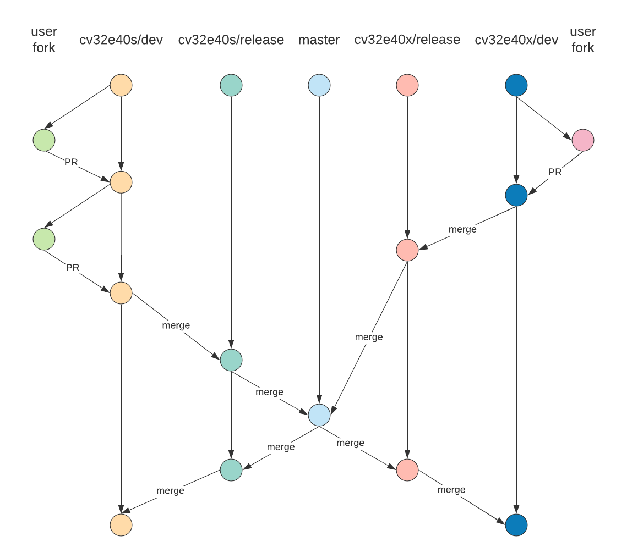
Parallel Development Repo Management

Slide 11
Core-v-verif Branches – When to merge
Will ask project/core leads every Thursday if there is need for a merge
Types of changes that require timely merges:
Common infrastructure in TB (lib/ mk/)
Common scripts (bin/)
Schedule of merges
No more than 1 month between merges
TBD: Look into generating reports of “dry-run” merges nightly to help determine when to merge

Slide 12
Core-v-verif Continuous Integration
With multiple cores and branches in development it becomes more critical to ensure all active branches are stable
Triggered CIs
Via Github actions, any push on a defbranch ca
Each core will have a ci_check regression YAML defined in its regress/
Purpose: Ensure sanity and stability
Scheduled CIs
Via Github actions, start large scale regressions on a nightly timer
Purpose: Track test pass/fail progress, track coverage, provide data for convergence

Slide 13
Triggered CIs
Branch | YAML | Name (Metrics) | Typical Action(s)
cv32e40x/dev | cv32e40x_ci_check.yaml | cv32e40x_ci_check_dev | User PR approval Release merge-back PR
cv32e40x/release | cv32e40x_rel_check.yaml | cv32e40x_ci_check_release | Release branch PR Release merge-back PR
cv32e40p/dev | cv32e40p_ci_check.yaml | cv32e40p_ci_check_dev | User PR approval Release merge-back PR
cv32e40p/release | cv32e40p_rel_check.yaml | cv32e40p_rel_check_release | Release branch PR Release merge-back PR
cv32e40s/dev | cv32e40s_ci_check.yaml | cv32e40s_ci_check_dev | User PR approval Release merge-back PR
cv32e40s/rel | cv32e40s_rel_check.yaml | cv32e40s_rel_check_release | Release branch PR Release merge-back PR
master | cv32e40x_rel_check.yaml cv32e40p_rel_check.yaml cv32e40s_rel_check.yaml | cv32e40x_rel_check_master cv32e40p_rel_check_master cv32e40s_rel_check_master | User hotfix PR approval Merges from release branch

Slide 14
Scheduled CIs
Measure coverage on all
On /dev branches
Minimal set per core:
cv32e40<n>_full_regression.yaml
cv32e40<n>_benchmark.yaml
cv32e40<n>_compliance.yaml
Others added as coverage/testing needs apply
e.g. adding regressions that target specific features of a core that need more targeted testing and coverage analysis

Slide 15
Core-v-verif Continuous Integration
CIs should allow for good visibility
OpenHW will enable Metrics account for OpenHW members to track results via core-v-verif
Naming of regressions will enable easy identification and tracking trends
General users: The Github Actions tab should enable a CI dashboard for any user to gain insight into pass/fail/results of
More details at next VTG

Slide 16
Open Issues

