Slide 1


CV32E40P* Verification Schedule Status Sprint #3
Mike Thompson
www.openhwgroup.org
© OpenHW Group
July 20 2020
<number>

Slide 2
Sprint #3: 2020-07-13 to 2020-07-31
Sprint #3 will produce the following outcomes:
Verification Planning for CV32E40P:
Completion and reviews of all required Vplans.
RV32IMCZ verification:
Complete and reviewed RV32IMCZ functional coverage model
90% functional coverage of RV32IMCZ instructions in regressions.
Agreement with Imperas on RM upgrades for CV32E40P
Implementation of these would be a stretch goal
Interrupt verification resourced.
Completion of CSR verification (stretch goal).
Tangible deliverables for Formal Verification:
OneSpin: integration of SAIL model.
Axiomise: completion (?) of RV32IC ISA verification.
Loose-ends:
Designer-level debug test integrated and passing.
Solution for compiling the Compliance Test Suite.
Automate testing of Metrics CI regression scripting.
Sprint #3 will introduce non gating activities:
Planning and Execution for XPULP verification:
Contribution by EM-US.
Suggesting a separate forked project for this.
Evaluation of SymbioticEDA “mutation tool”:
Trials have been on-going in the back-ground
Hope to incorporate status update this sprint.
Review of Axiomise formal test plan for RV32IC ISA verification.

Slide 3
Progress This Week
Overall, little progress this week.
Impacted by churn in the RTL and OpenHW Governance issues:
Expect Governance to take additional time this week.
Several Contributors impacted by non-OpenHW commitments.
Some good news:
Metrics CI regressions are running smoothly are now a significant aid for new code integration.
New Contributor from NXP: Vitor Eschholz.

Slide 4
Status as of 2020-07-20 (1 of 2)
Verification Planning for CV32E40P:
Met with Arjan to work-out review assignments.
New team member Vitor Eschholz of NXP joining in.
Additional Vplans identified – need someone to capture these.
RV32IMCZ verification:
No updates to RV32IMCZ functional coverage model this week.
Agreement with Imperas on RM upgrades for CV32E40P:
Updated the requirements spreadsheet, need to arrange review.
Interrupt verification resourced:
No progress this week.
Completion of CSR verification (stretch goal):
No progress this week (beyond a bit of reading).

Slide 5
Status as of 2020-07-20 (2 of 2)
Tangible deliverables for Formal Verification:
OneSpin: formal verification plan published.
Axiomise: nearing completion of RV32IC ISA verification.
Designer-level debug test integrated and passing
No progress this week.
Solution for compiling the Compliance Test Suite:
No progress this week.
Automate testing of Metrics CI regression scripting:
Discussion with Metrics – now ready to deploy.

Slide 6
Risks & Mitigation
Still have not been able to integrate RISC-V Compliance Test Suite:
Decided against using non-Xpulp toolchain in favor of newly minted CORE-V toolchain.
CORE-V toolchain doesn’t like the Compliance Suite (SW TG is on it).
Original Project Plan called for CSR and Exceptions verification to begin during this time-frame:
No engineering resource available for these tasks
The Google ISG might have capability to partially cover CSRs.
Debug effort on-hold until July 27 due to vacations:
It has been proposed to switch Oystein from Debug to Interrupts.

Slide 7
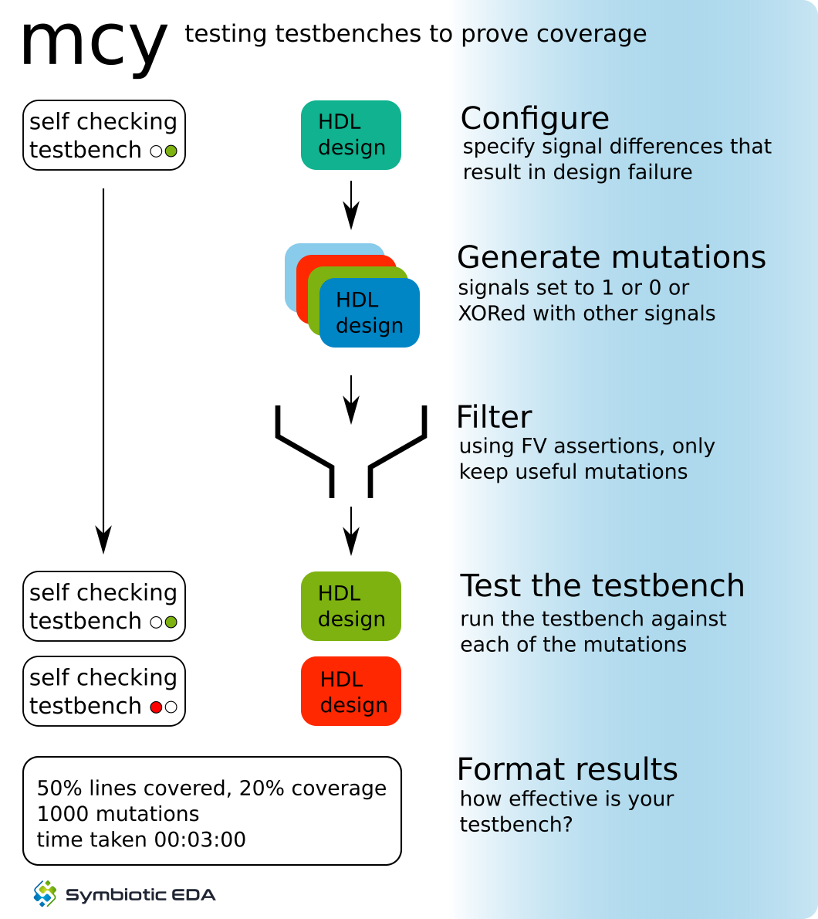
mcy - Mutation Coverage
Break the design on purpose to see if the testbench is able to catch the problem
Change one 1-bit wire
Run the test suite
If it fails, great – the testbench successfully detects this kind of problem
If it passes – is the testbench not good enough or is the mutation not breaking the design?
formal equivalence check
Inspect uncovered mutations and improve either test suite or equivalence check until 100% coverage reached
<number>

Slide 8
mcy - Mutation Coverage with Yosys
Divider as first example, two main clusters of uncovered mutations:
LoadEn_S: saves input values when starting division
Is core guaranteed to keep inputs stable while div is ongoing?
ResReg_DN: default branch of result mux
Supposed to keep result stable if division finished but OutRdy_SI is low – bugs would not be apparent when result is always consumed immediately
Find an instruction stream that creates a stall at just the right moment to delay using the result?
<number>

Slide 9
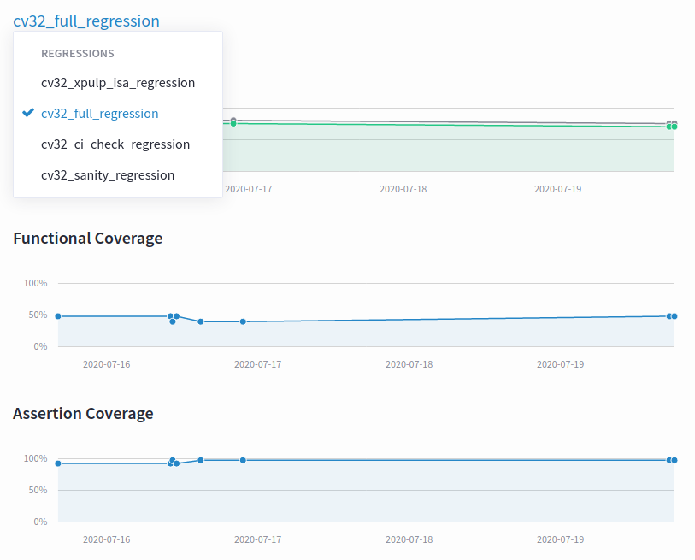
Makefiles, User Regressions and Metrics CI
The included Makefile cv32/sim/Common.mk selects the URL, branch and hash of the RTL code from the cv32e40p repo.
Allows for controlled integration of RTL and TB.
Can be overridden on the command-line: make sanity CV32E40P_HASH=1234567
Recommend we start tagging the RTL soon and using these instead of hashes
Steve Richmond proposed significant set of grades to Makefiles to ease developer’s work lives.
“User Regression” (ci_check):
Now known to be functional for Metrics dsim, Cadence Xcelium (xrun) and Synopsys vcs.
Looking for member support to pipe-clean user regressions with Mentor’s Questa (vsim).
Update: All tests in user regression are expected to pass.
URL for Metrics CI is https://openhwgroup.metrics.ca.
Now supports three Regressions:
cv32_full_regression: all running tests
cv32_ci_check_regression: same tests as user regression
cv32_xpulp_isa_regression: XPULP ISA tests from em-micro
cv32_sanity_regression: no longer runable (but results from previous tests are still available).

Slide 10
Thank You

