Slide 1


CV32E40P* Verification Schedule Status Sprint #3
Mike Thompson
www.openhwgroup.org
© OpenHW Group
July 27 2020
1

Slide 2
Sprint #3: 2020-07-13 to 2020-07-31
Sprint #3 will produce the following outcomes:
Verification Planning for CV32E40P:
Completion and reviews of all required Vplans.
RV32IMCZ verification:
Complete and reviewed RV32IMCZ functional coverage model
90% functional coverage of RV32IMCZ instructions in regressions.
Agreement with Imperas on RM upgrades for CV32E40P
Implementation of these would be a stretch goal
Interrupt verification resourced.
Completion of CSR verification (stretch goal).
Tangible deliverables for Formal Verification:
OneSpin: integration of SAIL model.
Axiomise: completion (?) of RV32IC ISA verification.
Loose-ends:
Designer-level debug test integrated and passing.
Solution for compiling the Compliance Test Suite.
Automate testing of Metrics CI regression scripting.
Sprint #3 will introduce non gating activities:
Planning and Execution for XPULP verification:
Contribution by EM-US.
Suggesting a separate forked project for this.
Evaluation of SymbioticEDA “mutation tool”:
Trials have been on-going in the back-ground
Hope to incorporate status update this sprint.
Review of Axiomise formal test plan for RV32IC ISA verification.

Slide 3
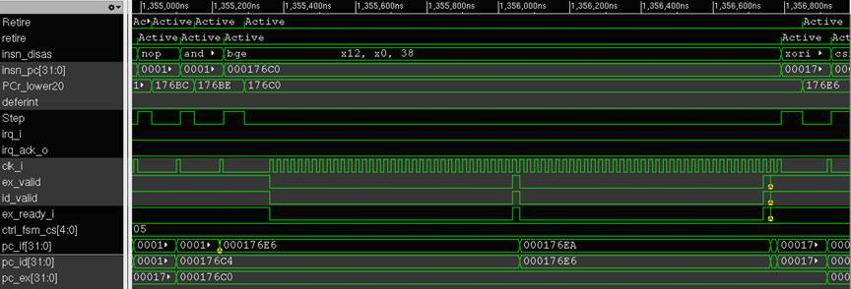
Finding by the em-micro team: BGE Stalls

Slide 4
Progress This Week
Overall,good-but-not-great progress this week.
OpenHW Governance issues:
Request definition of, and TWG-level acceptance of, OpenHW use of use of EDA tools (similar to SWTG Charter).
Several Contributors impacted by non-OpenHW commitments.
Some good news:
Metrics CI regressions are running smoothly are now a significant aid for new code integration.
New Contributor from NXP: Vitor Eschholz.

Slide 5
Status as of 2020-07-27 (1 of 3)
Verification Planning for CV32E40P:
Reviews have started (see “3 of 3” slide).
RV32IMCZ verification:
No updates to RV32IMCZ functional coverage model this week.
Agreement with Imperas on RM upgrades for CV32E40P:
Complete. First PR to integrate updated RM received.
Note: you must request an updated OVPsim license.
Interrupt verification resourced:
Steve Richmond made a bold statement...
Completion of CSR verification (stretch goal):
Mike put some effort on this to aid with RM discussion.
PoR test in place and published strategy for access-mode testing.
Vitor Eschholz has expressed interest in this task.

Slide 6
Status as of 2020-07-27 (2 of 3)
Tangible deliverables for Formal Verification:
OneSpin: Complete. OneSpin will be incorporated into next Sprint.
Axiomise: no discussions this week.
Designer-level debug test integrated and passing
No progress this week, but Oystein is now back from vacation.
Solution for compiling the Compliance Test Suite:
Waiting for Mr. Moore to return from vacation.
Automate testing of Metrics CI regression scripting:
No change from last week. Ready to deploy.

Slide 7
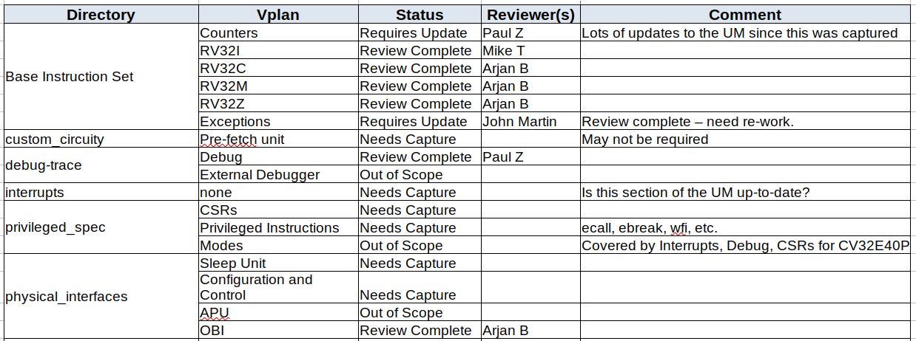
Status as of 2020-07-27 (3 of 3)

Slide 8
Risks & Mitigation
Still have not been able to integrate RISC-V Compliance Test Suite:
Decided against using non-Xpulp toolchain in favor of newly minted CORE-V toolchain.
CORE-V toolchain doesn’t like the Compliance Suite (SW TG is on it).
Original Project Plan called for CSR and Exceptions verification to begin during this time-frame:
No engineering resource available for Exceptions task.
The Google ISG might have capability to partially cover CSRs.
Debug effort restarts this week.
Welcome back Oystein!

Slide 9
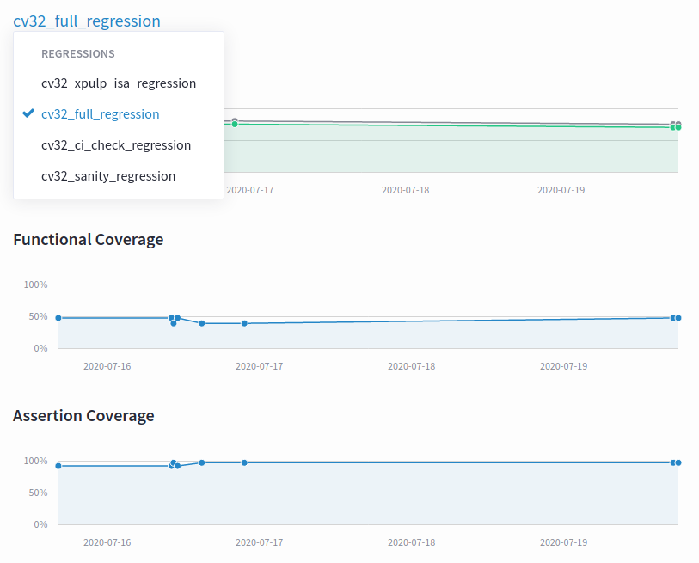
Makefiles, User Regressions and Metrics CI
The included Makefile cv32/sim/Common.mk selects the URL, branch and hash of the RTL code from the cv32e40p repo.
Allows for controlled integration of RTL and TB.
Can be overridden on the command-line: make sanity CV32E40P_HASH=1234567
Recommend we start tagging the RTL soon and using these instead of hashes
Steve Richmond proposed significant set of grades to Makefiles to ease developer’s work lives.
“User Regression” (ci_check):
Now known to be functional for Metrics dsim, Cadence Xcelium (xrun) and Synopsys vcs.
Looking for member support to pipe-clean user regressions with Mentor’s Questa (vsim).
Update: All tests in user regression are expected to pass.
URL for Metrics CI is https://openhwgroup.metrics.ca.
Now supports three Regressions:
cv32_full_regression: all running tests
cv32_ci_check_regression: same tests as user regression
cv32_xpulp_isa_regression: XPULP ISA tests from em-micro
cv32_sanity_regression: no longer runable (but results from previous tests are still available).

Slide 10
Thank You

