Slide 1


CV32E40P* Verification Schedule Status Sprints #3 and #4
Mike Thompson
www.openhwgroup.org
© OpenHW Group
August 3 2020
1

Slide 2
Sprint #3: 2020-07-13 to 2020-07-31
Sprint #3 will produce the following outcomes:
Verification Planning for CV32E40P:
Completion and reviews of all required Vplans.
RV32IMCZ verification:
Complete and reviewed RV32IMCZ functional coverage model
90% functional coverage of RV32IMCZ instructions in regressions.
Agreement with Imperas on RM upgrades for CV32E40P
Implementation of these would be a stretch goal
Interrupt verification resourced.
Completion of CSR verification (stretch goal).
Tangible deliverables for Formal Verification:
OneSpin: integration of SAIL model.
Axiomise: completion (?) of RV32IC ISA verification.
Loose-ends:
Designer-level debug test integrated and passing.
Solution for compiling the Compliance Test Suite.
Automate testing of Metrics CI regression scripting.
Sprint #3 will introduce non gating activities:
Planning and Execution for XPULP verification:
Contribution by EM-US.
Suggesting a separate forked project for this.
Evaluation of SymbioticEDA “mutation tool”:
Trials have been on-going in the back-ground
Hope to incorporate status update this sprint.
Review of Axiomise formal test plan for RV32IC ISA verification.

Slide 3
Status as of 2020-08-03 (1 of 3)
Verification Planning for CV32E40P:
Reviews on-going (see “3 of 3” slide).
RV32IMCZ verification:
RV32IMC functional coverage model integrated.
Mike will take over RV32Z coverage.
Coverage model has a few bugs: measured coverage is 80% but actual coverage is higher.
Agreement with Imperas on RM upgrades for CV32E40P:
Complete. First PR to integrate updated RM received.
Note: you must request an updated OVPsim license.
Interrupt verification resourced:
Complete: Steve Richmond has indicated SiLabs engineer will be assigned.
Completion of CSR verification (stretch goal):
Mike published CSR Vplan; RV32Zicsr Vplan needs review; PoR test in place.
Vitor Eschholz starts this task in Sprint #4 (now).

Slide 4
Status as of 2020-08-03 (2 of 3)
Tangible deliverables for Formal Verification:
OneSpin: Complete. OneSpin will be incorporated into Sprint #4.
Meeting with Axiomise immediately following this update.
Designer-level debug test integrated and passing:
Is this gated by anything anymore?
Oystein Knauserud status:
Debug Vplan updated, expect to issue PR shortly.
Started testcase coding based on previous work from Paul Zavalney.
Solution for compiling the Compliance Test Suite:
Lee Moore return this week from vacation, not last week as reported previously.
Automate testing of Metrics CI regression scripting:
No change from last week. Ready to deploy.

Slide 5
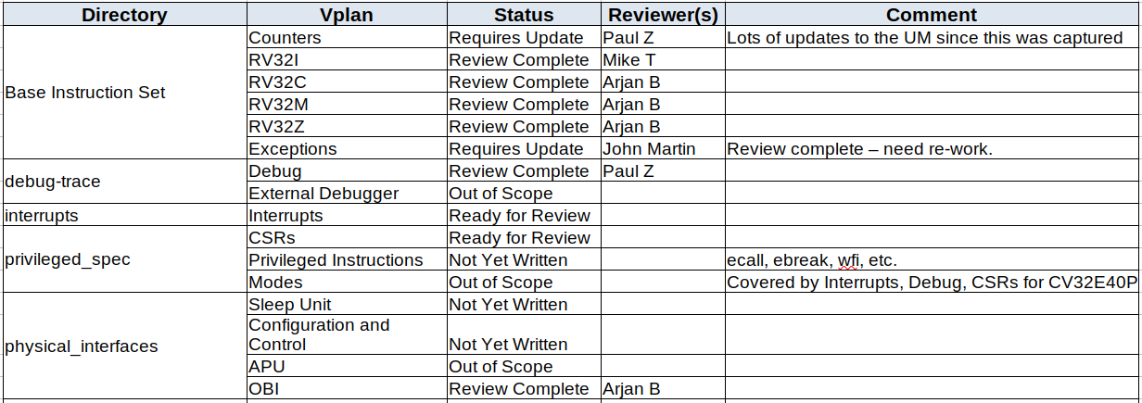
Status as of 2020-08-03 (3 of 3)

Slide 6
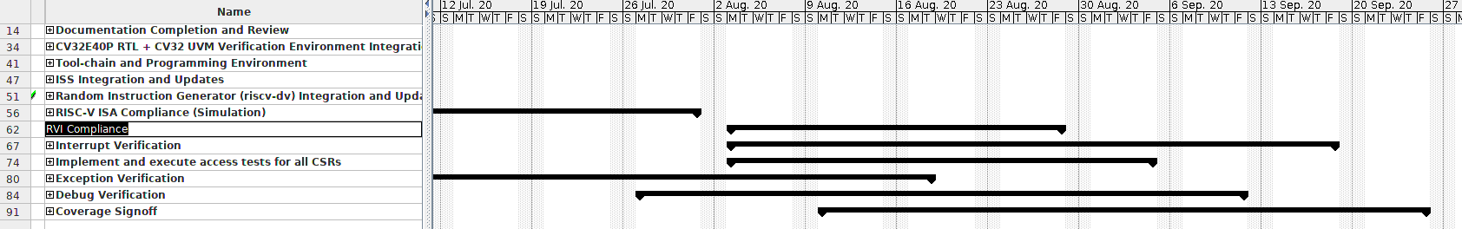
The Big Picture
Now
Tasks that need to start now:
RISC-V ISA Compliance: low risk to not complete on time
RVI (OBI) Compliance: medium risk, plan to staff with Student engineer (who will be on vacation in August).
Interrupt Verification: Steve Richmond owns this and starts this week.
CSR verification: medium risk, has started, jointly owned by Mike T. and Vitor Eschholz.
Exceptions Verification: no engineering resource – high risk task with high potential for bugs.
Debug Verification: medium risk. Oystein Knauserud is active on this.

Slide 7
Sprint #4: 2020-08-03 to 2020-08-21
Simulation Verification:
Completion and reviews of all required Vplans.
RV32IMCZ verification:
Complete and reviewed RV32IMCZ functional coverage model
90% functional coverage of RV32IMCZ instructions in regressions.
Begin active tracking of Functional and Code Coverage Review Data.
Integration of Imperas RM upgrades for CV32E40P.
Debug:
Completion of Directed Testcases as per Debug Vplan.
Running Debug tests against Imperas RM.
Interrupt verification:
Release a reviewed Vplan for interrupts
Complete directed (designer) interrupt tests
UVM Agent for random interrupt assertion/deassertion
Code assertions for interrupts as defined in Vplan
Completion of CSR verification.
Formal Verification:
Reset behavior
Exception mechanism:
Illegal instructions
Breakpoints
ECALL
RV32M ISA
Incomplete work from Sprint #3:
Verification Planning.
RV32IMCZ verification.
Compliance Test Suite.
Integration of Designer-level debug test.
Closure of SymbioticEDA “mutation” finding.
Review of Axiomise formal test plan for RV32IC ISA verification.

Slide 8
Risks & Mitigation
Vplan updates are stalled:
Mike needs to be able to make this a priority for this sprint.
Original Project Plan called for Exceptions verification to begin during this time-frame:
No engineering resource available for this task.
Can we assign this feature to Formal Verification?
Will have a significant impact simulation code coverage of decoder logic.

Slide 9
Thank You

