Slide 1


CV32E40P* Verification Schedule Status Sprint #4
Mike Thompson
www.openhwgroup.org
© OpenHW Group
August 31 2020
1

Slide 2
Administravia
Updated RM has been merged to the master branch:
If you haven’t already, you will need to fetch an updated license (its easy!).
Attendance is now being tracked for all OpenHW Task Group meetings:
This meeting qualifies as an OpenHW Group Task Group meeting.
Eligibility to vote in each committee depends on meeting attendance, as described in the OpenHW bylaws.

Slide 3
Risks & Mitigation
Meeting with the TWG on August 31. Requested two changes to PoR:
Cover Exception Verification with formal-verification only:
TWG asked for additional information regarding coverage, traceability and reproduce-ability
Will arrange future discussions to close on this.
Move date for “RTL Freeze” to 2020-09-25 to 2020-10-30:
This request was not as well received. Discussions on-going.
PR #436 (Adding back HWLoop) has been merged onto the head of cv32e40p.
You will pick it up automatically if you clone the head of the core-v-verif master branch and run a sim.
Anyone who is not using the core-v-verif Makefiles to clone the RTL must take steps to pick up the latest RTL!

Slide 4
Sprint #4: 2020-08-03 to 2020-08-28
Simulation Verification:
Completion and reviews of all required Vplans.
RV32IMCZ verification:
Complete and reviewed RV32IMCZ functional coverage model
90% functional coverage of RV32IMCZ instructions in regressions.
Begin active tracking of Functional and Code Coverage Review Data.
Integration of Imperas RM upgrades for CV32E40P.
Debug:
Completion of Directed Testcases as per Debug Vplan.
Running Debug tests against Imperas RM.
Interrupt verification:
Release a reviewed Vplan for interrupts
Complete directed (designer) interrupt tests
UVM Agent for random interrupt assertion/deassertion
Code assertions for interrupts as defined in Vplan
Completion of CSR verification.
Formal Verification:
Reset behavior
Exception mechanism:
Illegal instructions
Breakpoints
ECALL
RV32M ISA
Incomplete work from Sprint #3:
Verification Planning.
RV32IMCZ verification.
Compliance Test Suite.
Integration of Designer-level debug test.
Closure of SymbioticEDA “mutation” finding.
Review of Axiomise formal test plan for RV32IC ISA verification.

Slide 5
Simulation Status as of 2020-08-28
Vplans:
No activity this week.
RV32IMCZ verification:
RISC-V Compliance Test-suite fully integrated into core-v-verif.
As expected, this had almost no impact on coverage.
80% functional coverage of RV32IMCZ instructions in regressions.
Poor results largely driven by low CSR instruction coverage and known bugs (in coverage model).
Active tracking of Functional and Code Coverage:
Functional coverage tracking in place for some weeks.
Worked with Metrics to integrate automatic code coverage collection/merging in regression.
Still no joy on this front.
Integration of Imperas RM upgrades for CV32E40P:
Essentially complete – please update your licenses.
Debug:
Directed test passing with RM up to debug entry
Working with Imperas to resolve issues
Interrupt verification:
Release issue #460 : CSR checks fail during interrupted div instruction - Have local workaround to proceed with interrupt testing
Added corev-dv streams for changing MIE and MSTATUS.MIE in-flight
Lots of random interrupt tests passing (!)
Some random failures with WFI – debugging
Functional coverage with interrupts released – more to do
CSR verification
Waiting on core-v-docs PR #172.

Slide 6
Formal Status as of 2020-08-24
One Spin Plan:
Verification planning:
RV32M, RV32 Zicsr & Zifencei formal verification plans were submitted under the pull request https://github.com/openhwgroup/core-v-docs/pull/169
RV32 Exception mechanism without interrupts to be done in the next sprint.
Verification activities:
All tasks of the this sprint have WIP status
RV32Z and the memory instructions of the RV32I & RV32C to be verified in the next sprint.
Axiomise RISC-V Toolkit:
Axiomise has provided a copy of their RISC-V ISA toolkit verification plan.
I will review with Arjan/Davide this week.
OpenHW must treat this as confidential information (it cannot be published on GitHub).
Axiomise will re-run toolkit when PR#436 is merged and again when an “RTL Freeze” tag is available.
No formal update this week

Slide 7
Tasks from Previous Sprints
Verification Planning: progressing
RV32IMCZ: progressing
Compliance Test Suite:
This is now complete
Integration of Designer-level debug test:
In regression, not yet integrated with RM.
Closure of SymbioticEDA “mutation” finding:
No activity this week.

Slide 8
Program Note
This marks the end of Sprint #4:
Typically that would imply the definition of Sprint #5 at this time.
Given the state of Vplan reviews, Functional and Code coverage, it is clear that we will not achieve RTL Freeze by 2020-09-25.
Mike presented a new plan to the TWG on 08-31 to define a new date for RTL Freeze.
More discussions with (co)-chairs and Design leads to follow.
Possibility of extra resource?
The definition of Sprint #5 and future Sprints will be done pending the outcome of these discussions.
The team can focus on outstanding work from Sprints #3 and #4 in the meantime.

Slide 9
Test Specification Updates
For directed and random tests, provide single target in each simulation Makefile
Provide standard way to pass runtime arguments, select generator options
Initial PR: (xrun and vsim) https://github.com/openhwgroup/core-v-verif/pull/213
Maintaining backwards-compatible test targets in short-term
Extensible to timeouts and other specialized options
Each test lives in its own directory with YAML files
test.yaml -> Test specification
corev-dv.yaml -> Random generator specification
Test directories:
cv32/tests/core/corev-dv
cv32/tests/core/custom
cv32/tests/core

Slide 10
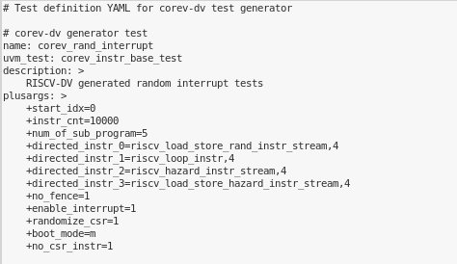
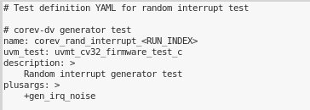
Test Specification Updates

Slide 11
Makefiles
Uniform variables across all simulator makefiles
TEST variable => Sets a test
For running a test, this would be the makefile target today (e.g. interrupt_test, hello-world)
COMP => Defaults to 1, set to 0 to skip a compile (in execution)
START_INDEX => Defaults to 0, valid for generation, sets index of gen
NUM_TESTS => Defaults to 1, valid for generation, generate <n> tests
RUN_INDEX => Defaults to 0, valid for execution, sets index of test to run
SEED => Defaults to 1, set a random seed, applicable to riscv-dv generation and test

Slide 12
Makefiles
Uniform targets across all simulator makefiles
comp => Compile the testbench snapshot
test => Compile and run a test
comp_riscv-dv => Compile riscv-dv snapshot
gen_riscv-dv => Run riscv-dv generation
waves => Run post-process waveform views
cov => Run post-process coverage viewer/reporting
Targets should be stackable – i.e. can run multiple targets sharing variables in same make

Slide 13
Makefile Examples
Run the hello-world and view post-process waves
% make test TEST=hello-world WAVES=1
% make waves TEST=hello-world
Compile and generate two tests (index 0 and 1) of the corev_rand_interrupt test (cloning riscv-dv snapshot if necessary)
% make comp_riscv-dv gen_riscv-dv TEST=corev_rand_interrupt START_INDEX=0 NUM_TESTS=2
Execute the corev_rand_interrupt test using test index 1 generated above and view post-processed waves
% make test TEST=corev_rand_interrupt RUN_INDEX=1 WAVES=1
Results are in <sim>_results/corev_rand_interrupt_1
% make waves TEST=corev_rand_interrupt RUN_INDEX=1

Slide 14
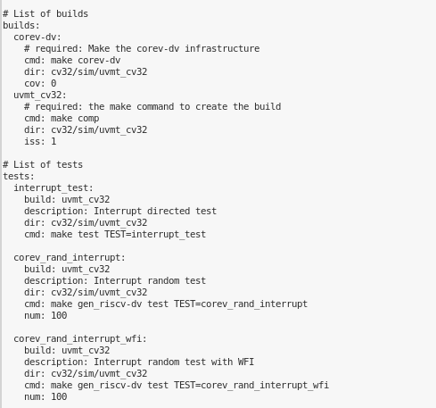
cv_regress
General purpose regression flow to enable YAML regression scripts
cv_regress does not run regression, but builds scripts/input files to other run managers
Users can write Jinja templates to build generators
Examples:
cv32/regress/cv32_interrupt.tcl

Slide 15
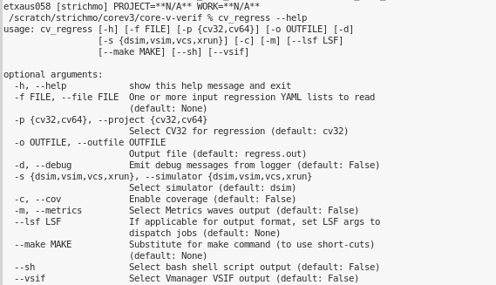
cv_regress
Supported output targets:
Metrics JSON
Shell script (no parallelization)
Vmanager VSIF

Slide 16
Thank You

