Slide 1


CV32E40P* Verification Schedule Status Sprint #5
Mike Thompson
www.openhwgroup.org
© OpenHW Group
September 14, 2020
1

Slide 2
Administravia
Attendance is now being tracked for all OpenHW Task Group meetings:
This meeting qualifies as an OpenHW Group Task Group meeting.
Eligibility to vote in each committee depends on meeting attendance, as described in the OpenHW bylaws.
The CORE-V CVA6 project is gearing up for a Preliminary Project Launch:
Check out discussion on MatterMost: https://mattermost.openhwgroup.org/all-users/channels/twg--cores--cva6
New method of specifying/organizing test-programs and simulations is now “live” on core-v-verif:
See slide "Test Specification Updates" in the 2020-08-31 CV32E40P project update.
If you have any questions or issues please reach out to me or Steve Richmond.

Slide 3
Risks & Mitigation
Request made to TWG to cover Exception Verification with formal-verification only:
TWG asked for additional information regarding coverage, traceability and reproduce-ability
Mike to review formal DV plans with OneSpin this week.
Em-micro has indicated they may be in a position to assist with simulation verification of Exceptions:
Mike and em-micro team to close review of Exceptions DV plan today.
Verification Plans are still not closed:
Mike to dedicate himself to this task over the next Sprint.
The good news: good progress this past week.
The bad news: performance counter DV plan looks more complex than anticipated.
CSR verification is no longer staffed.

Slide 4
Sprint #5: 2020-09-07 to 2020-09-25
Simulation Verification:
Completion and reviews of all required Vplans.
“Complete” verification of all major features:
RV32IMCZ
Debug
Interrupts
CSRs
Completion of the “test spec” updates:
Full Metrics support for new directories
Script generation of .metrics.json
Integration of Exception tests from em-micro
Ability to collect/report Functional and Code coverage data with both MetricsCI platform and with Cadence Xcelium.
Coverage collection support for other simulators will rely on Member interest.
Formal Verification:
Reset behavior
RV32IMCZ
Exception mechanism:
Illegal instructions
Breakpoints
ECALL

Slide 5
Simulation Status as of 2020-09-14
Vplans:
Reviews of Exceptions and Performance Counters.
RV32IMCZ verification:
No specific effort over past week.
Active tracking of Functional and Code Coverage:
Deployed JasperGold formal tools to automatically refine out PULP, FPU, code coverage when using Xcelium.
Debug:
Lots of work with reference model.
Expect to have directed test(s) all passing by the end of this week.
Coverage model is progressing:
Expect to integrate first pass this week.
Interrupt verification:
WFI random fixes (all TB and corev-dv related).
Corner case fixes to interrupt assertions
Issue #503: Issues with CSR clear of MIE before interrupt.
CSR verification:
Significant update to User Manual PR #172.

Slide 6
Formal Status as of 2020-09-14
One Spin Plan:
RV32IC unprivileged: “almost done”
RV32M: MUL progressing well, DIV on-going
Zicsr: complete except for counters
Zifencei: flush not fully verified
Counters: still open
Reset: covered RISC-V spec requirements for CSR reset
Exceptions: (excluding debug mode):
Illegal, ecall, ebreak ad mret done
Interrupts: on-going
OBI: started
Axiomise RISC-V Toolkit:
Lots of discussion between OpenHW (Arjan) and Axiomise (Ashish) this past week:
Is the review closed?

Slide 7
Tasks from Previous Sprints (which we are not forgetting about)
Verification Planning
Mike is happy with his progress on this last week.
RV32IMCZ coverage closure
Do not expect to get to this for another week
Closure of SymbioticEDA “mutation” finding
Can I book a meeting to discuss this?
Close review of Axiomise formal plan
Done?

Slide 8
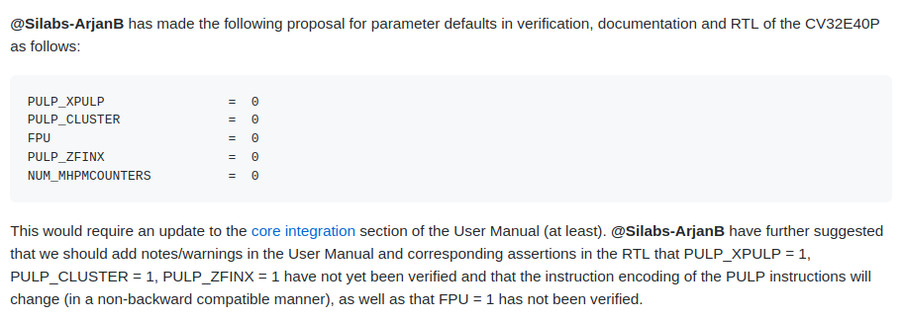
Hot Topic #1: Default parameters
CORE-V-DOCS GitHub Issue #189: Default parameter configuration for CV32E40P
Latest update to this Issue recommends NUM_MHPMCOUNTERS = 1

Slide 9
Hot Topic #2: CSR Updates
Several read-only unprivileged shadow CSRs of machine mode CSRs introduced:
cycle(h), instret(h), hpmcount(h)[3..31].
These are not modeled in Reference Model – are directed tests sufficient to cover these?
CV32E40P Performance Counters:
Until last week, these were not captured in DV plans.
Significant hole in our verification project plan.
Arjan has donated a directed test which Mike will integrate today.

Slide 10
Hot Topic #3
The Interrupt and Debug testcases rely on features of GCC 9.3.0 as this is used by SiLabs.
Specifically, attributes for writing an interrupt handler:
__attribute__((interrupt ("machine"))) void m_software_irq_handler(void);
This tells the compiler to insert stacking calls around the C function so that it can be used in C as an interrupt handler.
The PULP toolchain is based on GCC 7.1 which does not have complete support for this attribute.
The SiLabs team wishes to continue using the up-to-date toolchain.
OpenHW does not want to support multiple toolchains for CORE-V functional verification.

Slide 11
Thank You

