Slide 1


CV32E40P* Verification Schedule Status Sprint #6
Mike Thompson
www.openhwgroup.org
© OpenHW Group
October 8, 2020
1

Slide 2
Administravia
Attendance is now being tracked for all OpenHW Task Group meetings:
This meeting qualifies as an OpenHW Group Task Group meeting.
Eligibility to vote in each committee depends on meeting attendance, as described in the OpenHW bylaws.
Verification environment for CORE-V CVA6 has been integrated into CORE-V-VERIF:
CVA6 is a 6-stage “Application” core. Specification is at: https://cva6.readthedocs.io/en/latest/
CVA6 and FORCE-RISCV projects are looking for teams to drive projects toward their formal Project Launch.
“RTL Freeze” is coming:
We will be introducing the Checklist for “Functional RTL Freeze” in this meeting.

Slide 3
Functional RTL Freeze: Definition
‘Functional RTL Freeze’ means that:
IP is complete, functionally correct, validated against a specific software toolchain and ready to be used in a commercial-grade product.
The Specification, Design and Verification are complete and self-consistent.
Third-parties can obtain the specific version of the IP that meets the milestone criteria.
Functional RTL Freeze is defined by a Checklist (spreadsheet) that records the status of the IP:
Documentation
Design
Verification
Software
Thanks to everyone who contributed their expertise to creating this checklist.
Pull-request #221 was created today to add the checklist to CORE-V-DOCS

Slide 4
Achieving Functional RTL Freeze
This is new ground for OpenHW Group:
Industrial organizations handle this in different ways.
My recommendation is to assign each functional team to track their status against the Checklist:
Documentation: CTG
Design: CTG
Verification: VTG
Software: SWTG
We need to assign a specific individual to have oversight of the effort to complete the Checklist.

Slide 5
Tracking Verification Status to Functional RTL Freeze
Four Primary Methods:
Checklist (discussed in the previous two slides)
Completeness of Verification Plans
Issues (Documentation, Design and Verification)
Coverage Reports
The first three are easy for all to see on GitHub.
Steve and Mike are working on a way to publish coverage data for the community to easily see.

Slide 6
Verification Plans
Current status of simulation Vplans is provided at https://github.com/openhwgroup/core-v-docs/tree/master/verif/CV32E40P/SimulationVerificationPlan
Will start tracking the formal Vplans next week
Current “holes” in the simulation Vplans:
Zifence and Zifence.i: strategy for testing in place. Thanks to Dr. Schiavone for input on this.
CSRs: lots of work over the past week – need to document it all.
OBI: Vplan ready for review
Sleep Unit and Pipelines are not started(!)

Slide 7
Issues
CORE-V-DOCS:
16 open issues
6 related to PULP ISA and therefore not gating CV32E40P
Remaining almost evenly split between Vplan and User Manual
CV32E40P:
49 open issues (not all RTL)
19 are already waived for CV32E40P
CORE-V-VERIF:
31 open issues
15 are “tasks”

Slide 8
CV32E40P Code Coverage – 10/8/20
Steve Richmond steve.richmond@silabs.com
© OpenHW Group
August 2020
<number>

Slide 9
Refinements Applied
DUT
All PULP parameters set to 0
NUM_MHPMCOUNTERS set to 1
Hierarchical
Removes all but core_i in code coverage
Auto
Uses JasperGold UNR to filter “dead code” (due to PULP*=0)
Manual
None-yet
© OpenHW Group
August 2020
<number>

Slide 10
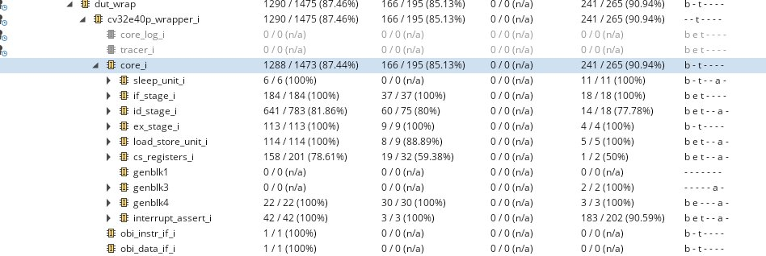
Refinements Applied
© OpenHW Group
May 2020
<number>

Slide 11
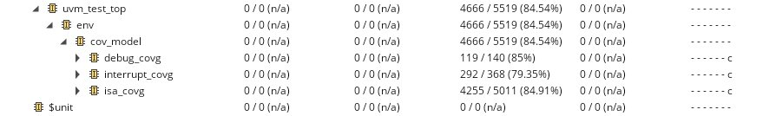
Functional Coverage
© OpenHW Group
May 2020
<number>

Slide 12
Thank You

