Slide 1
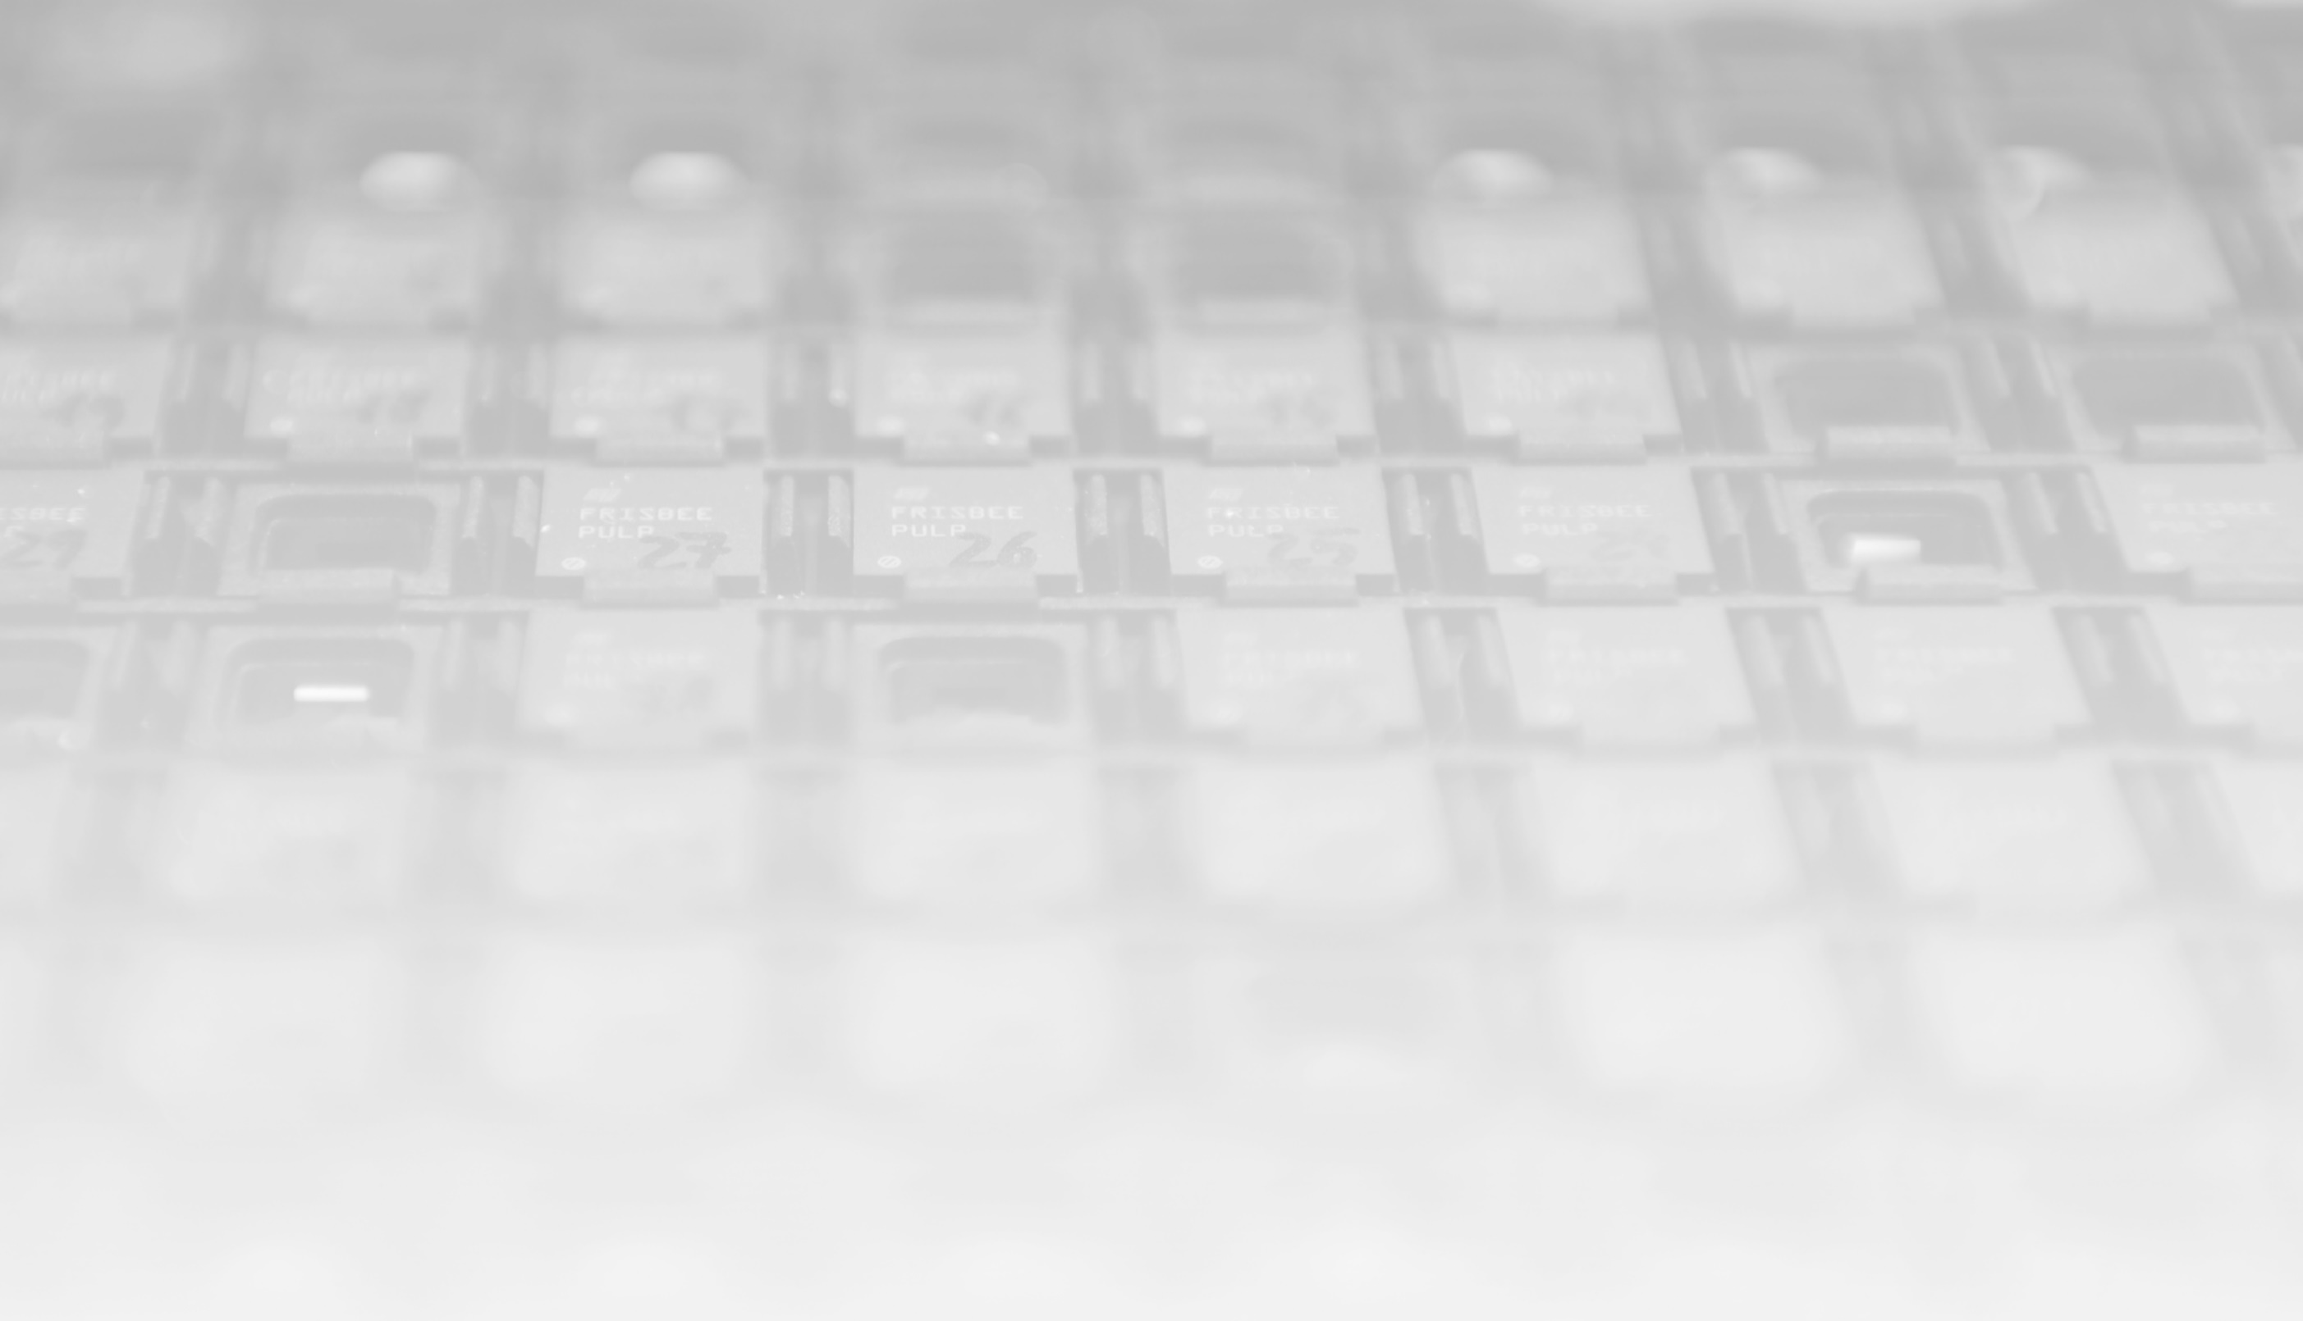

CV32E40Pv2 status
Pascal Gouédo
Yoann Pruvost

Slide 2
Project
Project
Design & Verification meeting
Wednesday 14:00 CEST every 2 weeks(Ical)
Dedicated technical meetings when needed
Reporting to Cores TG
Next: Make a mid-term schedule
Mattermost channels
TWG : Cores : CV32E4*P
TWG : Verification
Resources
Pascal Gouédo
Specification, Design, Verification
Yoann Pruvost
Design, Verification (core-v-verif & Formal)
1 Sub-contractor
Formal Verification (with OneSpin support)
OpenHW staff
Mike
Verification environment lead
Technical support
Davide
Architecture & Design technical support

Slide 3
Documentation
Specification
PR #452: PULP instructions re-encoding table proposal
Approved and merged
PR #704: Documentation updated with PULP instructions re-encoding
Reviewed, approved and merged in cv32e40p/dev
Next : Hardware loops
Add more details about constraints and behavior
Analyze all HWLoops issues (#266, #583, #584, #598, #618)
Specify behavior with respect to Interrupt and Debug

Slide 4
Design
PR #707 (FPU integration in cv32e40p wrapper)
Waiting for review and merge
Crossed FPU and OBI Data latencies uncovered:
4 cases of GPR/CSR multiple/out-of-order write per instruction
Multiple APU request generation per FPU instruction
⇨ Started to describe each case in issues but need core-v-verif/cv32e40p hash to finalize (next slide)

Slide 5
Verification
E40P core-v-verif environment
New Tracer to cope with OBI Data latencies (cv32e40p PR #699)
FPU move to cv32e40p + configurations management (core-v-verif PR #1274 depending on cv32e40p PR #707)
Waiting for review and merge
Environment fixes (core-v-verif PR #1273) ⇨ Merged
RVFI support in E40P core-v-verif environment
Ci basic test passing with rvfi/rvvi env
Waiting for Pascal’s PR to be merged before merging and issuing mine
Once done, correct other CI tests
https://github.com/YoannPruvost/cv32e40p/tree/dev_rvfi
https://github.com/YoannPruvost/core-v-verif/tree/cv32e40p/dev_rvfi

Slide 6
Formal Verification
CV32E40P
RV32IMC
No rule violation
PULP instruction
Started to make sail descriptions
FPU
Use of unofficial cv32e40p_wrapper (Core + Fpnew) with OneSpin tools
Starting to verify RV32F (all but DIV/SQRT)

Slide 7
Tools
SW toolchain
Embecosm business contract finalized (first step)

Slide 8
Miscelaneous
Pull Request/Reviews/Merge
Turn-around time is way too long
Decreases a lot our productivity
Especially when multiple inter-dependent PR
And with our E40P/FPU formal verification sub-contractors

