Slide 1


CV32E40Pv2 status

Slide 2
Project
Project
Design & Verification meeting
Wednesday 14:00 CEST every 2 weeks(Ical)
Dedicated technical meetings when needed
Reporting to Cores TG
Next: Make a mid-term schedule
Mattermost channels
TWG : Cores : CV32E4*P
TWG : Verification
Resources
Pascal Gouédo
Specification, Design, Verification
Yoann Pruvost
Design, Verification (core-v-verif & Formal)
Xavier Aubert
Verification leader
1 Sub-contractor
Formal Verification (with OneSpin support)
OpenHW staff
Mike
Verification environment lead
Technical support
Davide
Architecture & Design technical support

Slide 3
Documentation
Specification
Next
Add a Revision History section
Some analysis & cleanup
privlv, uhartid,…
Add MSTATUS.FS & MSTATUS.SD (once common agreement reached)
Move from PULP_ZFINX to RISC-V Zfinx
Hardware loops
Add more details about constraints and behavior
Analyze all HWLoops issues (#266, #583, #584, #598, #618)
Specify behavior with respect to Interrupt and Debug

Slide 4
Design
PR #716 (Move cv32e40p_fp_wrapper from bhv to rtl)
Merge to be done
FPU test execution highlighted missing MSTATUS.FS & MSTATUS. SD
Issue to be created & to be corrected (once common agreement reached)
Re-encoded PULP LD/ST and General ALU/Bit Manipulation/MAC RTL available for internal Formal verification
Crossed FPU and OBI Data latencies uncovered:
4 cases of GPR/CSR multiple/out-of-order write per instruction
Multiple APU request generation per FPU instruction
⇨ Started to describe each case in issues

Slide 5
Verification (1)
E40P core-v-verif environment
All on-going PR merged (1273, 699, 1274)
PR #1340 (step-and-compare update with F extension CSRs) created & merged
Added F extension enable function in floating point test
Showed missing MSTATUS.FS & SD
Test ok with OBI stall disabled (no CSRs & full RF check)
All FPU instructions need to be added to ISA Coverage
XPULP re-encoded instruction
Added ISS options to enable XPULP v2
ISS requires privlv and uhartid non RISC-V CSRs
To be removed from ISS or parametrized with PULP_SECURE?
pulp_post_increment_load_store (re-encoded) execution shows tracer & step-and-compare are missing second GPR write functionality
Google RISC-DV
Started to add XPULP instructions

Slide 6
Verification (2)
RVFI support in E40P core-v-verif environment
Ci basic test passing with rvfi/rvvi env
Waiting for Pascal’s PR to be merged before merging and issuing mine
Once done, correct other CI tests
https://github.com/YoannPruvost/cv32e40p/tree/dev_rvfi
https://github.com/YoannPruvost/core-v-verif/tree/cv32e40p/dev_rvfi
Next
Add Imperas Floating Point compliance tests in core-v-verif
Switch E40Pv2 test-bench to RVVI/Imperas-DV framework once fully functional on E40X

Slide 7
Formal Verification
CV32E40P
RV32IMC
No rule violation
PULP instruction
Sail descriptions finalized
LD/ST rules verified at 70%
FPU
Started to verify RV32F (all but DIV/SQRT)
13 rules violations up to now due to
F instructions decoding
F instructions result impact on pipeline
FFLAGS not correctly set

Slide 8
Tools
SW toolchain
Embecosm business contract finalized
Toolchain development for re-encoded PULP instruction will start on September 1st, 2022
Deliveries:
October 1st
Establish baseline RV32IMFCZcisr functionality, test and benchmarking environment
Implement the PULP 8- and 16-bit SIMD extensions
November 1st
Implement the PULP bit manipulation extensions
Implement the PULP 8- and 16-bit SIMD ext
December 1st
Implement Zfinx support
Benchmarking
Later on
Hardware Loop support
…

Slide 9
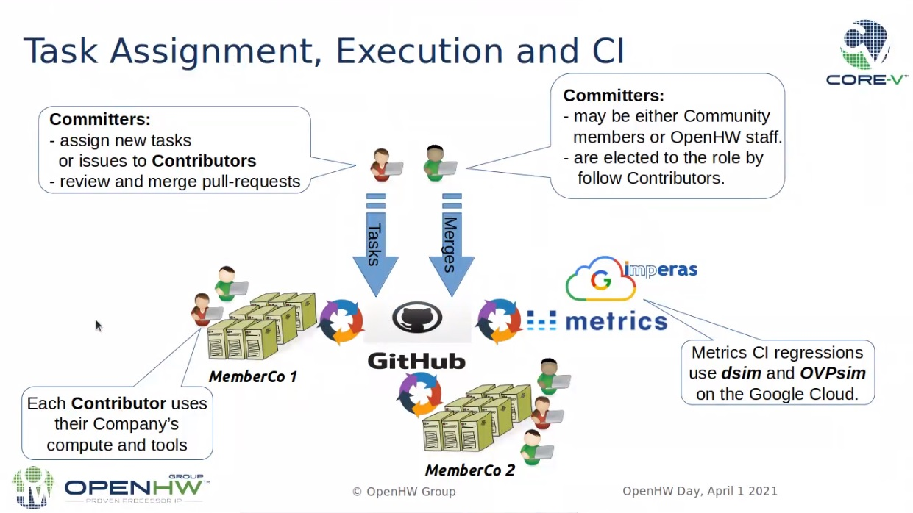
Miscelaneous
Pull Request/Reviews/Merge
Turn-around time is way too long
Decreases a lot our productivity
Especially when multiple inter-dependent PR
At least one Dolphin people should be able to be a “Committer” on core-v-verif and cv32e40p OpenHW github repos

