Slide 1


Integrating CVA6 Core IP
into CORE-V-VERIF
Mike Thompson
mike@openhwgroup.org
© OpenHW Group
April 16, 2021

Slide 2
Goals
Align CVA6 verification with the methods being used to verify the “E-class” CORE-V cores (cv32e40p, cv32e40s, cv32e40x).
Clairify the scope of the CVA6 to the OpenHW Group and open-source communities.
Set the CVA6 core IP on the path to “industrial grade” verification.
Support continued development of the “CORE-V APU FPGA platform” with minimal disruption.
April 16, 2021

Slide 3
Achieving the Goals
Agree on the scope of the IP for “CVA6 core IP”:
This presentation assumes this step has been completed (see next slide).
Restructure the CVA6 repository to explictly separate the “CVA6 core IP” and “CORE-V APU FPGA platform”.
Develop a “core testbench” for the CVA6.
Integrate the CVA6 above core testbench into the core-v-verif UVM environment.
April 16, 2021

Slide 4
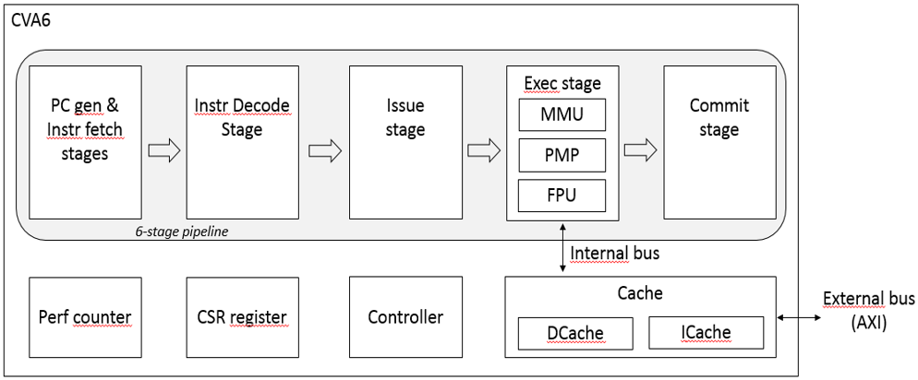
Scope of the CVA6 IP
April 16, 2021

Slide 5
Restructing the CVA6 Repository
Why is this necessary?
The current structure supports a “CORE-V APU” FPGA platform with many peripherals that are extraneous to the core itself.
This adds risk to the effort to fully verify the core as APU peripherals may inhibit controlability of the core.
The code of the core is heavily interwined and dependent on the APU and visa-versa. This makes it difficult to port the core to other platforms.
Core-v-verif is a verification environment for cores, not platforms.
April 16, 2021

Slide 6
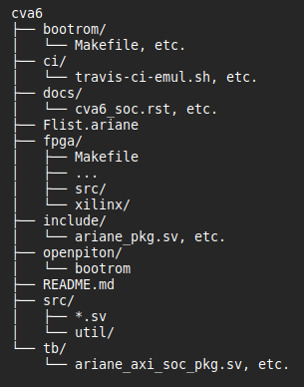
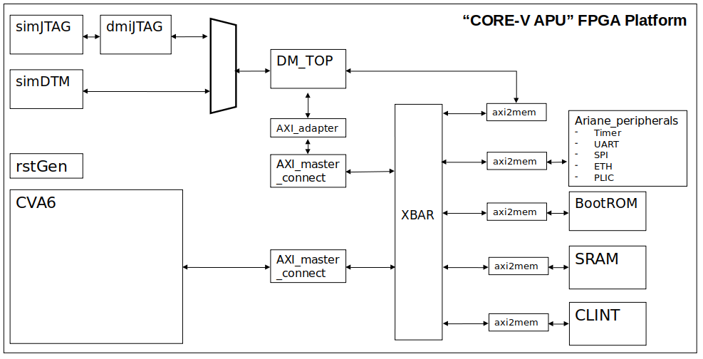
Where is the CVA6 “core” in the CVA6 repo?
??
??
April 16, 2021

Slide 7
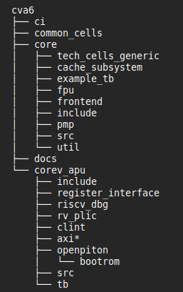
Seperating “core” and “apu” in the cva6 repo
April 16, 2021

Slide 8
This is a complex restructing
The ‘clean’ seperation on the previous slide cannot be done by merely moving around a few directories.
There are several dependancies between the core, soc and tb that must be resolved.
Many files in the (not just directories) will need to be moved.
Goal: make this transition transparent to CORE-V APU FPGA platform users.
Prototyping being done at: https://github.com/MikeOpenHWGroup/cva6 (on “cva6_core_only” branch).
April 16, 2021

Slide 9
Several Open Questions
Location of “common_cells”:
Either top of cva6 repo or at cva6/core/common_cells.
Should the core have an “example_tb” in cva6/core/example_tb?
Need separate manifest files for core and apu.
APU Makefiles must use both.
When will it be safe to cut-over to new structure?
“Make before break”
April 16, 2021

Slide 10
Recently Asked Questions
Does this mean two verification environments?
Yes. One for the CVA6 core and another for the CORE-V APU FPGA.
Who manages the two verification environments?
CVA6 core: Verification Task Group.
CORE-V APU FPGA: Hardware Task Group.
What methodolofy and tools are used for CVA6 core IP verification?
SystemVerilog/UVM.
Random Instruction Stream Generator: recommend we keep using Google.
Reference Model: TBD.
Same Makefiles/YAML testcase control and CI flow used by core-verif.
What methodology and tools are used for CORE-V APU FPGA verification?
Whatever satisfies the verification requirements of the APU.
Decided by HW TG and the APU team.
April 16, 2021

Slide 11

CVA6 CORE Testbench
Modeled after the CV32E40* core testbenches
RISC-V Compliance Tests
User Tests
etc...
Instruction & Data
memory model
Memory Mapped
Virtual Peripherals
riscv-gcc-toolchain
Memory
model
CVA6
Core
RTL
vp
addr
GCC
compile
elf2hex
I&D
data
testcase.S
irq/dbg
crt0.S,
syscalls.c,
link.ld,
etc.
“board support package”
SystemVerilog
“CORE” testbench
April 16, 2021

Slide 12
Creating the CVA6 Core Testbench
The easy part:
The SystemVerilog core testbench itself is very simple.
Almost a copy-n-paste from CV32E40* versions (with different interfaces, of course).
The hard part:
Board Support Package (not my area of expertise).
Will be more complex than the CV32E40* versions.
Can we start with a simple one based on CV32E40* capabilties?
April 16, 2021

Slide 13
Virtual Peripherals
A complete set of required VP capabilties cannot be known until the DV plan is complete, but we can define the minimum set based on CV32E40:
Virtual UART.
Simulation status flags (test complete, test-pass, test-fail).
Signature writer (required by Compliance).
Driver for irq and debug_req.
The BSP must know where these are.
See https://core-v-docs-verif-strat.readthedocs.io/en/latest/sim_tests.html#virtual-peripherals for a complete description.
April 16, 2021

Slide 14
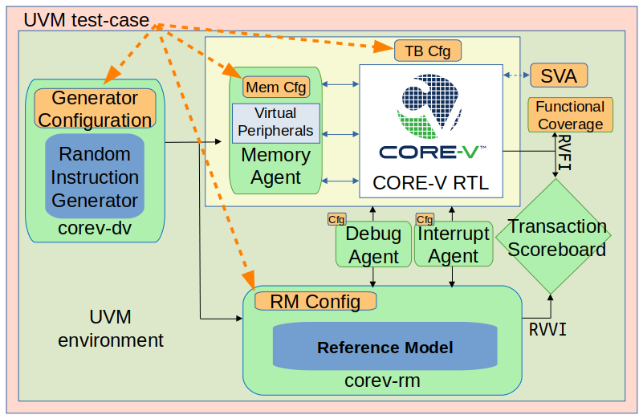
The CORE TB integrates into the UVM Environment
“CORE” testbench
The CORE TB and its associated BSP and TB Cfg are the ‘abstract core DUT’ for the UVM environment:
Random Instruction Generator only understands ISA.
Toolchain only understands BSP.
Functional coverage and scoreboarding only understand RVFI.
Of course, its never that simple:
Implementation of RM for CVA6 is open question.
Details of Debug and Interrupt verification always create problems.
Many key features of CVA6 are not currently supported by core-v-verif.
April 16, 2021

Slide 15
How To Get Started?
First, agree on an updated CVA6 repository:
Agree to restructure or not.
If yes, agree on structure.
Once we have an agreement, the rest is “just work” (and is already started).
Second, build the CVA6 core testbench:
Will need help from Thales s/w team for BSP. Embecosm may also be able to help.
Decide on test-case goals for core testbench:
‘hello world’
Compliance
Other tests?
Third, integrate into UVM environment:
Premature to discuss details at this point.
April 16, 2021

Slide 16
Open Issues
What is the implementation technology of for the Reference Model?
Imperas:
Is Imperas is interested in supporting CVA6?
Single-source solution.
Spike:
Considerable effort required to extend Spike into a RM suitable for complete CVA6 verification.
Discussions on-going with Silicon Labs and the Barcelona Supercomputer Centre.
Core-v-verif does not currently have an RV64 functional coverage model.
How to port RISCV-DV tests already developed to core-v-verif tests for CVA6.
April 16, 2021

Slide 17
Thank You!
© OpenHW Group
April 16, 2021

