Slide 1


CVFPU
Pascal Gouédo
Mike Thompson

Slide 2
Origin
FPnew developed by ETH
Donated to OpenHW group in May 2022 to become CVFPU
Support different Floating-Point precisions, formats, Packed-SIMD, pipeline stages, Implementation through parameters.

Slide 3
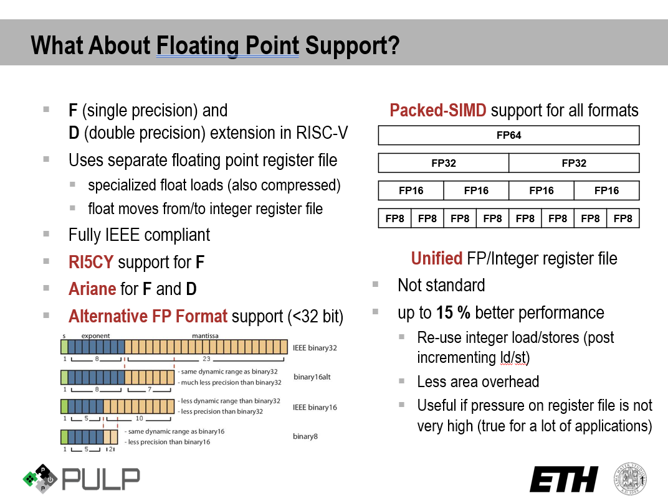
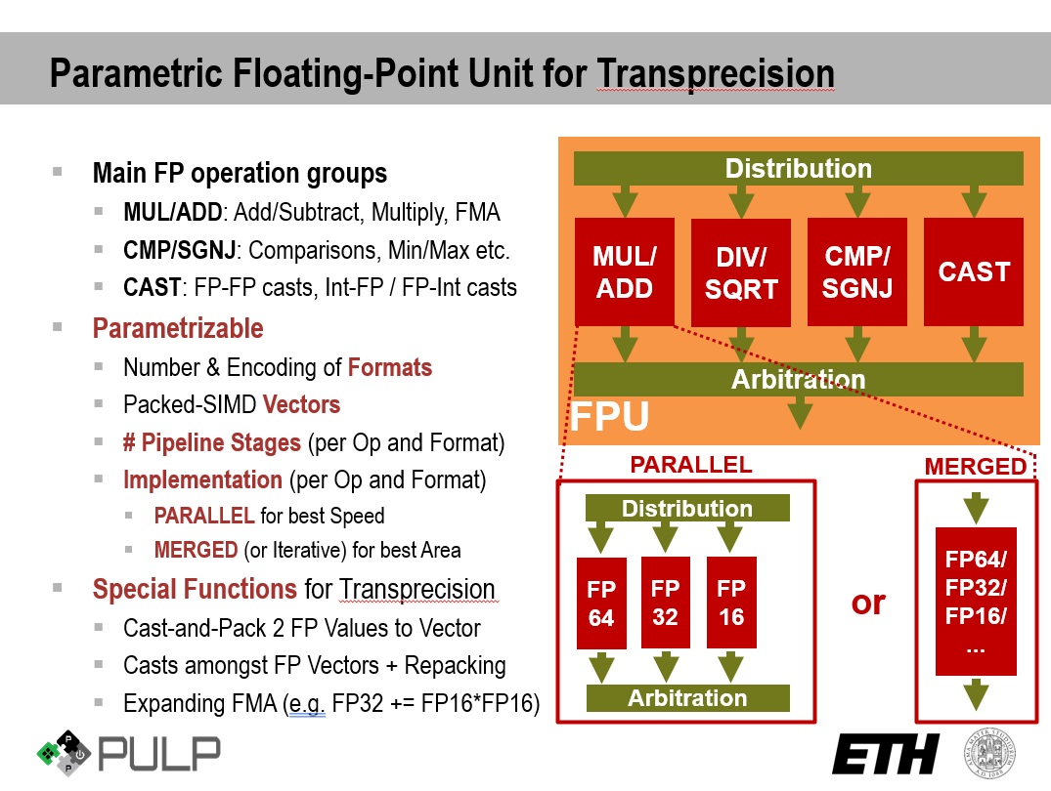
Documentation & Parameters
Specification
https://github.com/openhwgroup/cvfpu/blob/develop/docs/README.md

Slide 4
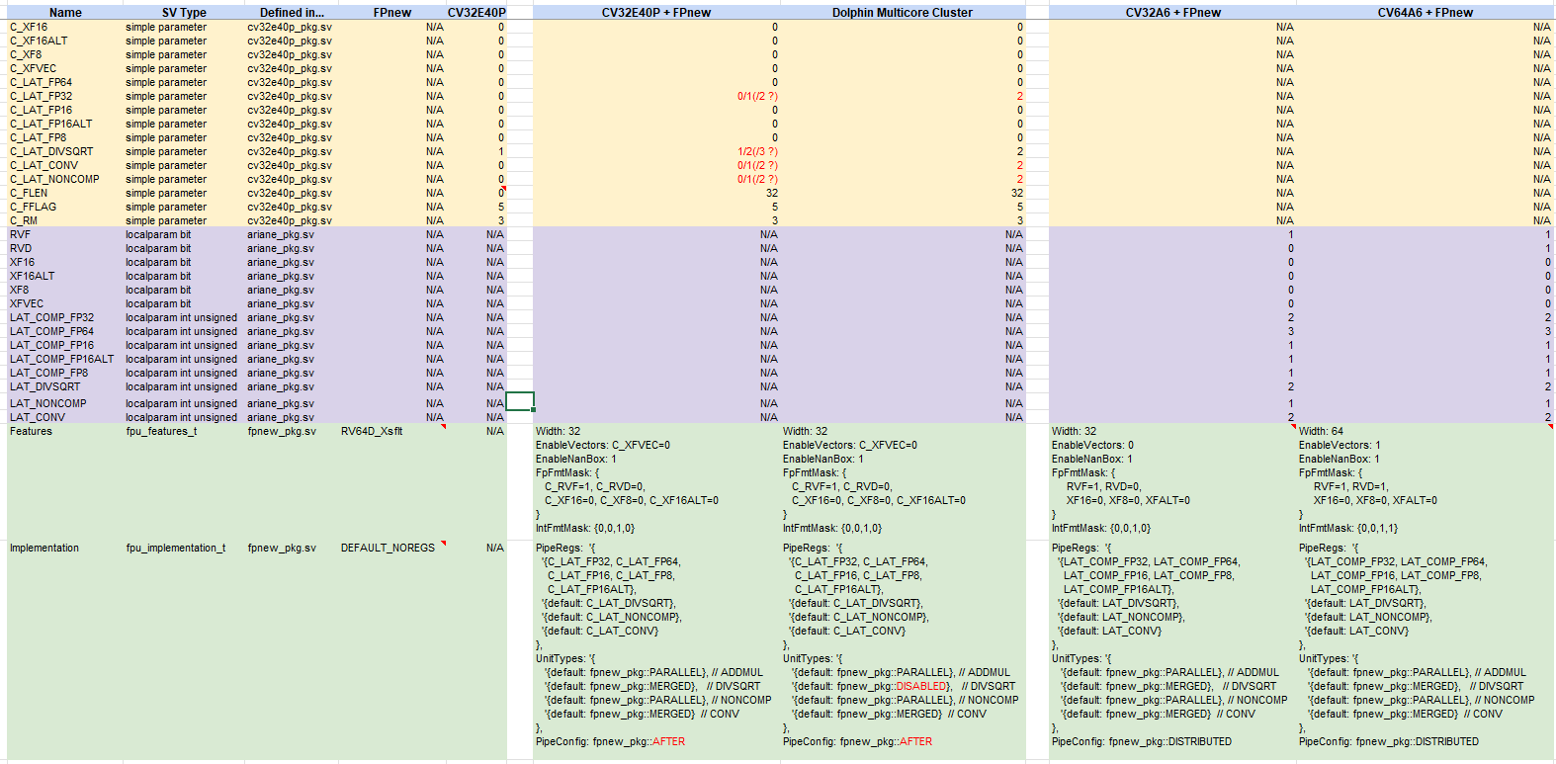
CVFPU configurations for CV32E40Pv2 and CVA6

Slide 5
Verification
Formal Verification
OneSpin proposes 2 Formal Verification App
RISC-V Processor Verification App with F extension
Floating-Point App (all instructions but DIV/SQRT)
As FP instructions decoding is done inside CV32E40P core and controls are propagated to CVFPU through APU interface, Processor app will be run on a CV32E40P + CVFPU wrapper.
CV32E40P core-v-verif environment
DIV/SQRT will be verified using core-v-verif and RISC-V DV test generator.

Slide 6
CVFPU status
DIV rounding modes and flags are not respecting IEEE 754 in some corner cases.
ETH is currently evaluating it and testing new DIV/SQRT unit coming from the T-head open core to replace actual one.
Formal verification started in June 2022 and should last until end of August 2022.
DIV/SQRT : Sync-up with Thales (and ASTC-Design?)

