Slide 1


CV32E20 Plan Approved Review
Joe Circello (NXP), Lee Hoff (Intrinsix),
March 27, 2023

Slide 2
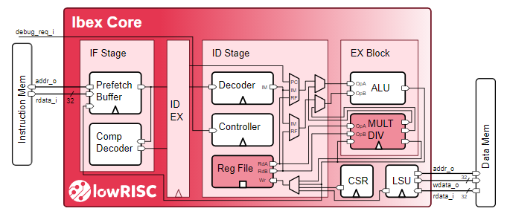


CV32E20 Project Details
Project summary
Ultra-low-end core cloned from Ibex (fka ETH-Zurich ZeroRISCY)
Targeted at the low-end of RISC-V MCU roadmaps
Any “compute constrained socket”
Processor element in embedded SoC subsystems
Planning for an initial two-phase development
Phase 1: RTL design of core starting from Ibex
RV32IMC and RV32EMC ISAs
OBI bus interfaces
CV32E40P-like interrupt interface
User and Machine privilege modes
Phase 2: Create core-complex aka “coreplex”
OBI to AHB-5 bridges (Intrinsix IP)
Interrupt controller design INTC (OpenTitan from PULP)
Debug design
Project resourcing
Co-sponsored by NXP and Intrinsix
NXP contributes architecture, RTL design and verification resources
Intrinsix contributes bus gasket IP and verification resources
https://github.com/lowRISC/ibex/blob/master/README.md

Slide 3

Project Details Continued
Core overview summary
Optimized for minimum gate count and lowest power
Future (CV32E20v2) design enhancements under consideration
Support for new compressed opcodes (“Zc”), possible inclusion of bit manipulation ISA
Exploration of 2-pin CJTAG debug interface
Exploration of ETH-Zurich’s “Tiny FPU”
Low granularity Physical Memory Protection module (PMP)

Slide 4
CV32E20: Status
Project gates
PC gate passed on 6/2021
PL gate passed on 2/2022
PA gate up for vote on 3/2023
Intended technical details are fairly well defined
RTL design resources started at the beginning of August 2022
Project completion now estimated as 8/31/2023
Project meetings
Every Tuesday 9:00 EDT
Mattermost channel - TWG : Cores : CVE20
Github repository - github.com/openhwgroup/cve2

Slide 5
CV32E20: Current Activities
Ongoing (weekly) discussions with multiple stakeholders
OpenHW Design (Davide Schiavone)
OpenHW Verification (Mike Thompson)
Imperas (Simon Davidmann)
Intrinsix + NXP CV32E20 teams
Recent discussions focused on…
Core-V-Verif strategies
Intent is to fully leverage existing Core-V-Verif strategy and methodologies (see next page)
Imperas core configuration definition for reference model creation
Creation of core specifications underway
Initial design environment
“Pipe cleaner” activities at both NXP + Intrinsix for GitHub repositories
Initial set of diagnostics running at NXP

Slide 6
CV32E20: Project Plan
Major Milestones: Due Date:
Documentation Complete 6/30/2023
Tools 3/31/2023
RTL Design 4/15/2023
Verification 5/15/2023
Design Completion 6/15/2023
Core Complex Design & Verification 8/31/2023
Project Freeze 8/31/2023

