Slide 1
Final Project
201700357 곽진섭
201704436 이홍렬

Slide 2
Application name Chameleon
Limit Switch – PHP
Soil Moisture - MQTT
Dust -MQTT
Analog Temp -MQTT

Slide 3
If Soil Moisture DCMotor On and Blue LED
If Dust DCMotor OFF and Buzz On
When (Limit Switch == 0) Buzz On

Slide 4
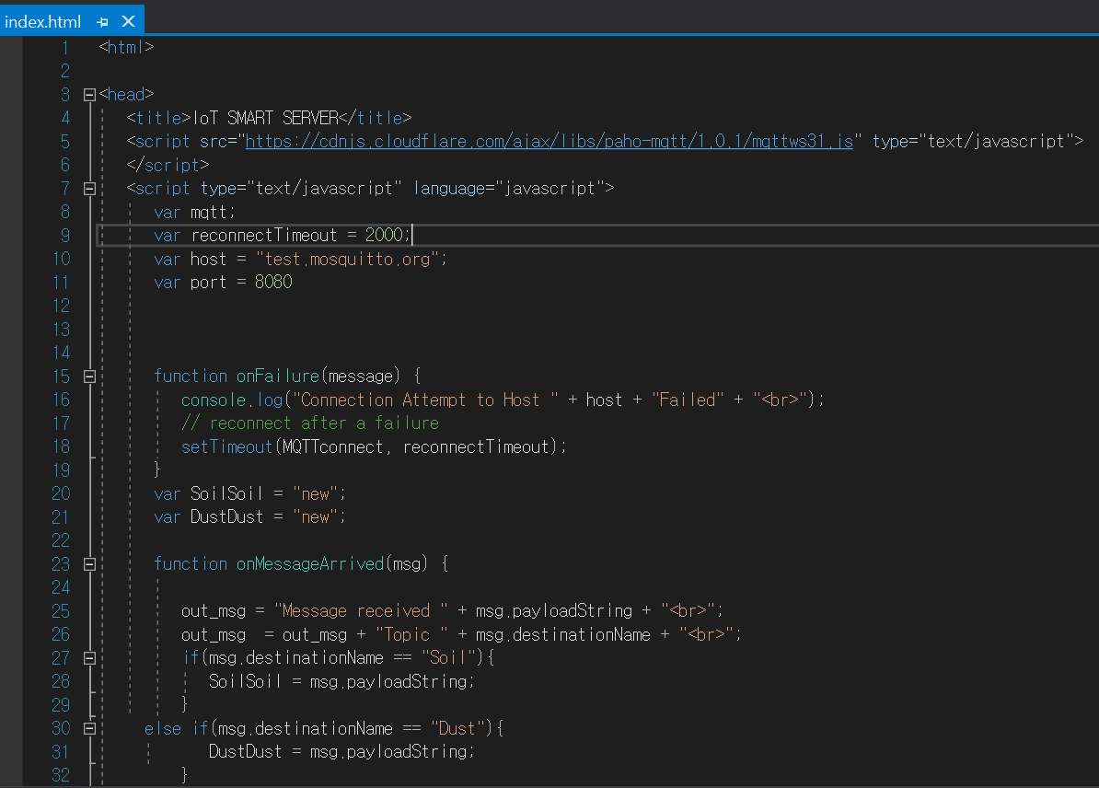
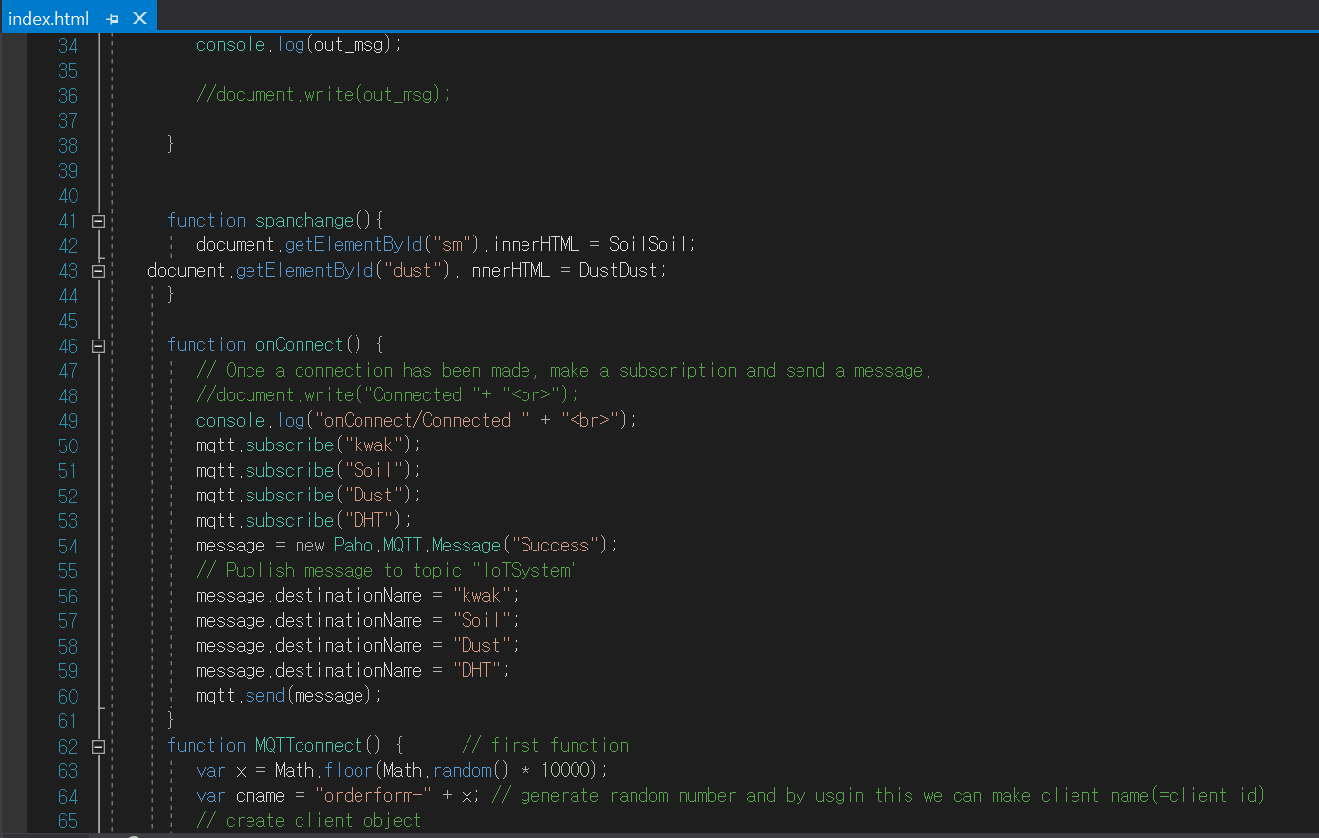
Index.html

Slide 5
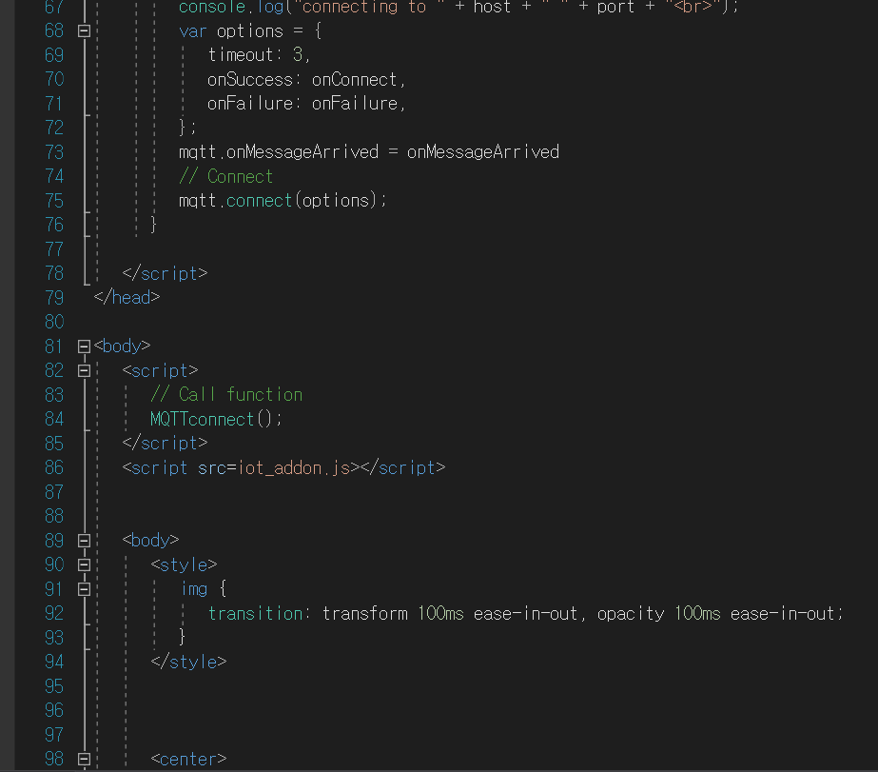
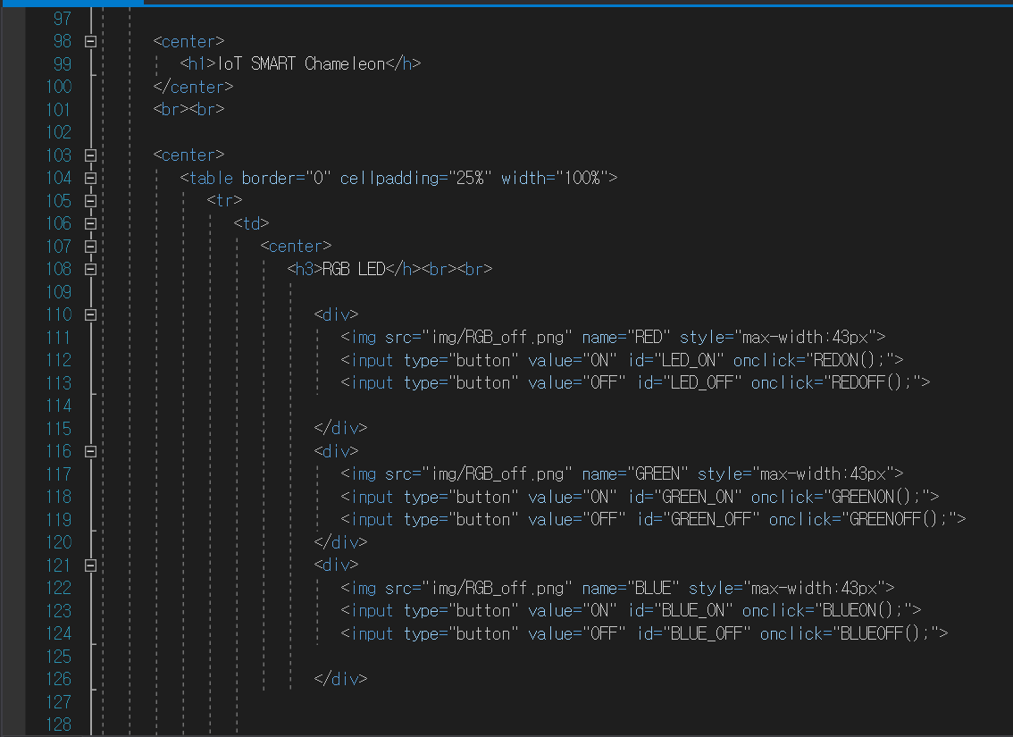

Slide 6
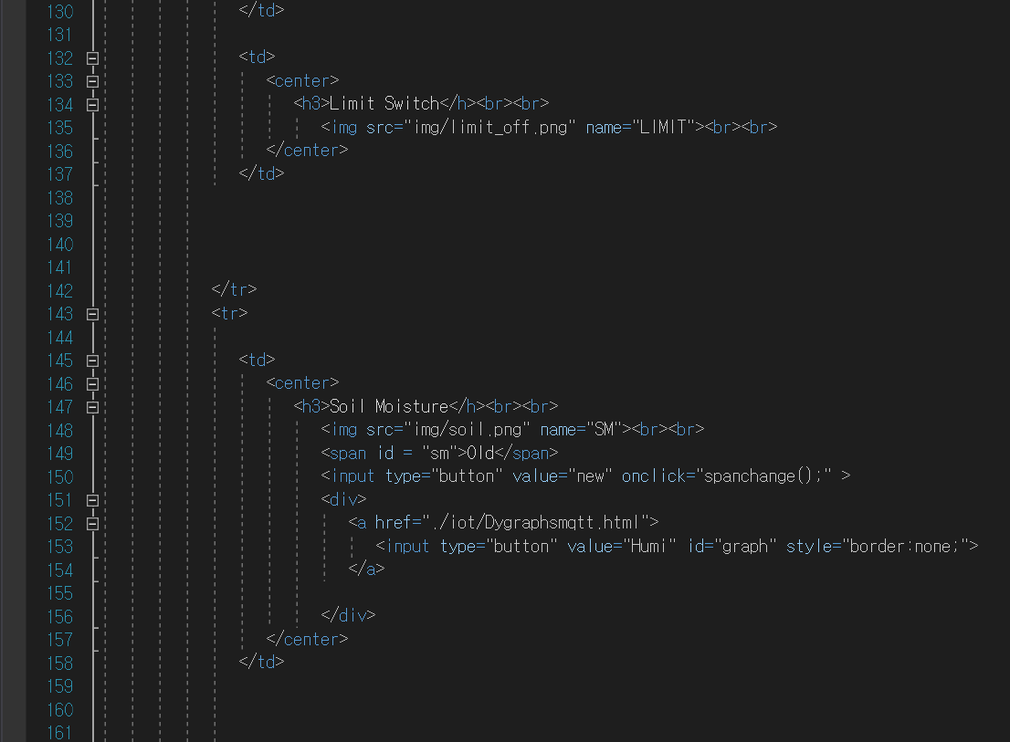
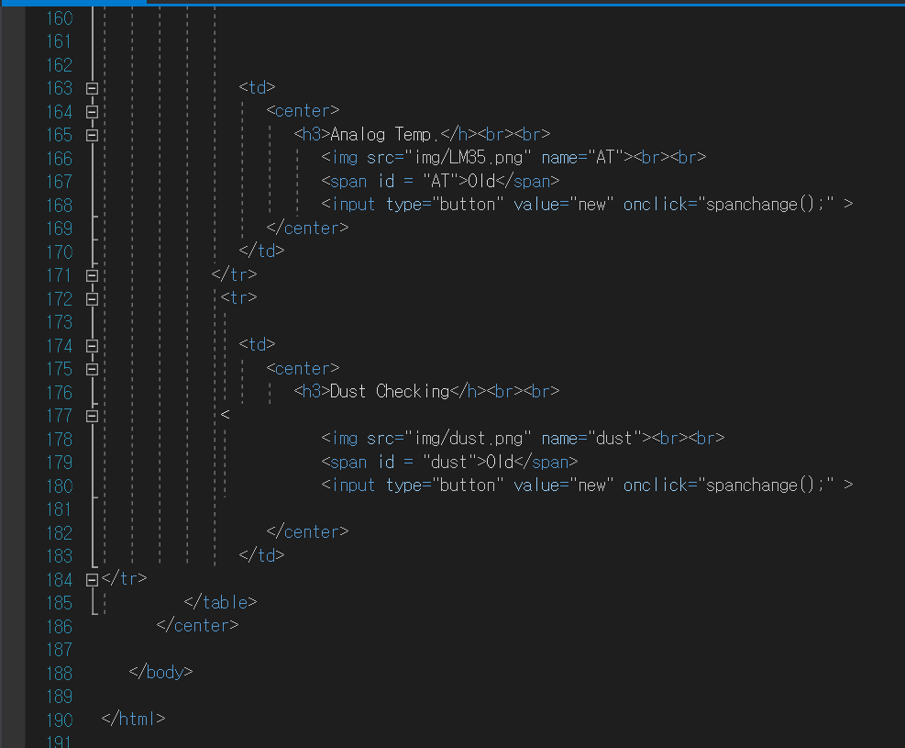

Slide 7
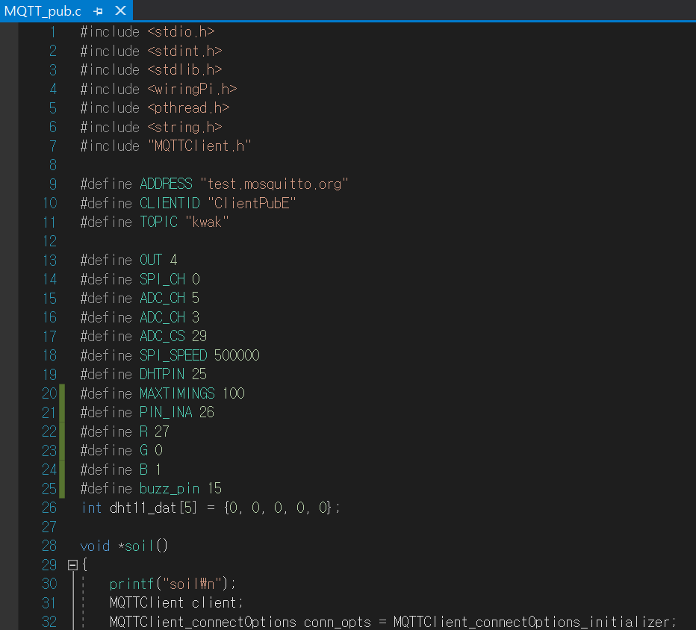
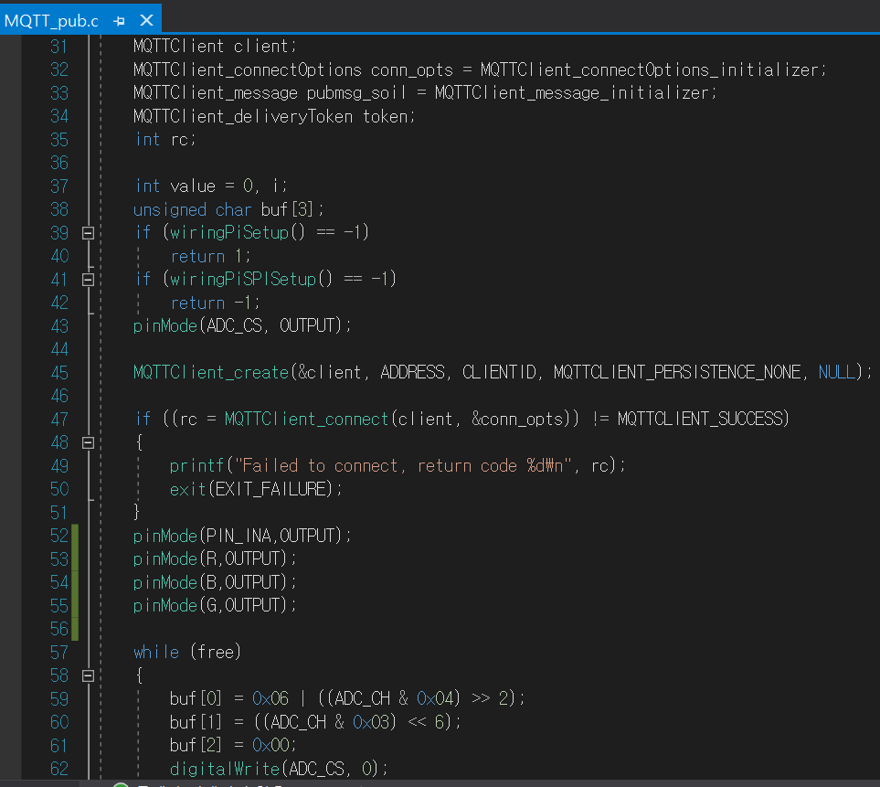
MQTT_pub.c

Slide 8
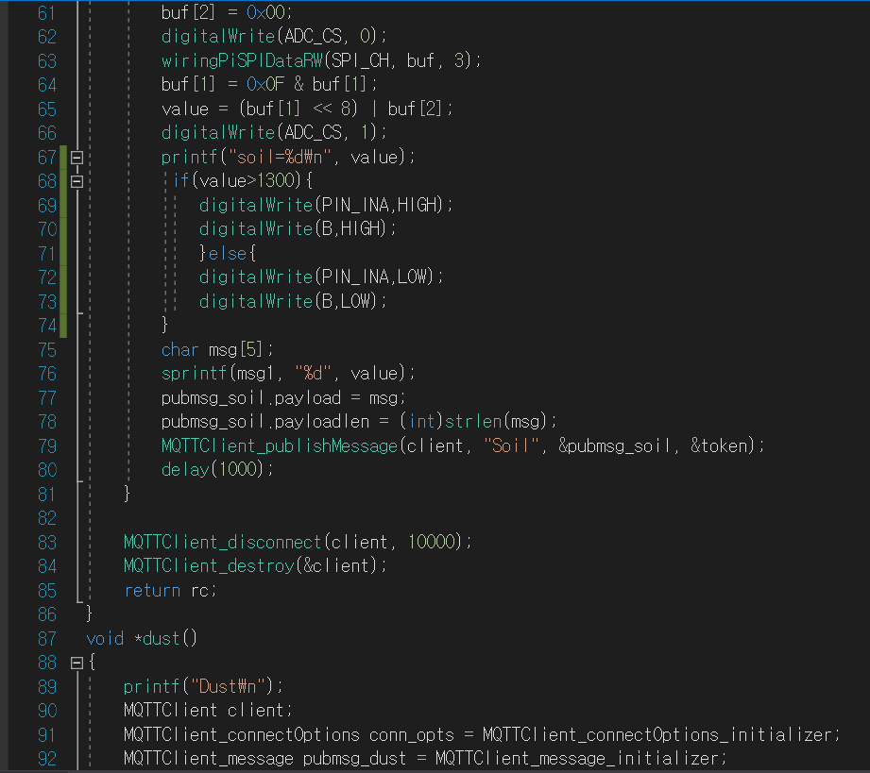
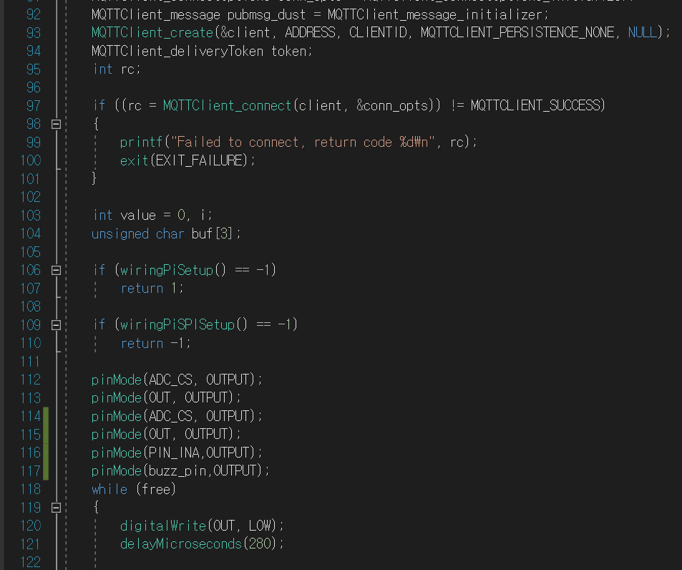

Slide 9
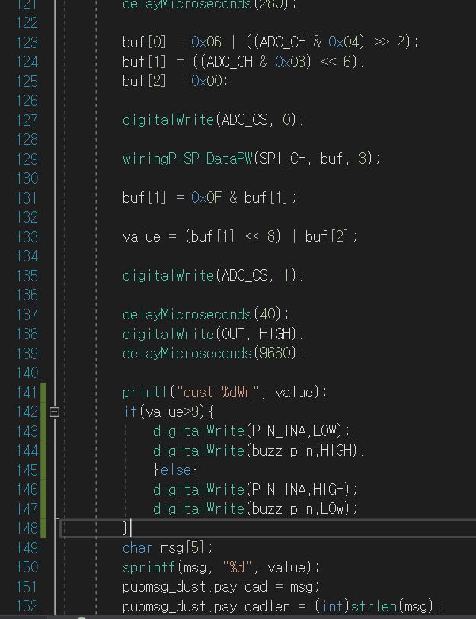
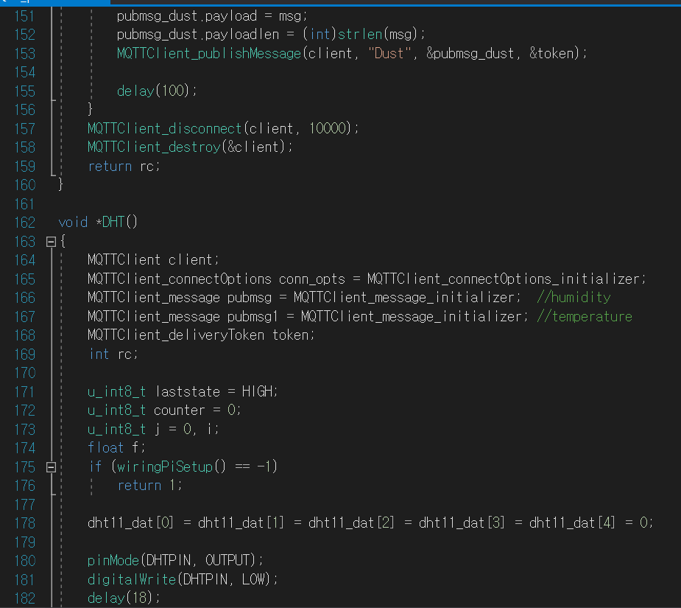

Slide 10
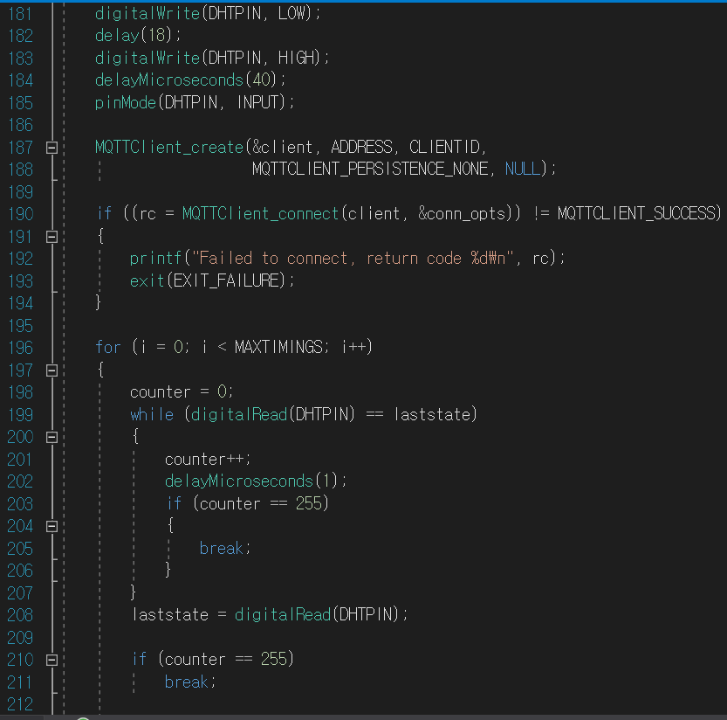
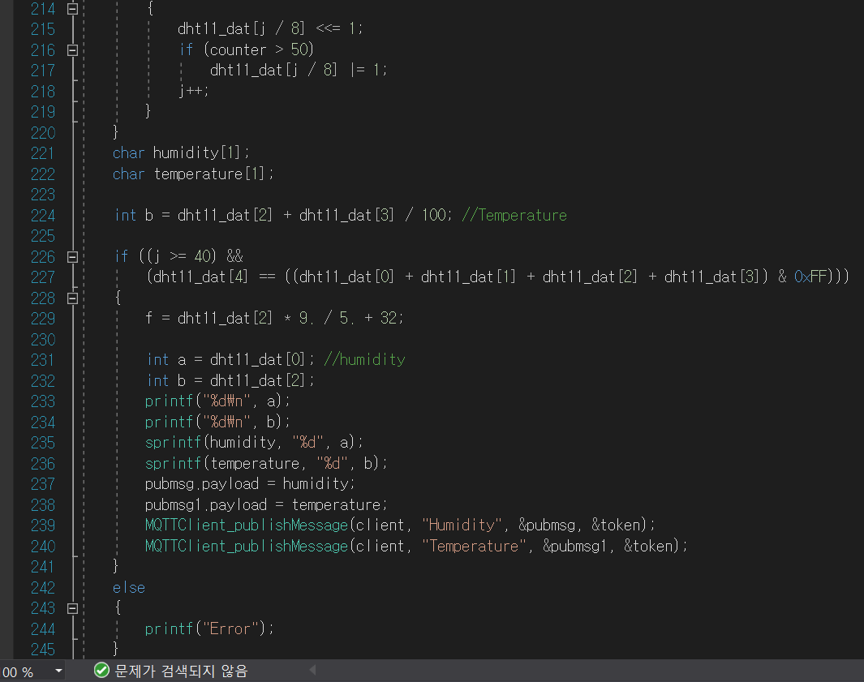

Slide 11
