Slide 1
Diamond-II
EBPM_Testbed
April 2021
Alan Tipper

Slide 2
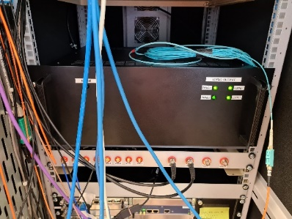
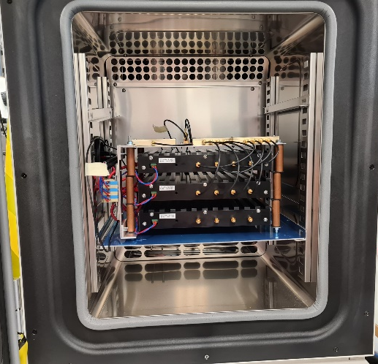
The Current Lab Testbed
Replicates the topology of the
pilot tone scheme and the
temperature variation in the tunnel
Will be used for stability assessment
Diagnostics Rack
(CIA)
Terminal Server
Terminal server ts0011.diamond.ac.uk
port 7015 connects to the RS485 multi-drop bus
(use telnet to connect)
uTCA
8
Temp Controlled
Chamber (Tunnel)
(beam)
RF
RF GEN
1:8
split
RS485
12V Power
4
4
Power
(RS485:1)
Pilot
Pilot
D2AFE
D2AFE
4
(RS485:2)
Up to 13 D2AFEs on
a single RS485 bus in
a cell on Diamond-II
RS485 to RS232
D2AFE
4
(RS485:3)

Slide 3
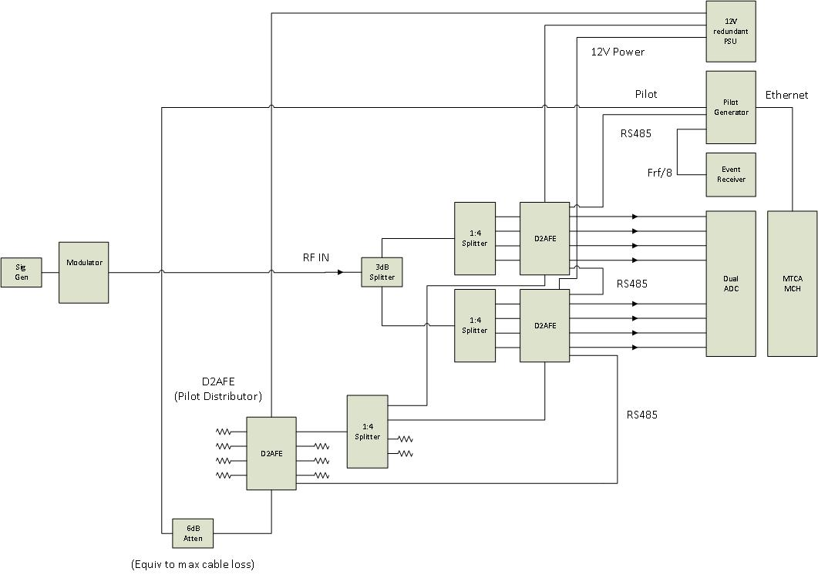
Working Towards a Complete Test System
Work in progress
Currently the RS485 is accessed via a terminal server
and the pilot is produced by a signal generator

