Slide 1
ID02J Endat Encoder
Data analysis of the endat encoder install on ID02J 09/06/2021

Slide 2
Background
On 09/06/2021 a Heidenhain linear endat encoder was installed mechanically in parallel with the SSI encoder on the control system (Axis 2).
This encoder was connected to a geobrick in the CIA with an IOC exposing the encoder value to the archiver

Slide 3
Aim
To determine if the Endat encoder is suitable for future control systems using the following criteria:
How does it handle beam loss?
How does it handle runtime radiation?
Does it continue to function?
Does it report any erroneous positions?

Slide 4
Data Analysis Method
There are some inconsistencies in the archiving which makes the data processing more challenging:
The Endat encoder produces ~93000 samples / day, the SSI only produces ~750 samples / day
The Endat appears to be sampling for every change no matter how small whereas the SSI appears to sample when there is a larger change, despite ADEL and MDEL being 0 for both.
The sheer amount of data means some scripting was needed

Slide 5
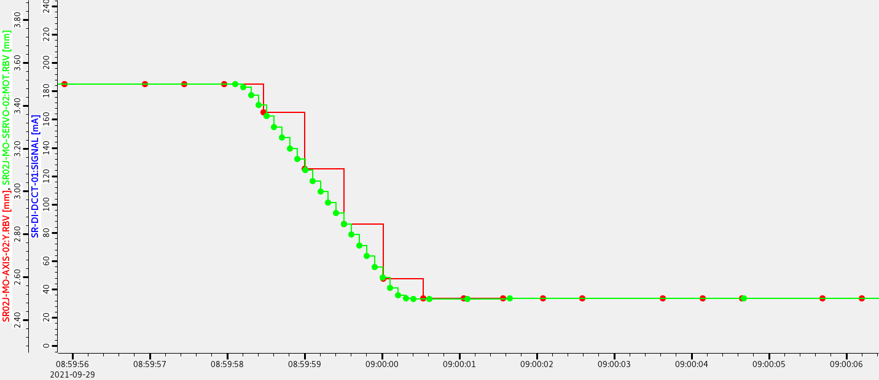
Data Analysis Method
Due to the inconsistent sample rate taking the difference between encoders during any motion would yield misleading results.
Fig 1
Unfortunately MOVN doesn't appear to have been archived which means it must be manually determined if a move is in progress
For a first pass samples were taken at hourly intervals and if the difference was > 100um it would create a point of interest for manual investigation

Slide 6
Results of first pass
TIME: Difference
2021-06-22T19:00:00.000000 52.43022000000001
2021-06-29T17:00:00.000000 -52.42741999999999
2021-07-21T01:00:00.000000 52.430400000000006
2021-08-05T02:00:00.000000 52.43001000000002
2021-09-03T13:00:00.000000 -52.42730999999999
2021-09-06T22:00:00.000000 52.4303
2021-09-14T21:00:00.000000 0.22666000000000963
2021-09-15T01:00:00.000000 0.22668000000000976
2021-09-21T23:00:00.000000 0.22667000000000925
2021-09-28T20:00:00.000000 1.0009999999999915
2021-09-29T08:00:00.000000 0.199600000000002
2021-10-06T08:00:00.000000 0.2316600000000122
2021-11-12T20:00:00.000000 52.43017000000001
2021-11-23T10:00:00.000000 52.43026000000001
2021-11-30T10:00:00.000000 52.42954000000002
2021-12-08T17:00:00.000000 -52.427889999999984
2022-01-18T01:00:00.000000 52.42991000000001
2022-02-01T18:00:00.000000 -52.42821
2022-03-25T21:00:00.000000 -52.42833999999999
2022-03-30T14:00:00.000000 52.42943
2022-04-02T19:00:00.000000 52.429240000000014
2022-04-03T06:00:00.000000 -52.428319999999985
2022-04-04T10:00:00.000000 52.42928000000001
2022-04-05T14:00:00.000000 -52.428399999999996
2022-04-05T20:00:00.000000 -52.428360000000005
2022-04-19T15:00:00.000000 -52.42808999999999
The following POIs were generated:
The majority of these POIs are caused by beam dumps (~+/-52mm). This will be detailed later but more concerning are the smaller differences that may not be the result of a beam dump.

Slide 7
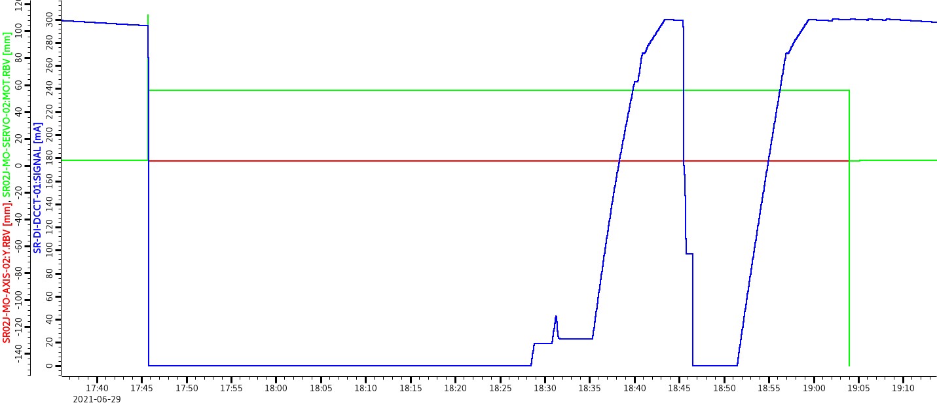
Results of first pass
Beam trip 22/06/2021
Fig 2
SSI encoder shows a large jump but is recovered. The Endat looks stable but is actually drifting slightly, see fig 3 on the next slide

Slide 8
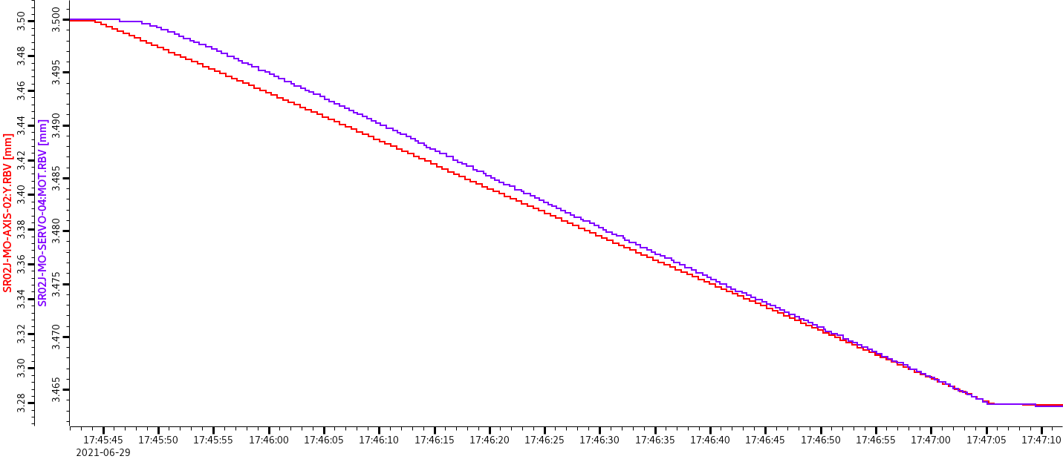
Results of first pass
Beam trip 22/06/2021
Fig 3
It can be seen that this drift is real as axis 4 (which has survived the beam dump) also shows this movement

Slide 9
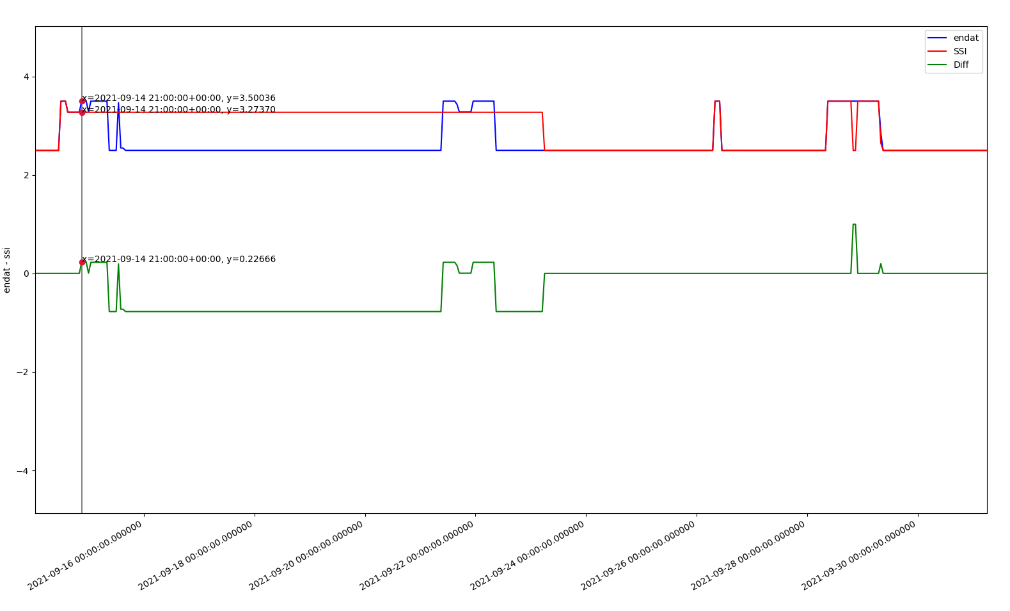
Results of first pass
~226um difference, 14/09/2021
Fig 4
Looking at a plot using data obtained every hour using aapy it can be seen that although the difference that caused the POI to flag is 0.226 the difference gets to ~700um (fig 5)

Slide 10
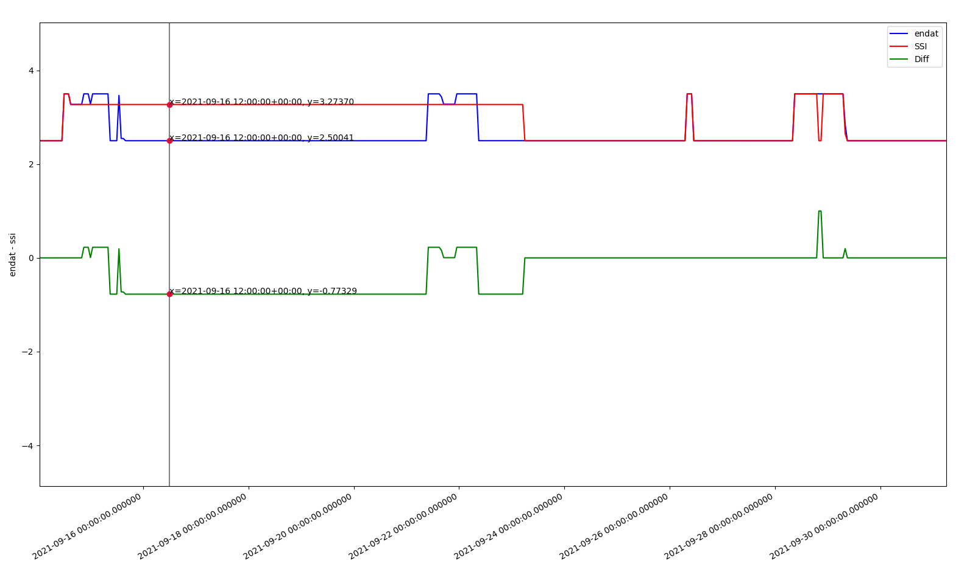
Results of first pass
~226um difference, 14/09/2021
Fig 5

Slide 11
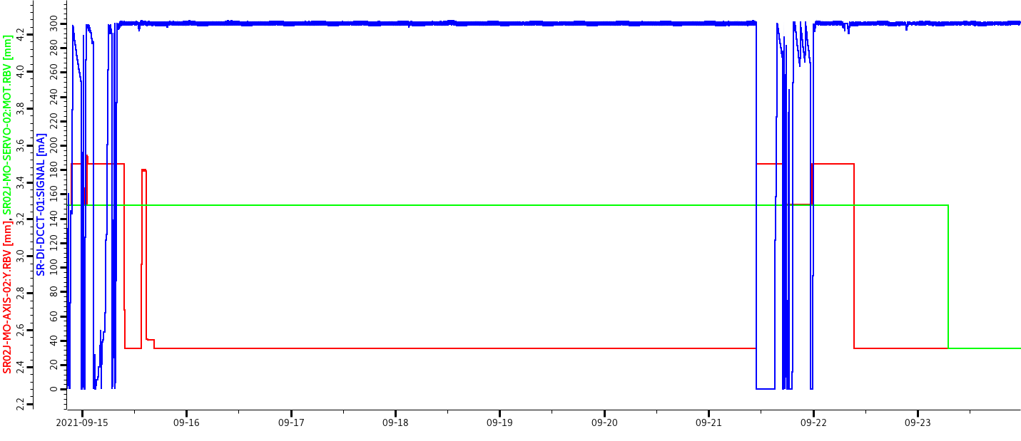
Results of first pass
~226um difference, 14/09/2021
Fig 6

Slide 12
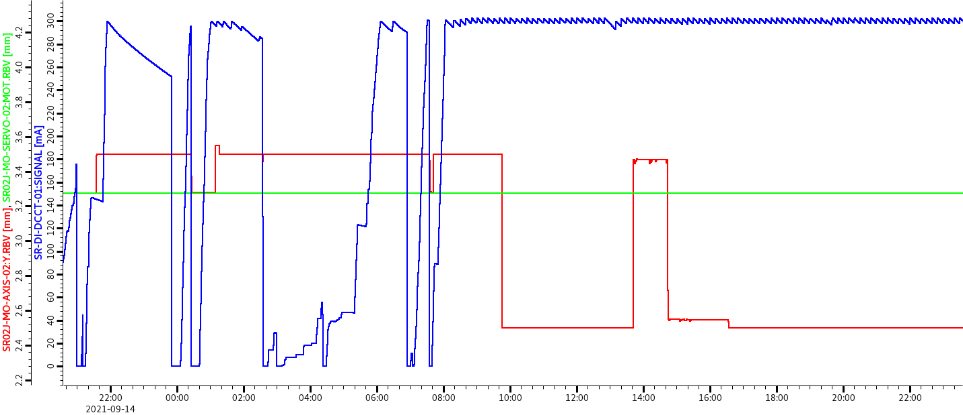
Results of first pass
~226um difference, 14/09/2021
Fig 7

Slide 13
Results of first pass
~226um difference, 14/09/2021
Fig 8
The endat encoder value is changing, the SSI is stable.
This was found to be archiving issues, no datapoints were gathered for the SSI encoder during this time:
2021-09-14 15:10:28.677016 [3.2737]
2021-09-23 06:59:58.060616 [2.4998]
Looking at the IOC logs it looks like there was a beam trip here. The ID was commanded to move to the set gap which would explain the small move:
[Tue Sep 14 21:34:55 2021]ops-vcg46195@cs01r-cs-pc-07.pri.diamond.ac.uk SR02J-MO-SERVC-01:GAPSET.PROC 0 -> 0

Slide 14
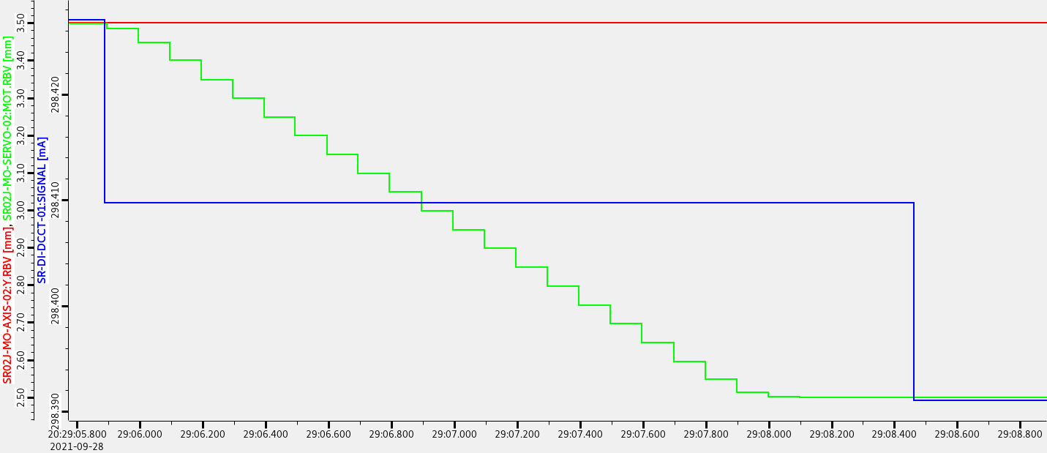
Results of first pass
~1mm difference, 28/09/2021
Fig 9
In this case the Endat encoder is stable but the SSI shows what appears to be a move. This is a real move as the other encoders show this.
Upon further investigation it appears the endat PV was not being archived between 11:34:08 and 23:41:37 on that date which would explain this.

Slide 15
Results of first pass
Summary of POIs @ hourly samples when diff > 100um
0 2021-05-31T23:00:00.000000 -0.12689000000000306 before installation so ignore
1 2021-06-08T08:00:00.000000 1.8994999999999962 Odd jump on endat (before installation so ignore)
2 2021-06-22T19:00:00.000000 52.43022000000001 Beam dump, ssi jumps to -49, endat stable
3 2021-06-29T17:00:00.000000 -52.42741999999999 Beam dump ssi jumps, endat starts to drift
4 2021-07-21T01:00:00.000000 52.430400000000006 Beam dump ssi jumps, endat starts to drift
5 2021-08-05T02:00:00.000000 52.43001000000002 Beam dump ssi jumps, endat stable
6 2021-09-03T13:00:00.000000 -52.42730999999999 Beam dump ssi jumps, ssi jump leads beam dump... Endat stable
7 2021-09-06T22:00:00.000000 52.4303 Beam dump ssi jumps, endat starts to drift
8 2021-09-14T21:00:00.000000 0.22666000000000963 Odd behaviour on endat, ssi stable
9 2021-09-15T01:00:00.000000 0.22668000000000976 Same incident as above
10 2021-09-21T23:00:00.000000 0.22667000000000925 Same incident as above
11 2021-09-28T20:00:00.000000 1.0009999999999915 SSI seems to show a move but the endat doesn't reflect this
12 2021-09-29T08:00:00.000000 0.199600000000002 False alarm, due to movement and sample rate
13 2021-10-06T08:00:00.000000 0.2316600000000122 False alarm, due to movement and sample rate
14 2021-11-12T20:00:00.000000 52.43017000000001 Beam dumps
15 2021-11-23T10:00:00.000000 52.43026000000001
16 2021-11-30T10:00:00.000000 52.42954000000002
17 2021-12-08T17:00:00.000000 -52.427889999999984
18 2022-01-18T01:00:00.000000 52.42991000000001
19 2022-02-01T18:00:00.000000 -52.42821
20 2022-03-25T21:00:00.000000 -52.42833999999999
21 2022-03-30T14:00:00.000000 52.42943
22 2022-04-02T19:00:00.000000 52.429240000000014
23 2022-04-03T06:00:00.000000 -52.428319999999985
24 2022-04-04T10:00:00.000000 52.42928000000001
25 2022-04-05T14:00:00.000000 -52.428399999999996
26 2022-04-05T20:00:00.000000 -52.428360000000005
27 2022-04-19T15:00:00.000000 -52.42808999999999

Slide 16
Results of first pass
The same process was repeated with a POI threshold of 5um an no further events were recorded
Sampling was increased to every 10 minutes and no further events >2um were recorded

Slide 17
Conclusion
The endat encoder appears to behave better than SSI during a beam trip
When the ID is stationary the endat is within 2um of the SSI
The Endat encoder was continuously functioning

Slide 18
Repo with tools used to get this data:
git@github.com:LeeHudsonDLS/id02jEndatInvestigation.git

