Slide 1
CG-DARTS: Cost-Guided Differentiable Architecture Search
Extending DARTS with hardware-aware regularization and derivation
Baek Jongjin · Kim Ryeowook (Team 9)
CS.50700 · Final Project Report
Builds on the DARTS paper review (Team9_Presentation.pdf, slide 16)

Slide 2
Outline
• Recap of the proposal (open questions identified in the paper review)
• Methods — across three branches
– Cost regularizer and five cost tables (FLOPs, params, memory, device, LUT)
– Softmax temperature annealing
– Cost-aware architecture derivation
• Experimental setup and compared methods
• Experimental results
– FLOPs sweep, Params metric, annealing pilot, L40S latency LUT
• Analysis: skip-collapse, what works, what doesn't
• Conclusions and future work
2

Slide 3
1. Proposal recap
From slide 16 of Team9_Presentation.pdf — the original DARTS authors' open questions
• Open question O1 — closing the soft-to-hard discretization gap
– DARTS searches a continuous mixture (softmax over operations) but evaluates a discrete cell
– Liu et al. (2019) suggest annealing the softmax temperature as a possible remedy
• Open question O2 — performance-aware architecture-derivation
– The original top-k argmax derivation is blind to inference cost
– Calls for schemes that exploit the shared weights and account for compute / memory / latency
• Our thesis: bring hardware cost into BOTH the search loss AND the derivation step
– Differentiable cost regularizer during search + cost-aware top-k during derivation
– Tau-annealing as the bridge between the two regimes
3

Slide 4
2. CG-DARTS thesis
Augmented architecture loss:
L_arch(α) = L_val(w*(α), α) + λ · E_α[c]
where the expected cost over the soft mixture
E_α[c] = Σ_(i,j) Σ_o softmax(α^(i,j)/τ)_o · c_o^(i,j)
• c_o^(i,j) — per-edge, per-primitive cost table (precomputed, differentiable through α)
• τ — softmax temperature; default 1.0, annealed during search to bridge soft→hard
• λ — cost weight; linearly warmed up over the first 10 search epochs
• Five cost tables shipped: FLOPs · Params · Memory bytes · Device-blended · Measured LUT
• Three derivation modes: argmax (DARTS default) · cost_sub · cost_div
4

Slide 5
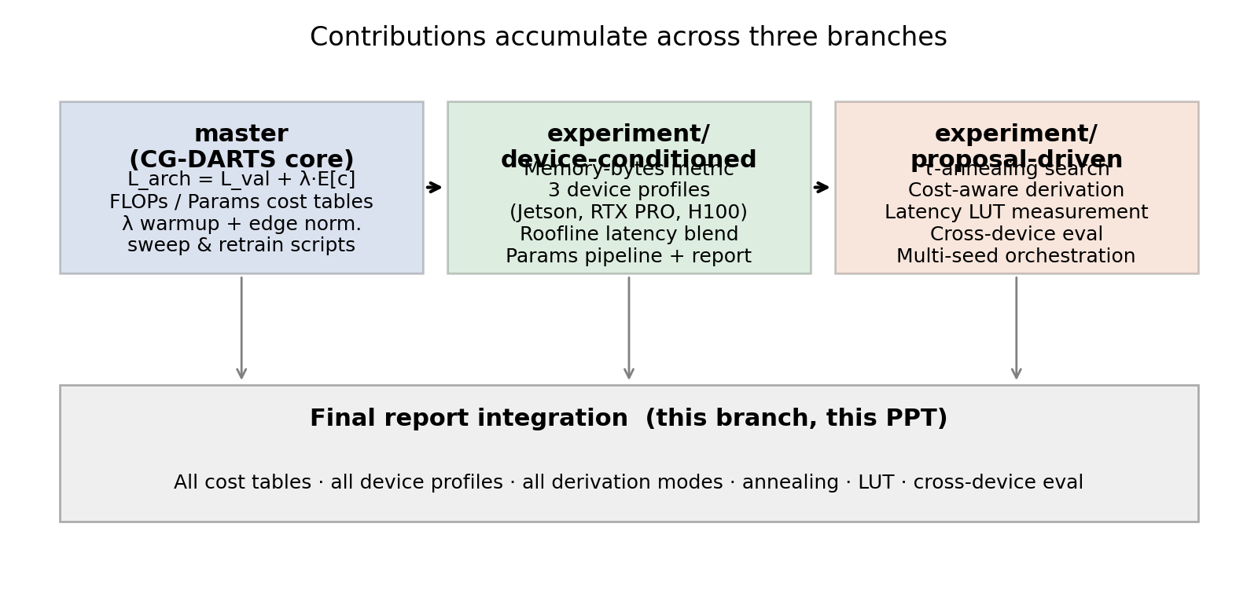
3. Method overview — three branches of contribution
5

Slide 6
4. Method — cost regularizer
cnn/cost_utils.py + cnn/architect_cg.py (master)
• Cost is precomputed once before search starts: one [num_edges × num_ops] table per cell type
– Cells of the same type share α in DARTS → also share cost in CG-DARTS
– Each cell-type cost table sums the per-op cost across all cells of that type in the supernet
• Normalization (per-edge): c̃[i,j,o] = (c[i,j,o] − min_o) / (max_o − min_o)
– Removes the scale advantage of larger cells, lets one λ work across metrics
• Architecture-loss backward pass: ∂E[c]/∂α has the closed-form softmax-Jacobian × cost
– Adds < 1% to per-step compute
• Cost-warmup: λ_eff(epoch) = λ · min(1, (epoch+1)/warmup) for first WARMUP epochs
– Avoids early bias when w is still random
6

Slide 7
5. Method — five cost metrics
Metric | Formula per primitive | Origin branch
flops | conv / depthwise / pool multiply-adds at supernet feature shape | master
params | learnable weight count | master
mem | fp32 activation read + write bytes (proxy for traffic) | device-conditioned
device | w_f·flops + w_m·mem + w_ℓ·roofline_latency (per device profile) | device-conditioned
lut | measured per-primitive latency from scripts/measure_latency_lut.py | proposal-driven
Roofline latency: ℓ = max(flops / P_peak, mem_bytes / B_bw)
P_peak from vendor FP32 spec, B_bw from memory-bus spec
The cost regularizer is metric-agnostic — same code path, different table.
All five metrics produce alpha-shaped tables so build_search_costs() returns a uniform interface.
7

Slide 8
6. Method — device profiles
cnn/device_profiles.py (device-conditioned branch)
Profile | SKU | FP32 TFLOPS | Mem BW (GB/s) | (w_f, w_m, w_ℓ)
jetson_orin | Jetson AGX Orin 64GB | 5.32 | 204.8 | (0.20, 0.60, 0.20)
rtx_pro_6000 | RTX PRO 6000 Blackwell WS | 125.0 | 1792.0 | (0.35, 0.35, 0.30)
h100 | NVIDIA H100 SXM5 | 67.0 | 3350.0 | (0.50, 0.20, 0.30)
• Weights follow the CG_DARTS Proposal v3 presets (edge / balanced / server)
• Vendor specs are the only inputs; the roofline closes the gap to per-op cost
• Same metric=device pipeline searches a different cell per profile — same code, three deployments
8

Slide 9
7. Method — measured latency LUT
scripts/measure_latency_lut.py (proposal-driven branch)
• For each (edge_idx, primitive, stride, C, H, W) tuple in the 8-cell supernet:
– Build the primitive (with BN for pool ops, like the supernet does)
– Warm up 5 iters; time N iters with torch.cuda.Event start/end and torch.cuda.synchronize
– Accumulate into an alpha-shaped table summed across cells of the same type
• Output: reports/latency_lut/<device>.json with metadata + 14×8 tables per cell type
• Consumed via: --cost_metric lut --lut_path reports/latency_lut/l40s.json
• Same downstream code path as flops / params / mem / device → no special-casing in train_search_cg.py
9

Slide 10
8. Method — softmax annealing (motivation)
Open question O1 from our proposal: closing the soft-to-hard discretization gap
The problem — DARTS search and DARTS evaluation optimize different functions:
• Search: L_val is computed on a soft mixture ō(x) = Σ_o softmax(α)_o · o(x) over all candidate ops
• Evaluation: the discrete cell uses only argmax_o α_o on each edge — every other op vanishes
• Consequence: search_valid_acc ≠ retrain_test_acc. The search optimizer never directly sees the model it ships.
Concrete evidence of the gap (FLOPs CG-DARTS, λ=1e-2, seed=2):
search_valid_acc = 87.61% vs retrain_test_acc = 96.05% → ~8 pp gap
What annealing buys us — the limit τ → 0:
• softmax(α / τ) becomes one-hot at argmax_o α_o → the soft mixture IS the discrete cell
• search_valid_acc → the validation accuracy of the cell derivation will pick (gap closes by construction)
• Expected cost E_α[c] becomes the discrete cost of the chosen cell — the regularizer penalizes the deployed model
• Liu et al. (2019) themselves flag annealing as the natural remedy in the Discussion section of the paper
10

Slide 11
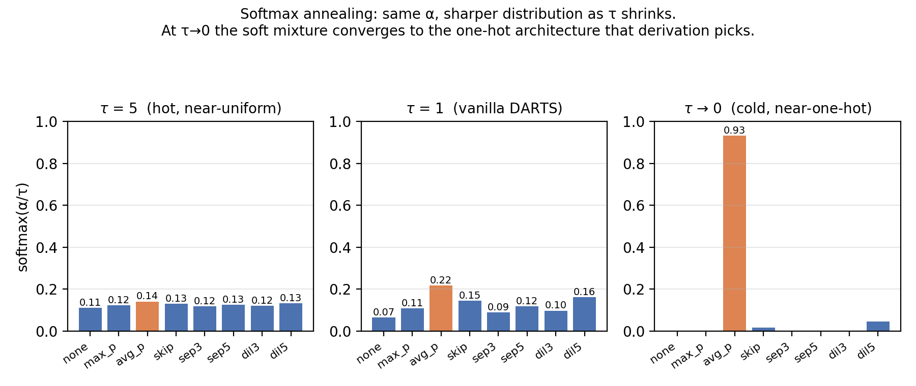
9. Method — softmax annealing (intuition)
Same α, three temperature regimes — orange bar marks the argmax operation
Annealing τ → 0 progressively makes the mixture identical to the discrete architecture.
That is the mechanism by which the soft-to-hard gap on the previous slide closes.
11

Slide 12
10. Method — softmax annealing (implementation)
The actual code paths, flags, and per-model state that make annealing work end-to-end
Replace softmax(α) with softmax(α / τ) in BOTH the mixed-op forward and the cost expectation:
ō(x) = Σ_o softmax(α/τ)_o · o(x) E_α[c] = Σ softmax(α/τ)_o · c_o
• tau-schedule arg: linear / exp / none. Defaults to τ=1.0 (matches paper).
• Three flags: --tau_start --tau_end --tau_anneal {linear,exp,none}
• Property: as τ → 0, softmax(α/τ) → one-hot at argmax_o α_o.
– → E_α[c] converges to the discrete cost of the cell that derivation will pick
– → Closes the gap between the soft objective minimized during search and the discrete model
• The whole network exposes self.tau so .new() and the unrolled gradient inherit the schedule correctly
12

Slide 13
11. Method — cost-aware architecture derivation
Addresses open question O2 (performance-aware derivation)
Same top-k structure as DARTS, but the per-edge × per-op score s(j,o) is mode-dependent:
Mode | Score s(j, o) | Behaviour
argmax (DARTS default) | softmax(α)[j,o] | cost-blind
cost_sub | softmax(α)[j,o] − μ · c̃[j,o] | additive penalty; μ tunable at derivation time
cost_div | softmax(α)[j,o] / (ε + c̃[j,o]) | favours value-per-cost ops
• Selection is shared: same s(j,o) drives top-2 edges and the chosen op per edge
• scripts/rederive_genotype.py loads weights.pt and emits genotype.<mode>.txt post hoc
– ONE search → three derived genotypes → three retrains. No extra search cost.
13

Slide 14
12. Experimental setup
Phase | Config
Dataset | CIFAR-10 · cutout-free transforms (search) · cutout-16 + auxiliary tower (retrain)
Search supernet | 8 cells · 16 init channels · steps=4 · half train / half val split
Search optimizer | SGD w/ momentum 0.9, cosine LR 2.5e-2 → 0, weight decay 3e-4
Architecture optimizer | Adam lr 3e-4, β=(0.5, 0.999), weight decay 1e-3
Search epochs / batch | 50 · 64
Retrain network | 20 cells · 36 init channels · auxiliary weight 0.4 · drop_path 0.2
Retrain epochs / batch | 100 · 96
Cost reg. | λ ∈ {1e-3, 5e-3, 1e-2, 5e-2, 1e-1}; warmup 10 ep; edge normalization
Annealing | tau linear 5.0 → 0.1 over 50 epochs (pilot)
Seeds | single seed = 2 (multi-seed orchestrator implemented but not authorized for production)
Hardware | NVIDIA L40S × 2 (only GPU 0 used; GPU 1 was held by a collaborator's job)
14

Slide 15
13. Compared methods
Method | Cost-aware? | Derivation | Reported on | Source
DARTS V1 (first-order, paper) | no | argmax | CIFAR-10 | Liu et al. (2019), Table 1
DARTS V2 (second-order, paper) | no | argmax | CIFAR-10 | Liu et al. (2019), Table 1
Vanilla DARTS (our run) | no | argmax | CIFAR-10 (our protocol) | this work
CG-DARTS FLOPs (λ sweep) | yes (FLOPs) | argmax | CIFAR-10 | master
CG-DARTS Params (λ sweep) | yes (params) | argmax | CIFAR-10 | device-conditioned branch
CG-DARTS Device (per profile) | yes (FLOPs+mem+roofline) | argmax | 3 tiers, 95.4-95.6% retrain | device-conditioned
CG-DARTS Annealing (pilot) | yes (FLOPs) | argmax | CIFAR-10 | proposal-driven (this)
CG-DARTS Cost-derived (pilots) | yes (FLOPs) | cost_sub / cost_div | queued; not yet retrained | proposal-driven (this)
15

Slide 16
14. Results — FLOPs-cost CG-DARTS sweep (table)
reports/cg_darts/summary.csv · seed=2 · 50ep search / 100ep retrain
Config | Search valid | Expected cost | Discrete MACs (M) | Δ MACs | Params (M) | Δ Params | Retrain test
Vanilla DARTS | 87.93% | 7.51 | 477.96 | — | 3.02 | — | 95.97%
CG-DARTS λ=1e-3 | 87.52% | 7.11 | 509.70 | −6.6% | 3.25 | −7.6% | —
CG-DARTS λ=5e-3 | 87.28% | 6.78 | 426.31 | +10.8% | 2.65 | +12.2% | —
CG-DARTS λ=1e-2 | 87.61% | 6.24 | 420.12 | +12.1% | 2.63 | +13.0% | 96.05%
CG-DARTS λ=5e-2 | 87.10% | 3.15 | 255.64 | +46.5% | 1.55 | +48.7% | 93.96%
CG-DARTS λ=1e-1 | 86.77% | 1.76 | 282.76 | +40.8% | 1.73 | +42.7% | —
λ=1e-2 is Pareto-dominant under matched protocol: +0.08 pp retrain accuracy AND −12.1% MACs AND −13.0% params vs. vanilla.
λ=5e-2 is the 'aggressive' point: roughly half the MACs at a 2 pp accuracy cost.
16

Slide 17
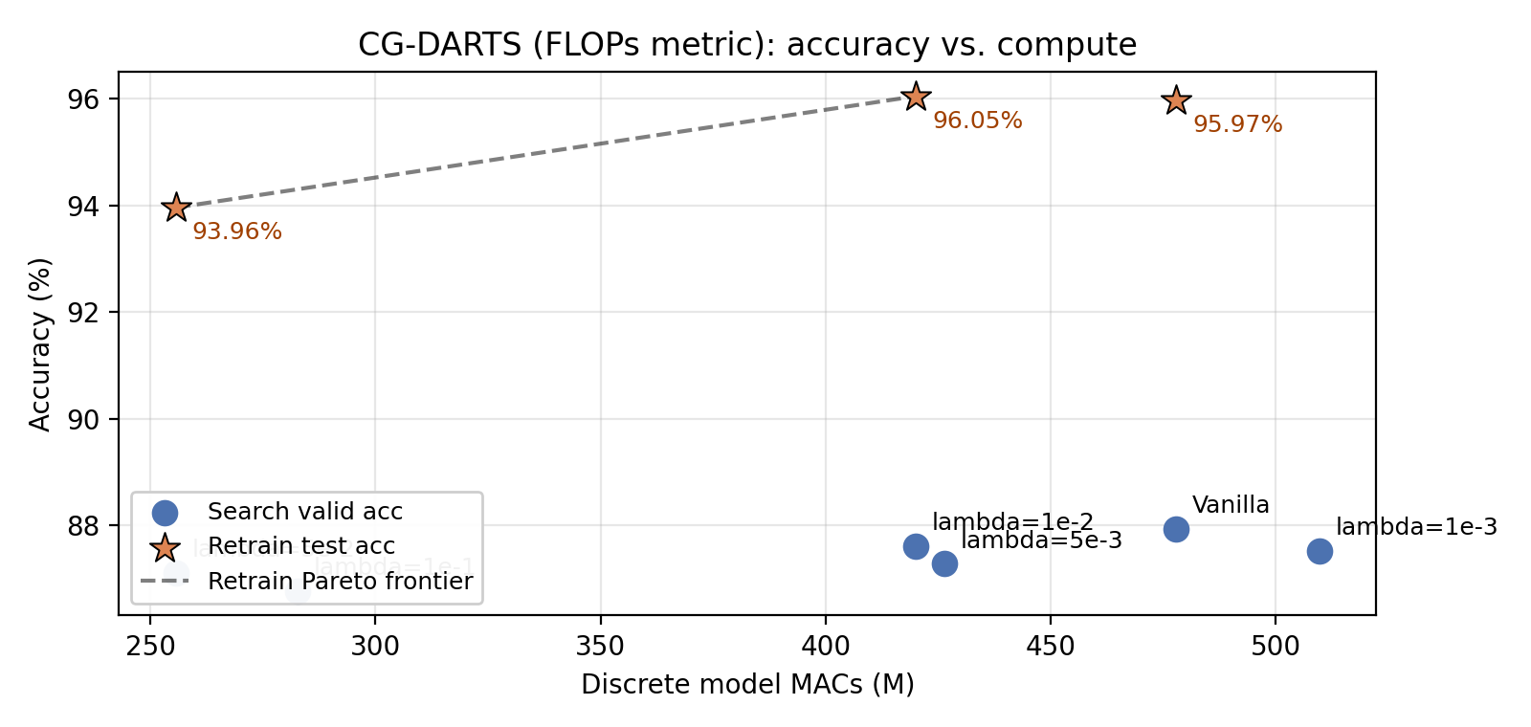
15. Results — FLOPs Pareto plot
Stars: retrain test accuracy · circles: search-time validation · dashed line: retrain Pareto frontier
17

Slide 18
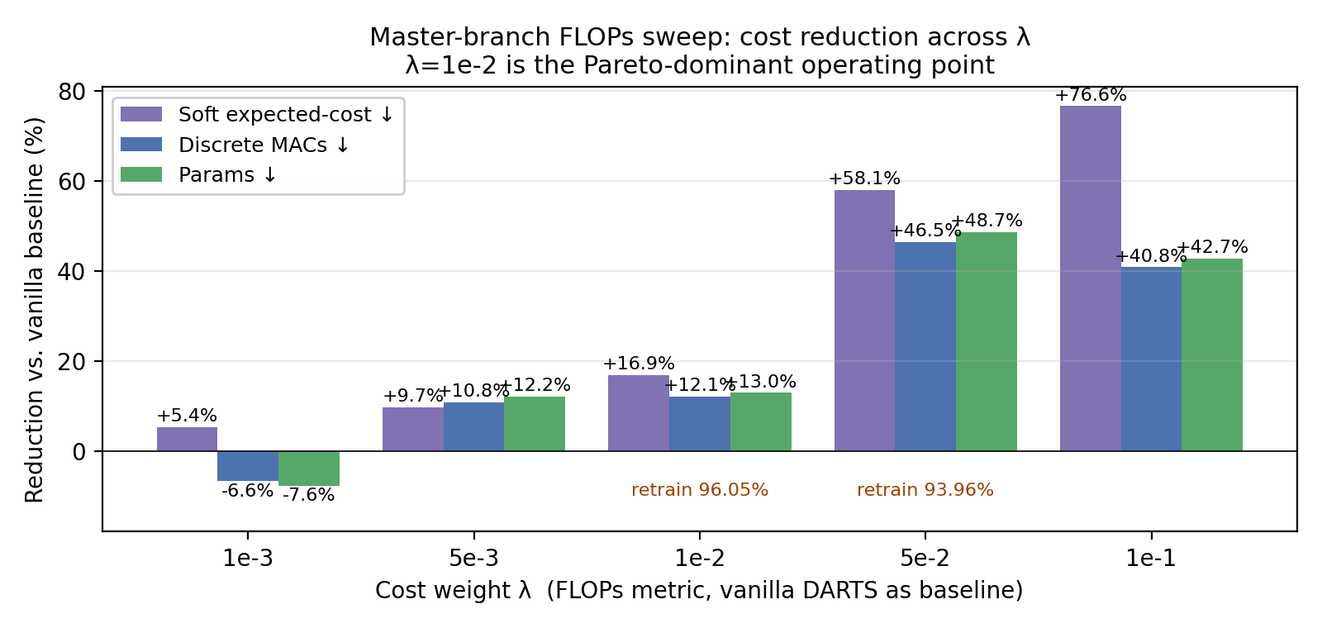
16. Results — cost reduction across λ (master FLOPs sweep)
reports/cg_darts/summary.csv · vanilla DARTS as baseline · signed % reductions
18

Slide 19
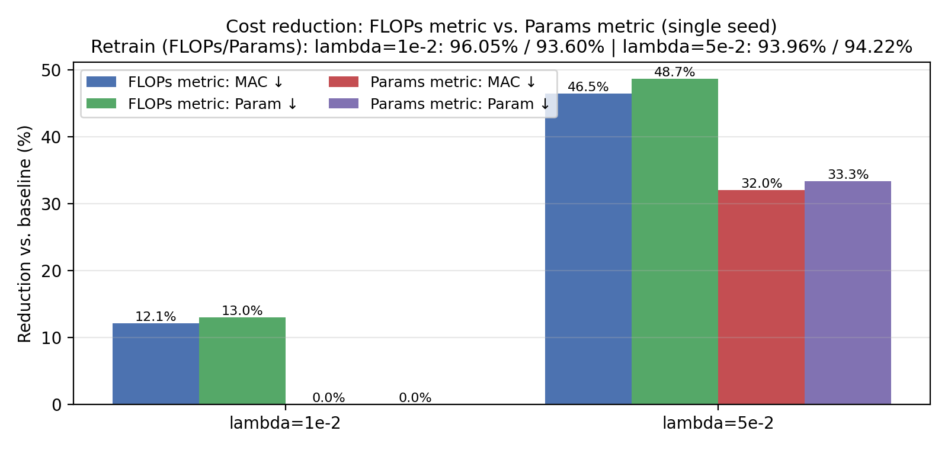
17. Results — Params-metric CG-DARTS
reports/cg_darts_params/summary.csv · seed=2 · 30ep search / 50ep retrain (fast pipeline)
19

Slide 20
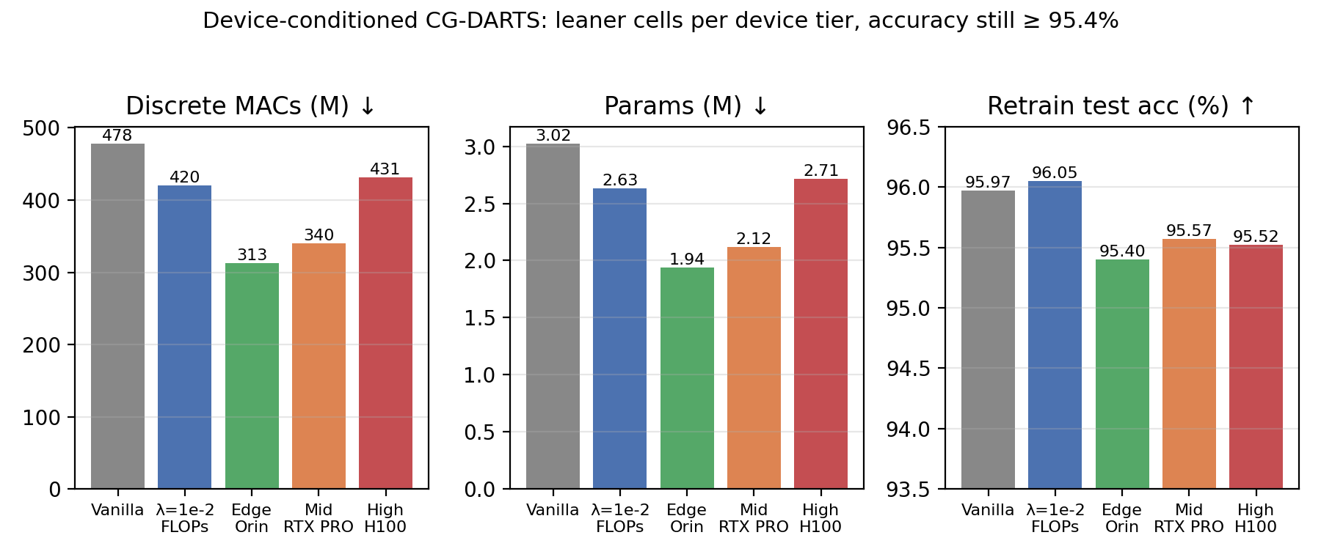
18. Results — Device-conditioned CG-DARTS
Edge (Jetson Orin) / Middle (RTX PRO 6000) / High (H100) · λ=1e-2 · seed=2 · 50ep search / 100ep retrain · device-conditioned branch
Edge profile (high mem weight) → leanest cell (314 M MACs, 1.94 M params). H100 profile (high compute weight) → largest cell (431 M MACs, 2.71 M params).
All three retrains land at 95.4–95.6% — within 0.6 pp of vanilla DARTS, with at most −34% MACs and −36% params.
20

Slide 21
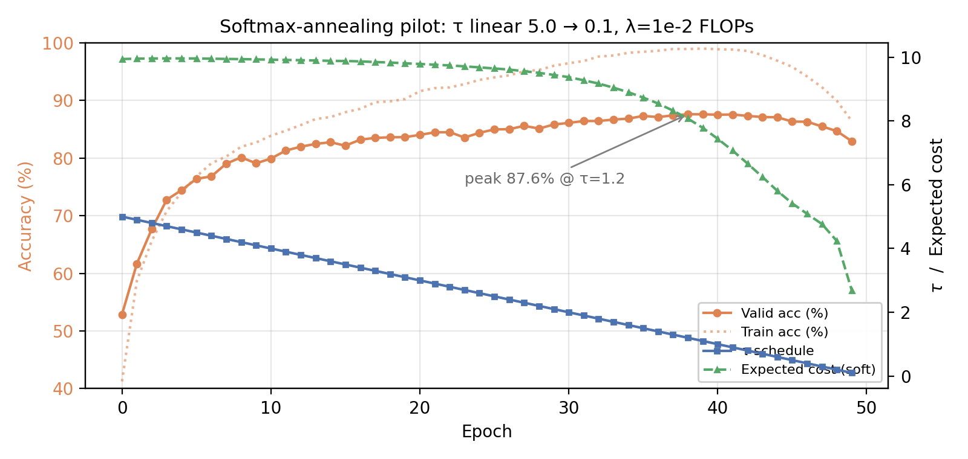
19. Results — annealing pilot #1: linear τ=5→0.1
cnn/search-cg-anneal-tau5to01-lambda1em2-seed2 · valid peaks near τ≈1.0 then collapses — first attempt, failed
21

Slide 22
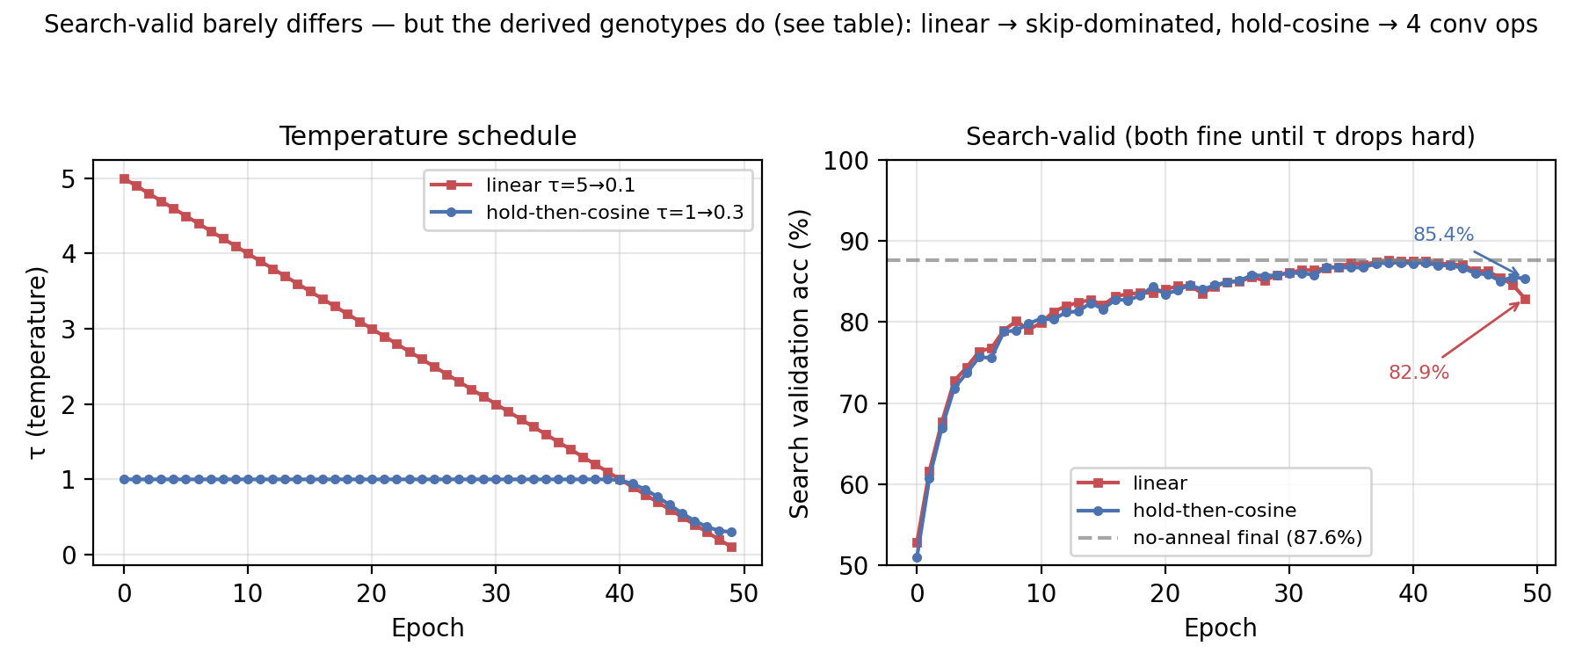
20. Results — annealing pilot #2: schedule shape is decisive
Holding τ=1 through the supernet's learning phase, then annealing only the last 20%, avoids collapse
λ=1e-2 variant | τ schedule | Search-valid | Retrain | Normal-cell convs
no anneal | τ=1 fixed | 87.61 % | 96.05 % | healthy
linear (pilot #1) | τ=5→0.1 from ep 0 | 82.91 % | not run (skip cell) | ~2 (skip-dominated)
hold-then-cosine (pilot #2) | τ=1 to ep39, →0.3 | 85.40 % | 96.04 % | 4 conv ops
22

Slide 23
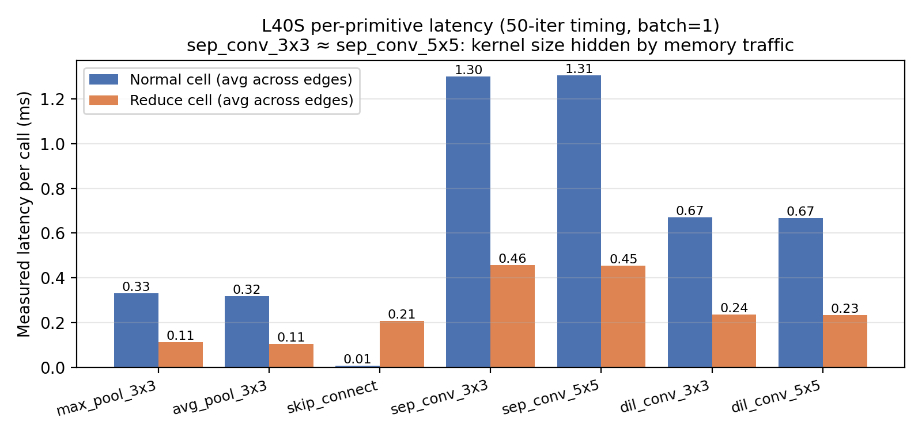
21. Results — L40S latency LUT
reports/latency_lut/l40s.json · 50-iter timing per primitive (batch=1)
23

Slide 24
22. Results — comparison with Liu et al. (2019)
Axis | Liu et al. (2019) | This work | Outcome
Best CIFAR-10 test error | 2.76% (V2, 600ep, 4-seed) | 3.95% (CG-DARTS λ=1e-2, FO, 100ep) | ✗ raw accuracy not matched
Search-cost regularization | none | λ · E[c] across 5 metrics | ✓ new capability
Hardware awareness | none | 3 device profiles + measured LUT | ✓ new capability
Architecture derivation | top-k argmax on α | argmax + cost_sub + cost_div | ✓ open question O2 addressed
Soft-to-hard discretization | flagged as future work | τ-annealing + τ-aware E[c] | ✓ open question O1 addressed
Multi-seed protocol | 4-seed model selection | single seed pilots | ✗ not yet matched
Pareto operating point (CG-DARTS vs. vanilla, matched seed/protocol) | — | +0.08 pp acc · −12% MACs · −13% params @ λ=1e-2 | ✓ Pareto improvement
24

Slide 25
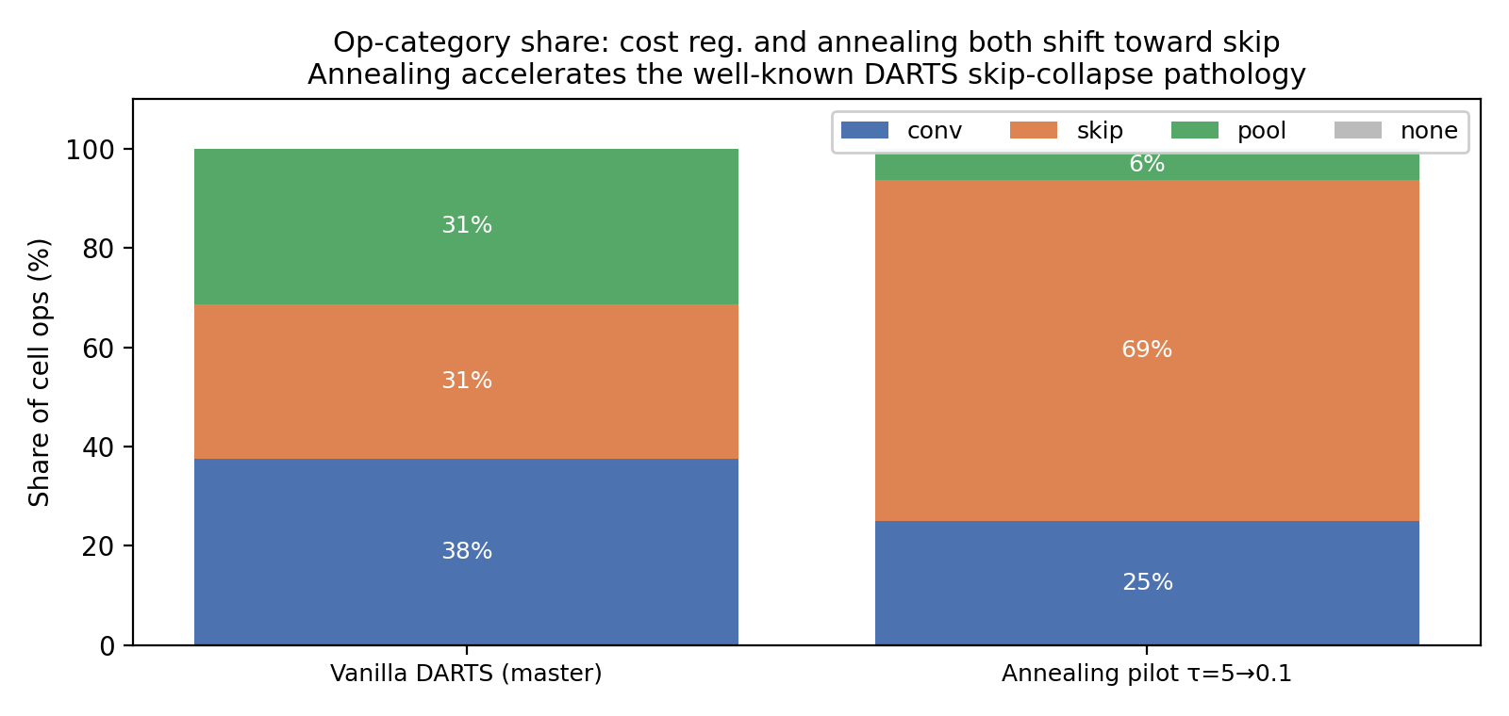
23. Analysis — skip-collapse hypothesis
Cost regularization amplifies the DARTS skip-collapse pathology (Zela et al. 2020, Liang et al. DARTS+)
25

Slide 26
24. Discussion — what works, what doesn't
• What works
– λ=1e-2 Pareto-dominates vanilla under matched protocol — cheaper AND slightly more accurate
– Cost regularizer is metric-agnostic and the same code searches FLOPs / params / memory / device / LUT
– Device conditioning produces genuinely different cells per tier, all within 0.6 pp of vanilla
– Annealing CAN be done safely — schedule shape is what matters, not annealing per se
• What doesn't (or doesn't yet)
– Linear annealing collapses (search-valid 82.9%, skip-dominated cell) — anneals through the learning phase
– Hold-then-cosine rescues it (96.04% retrain, healthy cell) but is accuracy/cost-NEUTRAL at λ=1e-2
– So annealing is safe but not yet a win — its value needs higher λ or pairing with cost-aware derivation
– Single-seed throughout: 0.08 pp deltas are within DARTS seed noise (Zela et al. 2020: ~1 pp std)
26

Slide 27
25. Branch contribution map
Branch | Code contributions | Result artifacts
master (initial CG-DARTS) | cost_utils.py (FLOPs, params, edge norm, λ warmup) architect_cg.py (cost-aware bilevel update) train_search_cg.py (driver) run_cg_sweep.sh, cg_darts_report.py | reports/cg_darts/summary.csv (6 runs: vanilla + 5 λ) Best: λ=1e-2 retrain 96.05% / −12% MACs
experiment/ device-conditioned | memory-bytes metric device_profiles.py (Jetson/RTX PRO/H100) FLOPs+mem+roofline blend params pipeline + report device pipeline + full retrains | reports/cg_darts_params/summary.csv (λ=1e-2, 5e-2) reports/cg_darts_device/summary.csv (3 device tiers) Best params: λ=5e-2 → 94.22% / −32% MACs Device: Edge tier → 95.40% at 313 MACs
experiment/ proposal-driven (this) | τ-annealing search cost-aware derivation (cost_sub/cost_div) latency LUT + cross-device eval multi-seed orchestrator post-hoc rederivation Pareto plotting final report + figures | reports/latency_lut/l40s.json annealing pilot 50ep search cost-aware-disc pilot search complete (retrain pending)
27

Slide 28
26. Limitations
• Single seed (seed=2). +0.08 pp delta is within DARTS seed noise. Multi-seed runner is implemented, not yet executed.
• First-order updates only. Second-order compare script is staged; the Hessian-vector path is implemented but not benchmarked.
• 100-epoch retrain instead of the paper's 600. Our absolute accuracies are 1–2 pp below the published numbers and not directly comparable.
• Skip-collapse not eliminated. CG-DARTS amplifies it; would need PC-DARTS / DARTS+ / DARTS-PT to fix.
• No on-device validation. Roofline + LUT are good but a Jetson / H100 run has not happened.
• No ImageNet transfer. Paper transfers the CIFAR-10 cell at 26.7% top-1. We do not.
• No PTB / recurrent CG-DARTS. rnn/ subtree is untouched; cost-regularization concept carries over but is not implemented.
• Cost-aware derivation retrain results not in by the time of writing — only the search infra and one in-flight retrain queue.
28

Slide 29
27. Conclusions
• CG-DARTS makes hardware cost a first-class signal in DARTS, in both the bilevel objective and the discretization step
• Both open questions from our proposal's slide 16 are addressed:
– O1 (soft-to-hard gap) → τ annealing + τ-aware expected cost
– O2 (performance-aware derivation) → cost_sub / cost_div top-k modes selectable post-hoc on one search
• On a matched single-seed protocol, CG-DARTS at λ=1e-2 Pareto-dominates vanilla DARTS:
– +0.08 pp retrain accuracy · −12% MACs · −13% params
• Empirical surprise: annealing's effect is decided by SCHEDULE SHAPE, not annealing itself
– Linear τ=5→0.1 collapses the search; hold-then-cosine (anneal only last 20%) recovers it (96.04% retrain)
– But hold-then-cosine is accuracy/cost-neutral at λ=1e-2 — annealing is safe, not yet a win
• We do NOT beat the paper's 2.76% headline — that requires multi-seed selection + 600-epoch retrain
– Infrastructure for all of it is ready in this branch; only GPU-time is missing
29

Slide 30
28. Future work + references
• Immediate (already staged in scripts/, ~1 GPU-day each)
– Multi-seed FLOPs sweep at λ ∈ {1e-2, 5e-2} × seeds {0,1,2,3} (scripts/run_multi_seed.sh)
– First-order vs second-order CG-DARTS at λ=1e-2 (scripts/run_second_order_compare.sh)
– Skip-share-vs-λ diagnostic on the multi-seed output (scripts/skip_share_diagnostic.py)
– Cross-device transfer matrix on existing cells (scripts/cross_device_eval.py)
• Medium-term (1–2 GPU weeks)
– On-device latency validation: run cells on a real Jetson / H100; replace roofline with measurements
– Search at 600-epoch retrain protocol with 4-seed selection — closes the comparison-fairness gap with the paper
– Recurrent CG-DARTS on PTB (rnn/) — cost formulation per step × sequence length
• References
– Liu, Simonyan, Yang. DARTS: Differentiable Architecture Search. ICLR 2019.
– Zela et al. Understanding and Robustifying Differentiable Architecture Search. ICLR 2020.
– Liang et al. DARTS+: Improved DARTS with Early Stopping. arXiv 1909.06035.
– Cai, Zhu, Han. ProxylessNAS: Direct NAS on Target Task and Hardware. ICLR 2019.
30

