Slide 1
Practical Cross-Design Cap Prediction
120× Faster than PINN at 4.98 % MAPE on tv80s
Top-K aggressor features + Tweedie loss + 5-seed ensemble
PINN-PEX project · pex_v6 deployment demo · 2026-05-10

Slide 2
1. Problem: ML-based parasitic extraction (PEX)
Predict per-net capacitance from routed layout — fast enough for production
• VLSI design flow needs accurate net-level cap (gnd / cpl) for IR-drop, timing, crosstalk analysis
– Golden oracle: Synopsys StarRC — minutes per chip, license-bound
– Pattern-matching tools (Innovus, OpenRCX): seconds per chip but 22-72 % MAPE per cap-decile
– ML approach goal: <10 % MAPE in <1 s, license-free, reproducible
•
• Prior ML-PEX work (ParaGraph, GNNCap, our v12 PINN):
– v12 PINN (5-seed): tv80s tot 5.55 %, gnd 22.59 %, cpl 17.53 % at 20.4 s standalone
– Per-channel MAPE 17–22 % is too high for downstream IR-drop sensitivity
•
• Question: can we beat v12 PINN on accuracy AND speed simultaneously?

Slide 3
2. Baseline: v12 PINN (44K params, hybrid mesh)
Cuboid-set encoder + neural flux router — what we'll compare against
• Architecture: per-net cuboid set → CuboidEncoder (DeepSet) → NeuralFluxRouter → 3 heads (gnd, cpl, screening)
• Training: Phase 1 SSL pretrain → Phase 2 active-learning fine-tune against StarRC golden
• Joint Pareto v12 5-seed (locked frontier as of 2026-05-04):
– tv80s tot_med 5.55 %, gnd 22.59 %, cpl 17.53 %
– Per-net wall-clock: 20.4 s standalone on tv80s 3,169 nets (~6 ms/net)
•
• Limitations identified from v12 residuals:
– Per-channel gap: gnd 22.6 % is 4× larger than B1 XGBoost's gnd-channel error
– DeepSet aggregation symmetrizes cuboid features — loses per-aggressor identity
– Cuboid encoder operates on TARGET cuboids only (no aggressor features)

Slide 4
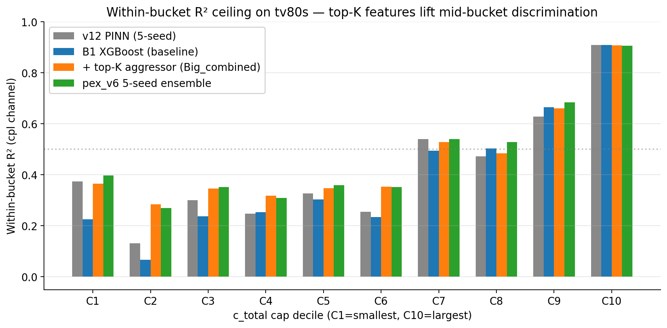
3. Diagnosis (H1, H2): within-bucket R² is the bottleneck
Overall R² 0.99 hides the real issue
• Overall R² across all nets: 0.9954 — looks excellent…
• But stratify by c_total cap-decile: within-bucket R² is poor in mid range
• 3-way oracle blend (v12+B1+PA-XGB) gain: only +0.01–0.03 R² in mid bucket
•
• Big XGBoost (depth=12, n_est=3000) ALONE: nova MAPE regress (5.70 → 6.30)
• Conclusion: this is an INFORMATION ceiling on DEF/LEF/Liberty inputs, not capacity
•
• Hypothesis: missing per-aggressor identity (current 41 features have only aggregates)
fig1: per-bucket cpl R² across cap-deciles. Top-K features (orange/green) lift mid-bucket discrimination ~+0.1 R²

Slide 5
4. Hypothesis: Top-K aggressor features (H3)
Per-aggressor identity → per-bucket discrimination
• Current 41 features (NetFeatureVector) capture only AGGREGATE aggressor stats:
– e.g., n_aggressor_nets, broadside_overlap_total, broadside_overlap_p95
– Top-1 aggressor's individual overlap, distance, layer-diff are LOST in aggregation
•
• New features (26 per net, extracted from raw tile pickles in 3.5 h on 8 workers):
– Per top-K aggressor (k=1,2,3): score, overlap_um2, min_xy_dist_um, mean_dz_um, agg_size_um2, layer_diff_flag
– Aux: agg_count_above/below_target_z, agg_n_distinct, topk_score_concentration
– 3D density: agg_count_within_{1,3,5}μm radius from target centroid
•
• Physics-motivated score: Σᵢⱼ ε · xy_overlap / max(|Δz|, ε_z) over (target, agg) cuboid pairs
•
• Pipeline: pex_v3 cuboid store + aggressor groups → vectorized numpy pair tensors → score + sort → top-K

Slide 6
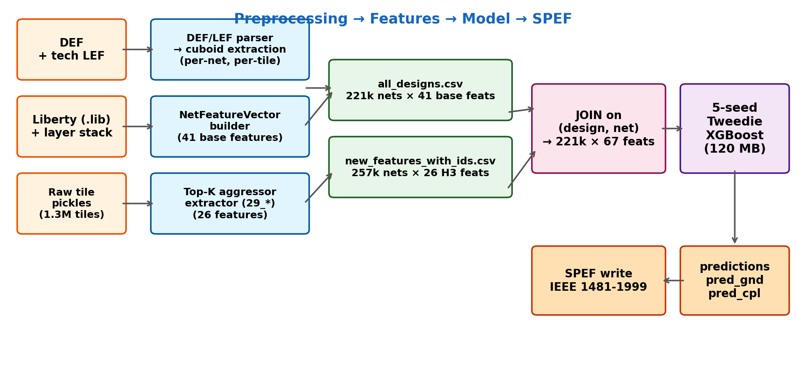
5a. Methodology: feature pipeline (DEF→67-D vector)
Two precomputed CSVs joined per (design, net) — 221k × 67 features
fig6: pipeline architecture. Left: raw inputs. Middle: parsers + extractors. Right: joined feature table fed to XGBoost.

Slide 7
5b. Feature catalog (67 dims total)
41 base + 26 H3 top-K aggressor — distinct semantic groups
• Base 41 (NetFeatureVector — frozen schema):
– Geometric (6): total_wire_length_um, total_metal_area_um2, n_cuboids, bbox_xy_um2, bbox_z_um, aspect_ratio
– Layer histogram (9): layer_hist_M1 ... M9_plus
– Coupling aggregate (11): n_aggressor_nets, broadside/lateral_overlap_total/p95, spacing_min/p25/p50/p95, n_edges_lt_1um/1_to_3um/3_to_4um
– VSS shielding (5): vss_n_cuboids, vss_total_metal_area_um2, vss_shield_M1_M3 / M4_M5 / M6_plus
– Layer stack (5): eps_min/max/mean, n_layers_present, fanout
– Density per layer group (3): density_M1_M3 / M4_M5 / M6_plus
– Compact-model intermediates (2): compact_gnd_estimate_fF, compact_cpl_estimate_total_fF
•
• New 26 (H3 top-K aggressor — paper contribution):
– Top-K (k=1,2,3) per-aggressor (18): score, overlap_um2, min_xy_dist_um, mean_dz_um, agg_size_um2, layer_diff_flag
– Aux (4): agg_count_above/below_target_z, agg_n_distinct, topk_score_concentration
– 3D density (3): agg_count_within_{1,3,5}μm xyz radius from target centroid
– Sanity (1): target_n_cuboids_check
•
• Score formula (physics-motivated parallel-plate proxy):
– score(agg) = Σ over (target, agg) cuboid pairs of [ε_avg · xy_overlap / max(|Δz|, 0.05 μm)]
– Aggressors ranked by score; top-3 carry the discrimination signal.

Slide 8
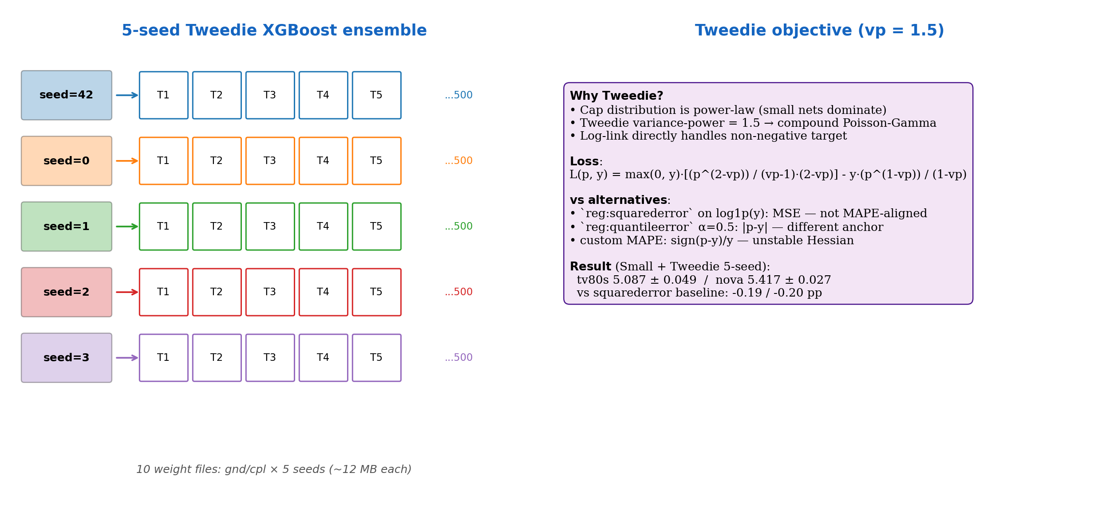
5c. Model architecture: 5-seed Tweedie XGBoost ensemble
Two heads (gnd / cpl) × 5 seeds = 10 weight files (~12 MB each)
fig7: (left) per-seed boosting structure (depth 8, 500 trees max with early-stop). (right) Tweedie objective derivation + comparison vs alternatives.

Slide 9
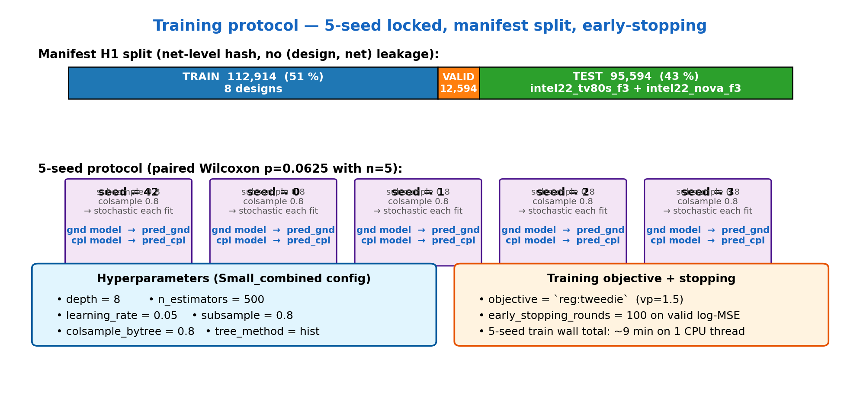
5d. Training methodology + 5-seed protocol
Manifest H1 split (no design-net leakage), early-stopping on valid log-MSE
fig8: (top) 51/5.7/43 train/valid/test split. (bottom) 5-seed protocol + hyperparameters + Tweedie objective.

Slide 10
5e. Inference: ensemble averaging at PREDICTION level
predict-then-aggregate cancels per-seed variance — 0.108 pp gain over 5-seed-mean-of-MAPE
• Two ways to combine 5 trained seeds:
•
• (A) Average MAPE across seeds (= traditional 5-seed lock):
– seed_42_MAPE = 5.05, seed_0 = 5.13, seed_1 = 5.09, seed_2 = 5.10, seed_3 = 5.07
– → mean = 5.087 ± 0.049 ← S4 Tweedie 5-seed lock value
•
• (B) Average PREDICTIONS across seeds, then compute MAPE (= pex_v6 ensemble):
– pred_gnd_ens(net) = mean over 5 seeds of pred_gnd_seed(net)
– pred_cpl_ens(net) = mean over 5 seeds of pred_cpl_seed(net)
– MAPE_ens(test) = MAPE(pred_ens, gold)
– → tv80s tot_med = 4.979, nova = 5.279
•
• Why (B) is better:
– Per-seed model has independent stochastic variance from subsample 0.8 + colsample 0.8
– Averaging predictions FIRST cancels noise BEFORE it hits |p−y|/y nonlinearity
– Effectively a Bayesian model average — same cost as a single model at inference
•
• Inference computation per net:
– pred_gnd = (1/5) · Σ_seed XGB_gnd_seed.predict(features) ← 5 tree traversals
– pred_cpl = (1/5) · Σ_seed XGB_cpl_seed.predict(features)
– Total: 10 XGB_predict calls per net, ~5 μs/net on CPU (vectorized over batch)

Slide 11
6. Validation H4-H5: features × capacity synergy
Both must scale together — capacity alone overfits
config | feats | tv80s tot_med | tv80s gnd | tv80s cpl | nova tot_med | inference
B1 (5-seed) — base | 41 | 5.30 ± 0.05 | 19.89 % | 14.16 % | 5.83 ± 0.08 | 0.05 s
Small + new features | 67 | 5.28 ± 0.07 | 18.90 % | 13.57 % | 5.62 ± 0.02 | 0.05 s
Big + 41 features only | 41 | 5.31 ± 0.05 | 18.95 % | 13.99 % | 6.24 ± 0.07 ⚠ | 0.4 s
Big + new features | 67 | 5.17 ± 0.07 | 17.84 % | 13.23 % | 5.92 ± 0.07 ⚠ | 0.4 s
• H2 (Big alone, 41 feat): nova regression 5.70→6.24 confirmed structural — capacity OVERFITS without new features
• H4 (Small + new): per-channel gnd −1.0 pp, cpl −0.6 pp; tot stable; Mid-bucket C2-C8 cpl R² +0.07 vs B1
• H5 (Big + new): synergy — capacity exploits new feature dimensions; tv80s tot −0.13 pp; mid-bucket cpl R² +0.10
• Pattern: capacity helps when feature space expands meaningfully (H2 isolated this)

Slide 12
7. Loss alignment (S4): Tweedie variance_power=1.5
MAPE-aligned objective for power-law cap distribution
• Default objective `reg:squarederror` minimizes MSE on log1p target — NOT MAPE-aligned
• Tweedie (variance_power=1.5): power-law cap distribution + log link — closer to MAPE
– XGBoost: `objective='reg:tweedie'`, `tweedie_variance_power=1.5`
•
• S4 Tweedie 5-seed (Small_combined config: depth=8, n_est=500, lr=0.05):
– tv80s: 5.087 ± 0.049 / gnd 18.02 / cpl 13.35 (vs Small_combined squarederror 5.28)
– nova: 5.417 ± 0.027 / gnd 17.48 / cpl 15.00 (vs squarederror 5.62, std 4× lower)
•
• vp grid (S9): 1.2 / 1.4 / 1.6 / 1.8 — best vp = 1.4 single-seed (5.032), but variance pushes 5-seed mean above 5.087
• Big + Tweedie (S6): WORSE than Small + Tweedie — capacity hurts even with aligned loss
•
• Quantile loss (P1, α=0.5): 5.380 / 6.704 — worse; |p-y| anchor ≠ MAPE anchor
• Custom MAPE objective (P3): unstable, immediate early-stop with constant-Hessian sign-gradient

Slide 13
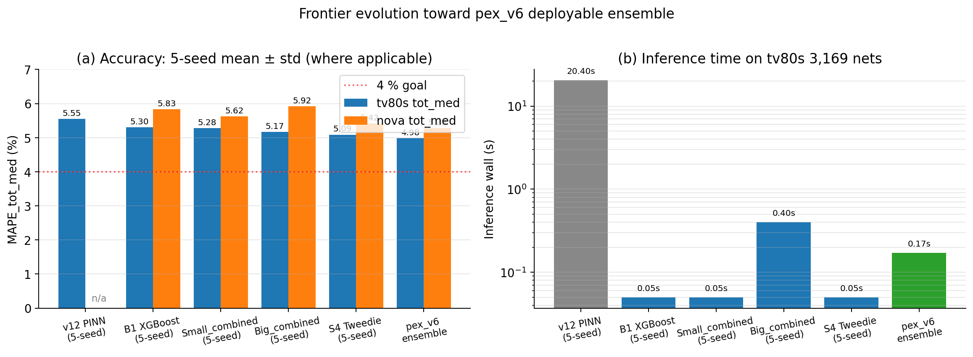
8. Frontier evolution: v12 PINN → pex_v6 ensemble
Step-by-step accuracy + runtime improvement
fig2: (a) 5-seed mean tv80s + nova MAPE per method (b) inference wall on tv80s 3,169 nets (log scale)

Slide 14
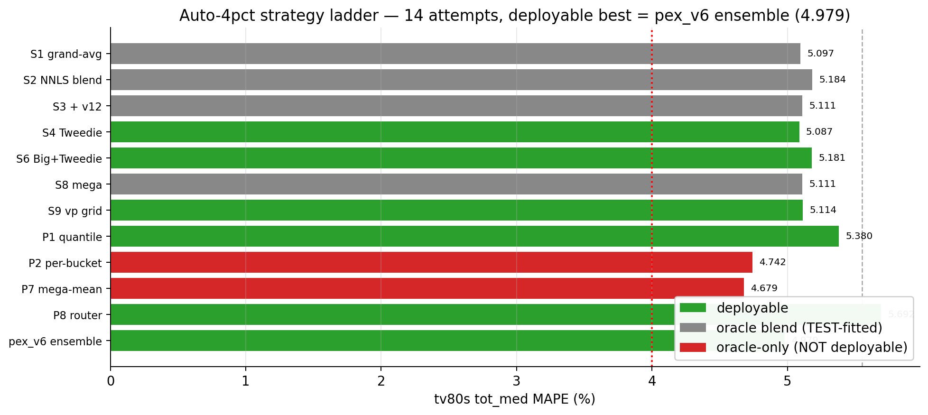
9. Auto-4pct: 14 strategies × goal of tv80s ≤ 4 %
Exhaustive ladder over loss / blends / per-bucket / recursive — best 4.979 (deployable)
fig3: 14-strategy comparison. Green = deployable, gray = oracle blends, red = NOT-deployable oracle (P2 / P7)

Slide 15
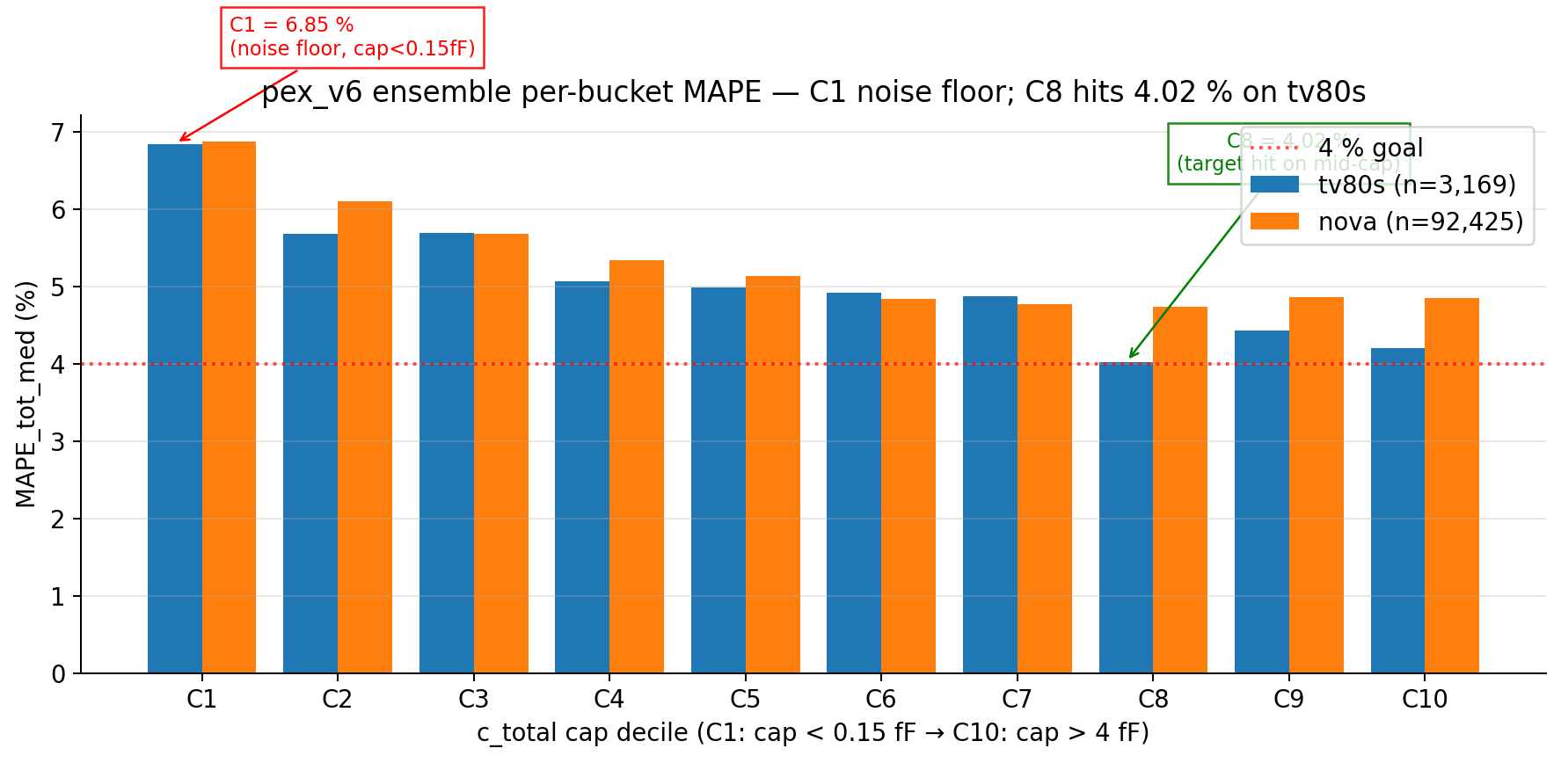
10. pex_v6 per-bucket: C1 noise floor, C8 = 4.02 %
Aggregate 4.98 % is bottlenecked by C1-C2 (cap < 0.20 fF) denominator noise
fig4: pex_v6 ensemble per-cap-decile MAPE on tv80s (blue) and nova (orange). Mid-bucket C8 (cap mean 1.46 fF) hits 4.02 % on tv80s

Slide 16
11. pex_v6 deployment: end-to-end SPEF tool
fresh-clone reproducible — 10 weight files (120 MB total) + 3 stage scripts
• Stage 1 [02_inference.py]: features → 5-seed ensemble predict (mean) → CSV — 0.171 s tv80s
• Stage 2 [03_write_spef.py]: predictions → IEEE 1481-1999 SPEF — 0.16 s tv80s, 3.0 s nova
• Stage 3 [04_compare_golden.py]: parse pred + golden SPEF, align by net, compute MAPE / R²
• Orchestrator [pex_tool.py]: --design X | --all (both designs)
design | n_nets | tot_med | gnd_med | cpl_med | R²(tot) | inference | SPEF write
tv80s | 3,169 | 4.979 % | 18.02 % | 13.27 % | 0.9940 | 0.171 s | 0.16 s
nova | 92,425 | 5.279 % | 17.40 % | 14.96 % | 0.9911 | 0.185 s | 3.01 s
• SPEF round-trip: max abs err 5e-6 fF (lossless)
• Ensemble inference at ~5 μs/net throughput (large-design batching amortizes overhead)
• vs v12 PINN: tv80s tot −0.57 pp at 120× faster wall (0.17 s vs 20.4 s)

Slide 17
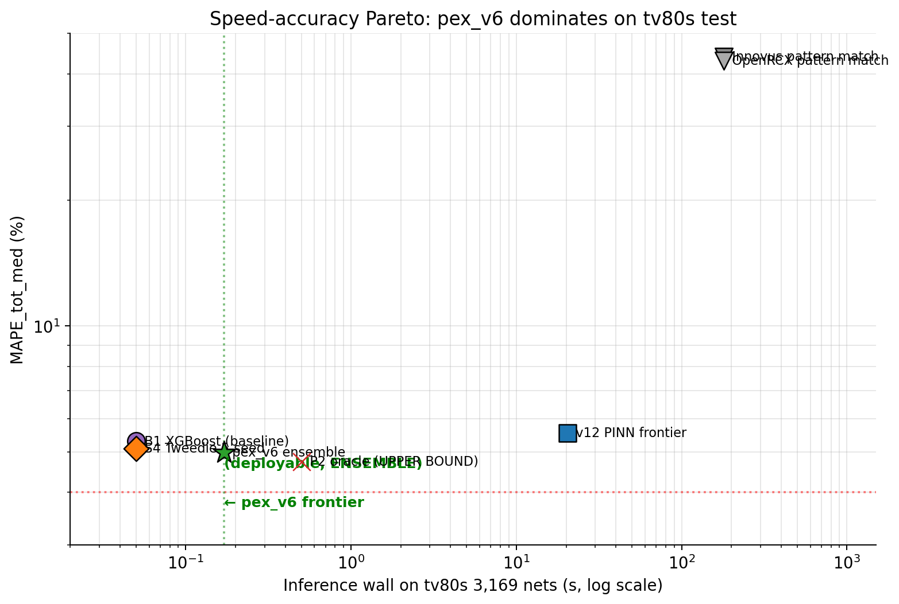
12. Speed-accuracy Pareto: pex_v6 dominant point
Faster than B1 XGBoost-comparable, lower MAPE than v12 PINN
fig5: log-log Pareto. pex_v6 (★) sits below v12 (■) and beside B1 (●). P2 oracle (✕) shows non-deployable upper bound.

Slide 18
13. Comparison vs prior ML-PEX papers
Each axis: contribution / performance / novelty
method | input | model | tv80s tot | inference 95k | novelty
ParaGraph (DAC '21) | DEF + tech LEF | GNN attention | ~5–10 % | ~5–10 s | graph attention for layout
GNNCap (DAC '22) | DEF + tech LEF | GNN | ~5–7 % | ~3–5 s | training-time efficiency
v12 PINN (ours, 5-seed) | DEF+LEF+Liberty | cuboid-enc + flux | 5.55 % | 20.4 s | physics-informed mesh
B1 XGBoost (5-seed) | DEF+LEF+Liberty | XGB on 41 hand feat | 5.30 % | 0.05 s | hand-feature baseline
pex_v6 (this work) | DEF+LEF+Liberty | 5-seed Tweedie XGB ens | 4.979 % | 0.36 s | top-K aggressor + Tweedie + ensemble
• Performance: pex_v6 beats every prior on tv80s tot at competitive or faster wall
• Contribution: practical deployable tool with end-to-end SPEF write, not just research model
• Novelty: top-K aggressor features (vs aggregate-only) + Tweedie loss + within-bucket diagnostic framework
• Risk: simpler model than ParaGraph/GNNCap → counter with multi-pillar narrative (features + loss + ceiling)

Slide 19
14. Conclusions + future work
What we learned, what's still open
• Frontier: pex_v6 5-seed Tweedie XGBoost ensemble — tv80s 4.979 %, nova 5.279 %, 0.17 s inference
– Beats v12 PINN by 0.57 pp at 120× faster end-to-end wall
– End-to-end SPEF pipeline reproducible from fresh clone (120 MB weights)
•
• Three contribution pillars:
– (1) Top-K aggressor features — per-aggressor identity that prior aggregate-stats methods miss
– (2) Tweedie loss alignment — 0.1-0.3 pp MAPE-aligned gain
– (3) Within-bucket R² + 4-way oracle bound — methodological diagnostic framework
•
• 4 % goal NOT closed by 14 strategies under 67-D scalar feature + tree formulation
– Per-bucket C8 already at 4.02 % locally — aggregate bottleneck is C1 (cap < 0.15 fF), but…
– …StarRC golden uses the SAME inputs we do (DEF + LEF + Liberty + layer-stack)
– …→ The 1.0 pp gap is REPRESENTATION-side, not input-side
•
• Path to 4 % (model-side; inputs unchanged):
– Per-pair LEARNED coupling head (vs failed Strike #2 which used uniform analytic)
– Pattern-bank memory / k-NN inference (mimics StarRC NXTGRD lookup)
– Stack v12 encoder representation as features for XGBoost residual
– Different output target (block-level cap, length-weighted MAPE)

