Slide 1
手写字体分类案例
苏康

Slide 2
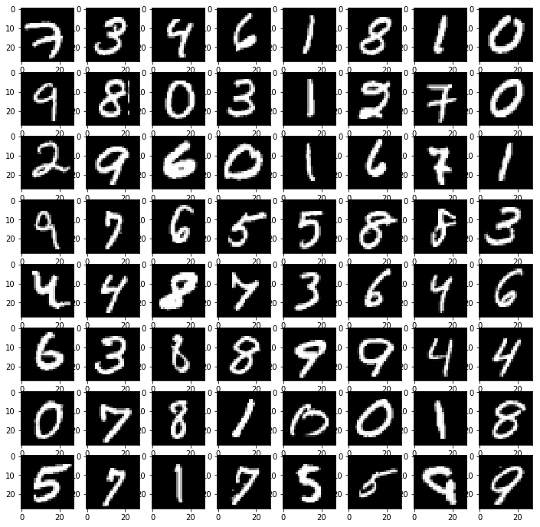
手写字体

Slide 3
手写字体不同算法分类结果
http://yann.lecun.com/exdb/mnist/

Slide 4
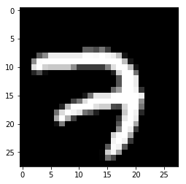
数据集介绍及不同算法分类准确率
28*28，一个图像784个像素
p1 | p2 | p3 | … | p782 | p783 | p784
训练集尺寸：(55000, 784)，表示5.5W张图像。784是图像像素的展开形式
Q:训练集目标尺寸(55000, 10)?

Slide 5
独热编码(one-hot coding)
0
1
2
3
4
5
6
7
8
9
1,0,0,0,0,0,0,0,0,0
0,1,0,0,0,0,0,0,0,0
0,0,1,0,0,0,0,0,0,0
0,0,0,1,0,0,0,0,0,0
0,0,0,0,1,0,0,0,0,0
0,0,0,0,0,1,0,0,0,0
0,0,0,0,0,0,1,0,0,0
0,0,0,0,0,0,0,1,0,0
0,0,0,0,0,0,0,0,1,0
0,0,0,0,0,0,0,0,0,1
独热
编码

Slide 6

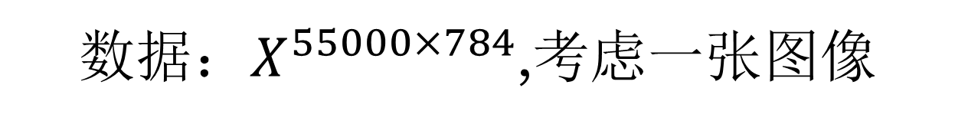

分类过程
${数据：X}^{55000×784}$,考虑一张图像
${线性模型：X}^{1×784}∙W^{784∗10}$+b
10,3,1,0,0,0,-5,0,0,0(数字0)
softmax
$${Tensor}^{1∗10}(数值介于0到1)$$
交叉熵损耗函数
$${loss:number}^{1∗1}$$

Slide 7
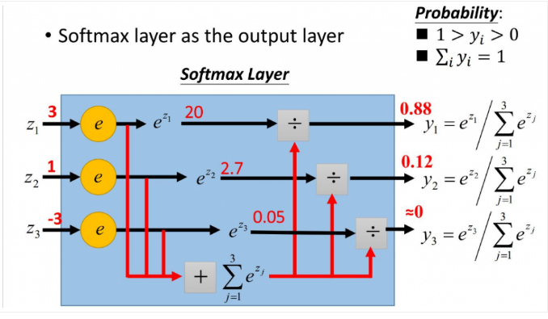
作用：多分类过程中，它将多个神经元的输出，映射到（0,1）区间内，可以看成概率来理解。
softMax 函数

Slide 8
交叉熵损失函数
预测分布[p1,p2]
实际分布[p3,p4]
CE=-[p3*log(p1)+ p4*log(p2)]
如：
预测分布[0.3,0.7]
实际分布[0.4,0.6]
CE=-[0.4*log(0.3)+ 0.6*log(0.7)]

Slide 9
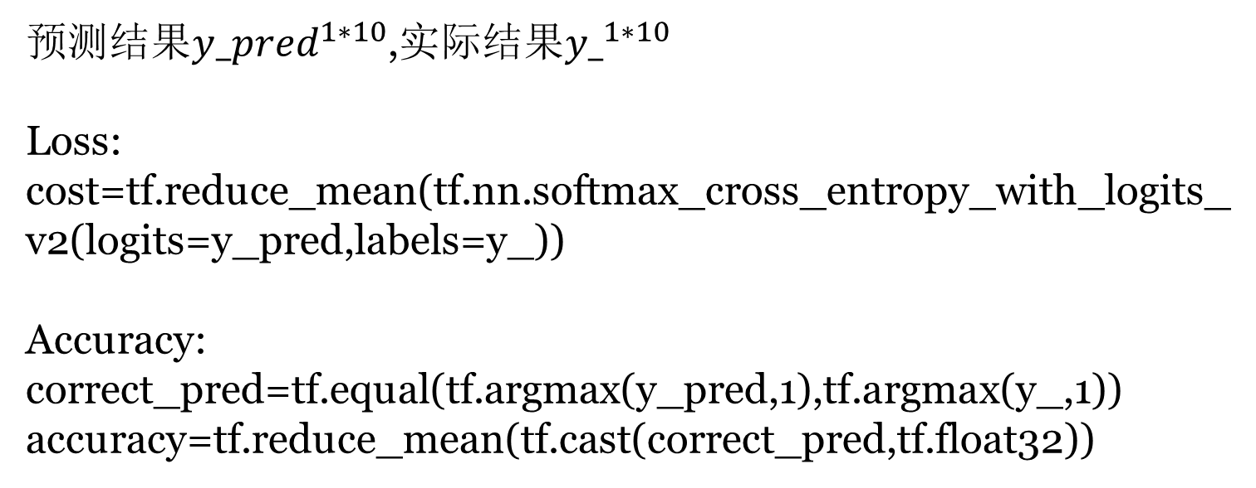
TensorFlow 代码
预测$结果{y_pred}^{1∗10}$,实际结果${y_}^{1∗10}$
Loss:
cost=tf.reduce_mean(tf.nn.softmax_cross_entropy_with_logits_v2(logits=y_pred,labels=y_))
Accuracy:
correct_pred=tf.equal(tf.argmax(y_pred,1),tf.argmax(y_,1))
accuracy=tf.reduce_mean(tf.cast(correct_pred,tf.float32))

Slide 10
import numpy as np import matplotlib.pyplot as plt import tensorflow as tf lr=0.01 x=np.array([[1.],[2.],[3.],[4.],[5.]])##横坐标 y=np.array([[2.],[3.1],[3.8],[5.1],[6.]])##纵坐标 w=tf.Variable(tf.random_normal([1,1]),name='weight') b=tf.Variable(tf.random_normal([1,1]),name='bias') ###定义输入的横坐标和纵坐标 x_=tf.placeholder(tf.float32,shape=(5,1)) y_=tf.placeholder(tf.float32,shape=(5,1)) ### 损耗函数 y_predict=tf.matmul(x_,w)+b loss=tf.reduce_mean(tf.square(y_predict-y_)) ###梯度下降 train_step=tf.train.GradientDescentOptimizer(lr).minimize(loss) init=tf.global_variables_initializer() ##训练过程 with tf.Session() as sess: sess.run(init) ##训练1000次 for i in range(1000): sess.run(train_step,feed_dict={x_:x,y_:y}) if (i+1)%50==0: print("循环次数:",(i+1)) print("loss:",sess.run(loss,feed_dict={x_:x,y_:y})) print("w:",sess.run(w),"b:",sess.run(b))
源程序可以如何修改？

