Slide 1
线性回归回顾及发散
苏康

Slide 2
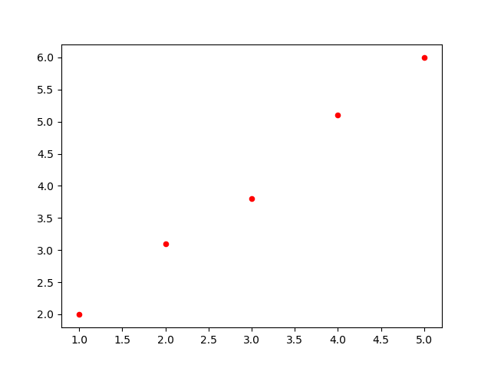
线性回归
需要拟合直线

Slide 3
import numpy as np import matplotlib.pyplot as plt import tensorflow as tf lr=0.01 x=np.array([[1.],[2.],[3.],[4.],[5.]])##横坐标 y=np.array([[2.],[3.1],[3.8],[5.1],[6.]])##纵坐标 w=tf.Variable(tf.random_normal([1,1]),name='weight') b=tf.Variable(tf.random_normal([1,1]),name='bias') ###定义输入的横坐标和纵坐标 x_=tf.placeholder(tf.float32,shape=(5,1)) y_=tf.placeholder(tf.float32,shape=(5,1)) ### 损耗函数 y_predict=tf.matmul(x_,w)+b loss=tf.reduce_mean(tf.square(y_predict-y_)) ###梯度下降 train_step=tf.train.GradientDescentOptimizer(lr).minimize(loss) init=tf.global_variables_initializer() ##训练过程 with tf.Session() as sess: sess.run(init) ##训练1000次 for i in range(1000): sess.run(train_step,feed_dict={x_:x,y_:y}) if (i+1)%50==0: print("循环次数:",(i+1)) print("loss:",sess.run(loss,feed_dict={x_:x,y_:y})) print("w:",sess.run(w),"b:",sess.run(b))

Slide 4
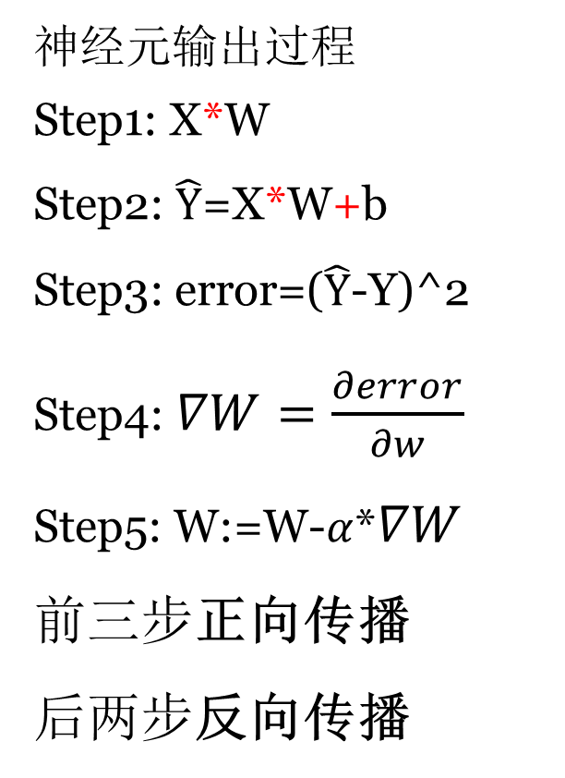

线性回归网络结构
神经网络训练过程
神经元输出过程
Step1: X*W
Step2: $\hat{Y}$=X*W+b
Step3: error=($\hat{Y}$-Y)^2
Step4: $∇W=\frac{∂error}{∂w}$
Step5: W:=W-$α$*$∇W$
前三步正向传播
后两步反向传播
W
b
误差
X
+
$$\hat{Y}$$
预测函数
*
权重更新过程

Slide 5


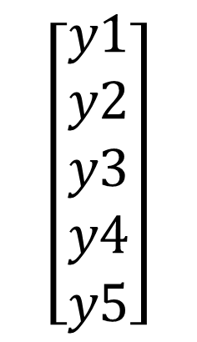
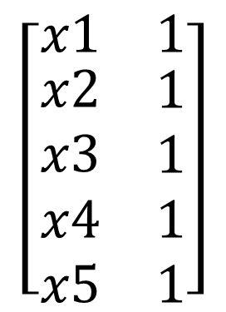
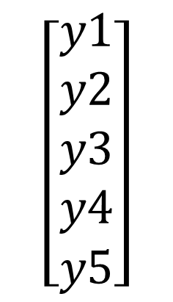

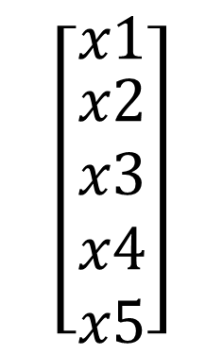


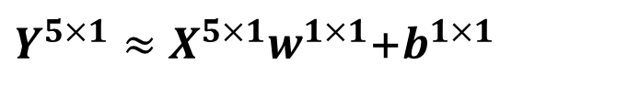
线性回归
$$\left[\begin{matrix}x1 \\ \begin{aligned}x2 \\ x3 \\ x4 \\ x5\end{aligned}\end{matrix}\right]$$
$$\left[\begin{matrix}y1 \\ \begin{aligned}y2 \\ y3 \\ y4 \\ y5\end{aligned}\end{matrix}\right]$$
$$X^{5×1}=$$
$$Y^{5×1}=$$
$Y^{5×1}≈X^{5×1}w^{1×1}$+$b^{1×1}$
$$\left[\begin{matrix}x1 & 1 \\ \begin{aligned}x2 \\ x3 \\ x4 \\ x5\end{aligned} & \begin{aligned}1 \\ 1 \\ 1 \\ 1\end{aligned}\end{matrix}\right]$$
$$\left[\begin{matrix}y1 \\ \begin{aligned}y2 \\ y3 \\ y4 \\ y5\end{aligned}\end{matrix}\right]$$
$$X^{5×2}=$$
$$Y^{5×1}=$$
$$Y^{5×1}≈X^{5×2}W^{2×1}$$
两行一列的张量
W2=[w1
b1 ]
Q:${ 数学上W}^{2×1}$和$w^{1×1}，b^{1×1}有什么关系？$

Slide 6
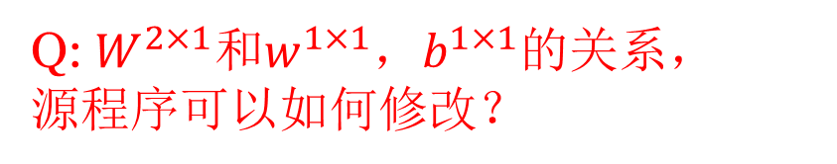
import numpy as np import matplotlib.pyplot as plt import tensorflow as tf lr=0.01 x=np.array([[1.],[2.],[3.],[4.],[5.]])##横坐标 y=np.array([[2.],[3.1],[3.8],[5.1],[6.]])##纵坐标 w=tf.Variable(tf.random_normal([1,1]),name='weight') b=tf.Variable(tf.random_normal([1,1]),name='bias') ###定义输入的横坐标和纵坐标 x_=tf.placeholder(tf.float32,shape=(5,1)) y_=tf.placeholder(tf.float32,shape=(5,1)) ### 损耗函数 y_predict=tf.matmul(x_,w)+b loss=tf.reduce_mean(tf.square(y_predict-y_)) ###梯度下降 train_step=tf.train.GradientDescentOptimizer(lr).minimize(loss) init=tf.global_variables_initializer() ##训练过程 with tf.Session() as sess: sess.run(init) ##训练1000次 for i in range(1000): sess.run(train_step,feed_dict={x_:x,y_:y}) if (i+1)%50==0: print("循环次数:",(i+1)) print("loss:",sess.run(loss,feed_dict={x_:x,y_:y})) print("w:",sess.run(w),"b:",sess.run(b))
Q:${ W}^{2×1}$和$w^{1×1}，b^{1×1}的关系，$
源程序可以如何修改？

Slide 7

从线性回归来看网络定义
定义网络参数和输入
w=tf.Variable(tf.random_normal([1,1]),name='weight') b=tf.Variable(tf.random_normal([1,1]),name='bias') x_=tf.placeholder(tf.float32,shape=(5,1)) y_=tf.placeholder(tf.float32,shape=(5,1))
w
b
X
+
$$\hat{Y}$$
*

Slide 8
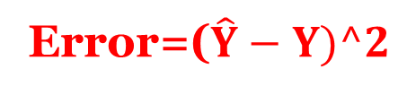

从线性回归来看网络定义
2. 定义网络损耗函数和优化算法
y_predict=tf.matmul(x_,w)+b loss=tf.reduce_mean(tf.square(y_predict-y_))
train_step=tf.train.GradientDescentOptimizer(lr).minimize(loss)
X
+
$$\hat{Y}$$
*
Error=($\hat{Y}−Y)^2$
优化算法

Slide 9
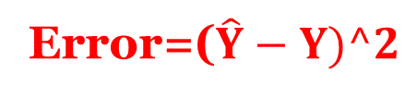
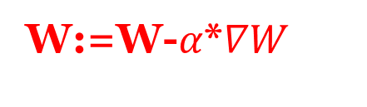

从线性回归来看网络定义
3. 训练神经网络
with tf.Session() as sess: sess.run(init) ##训练1000次 for i in range(1000): sess.run(train_step,feed_dict={x_:x,y_:y})
w
b
X
$$\hat{Y}$$
*
+
Error=($\hat{Y}−Y)^2$
优化算法
W:=W-$α$*$∇W$

Slide 10
波斯顿房价拟合
##波斯顿房价拟合
import numpy as np
import tensorflow as tf
#array(['CRIM', 'ZN', 'INDUS', 'CHAS', 'NOX', 'RM', 'AGE', 'DIS', 'RAD','TAX', 'PTRATIO', 'B', 'LSTAT'])
data_all=np.loadtxt(r'D:\\Python\\workspace\\boston_data.csv', delimiter=',')
features=data_all[:,:-1]
print("整个数据矩阵尺寸为:",data_all.shape,"特征矩阵尺寸为:",features.shape)
price=data_all[:,-1]
print("价格矩阵尺寸为:",price.shape)
##features增加一个特征(常数1)，把price向量转为张量
X=np.concatenate((features,np.ones((price.shape[0],1))),axis=1)
Y=price[:,np.newaxis]
print("训练矩阵尺寸为:",X.shape,"目标矩阵尺寸为:",Y.shape)

