Slide 1
Assignment #2: CNN Implementation
Paul Hongsuck Seo
phseo@korea.ac.kr
Korea University

Slide 2
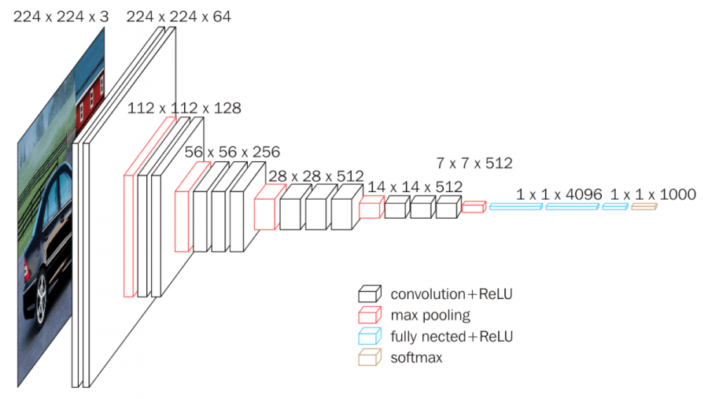
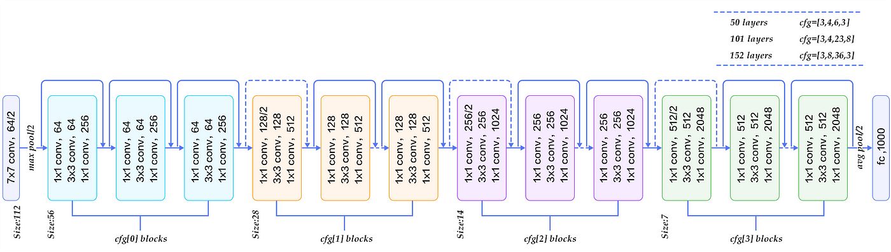
CNN Implementation
Implement CNN Classifier
Perform the image classification using “CIFAR-10” dataset with CNN (VGG and ResNet).
The Ipython Notebook “CNN_Implementation.ipynb” will walk you through the implementation of CNN classifier.

Slide 3
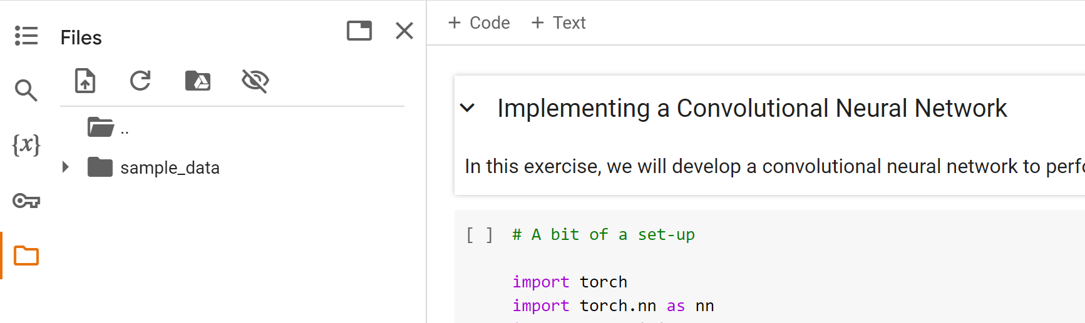
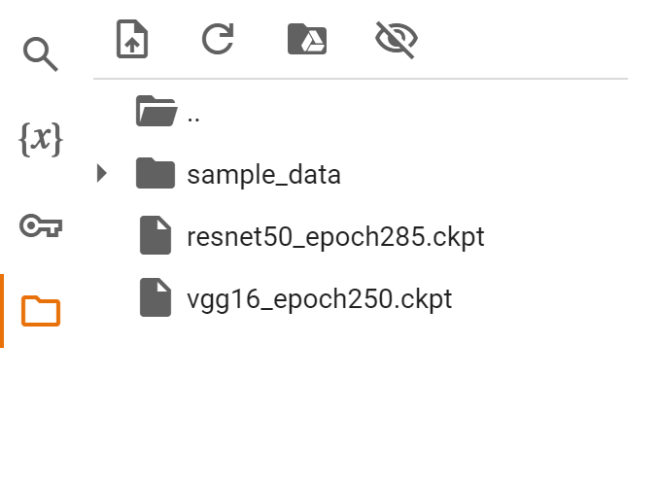
CNN Implementation
Requirements
Download the attached zip file
Open the CNN_Implementation.ipynb with colab notebook
Upload the other .ckpt files to session storage

Slide 4
CNN Implementation
Instructions
Follow the instructions in the CNN_Implementation.ipynb notebook to complete the assignment.
Load the “CIFAR-10” data (No need for any modifications)
Practice training using the provided VGG code (No need for any modifications)
Complete the ResNet code and train the ResNet model
CNN_Implementation.ipynb is based on PyTorch.

Slide 5
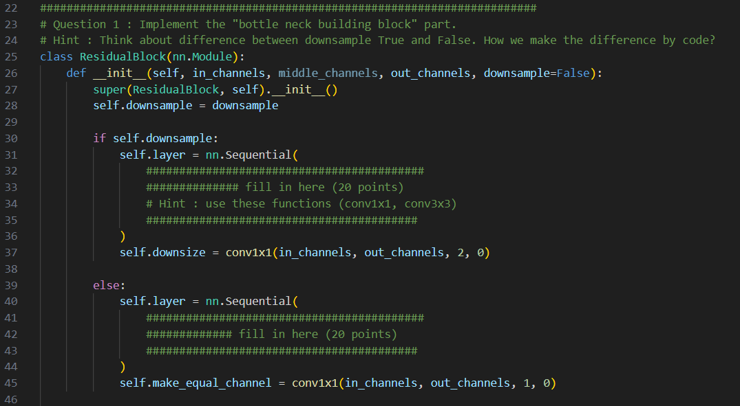
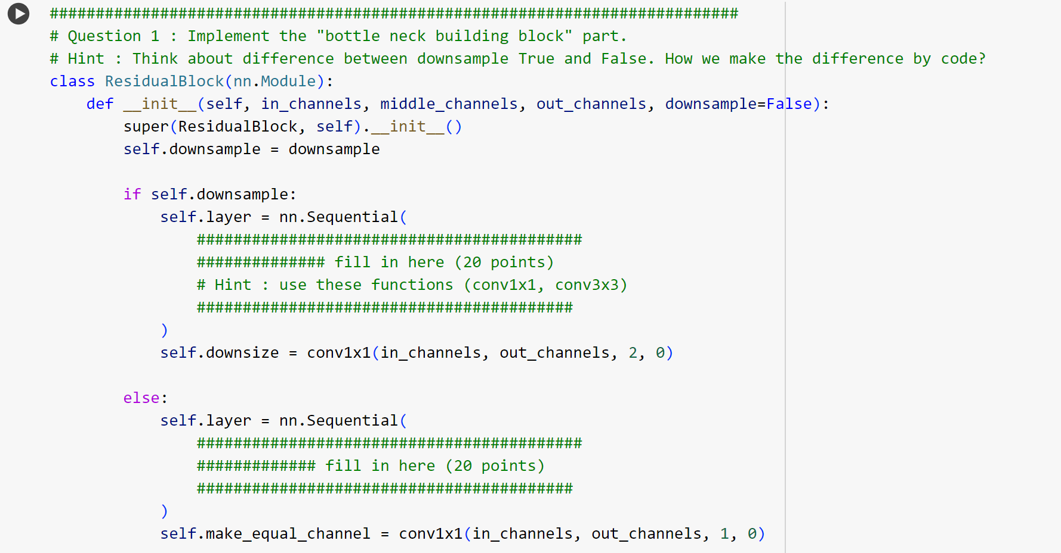
CNN Implementation
Instructions
After practicing with the provided VGG code, complete the resnet50_skeleton.py and the corresponding cell in CNN_Implementation.ipynb
Training ResNet-50 Model using the other cells in the CNN_Implementation.ipynb

Slide 6
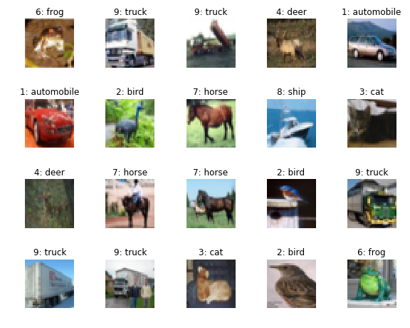
CIFAR-10 Dataset
What is CIFAR-10?
CIFAR-10 stands for the Canadian Institute For Advanced Research.
The dataset consists of 60,000 32x32 color images in 10 different classes.
https://www.cs.toronto.edu/~kriz/cifar.html
Dataset Composition
Training Set: 50,000 images.
Test Set: 10,000 images.
Each image is a 32x32 color pixel image (32x32 pixels x 3 color channels).

Slide 7
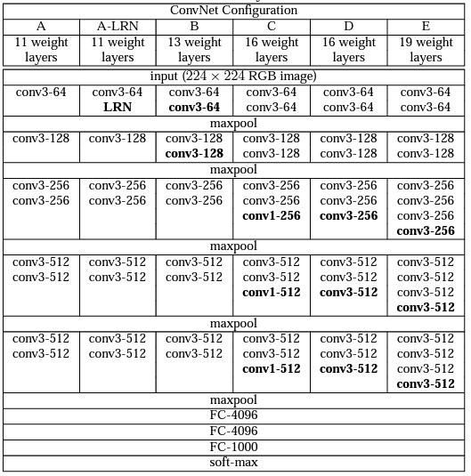
VGG Networks – Practice
VGG Networks
VGG is a deep convolutional neural network architecture developed by researchers at the University of Oxford
VGG use small 3x3 convolutional filters consistently across the entire network.
https://arxiv.org/abs/1409.1556

Slide 8
VGG Networks – Practice
VGG Networks
Design Characteristics
The VGG family consists of several models, named from A to E.
VGG networks range from 11 to 19 layers, with increasing depth.
Starting with 64 channels, the number doubles after each max-pooling layer, reaching 512 channels.
All configurations follow a similar design but differ in depth and the number of convolutional layers.

Slide 9
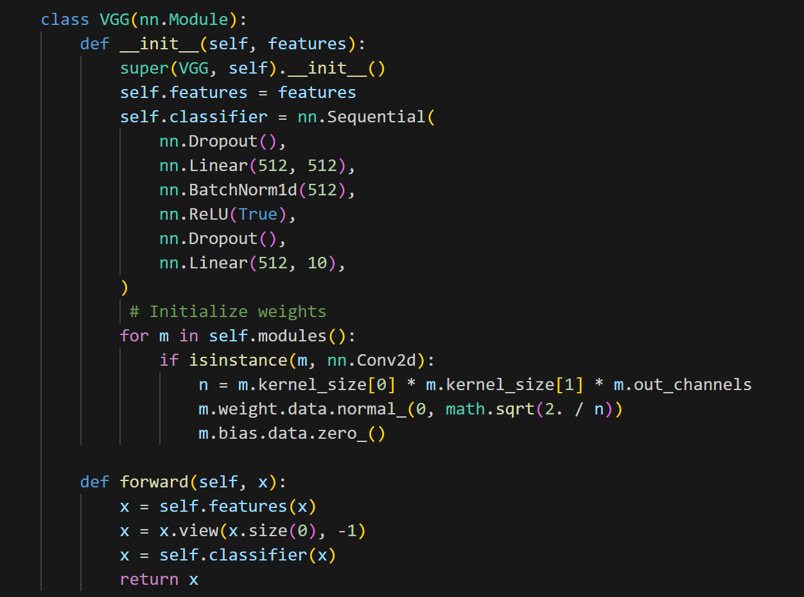
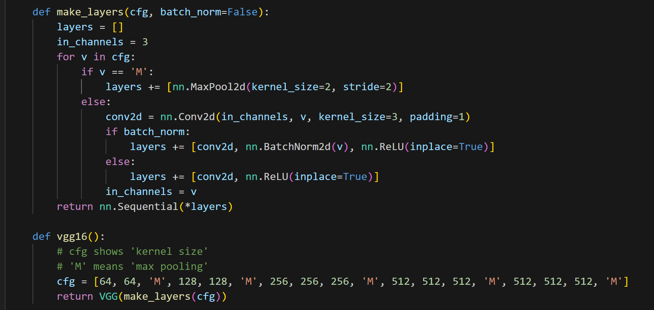

VGG Networks – Practice
Train “VGG-16”
Code Flow
Initialize
Make layers
- ‘M’ : Maxpool
- Else: Convolution + ReLu
Forward

Slide 10
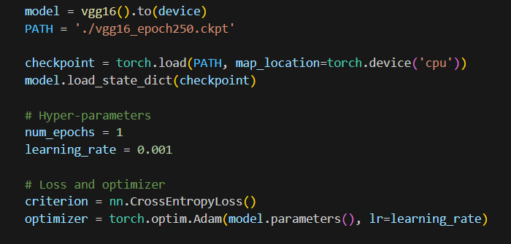
VGG Networks – Practice
Train “VGG-16” model with “CIFAR-10” datasets
Optimize parameters with Adam optimizer and cross Entropy Loss
Use “VGG-16” model with torch.nn library
Get “CIFAR-10” Dataset with torchvision library
Procedure
Load the trained model (which is given)
Train it with CPU or GPU
You can use a trained checkpoint parameters of 250 epochs. You will train model only 1 epoch.

Slide 11
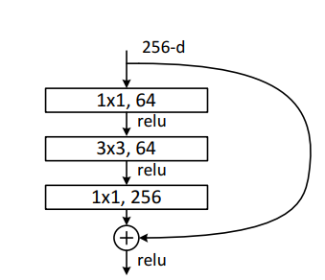
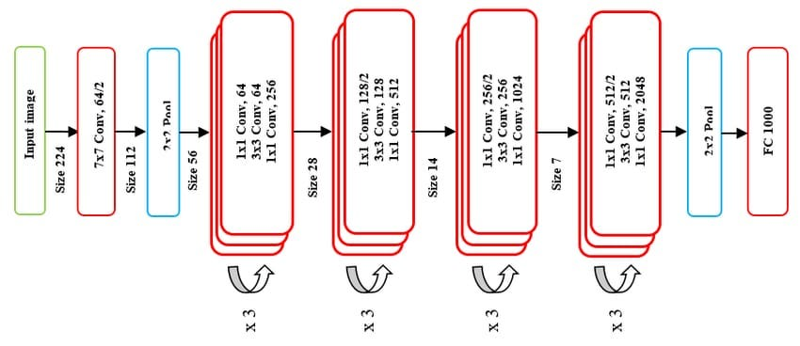
ResNet – Question
ResNet
ResNet is a deep convolutional neural network architecture developed by researchers at Microsoft Research.
ResNet introduced the concept of "residual learning" to address the problem of vanishing gradients in very deep networks.
The network uses skip connections to bypass one or more layers.
https://arxiv.org/abs/1512.03385
Note) The homework codes are different from the original Resnet50 structure. When you do homework, please refer to the table on page 13,14 not left figure.

Slide 12
ResNet – Question
ResNet
Design Characteristics
The ResNet family consists of several models, such as ResNet-18, ResNet-34, ResNet-50, ResNet-101, and ResNet-152, with varying depths.
Each residual block contains two or more convolutional layers and a shortcut connection that adds the input of the block directly to its output.
This design enables very deep networks without the degradation problem, making it possible to build networks with hundreds of layers.

Slide 13
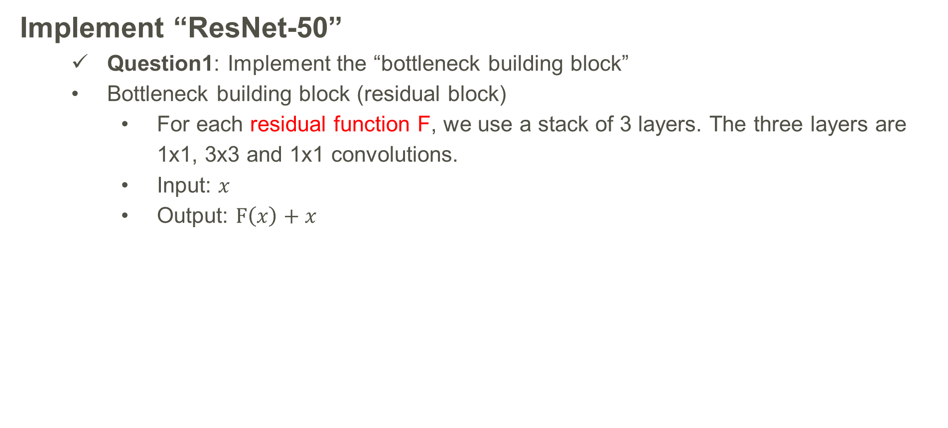
ResNet – Question
Implement “ResNet-50”
Question1: Implement the “bottleneck building block”
Bottleneck building block (residual block)
For each residual function F, we use a stack of 3 layers. The three layers are 1x1, 3x3 and 1x1 convolutions.
Input: $x$
Output: $F\left(x\right)+x$
Note) This structure is different form the
original Building block on the Resnet. In the
original ResNet, “relu” is executed after
operation”.

Slide 14
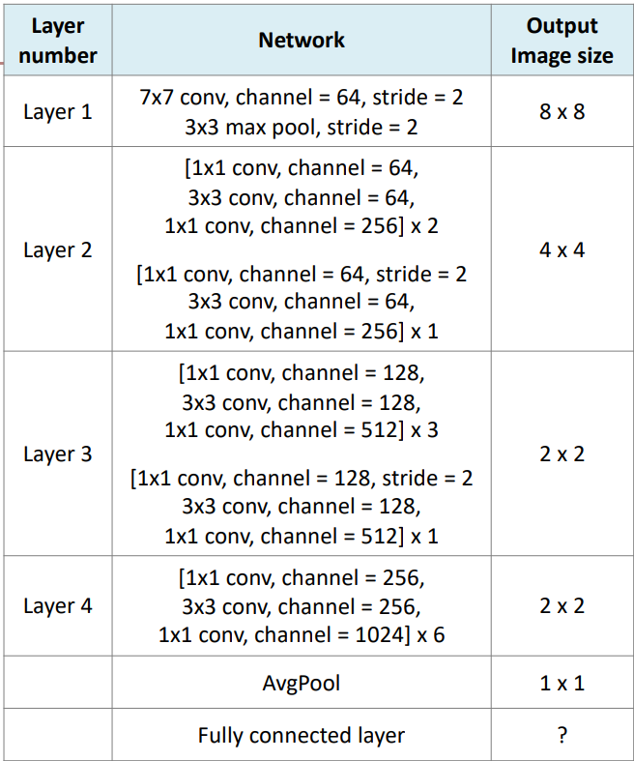
ResNet – Question
Implement “ResNet-50”
Question2: Implement the “ResNet50_layer4”
Network Architecture
It is different from the original ResNet50.
Complete the network code by looking at the table.
Fill in the #blank# in the code.
You need to accurately structure the network architecture in the table!
The code may still run even if the structure differs, but points may be deducted.

Slide 15
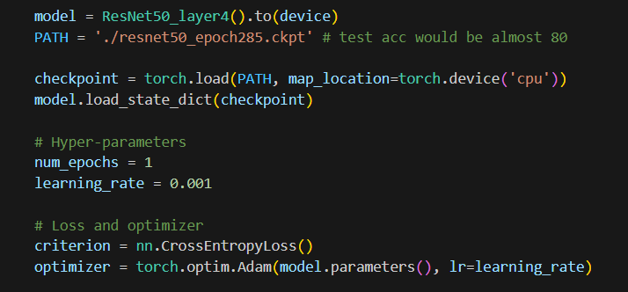
ResNet – Question
Train “ResNet-50” model with “CIFAR-10” datasets
Optimize parameters with Adam optimizer and cross Entropy Loss
Use “ResNet-50_layer4” model that you completed
Get “CIFAR-10” Dataset with torchvision library
Procedure
Load the trained model (which is given)
Train it with CPU or GPU
You can use a trained checkpoint parameters of 285 epochs. You will train model only 1 epoch.

Slide 16
CNN Implementation
You must submit “resnet50_skeleton.py” along with the report (Do not modify the name of the “resnet50_skeleton.py”)
Include a 1 page report in CVPR format that describes your code, results, and discussions.
The report should be written in English.
CVPR format : https://cvpr.thecvf.com/Conferences/2025/AuthorGuidelines
→ Download CVPR 2025 Author Kit

Slide 17
CNN Implementation
Please do NOT copy your friends’ and internet sources.
Please start your assignment EARLY.
“Late submissions will not be accepted”

Slide 18


