Slide 1
Assignment #1: MLP Implementation
Paul Hongsuck Seo
phseo@korea.ac.kr
Korea University

Slide 2
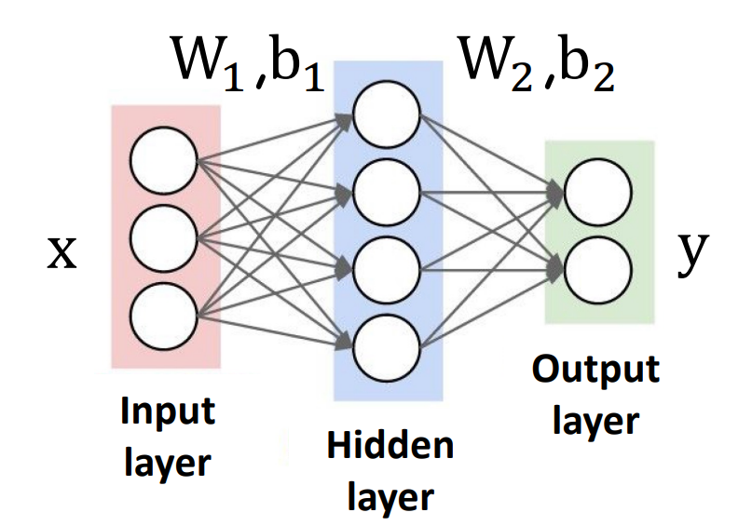
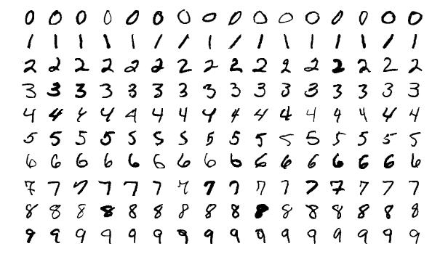

MLP Implementation
Implement 2-Layer Neural Net with Sofmax Classifier
Perform the image classification using “MNIST” dataset.
Two weight matrices $W_{1}$, $W_{2}$ with biases $b_{1}$, $b_{2}$.
Predicted output $y^{′}=W_{2}\left(relu\left(W_{1}x+b1\right)\right)+b_{2}$.
Total loss = data loss (softmax + log likelihood loss) + L-2 regularization loss (to $W_{1}$, $W_{2}$, not $b_{1}$, $b_{2}$).
The Ipython Notebook “two_layer_net.ipynb” will walk you through the implementation of a two layer neural network classifier.
Label: 0
Label: 1
Label: 2
Label: 3
Label: 4
Label: 5
Label: 6
Label: 7
Label: 8
Label: 9

Slide 3
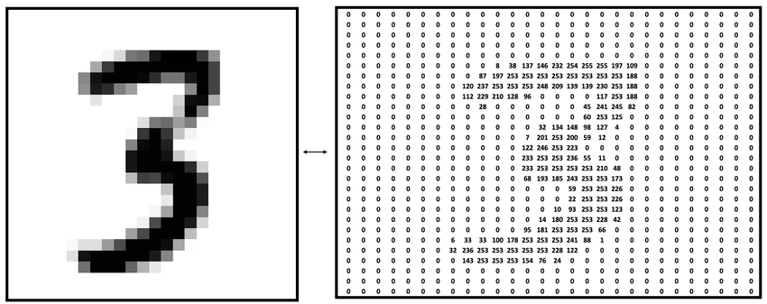
MINST Dataset
What is MNIST?
MNIST stands for Modified National Institute of Standards and Technology database.
The dataset consists of 70,000 images of handwritten digits (0-9).
https://www.tensorflow.org/datasets/catalog/mnist
Dataset Composition
Training Set: 60,000 images.
Test Set: 10,000 images.
Each image is a 28x28 grayscale pixel image, resulting in 784 features per image.

Slide 4
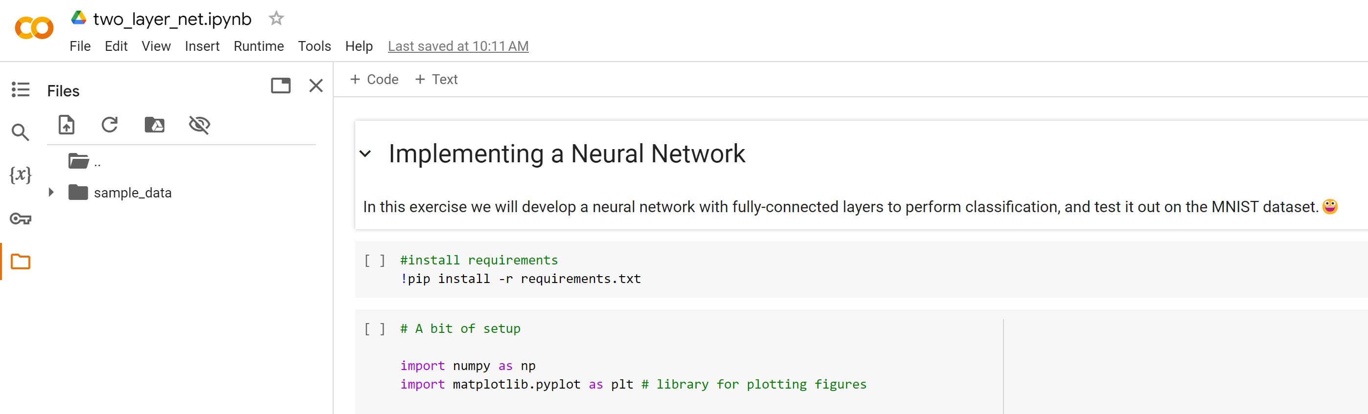
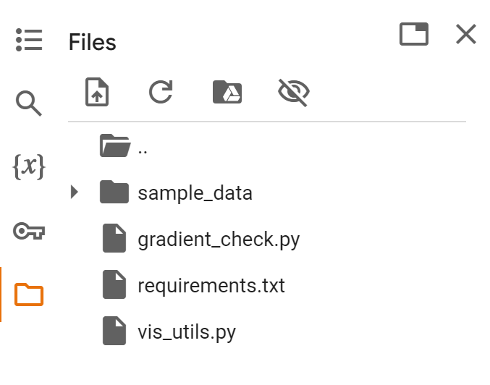
MLP Implementation
Requirements
Download the attached zip file
Open the two_layer_net.ipynb with colab notebook
Upload the other .py files to session storage

Slide 5
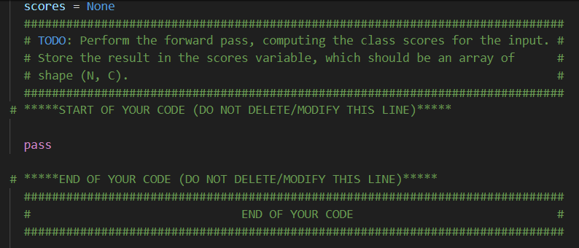
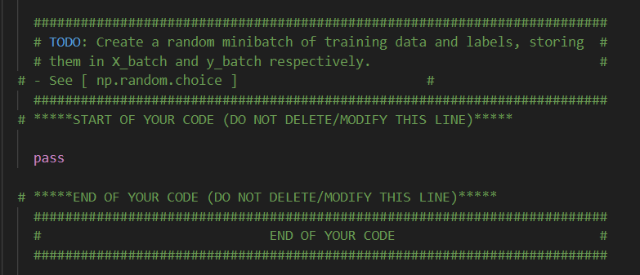
MLP Implementation
Do the following!
Fill the code by following the instructions provided in the TODO comments
neural_net.py
There are “#START OF YOUR CODE” / “#END OF YOUR CODE” tags denoting the start and end of code sections you should fill out.
No need to modify any code other than neural_net.py and two_layer_net.ipynb

Slide 6
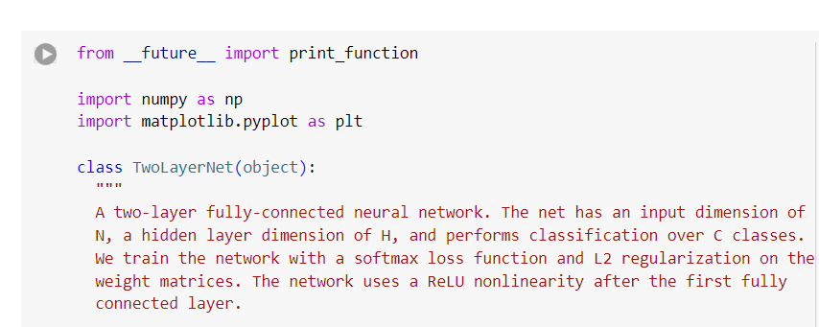
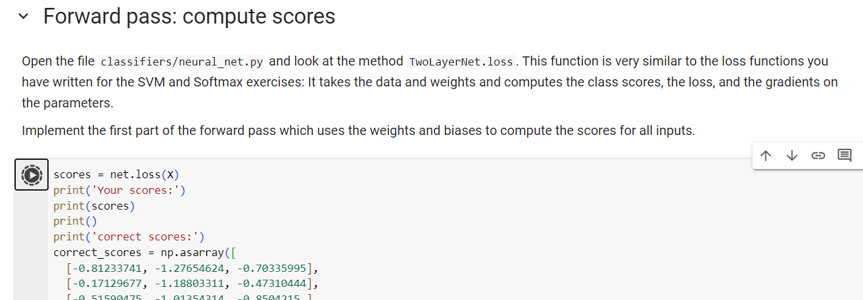
MLP Implementation
Do the following!
After filling the code in neural_net.py, update the corresponding cell in the two_layer_net.ipynb with the modified code.
Debug, training and tune your hyperparameters using the other cells in the two_layer_net.ipynb
Update TwoLayerNet class in two_layer_net.ipynb
Complete the implementation using the other cells in two_layer_net.ipynb

Slide 7
MLP Implementation
Due on Mar. 31 (Mon.), 11:59 pm (in Blackboard)
You must submit “neural_net.py” along with the report. Submitting a zip file may cause error, try uploading the individual files.
Include a 1 page report in CVPR format that describes your code, results, and discussions.
The report should be written in English.
CVPR format : https://cvpr.thecvf.com/Conferences/2025/AuthorGuidelines
→ Download CVPR 2024 Author Kit

Slide 8
MLP Implementation
Please do NOT copy your friends’ and internet sources.
Please start your assignment EARLY.
“Late submissions will not be accepted”

Slide 9


