Slide 1
Assignment #3: RNN Implementation
Paul Hongsuck Seo
phseo@korea.ac.kr
Korea University

Slide 2
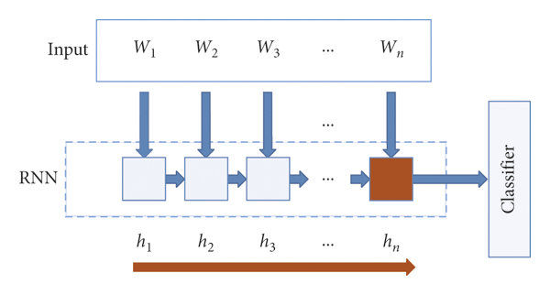

RNN Implementation
Implement RNN Classifier
Perform the text classification Recurrent Neural Network (vanilla RNN and GRU).
The Ipython Notebook “RNN_Implementation.ipynb” will walk you through the implementation of RNN classifier.
Politics
Sport
Technology
Entertainment
Business

Slide 3
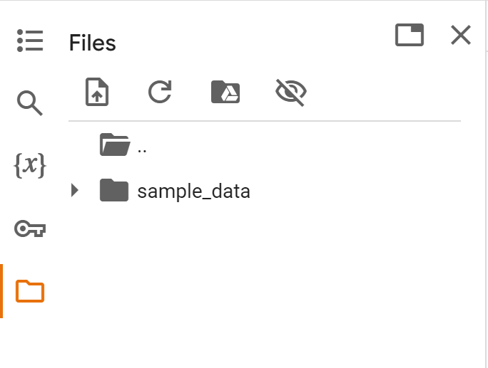
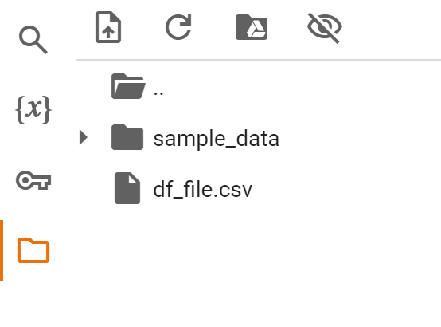
RNN Implementation
Requirements
Download the attached zip file
Open the RNN_Implementation.ipynb with colab notebook
Upload the other df_file.csv to session storage

Slide 4
RNN Implementation
Instructions
Follow the instructions in the RNN_Implementation.ipynb notebook to complete the assignment.
Load the text documentation data (No need for any modifications)
Preprocessing the data (No need for any modifications)
Complete the vanilla RNN code and train the vanilla RNN model
Complete the GRU code and train the GRU model
Complete GRU_skeleton.py and RNN_skeleton.py
→ same as the cells in RNN_Implementation.ipynb

Slide 5
Text Documentation Classification Dataset
Text Documentation Classification Dataset
Contains 2225 text data and five categories of documents
We can use this dataset for documents classification
https://www.kaggle.com/datasets/tanishqdublish/text-classification-documentation/data
Dataset Composition
The dataset is provided in CSV format (2225 Rows and 2 Columns)
It consists different categories of text data and labels
Five different categories: Politics:0, Sport:1, Technology:2, Entertainment:3, Business:4
Budget to set scene for election
Gordon Brown will seek to put the economy at the centre of Labour's bid for a third term in power when he delivers his ninth Budget at 1230 GMT.
…
Label: 0 (Politics)

Slide 6
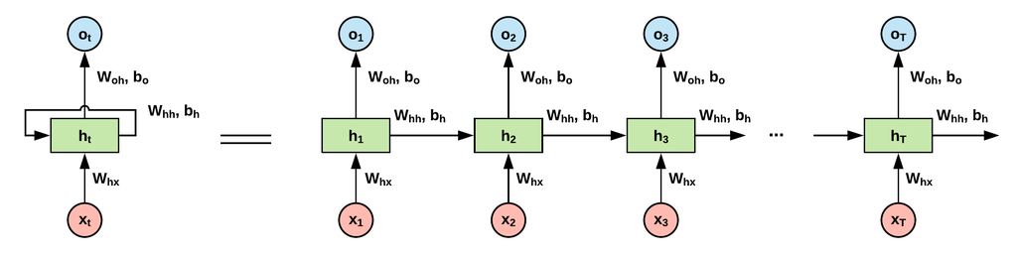
RNNs
Recurrent Neural Networks
RNNs are neural networks for sequential data processing
RNNs process data across multiple time steps, making them well adapted for modelling and processing text, speech and time series.
We will develop a recurrent neural network with vanilla RNN and GRU

Slide 7






Vanilla RNN
Vanilla RNN
Vanilla RNN is the most basic type of RNN architecture.
Vanilla RNN takes the current input $x_{t}$ and previous hidden state $h_{t−1}$ to compute the current hidden state $h_{t}$
After processing the entire sentence, the hidden state reflects the context of the full sequence.
The final output passes through a fully connected (FC) layer.
Vanilla RNN
$$h_{t}$$
…
$$y$$
$$h_{t}=\tanh{(W_{x}x_{t}+W_{h}h_{t−1}+b_{h})}$$
$$y=\tanh{(W_{y}h_{t}+b_{y})}$$
$$x_{t}$$

Slide 8
GRU
GRU (Gated Recurrent Unit)
GRU is a type of RNN designed to handle sequential data and avoid the vanishing gradient problem.
It uses two gates: reset and update, to control the flow of information.
The reset gate decides how much past information to forget, and the update gate controls the new hidden state based on the current input and previous state.
The final output is computed after processing the sequence, and it can pass through a fully connected (FC) layer.
https://arxiv.org/abs/1406.1078

Slide 9
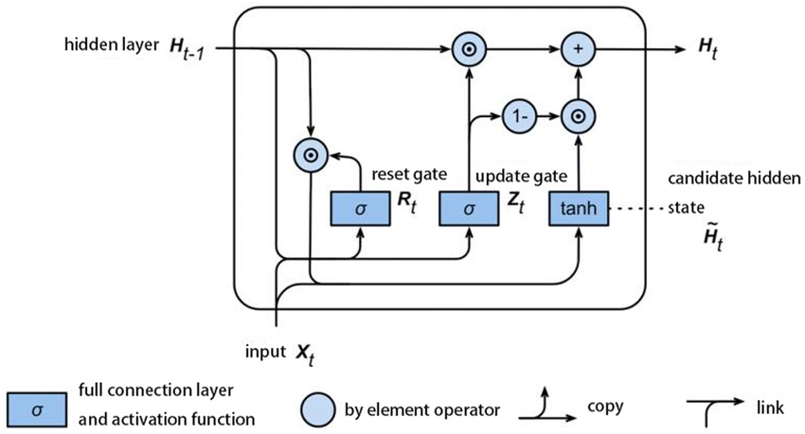
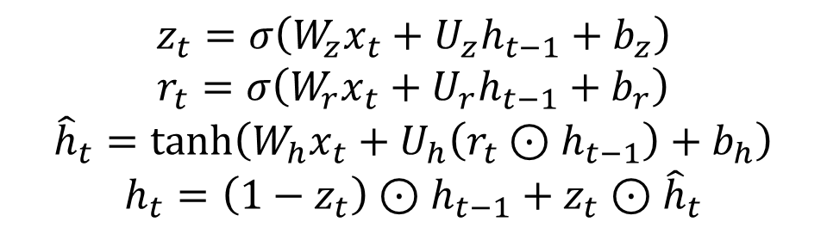

GRU
GRU (Gated Recurrent Unit)
The structure of the GRU is as shown in the diagram and equations below.
You need to understand the structure of the GRU and correctly fill in the blanks in the code.
$$z_{t}=σ\left(W_{z}x_{t}+U_{z}h_{t−1}+b_{z}\right)$$
$$r_{t}=σ\left(W_{r}x_{t}+U_{r}h_{t−1}+b_{r}\right)$$
$${\hat{h}}_{t}=\tanh\left(W_{h}x_{t}+U_{h}\left(r_{t}⊙h_{t−1}\right)+b_{h}\right)$$
$$h_{t}=\left(1−z_{t}\right)⊙h_{t−1}+z_{t}⊙{\hat{h}}_{t}$$
$σ$: activation function (sigmoid)

Slide 10
RNN Implementation
You must submit “RNN_skeleton.py” and “GRU_skeleton.py” along with the report. (Do not modify the name of the Python file.)
Include a 1 page report in CVPR format that describes your code, results, and discussions.
The report should be written in English.
CVPR format : https://cvpr.thecvf.com/Conferences/2025/AuthorGuidelines
→ Download CVPR 2025 Author Kit

Slide 11
RNN Implementation
Please do NOT copy your friends’ and internet sources.
Please start your assignment EARLY.
“Late submissions will not be accepted”

Slide 12


