Slide 1
Assignment #4: Transformer Implementation
Paul Hongsuck Seo
phseo@korea.ac.kr
Korea University

Slide 2
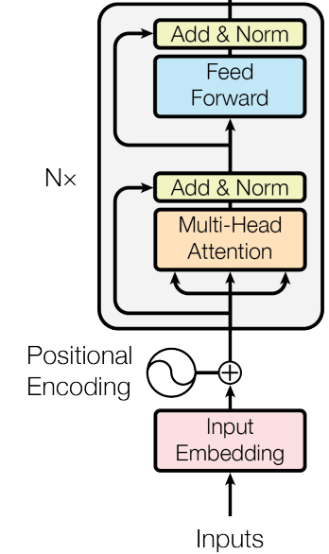

Transformer Implementation
Implement Transformer Classifier
Perform the text classification using “IMDb Movie Reviews” dataset with transformer
The Ipython Notebook “Transformer_Implementation.ipynb” will walk you through the implementation of transformer classifier.
Outputs
Movie review
Positive
Negative

Slide 3
Transformer Implementation
Instructions
Follow the instructions in the Transformer_Implementation.ipynb notebook to complete the assignment.
Load the IMDb data (No need for any modifications)
Preprocessing the data (No need for any modifications)
Complete the transformer code and train the transformer model
Use the pre-trained BERT model weights and fine-tune them for the IMDb dataset.
Complete transformer_skeleton.py
→ same as the cells in Transformer_Implementation.ipynb

Slide 4
IMDb movie review Dataset
IMDb Movie Reviews dataset
Contains 50,000 movie reviews taken from IMDb (Internet Movie Database)
https://ai.stanford.edu/~amaas/data/sentiment/
Dataset Composition
25,000 reviews are used for training and 25,000 reviews are used for testing.
Reviews are labeled as either positive or negative
After seeing this film months ago, it keeps jumping back into my consciousness and I feel I must buy it or at least see it again, even though I watched it at least 3 times when I rented it at that point…
Label: 1 (Positive)

Slide 5
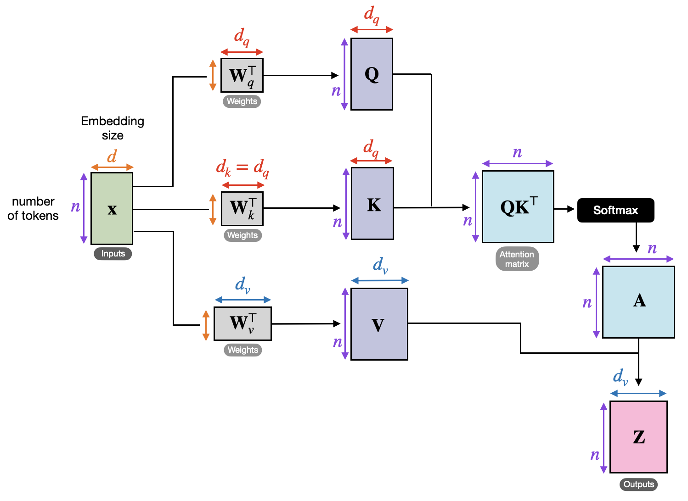
Transformer
Transformer
Transformers are neural networks designed for sequential data processing.
They process entire sequences simultaneously, using self-attention mechanisms to handle dependencies between tokens.
Multi-head attention enables the model to focus on different parts of the sequence simultaneously.
We will explore Transformer architecture.
Outputs

Slide 6
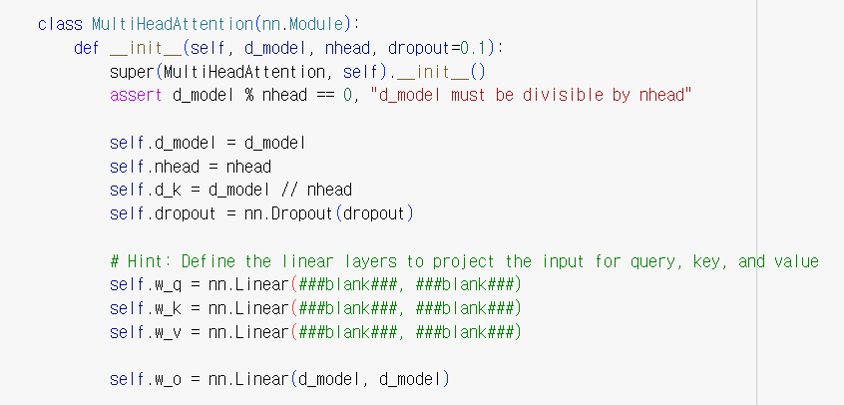
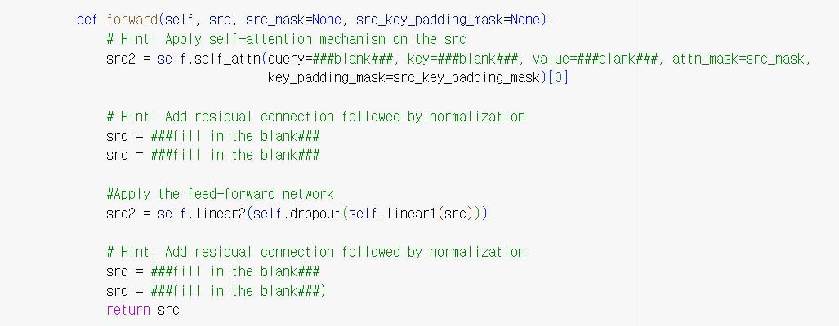
Transformer implementation
Instructions
You need to complete the Transformer Model code accurately based on the explanation of the transformer provided in the following slide.
It includes Positional Encoding, Multi-Head Attention, and the internal operations of the transformer, among others.

Slide 7
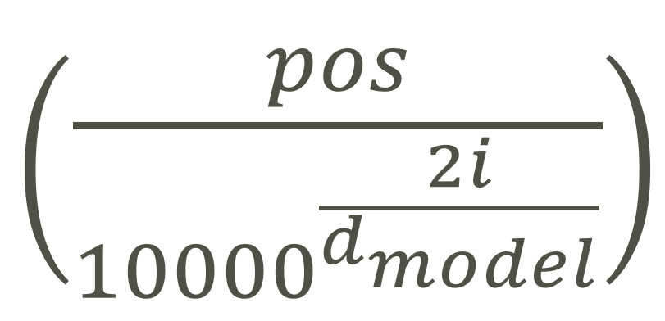
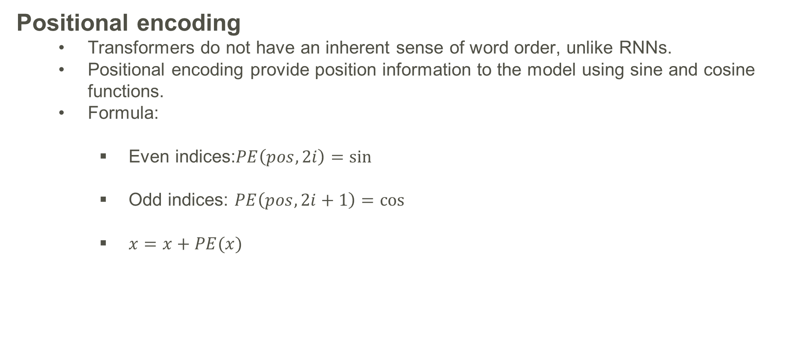
Transformer implementation
Positional encoding
Transformers do not have an inherent sense of word order, unlike RNNs.
Positional encoding provide position information to the model using sine and cosine functions.
Formula:
Even indices:$PE\left(pos,2i\right)=\sin{}$
Odd indices: $PE\left(pos,2i+1\right)=\cos{}$
$x=x+PE(x)$

Slide 8
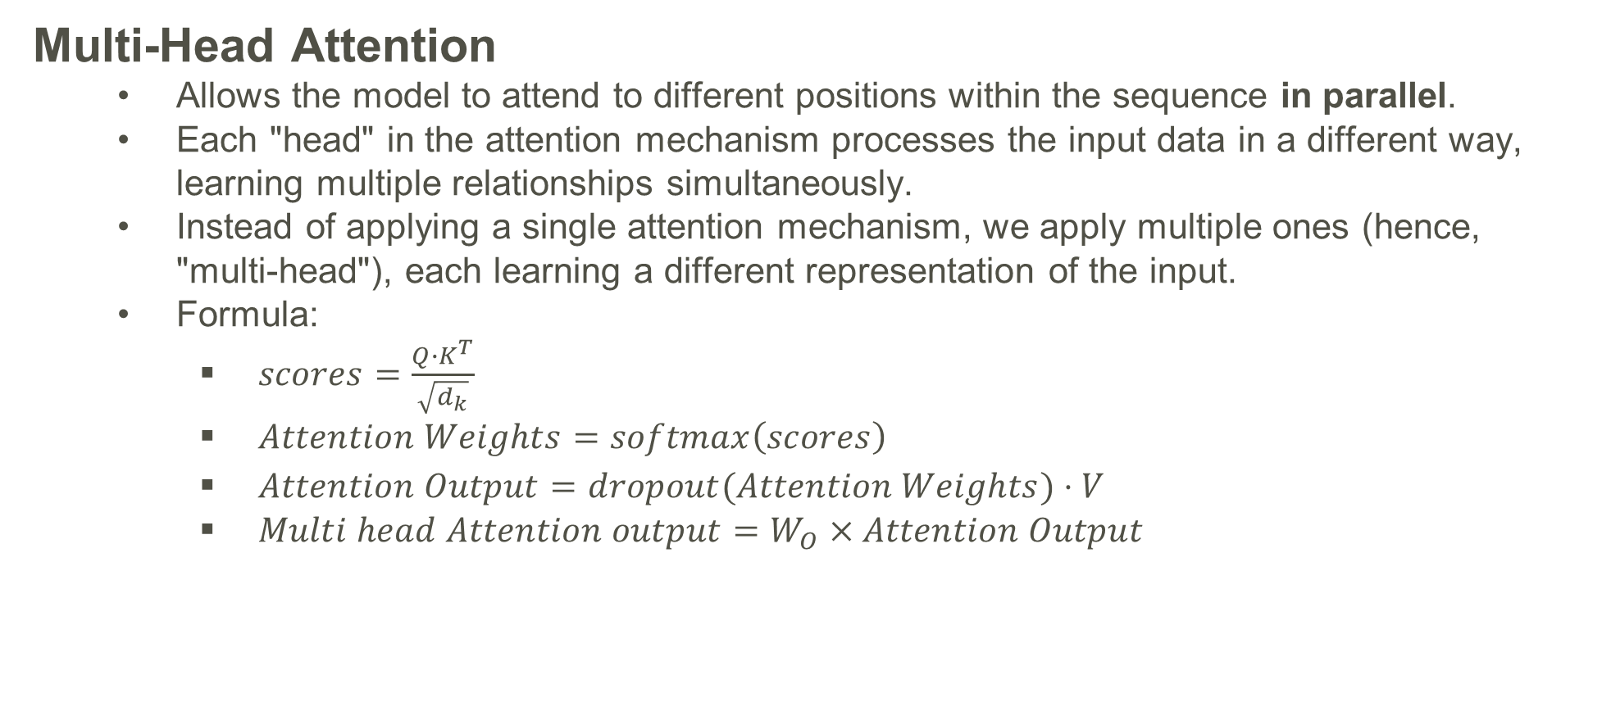
Transformer implementation
Multi-Head Attention
Allows the model to attend to different positions within the sequence in parallel.
Each "head" in the attention mechanism processes the input data in a different way, learning multiple relationships simultaneously.
Instead of applying a single attention mechanism, we apply multiple ones (hence, "multi-head"), each learning a different representation of the input.
Formula:
$scores=\frac{{Q∙K}^{T}}{\sqrt{d_{k}}}$
$Attention Weights=softmax\left(scores\right)$
$Attention Output=dropout(Attention Weights)⋅V$
$Multi head Attention output=W_{O}×Attention Output$

Slide 9
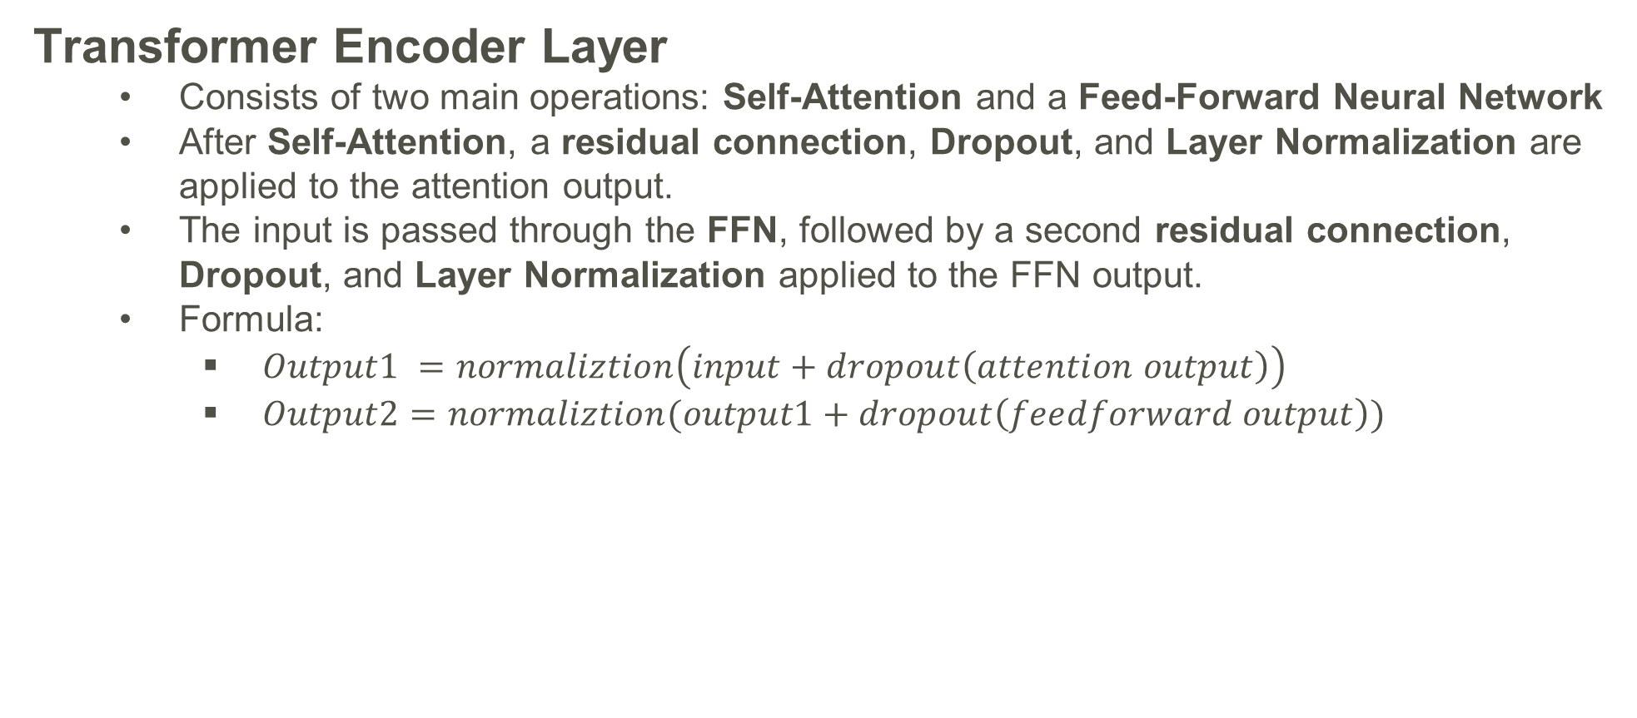
Transformer implementation
Transformer Encoder Layer
Consists of two main operations: Self-Attention and a Feed-Forward Neural Network
After Self-Attention, a residual connection, Dropout, and Layer Normalization are applied to the attention output.
The input is passed through the FFN, followed by a second residual connection, Dropout, and Layer Normalization applied to the FFN output.
Formula:
$Output1 =normaliztion\left(input+dropout\left(attention output\right)\right)$
$Output2=normaliztion(output1+dropout\left(feedforward output\right))$

Slide 10
Transformer implementation
Transformer
The Transformer first applies Positional Encoding (PE) to the input to provide information about the order of tokens in the sequence.
After positional encoding, the input passes through N Transformer layers, where each layer performs self-attention and feed-forward operations with residual connections and normalization.
Finally, the output passes through a fully connected (FC) layer, producing the final output.
Outputs

Slide 11
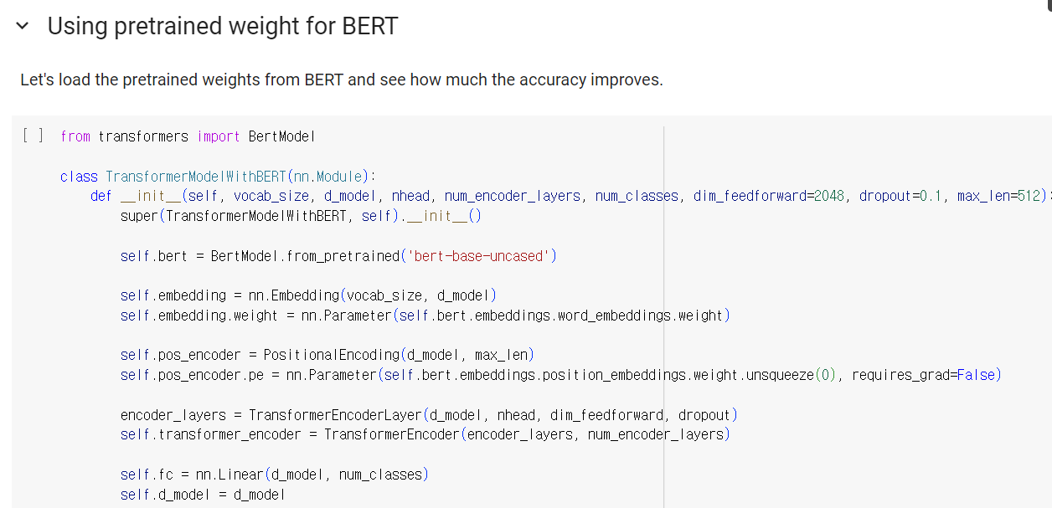
Transformer implementation
Train the transformer model
Train the Transformer model using the provided code.
Load pretrained BERT
Load the pretrained BERT model using the provided code and train it.
Analyze the results and write a report based on your findings.

Slide 12
Transformer Implementation
You must submit “transformer_skeleton.py” along with the report. (Do not modify the name of the Python file.)
Include a 1 page report in CVPR format that describes your code, results, and discussions.
The report should be written in English.
CVPR format : https://cvpr.thecvf.com/Conferences/2024/AuthorGuidelines
→ Download CVPR 2024 Author Kit

Slide 13
Transformer Implementation
Please do NOT copy your friends’ and internet sources.
Please start your assignment EARLY.
“Late submissions will not be accepted”

Slide 14


