Slide 1
Introduction to Unsupervised Learning

Slide 2
Legal Notices and Disclaimers
This presentation is for informational purposes only. INTEL MAKES NO WARRANTIES, EXPRESS OR IMPLIED, IN THIS SUMMARY.
Intel technologies’ features and benefits depend on system configuration and may require enabled hardware, software or service activation. Performance varies depending on system configuration. Check with your system manufacturer or retailer or learn more at intel.com.
This sample source code is released under the Intel Sample Source Code License Agreement.
Intel and the Intel logo are trademarks of Intel Corporation in the U.S. and/or other countries.
*Other names and brands may be claimed as the property of others.
Copyright © 2017, Intel Corporation. All rights reserved.

Slide 3
Types of Machine Learning
Supervised
data points have known outcome
Unsupervised
data points have unknown outcome
Notes:
Today we are going to talk about a whole other class of ML algorithms called unsupervised learning.

Slide 4
Types of Machine Learning
Supervised
data points have known outcome
Unsupervised
data points have unknown outcome
Notes:
This class of algorithms are relevant when we don’t have outcomes we are trying to predict.
We’re more interested in finding structures within our dataset, and partition the dataset into smaller pieces

Slide 5
Types of Unsupervised Learning
Clustering
identify unknown structure in data
Dimensionality Reduction
use structural characteristics to simplify data
Notes:
There can be a couple of usecases for this.
One popular use case is called “clustering”. E.g. Segmentize our customers.
Due to it's nature, unsupervised machine learning is often a more complex topic for students who are new to the field to grasp
One type of machine learning,

Slide 6
Types of Unsupervised Learning
Clustering
identify unknown structure in data
Dimensionality Reduction
use structural characteristics to simplify data
Notes:
Some of the unsupervised algorithms can be used to reduce dimensionality.
Namely use structural characteristics to get rid of some columns.
We’re going to only cover clustering today. So let’s focus on that. Dim.Red is next.

Slide 7
Unsupervised Learning Overview
fit
unlabeled data (no answers)
structure
new unlabeled data
predict
map new data to structure
+
model
Notes:
clustering takes data that does not have a label and attempts to use the features of the data to determine groups or identify structure
The model is fit when it contains parameters that create the best groups, according to some measurement
This model can then be used to predict to which group the new data points belong

Slide 8
Clustering: Finding Distinct Groups
text articles of unknown topics
fit
+
model
model
text articles of unknown topics
predict
predict similar articles
+
model
Notes:
Let's take a look at an example of clustering
Assume we have many articles of unknown topics
For a given article, there can also be multiple topics, but again, we don't know what those topics are
The text of these articles can be used as features to fit the parameters of a model
This model, in turn, can then help determine which cluster (or group) to which a new article belongs
(topic modeling)

Slide 9
Dimensionality Reduction: Simplifying Structure
high resolution images
fit
+
model
model
high resolution images
predict
compressed images
+
model
Notes:
The other type of unsupervised learning can be used in reducing dimensionality, but essentially preserving the contents.
We want to reduce our data but keep the important structures mostly intact.

Slide 10
Introduction to Unsupervised Learning
Users of a web application:
One feature (age)
Age
Notes:
Let’s look at how this might work visually:
Here are users of a web app, with one feature Age.
If we were to cluster these users into two groups, where do we draw the line?

Slide 11
Introduction to Unsupervised Learning
Users of a web application:
One feature (age)
Two clusters
Age
Notes:
Probably this is the best choice. Visually, it makes sense. These are our 2 clusters.
We are going to explore how this works mathematically / algorithmically later.

Slide 12
Introduction to Unsupervised Learning
Users of a web application:
One feature (age)
Three clusters
Age
Notes:
Here is what 3 clusters might look like.

Slide 13
Introduction to Unsupervised Learning
Users of a web application:
One feature (age)
Five clusters
Age
Notes:
5 clusters

Slide 14
K-Means Algorithm
K = 2 (find two clusters)
Income
Age
Notes:
Similar example, this time we have 2 features. Age and Income
Visually, how would you cluster this dataset into 2 clusters?
The answer is obvious to us, but let’s see if we can get there algorithmically.

Slide 15
K-Means Algorithm
K = 2, Randomly assign cluster centers
Income
Age
Notes:
Since we prescribed 2 clusters, initialize the algorithm by picking 2 random points.
These are going to be the center of the clusters.
Name the clusters. Here we’re doing this by colorcoding.

Slide 16
K-Means Algorithm
K = 2, Each point belongs to closest center
Income
Age
Notes:
For each example in our space, determine which cluster it belongs to by computing distance and getting the closest.
Here, in the frst iteration, the examples are color coded like this.
So now, every point belongs to a cluster, but we are not done, as this assignment is somewhat arbitrary, and it has not converged yet.

Slide 17
K-Means Algorithm
K = 2, Move each center to cluster's mean
Income
Age
Notes:
Second step is to adjust the points (so called cluster centers) to the new center of the clusters.
The new location of green square is right on the middle point of all the green circles. Same for blue.
We’re thru the first iteration. We are going to keep repeating this process, until no example is assigned to a different cluster.

Slide 18
K-Means Algorithm
K = 2, Each point belongs to closest center
Income
Age
Notes:
So let’s see the first step of the 2nd iteration.
With our new cluster centers in place, identify which cluster each point belongs to again.

Slide 19
K-Means Algorithm
K = 2, Move each center to cluster's mean
Income
Age
Notes:
And move the centers to the new center.

Slide 20
K-Means Algorithm
K = 2, Points don't change → Converged
Income
Age
Notes:
And the 3rd iteration.

Slide 21
K-Means Algorithm
K = 2, Each point belongs to closest center
Income
Age
Notes:
The cluster centers don’t move anymore!
Convergence!
It found the visual structure in the dataset automatically.

Slide 22
K-Means Algorithm
K = 3
Income
Age
Notes:
For 3 clusters, clusters can look like this.
However, there can be other solutions.

Slide 23
K-Means Algorithm
K = 3, Results depend on initial cluster assignment
Income
Age
Notes:
Such as this.
The problem with the K-means algorithm is, that it is sensitive to the choice of initial points.
Different initial configurations may yield different results (it may converge to local optimas)

Slide 24
Which Model is the Right One?
Income
Age
Notes:
Here is another local optimum. Which clustering makes more sense?
We need a way of judging the converged results, and rank them according to “goodness”

Slide 25
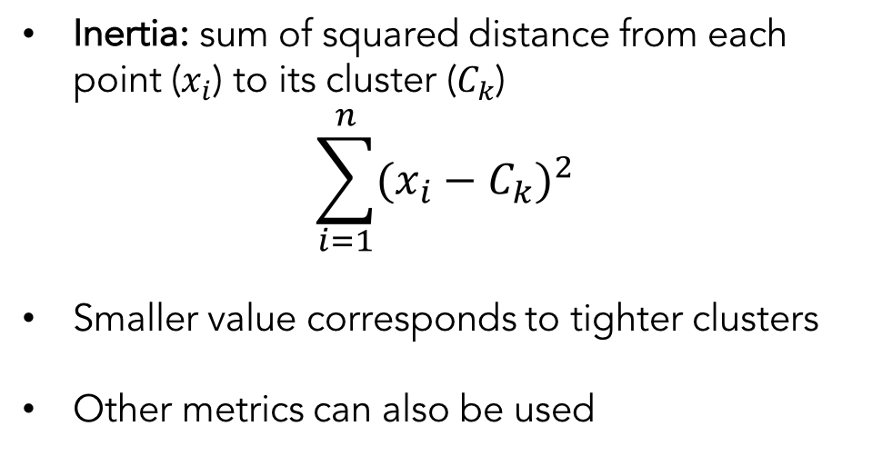
Which Model is the Right One?
Inertia: sum of squared distance from each point ($x_{i}$) to its cluster ($C_{k}$)
$$\sum_{i=1}^{n}{{(x_{i}−C_{k})}^{2}}$$
Smaller value corresponds to tighter clusters
Other metrics can also be used
Notes:
Inertia is a popular metric to do that.
Rank the different clustering configurations according to the sum of squared distance from each point to the center of the cluster.
This way, we’re penalizing spread out clusters and rewarding tight clusters.
Depending on the application, (domain expertise) other metrics can be used.

Slide 26
Which Model is the Right One?
Initiate multiple times,
take model with the best score
Income
Age
Notes:
So what we can do in order to find the clustering with best inertia is, we can initiate our k-means algorithm several times
With different initial configurations
And compute the resulting inertia. Keep the result with the best inertia.

Slide 27
Which Model is the Right One?
Inertia = 12.645
Income
Age
Notes:
For this one, it is 12.645

Slide 28
Which Model is the Right One?
Inertia = 12.943
Income
Age
Notes:
For this one, it is 12.943

Slide 29
Which Model is the Right One?
Inertia = 13.112
Income
Age
Notes:
For this one, it is 13.112

Slide 30
Smarter Initialization of K-Means Clusters
Income
Age
Notes:
Another idea is to initialize in a smarter way;
Local optima often happen when two cluster centers are initialized close to each other
So, we can make an effort to initialize with points that are faraway enough from each other.

Slide 31
Smarter Initialization of K-Means Clusters
Pick one point at random as initial point
Income
Age
Notes:
Start by a random initial point.

Slide 32
Smarter Initialization of K-Means Clusters
Pick next point with 1/distance² probability
Income
Age
Notes:
For the 2nd pick, instead of getting it randomly, let’s prioritize faraway points by assigning a probability of 1/dist**2 to each point.
Most likely we’re going to end up with a not-so-close point such as this blue one as our 2nd cluster center.

Slide 33
Smarter Initialization of K-Means Clusters
Pick next point with 1/distance² probability
Income
Age
Notes:
Same process. Weigh the points according to sum(1/dist**2) and pick.

Slide 34
Smarter Initialization of K-Means Clusters
Pick next point with 1/distance² probability
Income
Age
Notes:
XXX

Slide 35
Smarter Initialization of K-Means Clusters
Assign clusters
Income
Age
Notes:
This algorithm is called K-means++.
It avoids getting stuck at local optima.
This is the default implementation of K-means in sklearn.

Slide 36
Choosing the Right Number of Clusters
Notes:
Now that we are familiarized with how k-means works, let’s ask an important question; how do we choose K? the number of clusters?

Slide 37
Choosing the Right Number of Clusters
Sometimes the question has a K
Notes:
Sometimes, the problem we’re solving comes with a K. Let’s see some examples.

Slide 38
Choosing the Right Number of Clusters
Sometimes the question has a K
Clustering similar jobs on 4 CPU cores (K=4)
Notes:
The computer has 4 cores, so question naturally becomes 4 clusters.

Slide 39
Choosing the Right Number of Clusters
Sometimes the question has a K
Clustering similar jobs on 4 CPU cores (K=4)
A clothing design in 10 different sizes to cover most people (K=10)
Notes:
Business side of the organization may dictate there are 10 clusters.

Slide 40
Choosing the Right Number of Clusters
Sometimes the question has a K
Clustering similar jobs on 4 CPU cores (K=4)
A clothing design in 10 different sizes to cover most people (K=10)
A navigation interface for browsing scientific papers with 20 disciplines (K=20)
Notes:
Other times though, we are free to pick the number of clusters.

Slide 41
Choosing the Right Number of Clusters
Inertia measures distance of point to cluster
Value decreases with increasing K as long as cluster density increases
Inertia
2
4
6
8
10
K
Notes:
Other times though, we are free to pick the number of clusters.
We can still use inertia to pick our K.
Recall that inertia is the sum of distance**2 between points and their cluster centers.
We used inertia to compare different configurations of cluster centers when K was held constant.
Inertia will most of the time go down as num. clusters K goes up.

Slide 42
Choosing the Right Number of Clusters
Inertia measures distance of point to cluster
Value decreases with increasing K as long as cluster density increases
Inertia
2
4
6
8
10
K
Notes:
Here is an inflection point that could be chosen as a good K.
Until that point, inertia goes down a lot.
After that point, inertia goes down still but very slowly.
This seems like a logical choice of K.

Slide 43
K-Means: The Syntax
Import the class containing the clustering method
from sklearn.cluster import KMeans
Create an instance of the class
kmeans = KMeans(n_clusters=3,
init='k-means++')
Fit the instance on the data and then transform the data
X_trans = kmeans.fit_transform(X_sparse)
Can also be used in batch mode with MiniBatchKMeans.
Notes:
import

Slide 44
K-Means: The Syntax
Import the class containing the clustering method
from sklearn.cluster import KMeans
Create an instance of the class
kmeans = KMeans(n_clusters=3,
init='k-means++')
Fit the instance on the data and then transform the data
X_trans = kmeans.fit_transform(X_sparse)
Can also be used in batch mode with MiniBatchKMeans.
Notes:
instantiate

Slide 45
K-Means: The Syntax
Import the class containing the clustering method
from sklearn.cluster import KMeans
Create an instance of the class
kmeans = KMeans(n_clusters=3,
init='k-means++')
Fit the instance on the data and then transform the data
X_trans = kmeans.fit_transform(X_sparse)
Can also be used in batch mode with MiniBatchKMeans.
final number of clusters
Notes:
Number of clusters.

Slide 46
K-Means: The Syntax
Import the class containing the clustering method
from sklearn.cluster import KMeans
Create an instance of the class
kmeans = KMeans(n_clusters=3,
init='k-means++')
Fit the instance on the data and then transform the data
X_trans = kmeans.fit_transform(X_sparse)
Can also be used in batch mode with MiniBatchKMeans.
kmeans++ cluster initiation
Notes:
And the initialization method. This is the default so no need to specify like this. Can be ‘random’.

Slide 47
K-Means: The Syntax
Import the class containing the clustering method
from sklearn.cluster import KMeans
Create an instance of the class
kmeans = KMeans(n_clusters=3,
init='k-means++')
Fit the instance on the data and then predict clusters for new data
kmeans = kmeans.fit(X1)
Can also be used in batch mode with MiniBatchKMeans.
Notes:
fit

Slide 48
K-Means: The Syntax
Import the class containing the clustering method
from sklearn.cluster import KMeans
Create an instance of the class
kmeans = KMeans(n_clusters=3,
init='k-means++')
Fit the instance on the data and then predict clusters for new data
kmeans = kmeans.fit(X1)
y_predict = kmeans.predict(X2)
Can also be used in batch mode with MiniBatchKMeans.
Notes:
Predict.

Slide 50
Distance Metrics

Slide 51
Distance Metric Choice
Choice of distance metric is extremely important to clustering success
Each metric has strengths and most appropriate use-cases…
…but sometimes choice of distance metric is also based on empirical evaluation
Notes:
Preprocessing our data (scaling etc) but also the definition of distance become extremely important in clustering success.
Let’s remember some of the popular distance metrics and look at their properties a bit closer. We discussed this during KNNs.

Slide 52
Euclidean Distance
Income
Age
Notes:
The most intuitive distance is the euclidean distance.
Another name for this is the L2 distance.

Slide 53
Euclidean Distance
Income
Age
Notes:
Let’s take these two points and compute the euclidean distance between them.

Slide 54

Euclidean Distance (L2 Distance)
d
∆ Income
Income
∆ Age
$$d= \sqrt{{∆Age}^{2}+{∆Income}^{2}}$$
Age
Notes:
You might remember from math class this is the formula.

Slide 55
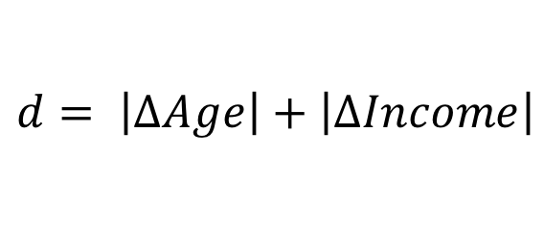
Manhattan Distance (L1 or City Block Distance)
∆ Income
Income
∆ Age
$$d= \left|∆Age\right|+\left|∆Income\right|$$
Age
Notes:
L1 distance, instead of squaring each term, we’re adding up the abs. value.
It’s larger then the L2 distance unless they lie on the same ax. (same age or same income).

Slide 56
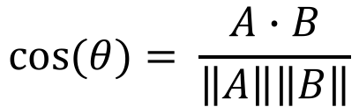

Cosine Distance
Income
$$θ$$
$$\cos{(θ)}= \frac{A∙B}{\left\|A\right\|\left\|B\right\|}$$
Age
Notes:
Here’s a little less intuitive distance metric:
This is the cosine distance. It gives us the cosine of the angle between the vectors defined by points.
It is insensitive to scaling with respect to the origin.

Slide 57
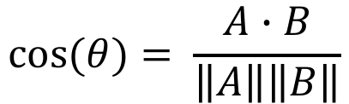

Cosine Distance
Income
$$θ$$
$$\cos{(θ)}= \frac{A∙B}{\left\|A\right\|\left\|B\right\|}$$
Age
Notes:
That is, we can move one of the points like this, on that line, and the distance will be the same.
So, any two points on the same RAY (not line) passing through the origin will have distance zero.

Slide 58
Euclidean vs Cosine Distance
Euclidean is useful for coordinate based measurements
Cosine is better for input data such as text where location of occurrence is less important
Euclidean distance is more sensitive to curse of dimensionality (see lesson 12)

Slide 59
Euclidean vs Cosine Distance
Euclidean is useful for coordinate based measurements
Cosine is better for data such as text where location of occurrence is less important
Euclidean distance is more sensitive to curse of dimensionality (see lesson 12)
Notes:
For two vectors that point to the same direction, cosine distance will spit out zero. It will think of them as “very close”
For euclidean distance, it may think of them very far away though!
Let’s say we have text data. And our features are counts of words in the documents.
Just because one document is longer than another, (more counts of words) does not mean the need to be faraway from each other
Maybe they are about the same thing. Maybe one is the summary of the other! In that case you want to mark them as “close to each other”.
Cosine distance will come in handy in that situation.

Slide 60
Euclidean vs Cosine Distance
Euclidean is useful for coordinate based measurements
Cosine is better for data such as text where location of occurrence is less important
Euclidean distance is more sensitive to curse of dimensionality (see lesson 12)
Notes:
Another advantage of cosine distance is that it’s more robust against curse of dimensionality.
Euclidean distance can get affected and lose meaning if we have a lot of features.
Takeaway is, the best choice of distance depends on the application.

Slide 61
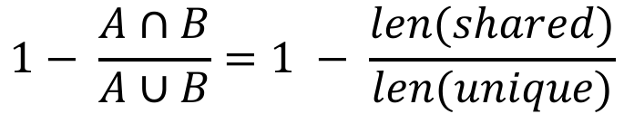
Jaccard Distance
Applies to sets (like word occurrence)
Sentence A: “I like chocolate ice cream.”
set A = {I, like, chocolate, ice, cream}
Sentence B: “Do I want chocolate cream or vanilla cream?”
set B = {Do, I, want, chocolate, cream, or, vanilla}
$$1− \frac{A∩B}{A∪B}=1 − \frac{len(shared)}{len(unique)}$$
Notes:
Another distance metric is the Jaccard distance
Applies to sets.
Can be used as a different option when we have text documents for example.

Slide 62
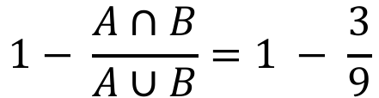
Jaccard Distance
Applies to sets (like word occurrence)
Sentence A: “I like chocolate ice cream.”
set A = {I, like, chocolate, ice, cream}
Sentence B: “Do I want chocolate cream or vanilla cream?”
set B = {Do, I, want, chocolate, cream, or, vanilla}
$$1− \frac{A∩B}{A∪B}=1 − \frac{3}{9}$$
Notes:
Here’s an example. Intersection has 3 words, and there are 9 unique words total. So distance is 1-1/3 = 2/3 – 0.67

Slide 63
Distance Metrics: The Syntax
Import the general pairwise distance function
from sklearn.metrics import pairwise_distances
Calculate the distances
dist = pairwise_distances(X, Y,
metric='euclidean')
Other distance metric choices are: cosine, manhattan, jaccard, etc.
Distance metric methods can also be imported specifically, e.g.:
from sklearn.metrics import euclidean_distances
Notes:
Pairwise_distances import

Slide 64
Distance Metrics: The Syntax
Import the general pairwise distance function
from sklearn.metrics import pairwise_distances
Calculate the distances
dist = pairwise_distances(X, Y,
metric='euclidean')
Other distance metric choices are: cosine, manhattan, jaccard, etc.
Distance metric methods can also be imported specifically, e.g.:
from sklearn.metrics import euclidean_distances
Notes:
Calculate distances with a given metric

Slide 65
Distance Metrics: The Syntax
Import the general pairwise distance function
from sklearn.metrics import pairwise_distances
Calculate the distances
dist = pairwise_distances(X, Y,
metric='euclidean')
Other distance metric choices are: cosine, manhattan, jaccard, etc.
Distance metric methods can also be imported specifically, e.g.:
from sklearn.metrics import euclidean_distances
distance metric choice
Notes:
euclidean

Slide 66
Distance Metrics: The Syntax
Import the general pairwise distance function
from sklearn.metrics import pairwise_distances
Calculate the distances
dist = pairwise_distances(X, Y,
metric='euclidean')
Other distance metric choices are: cosine, manhattan, jaccard, etc.
Distance metric methods can also be imported specifically, e.g.:
from sklearn.metrics import euclidean_distances
Notes:
Others are

Slide 67
Distance Metrics: The Syntax
Import the general pairwise distance function
from sklearn.metrics import pairwise_distances
Calculate the distances
dist = pairwise_distances(X, Y,
metric='euclidean')
Other distance metric choices are: cosine, manhattan, jaccard, etc.
Distance metric methods can also be imported specifically, e.g.:
from sklearn.metrics import euclidean_distances
Notes:
XXX

Slide 69
Hierarchical Agglomerative Clustering

Slide 70
Hierarchical Agglomerative Clustering
Income
Age
Notes:
Let’s see how Hierarchical agglomerative clustering works.
Here is the same example as before.

Slide 71
Hierarchical Agglomerative Clustering
Find closest pair, merge into a cluster
Income
Age
Notes:
Start by looking at the points and identify the pair which has the minimal distance.
Notice that again, distance becomes a very important factor in the success of this.
Declare that pair a cluster. Color coded by green here.

Slide 72
Hierarchical Agglomerative Clustering
Find next closest pair and merge
Income
Age
Notes:
Do it again for the remaining points.

Slide 73
Hierarchical Agglomerative Clustering
Find next closest pair and merge
Income
Age
Notes:
Keep doing it.

Slide 74
Hierarchical Agglomerative Clustering
Keep merging closest pairs
Income
Age
Notes:
The next “closest pair” can be a pair of clusters!
It depends on the “linkage criterion” chosen.
Maybe it’s the average of points in a given cluster.
Maybe it’s the minimal distance between all points in a given cluster.
If it is a pair of clusters, then merge them.

Slide 75
Hierarchical Agglomerative Clustering
If the closest pair is two clusters, merge them
Income
Age
Notes:
So the blue cluster disappeared and became green!.

Slide 76
Hierarchical Agglomerative Clustering
Keep merging closest pairs and clusters
Income
Age
Notes:
We can keep doing this. At each step we have 1 less clusters.
Here I am assuming in the beginning, every point is its own cluster.

Slide 77
Hierarchical Agglomerative Clustering
Keep merging closest pairs and clusters
Income
Age
Notes:
XXX

Slide 78
Hierarchical Agglomerative Clustering
Current number of clusters = 6
Income
Age
Notes:
Here we are @ 6 clusters.

Slide 79
Hierarchical Agglomerative Clustering
Current number of clusters = 5
Income
Age
Notes:
5 clusters.

Slide 80
Hierarchical Agglomerative Clustering
Current number of clusters = 4
Income
Age
Notes:
XXX

Slide 81
Hierarchical Agglomerative Clustering
Current number of clusters = 3
Income
Age
Notes:
Finally, we recover the same 3 clusters as K-means.

Slide 82
Hierarchical Agglomerative Clustering
Current number of clusters = 2
Income
Age
Notes:
And if we went one more step, we recover the same 2-clusters as k-means.

Slide 83
Hierarchical Agglomerative Clustering
Current number of clusters = 1
Income
Age
Notes:
And if we don’t stop, this process is going to converge to just 1 cluster, to which everything belongs.
This means, we need to stop the algorithm at an appropriate place.

Slide 84
Agglomerative Clustering Stopping Conditions
Condition 1
the correct number of clusters is reached
Condition 2
minimum cluster distance reaches a set value
Notes:
As in K-means, if we have a prescribed number of clusters we need to reach, we can stop once we hit that number.

Slide 85
Agglomerative Clustering Stopping Conditions
Condition 1
the correct number of clusters is reached
Condition 2
minimum average cluster distance reaches a set value
Notes:
Another option that can be used is, we can stop when the clusters are big enough
And we can measure that by looking at the average cluster distances across all clusters
That is, calculate the distances between points belonging to the cluster, and average them out.
Observe that if we merge two clusters, that average distance is going to grow.
stop when the min. avg distance is bigger then a threshold.
Let’s visualize this idea.

Slide 86
Hierarchical Agglomerative Clustering
Current number of clusters = 5
Income
Age
Notes:
Let’s say we are at this stage:

Slide 87
Hierarchical Agglomerative Clustering
Current number of clusters = 5
Cluster distance
Notes:
Maybe the average cluster distances are like this.
Gray dotted line marks the point where we are to stop once all the avg distances are above that line.

Slide 88
Hierarchical Agglomerative Clustering
Current number of clusters = 4
Income
Age
Notes:
In the next iteration, purple and cyan clusters are merged
Therefore, the avg cluster distance for that cluster is going to increase.

Slide 89
Hierarchical Agglomerative Clustering
Current number of clusters = 4
Cluster distance
Notes:
So the average cluster distance for the new cluster is higher then the previous ones.
Our 4 remaining clusters are closer to the limit set (grey line)

Slide 90
Hierarchical Agglomerative Clustering
Current number of clusters = 3
Income
Age
Notes:
In the next step, yellow cluster is merged with green.

Slide 91
Hierarchical Agglomerative Clustering
Current number of clusters = 3
Cluster distance
Notes:
The new cluster formed is above the threshold.
We won’t stop now though.
We are going to stop once the minimum is above that threshold. Cyan and red are still below.

Slide 92
Hierarchical Agglomerative Clustering
Current number of clusters = 2
Income
Age
Notes:
Now cyan and red clusters are merged.

Slide 93
Hierarchical Agglomerative Clustering
Current number of clusters = 2
Cluster distance
Notes:
Finally, all clusters are above the threshold.
They are big enough.
Algorithm has converged.

Slide 94
Hierarchical Linkage Types
Single linkage: minimum pairwise distance between clusters
Income
Age
Notes:
We mentioned merging clusters that are closest to each other, but that’s an ambiguous concept, when there are multiple points belonging to a cluster.
There are several methods to measure that distance.
This is called “linkage type”.
Example is “single linkage”. It’s the minimum pairwise distance between clusters.
That is, it’s the distance between two closest points, one from green cluster and one from yellow.
We takethat distance between those specific points, and declare that that is the distance between the yellow cluster and the green cluster.

Slide 95
Hierarchical Linkage Types
Single linkage: minimum pairwise distance between clusters
Income
Age
Notes:
For any pair of clusters, get the minimum such distance.
The gray arrows are the ones that determine the cluster distances in this example.

Slide 96
Hierarchical Linkage Types
Complete linkage: maximum pairwise distance between clusters
Income
Age
Notes:
Another linkage is the complete linkage.
Instead of minimum, we take the maximum!

Slide 97
Hierarchical Linkage Types
Complete linkage: maximum pairwise distance between clusters
Income
Age
Notes:
XXX

Slide 98
Hierarchical Linkage Types
Average linkage: average pairwise distance between clusters
Income
Age
Notes:
Alternatively, we can take the average of all points for a given cluster.
And use those averages (cluster centers) to determine distance between clusters.

Slide 99
Hierarchical Linkage Types
Average linkage: average pairwise distance between clusters
Income
Age
Notes:
XXX

Slide 100
Hierarchical Linkage Types
Ward linkage: merge based on best inertia
Income
Age
Notes:
Ward linkage is the final linkage we’re going to cover.
It computes the inertia for each pair of clusters, and picks the pair that minimizes that value.
So it’s trying to minimize the sum of squares of distances to the cluster centers. In that sense, similar to k-means.

Slide 101
Hierarchical Linkage Types
Ward linkage: merge based on best inertia
Income
Age
Notes:
XXX

Slide 102
Agglomerative Clustering: The Syntax
Import the class containing the clustering method
from sklearn.cluster import AgglomerativeClustering
Create an instance of the class
agg = AgglomerativeClustering(n_clusters=3,
affinity='euclidean',
linkage='ward')
Fit the instance on the data and then predict clusters for new data
agg = agg.fit(X1)
y_predict = agg.predict(X2)
Notes:
Syntax:
Import, instantiate and fit/predict.

Slide 103
Agglomerative Clustering: The Syntax
Import the class containing the clustering method
from sklearn.cluster import AgglomerativeClustering
Create an instance of the class
agg = AgglomerativeClustering(n_clusters=3,
affinity='euclidean',
linkage='ward')
Fit the instance on the data and then predict clusters for new data
agg = agg.fit(X1)
y_predict = agg.predict(X2)
final number of clusters
Notes:
N_clusters and linkage, and the distance paramteres.

Slide 104
Agglomerative Clustering: The Syntax
Import the class containing the clustering method
from sklearn.cluster import AgglomerativeClustering
Create an instance of the class
agg = AgglomerativeClustering(n_clusters=3,
affinity='euclidean',
linkage='ward')
Fit the instance on the data and then predict clusters for new data
agg = agg.fit(X1)
y_predict = agg.predict(X2)
cluster affinity and aggregation
Notes:
XXX

Slide 105
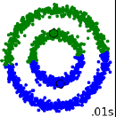
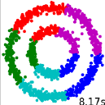
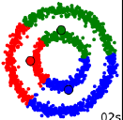
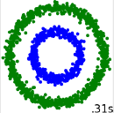
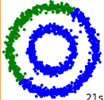
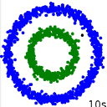
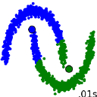
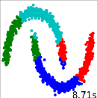
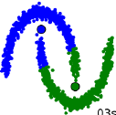
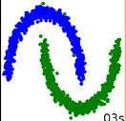
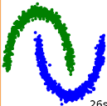
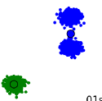
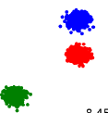
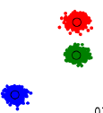
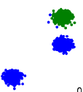
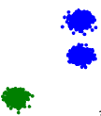
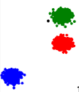
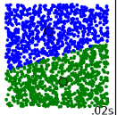
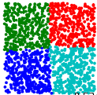
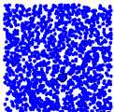
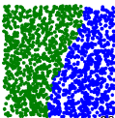
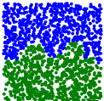
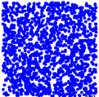
Other Types of Clustering
Mini-Batch
K-Means
Affinity
Propagation
Mean
Shift
Spectral
Clustering
Ward
DBSCAN
.01s
8.17s
.02s
.31s
.21s
.10s
0.1s
8.17s
.03s
.03s
.26s
.10s
.01s
8.45s
.03s
.04s
.31s
.11s
.02s
8.53s
.06s
.08s
.21s
.10s
Reference: http://scikit-learn.org/stable/auto_examples/cluster/plot_cluster_comparison.html

